Slide 1

We are into
manufacturing of …
Connector Assemblies Wire Harness
Power Cords Wire & Cables
Data cables Drawn Copper
CONTACT US AT:
D-28, Hosiery Complex, Phase-II,NOIDA (201305), U.P., INDIA
(M) : +91 – 98103 22643
EMAIL: ankit.gupta@noidaelectronics.com / ankitgupta2001@gmail.com

Slide 2
OUR VISION
“ To provide our customers with a comprehensive range of products under one roof”

Slide 3
Products
Connector Assemblies
Wire Harness
Power Cords / Molded Plugs
Wire & Cables
Data cables for mobile phones
Annealed & tinned copper wire and TTT wire

Slide 4
ORGANISATION CHART
C.E.O
MKT. HEAD
PROD HEAD
PURC. HEAD
Q.C. HEAD
ADMIN HEAD
FINANCE HEAD
Q.C In charge
ACCOUNTS
MKT. Exec.
Dispatch
R.M STORE
IQC
LQC
OQC
OPERATORS
M/C
SUPERVISOR
ASSEMBLY
SUPERVISOR
WIRE MKG.
SUPERVISOR
MOULDING
SUPERVISOR
OPERATORS

Slide 5
milestones …
1990: Began with Representing Overseas supplier of Semi-conductor raw mat.
1991: Authorized Distributors for local components manufacturers.
1992: Represented Toshiba Semi-conductors in India
1993 : Authorized stocking distributors of overseas Electronic components mfg.
1995 : Components in Kit Form
2003 : Began manufacturing of Connector Assemblies & Wire Harness
2006: Achieved ISO 9001:2000 Certification
Oct.06: Began direct Exports

Slide 6
Nov. 2009 : Setup in-house PVC Wire extrusion facility
Aug 2010 : Setup fully automated Power cord / Molded plug facility
June 2011 : Achieved ISO14001:2004 certification
July 2011 : Achieved ISI certification License no. 3228045
Dec. 2011 : Fully integrated facility of copper drawing, annealing & tinning
April 2012 : Achieved UL certification for cables (file no. E341182)
July 2013 : Achieved IS1293 for Molded Plugs
June 2016 : Added Data cables for mobile phone industry
Aug 2018 : Started indirect exports

Slide 7
the path ahead…
  Add products with related to mobile phone industry.
  Upgrade and Enhance our production capability as per the industry standards
  Grow at a rate of 50% P.A.
  Work to achieve customer delight
  Achieve 100% rating from customers on Quality, Cost and Delivery front

Slide 8
Connection with Connectors is what we make
You design and we Harness it for you

Slide 9
wire harness & connector assemblies
Started operations in Sept. 2003
Possess the most advanced machinery available for this industry
Highest level of automation as per Electronics industry
Automatic two end crimping, one end crimping other end twisting & tinning machine from Kodera Japan.
Capacity to crimp : 18KK terminals
Over 40 types of crimp tooling's available
Circuit continuity testing on final product to ensure 100% correct sequencing
Connector Types with various pitch configuration
  Wire to wire
  Wire to board
  Board to board
  Wire to Board in

Slide 10
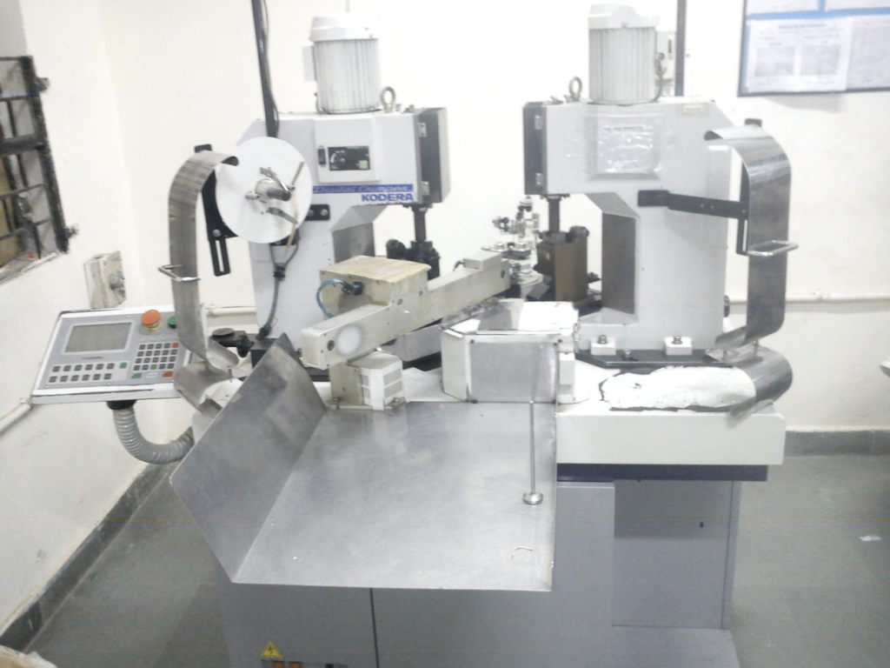
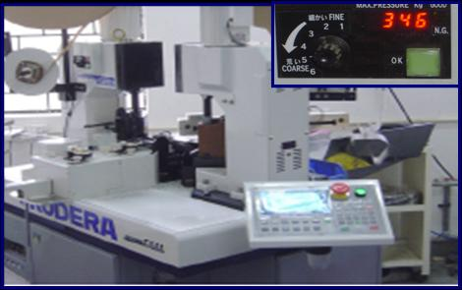
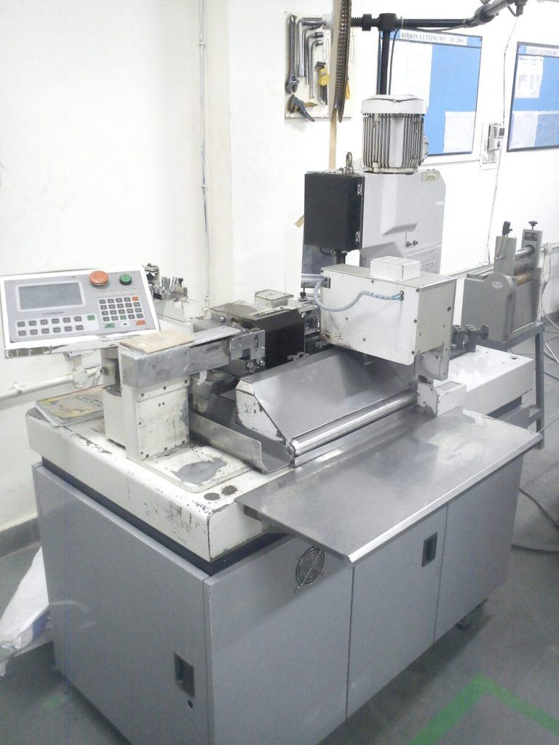
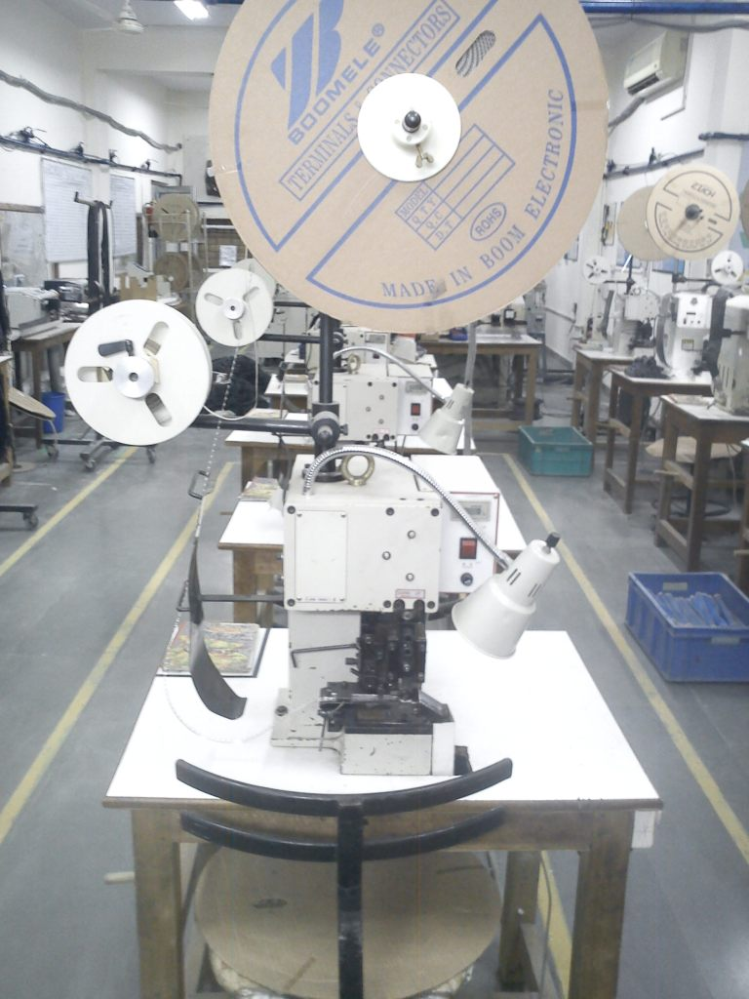
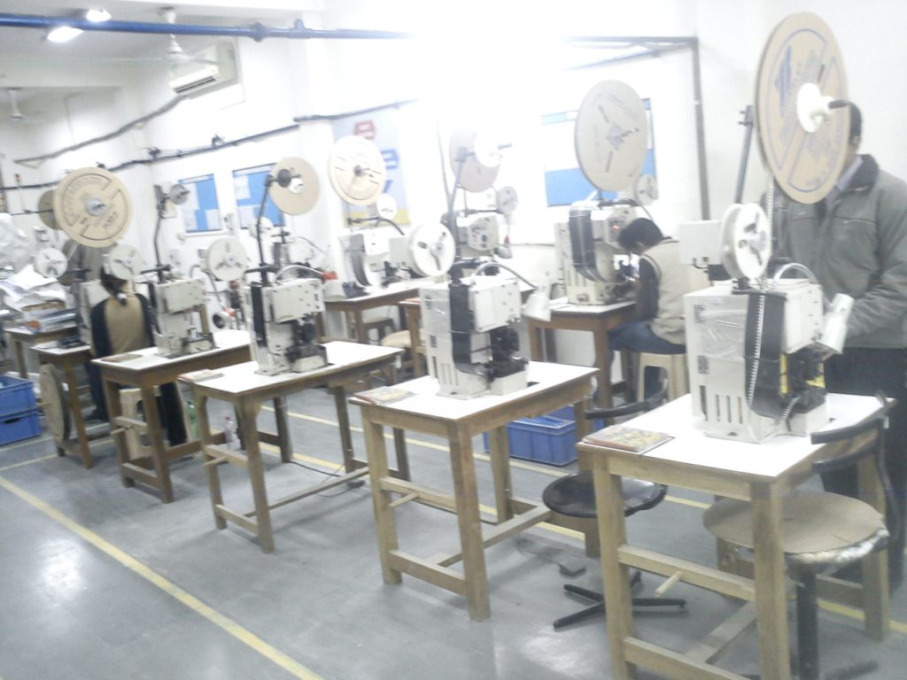
machine area

Slide 11
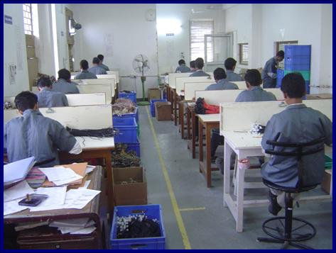
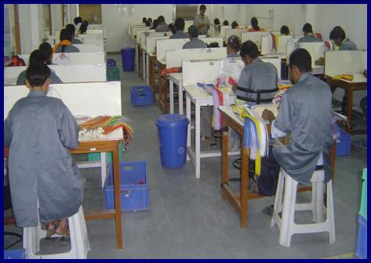
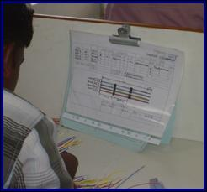
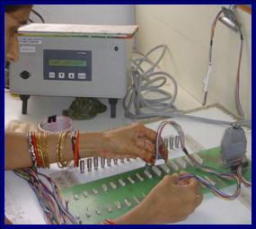
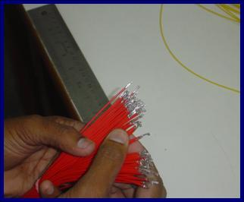
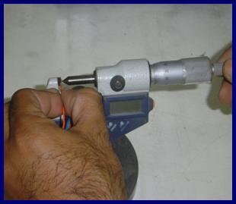
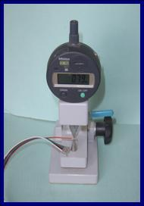
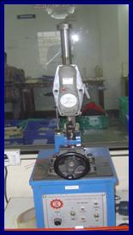
assembly &
packing area

Slide 12
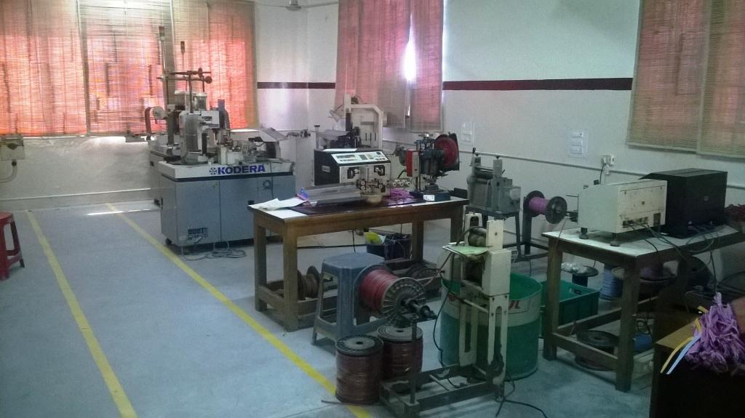
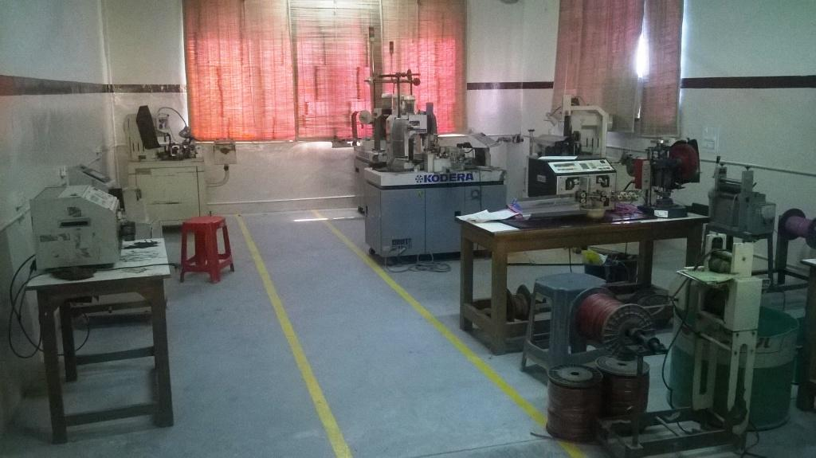
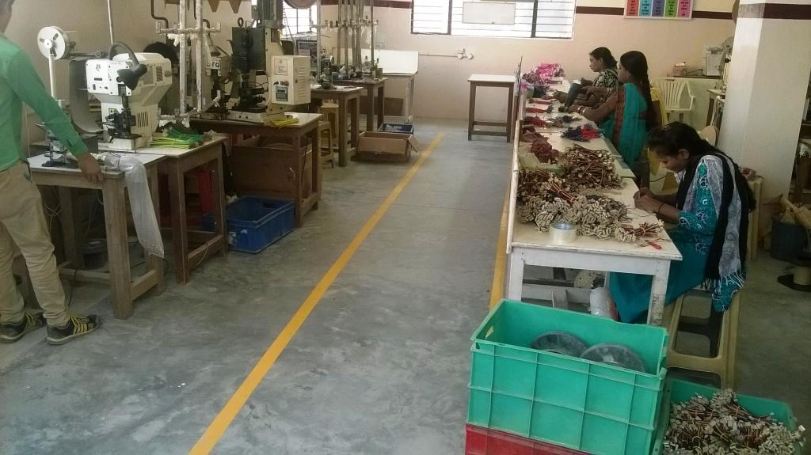
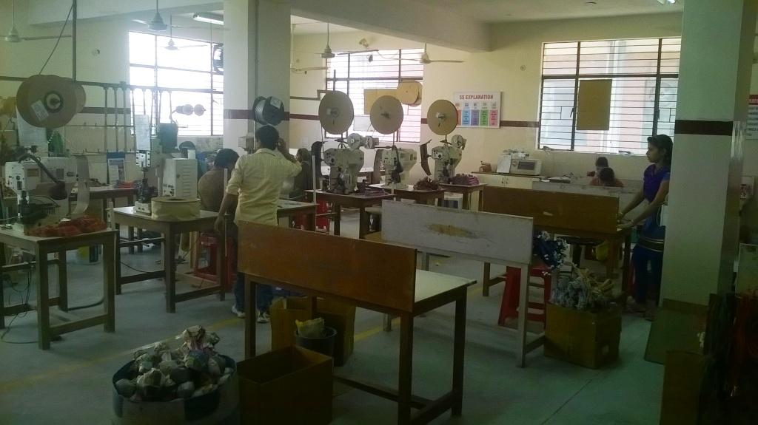

Slide 13
Un-Plug your past
&
Plug your future with us…

Slide 14
Power Cords / Molded Plugs
Set up the facility in Aug. 2010
Fully automated Sliding type Horizontal injection molding machine
On-line 100% HV testing to ensure ZERO defect product
Products
  2pin 2.5Amp, 3Amp, 6Amp
  3 pin 6amp, 10Amp, 16Amp
Present Capacity
  375kpcs of 2 pin plug type / month
  250kpcs of 3 pin plug type / month(6amp / 10Amp)
  25kpcs of 3 pin plug type / month (16amp)
14

Slide 15
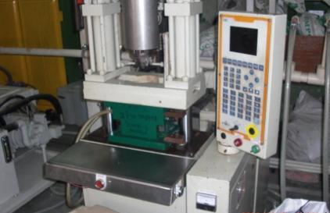
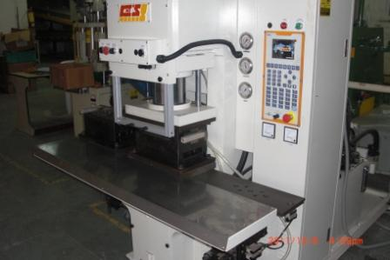
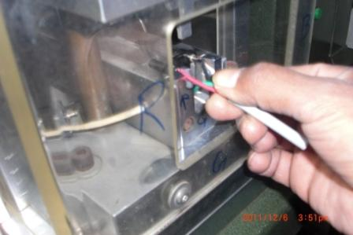
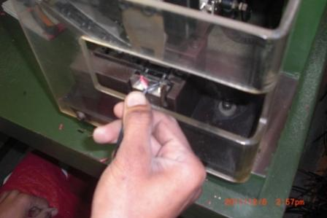
Molding Section
Soldering
100% crimping process

Slide 16
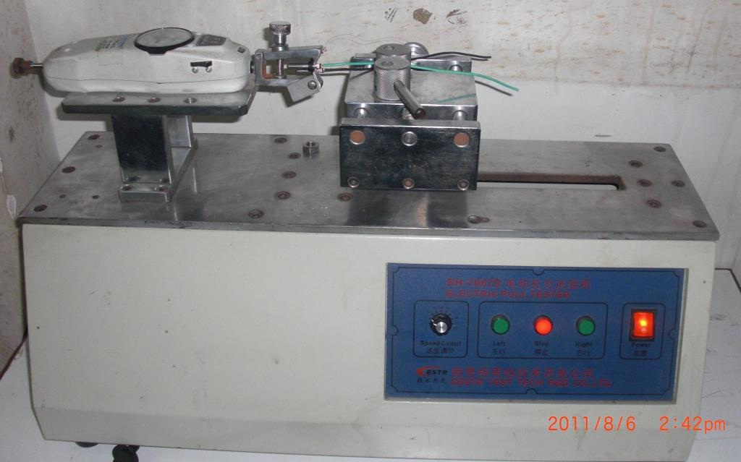
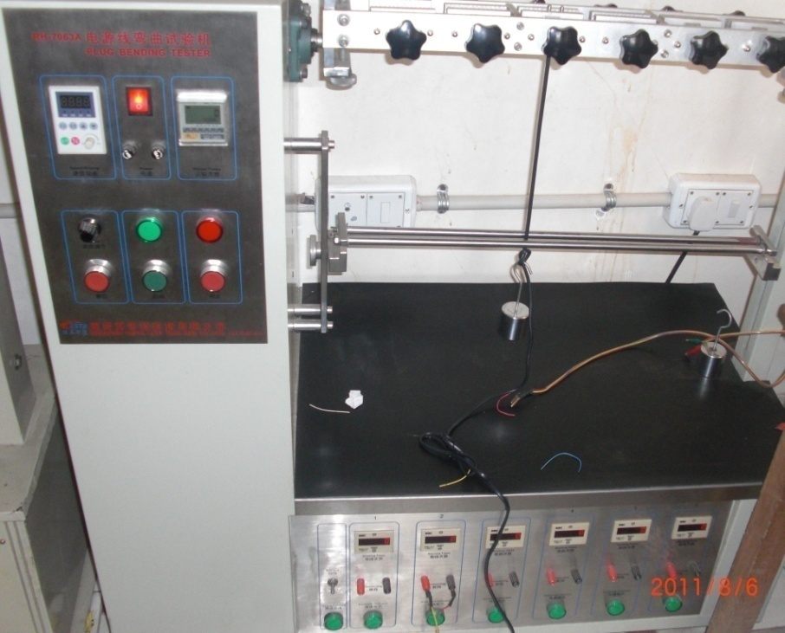
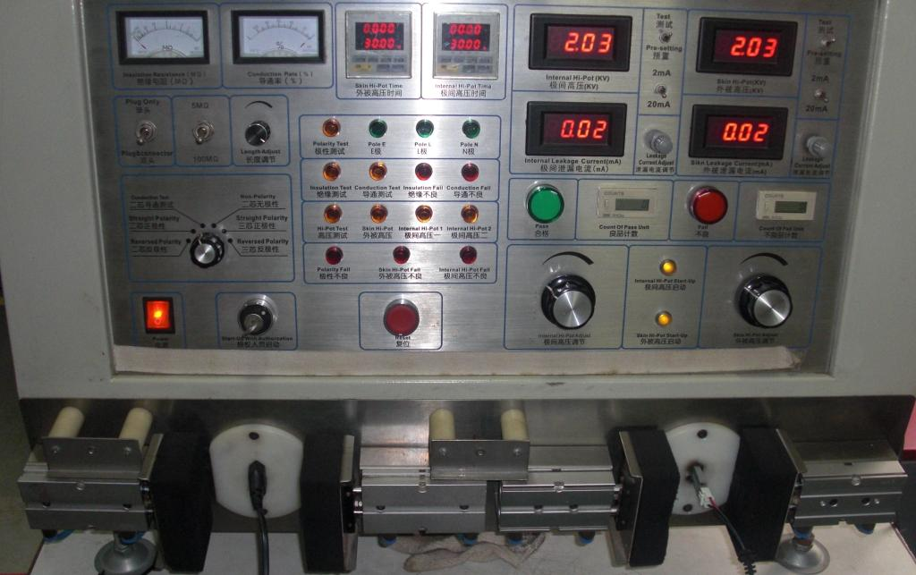
Push pull Tester – Gromet, crimping
Test equipments
– power cord
High Voltage tester
Plug Bending tester

Slide 17
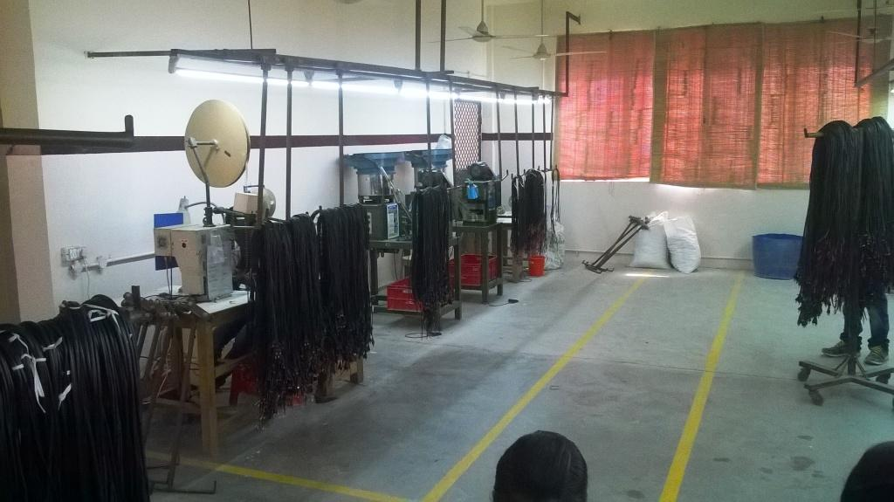
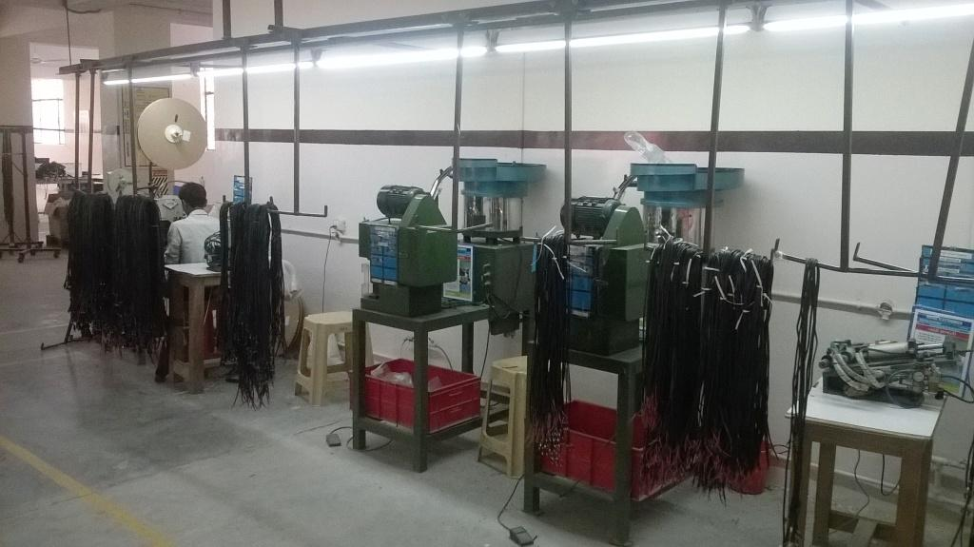
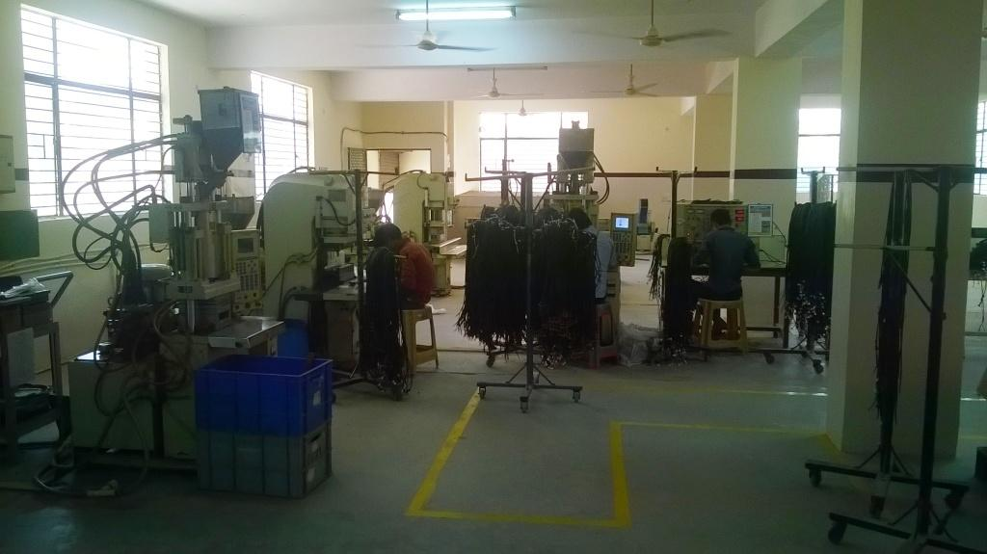
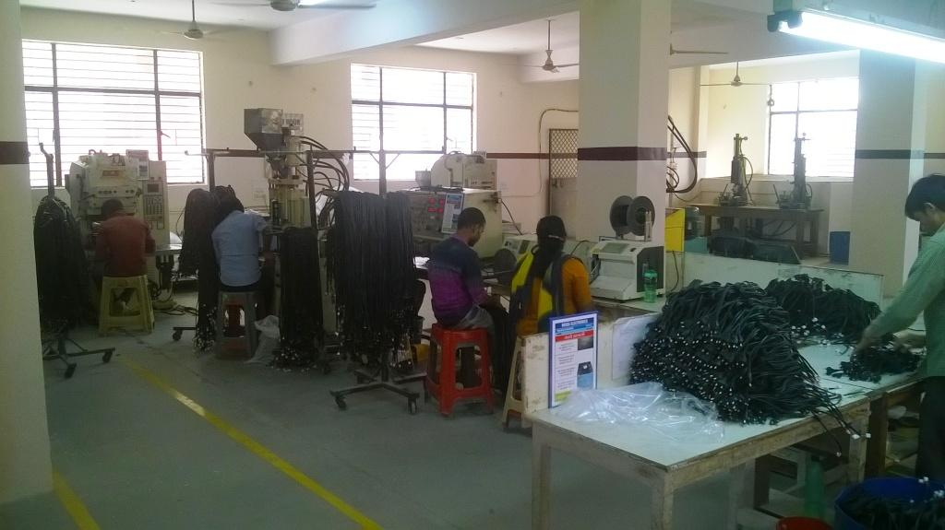

Slide 18
Cu + PVC
Wire’s & Cables

Slide 19
Wire & Cables
Set up the facility in Nov. 2009
High Speed PVC extrusion line with a top speed of 300mts / min.
Fully automated Inline copper annealing & tinning set up
Three sets of High speed bunching machine for fine wires and higher size cables
In house upto 4 core cable laying machine
100% Online HV testing
Online diameter controller
Fully equipped Lab as per IS 694, UL norms
Single core, Multi-core, Solid conductor, Multi conductor wires & cables
19

Slide 20
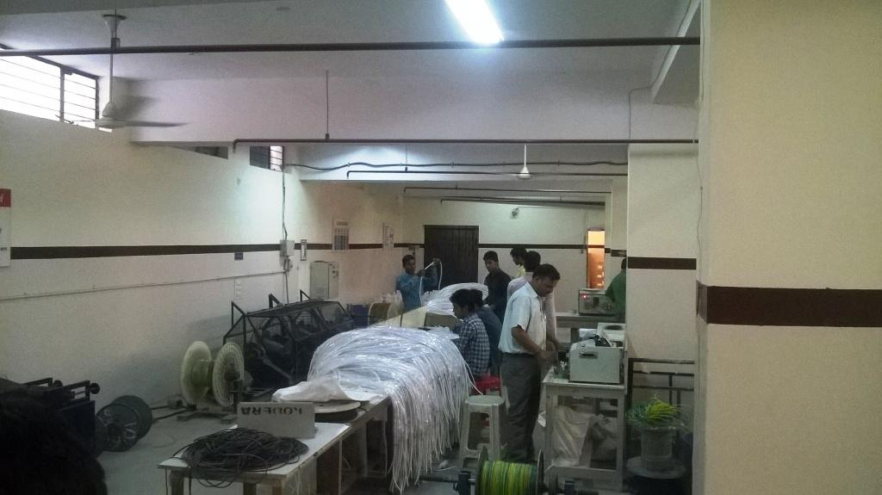
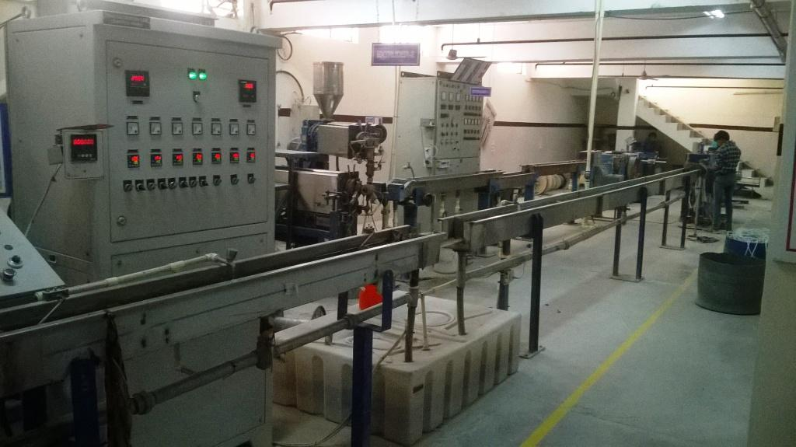

Slide 21
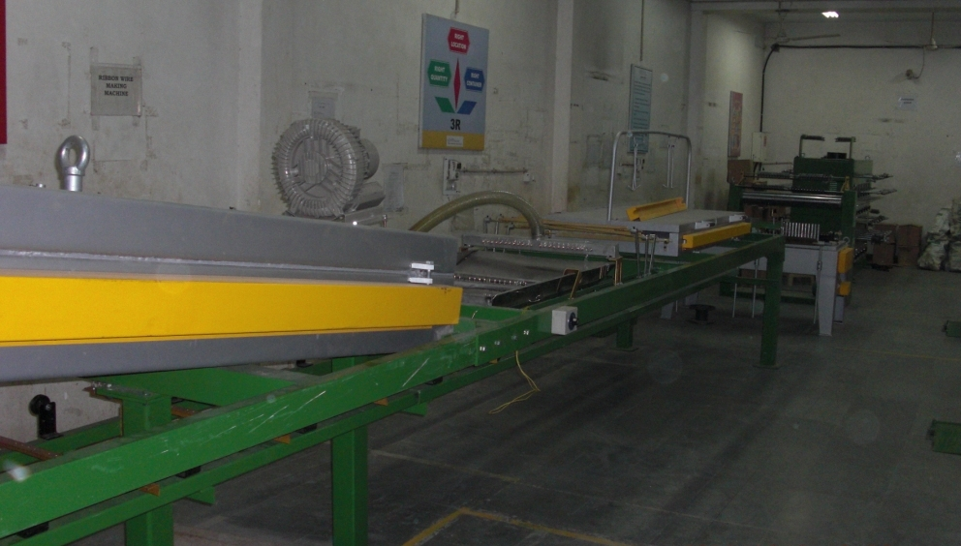
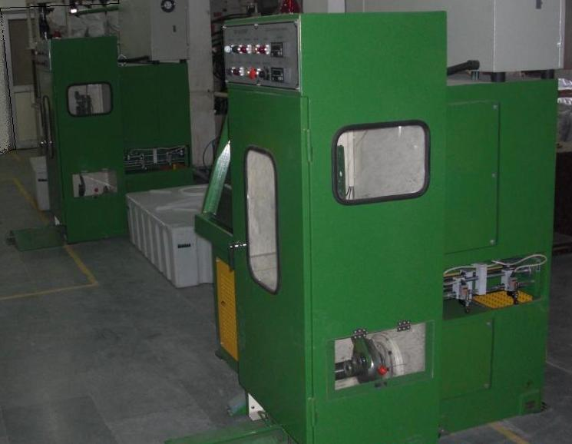
Wire Drawing section
Wire drawing range from 0.08mm up to 0.6mm
Online annealing & tinning machine
Diamond dies for highly precision drawing
Floating diamond dies for High precision tinning

Slide 22
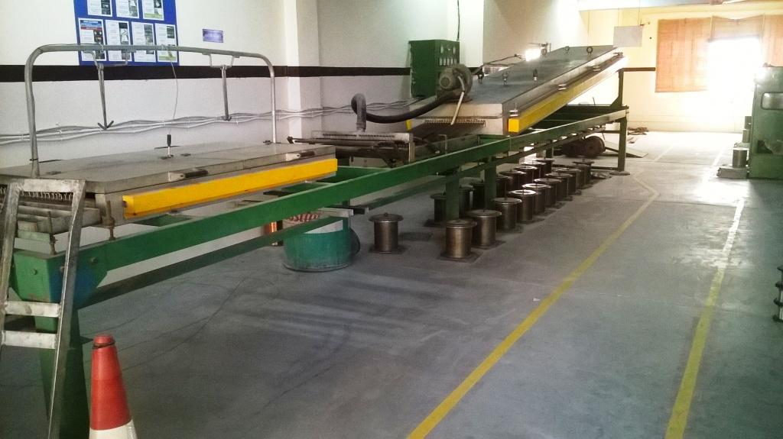
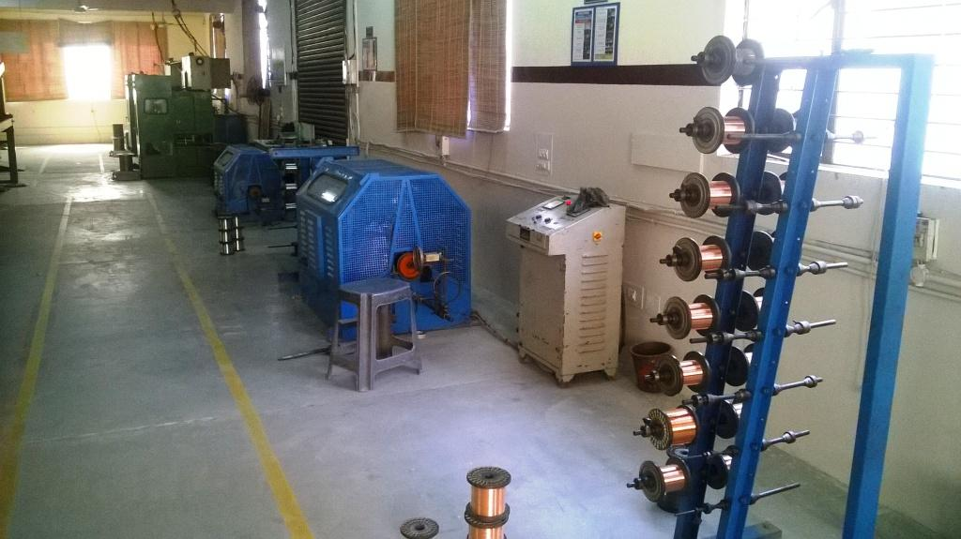

Slide 23
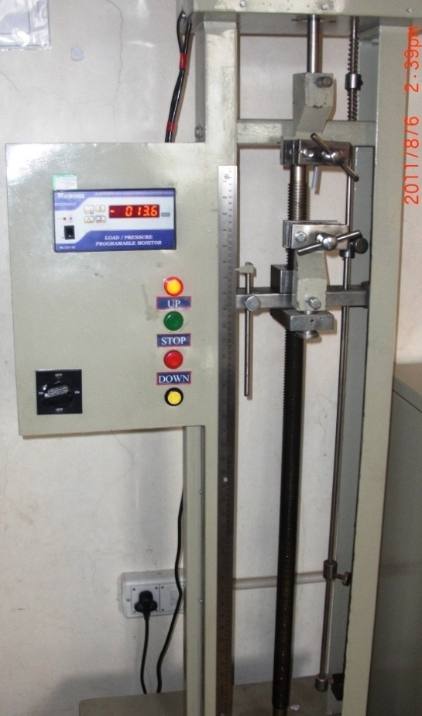
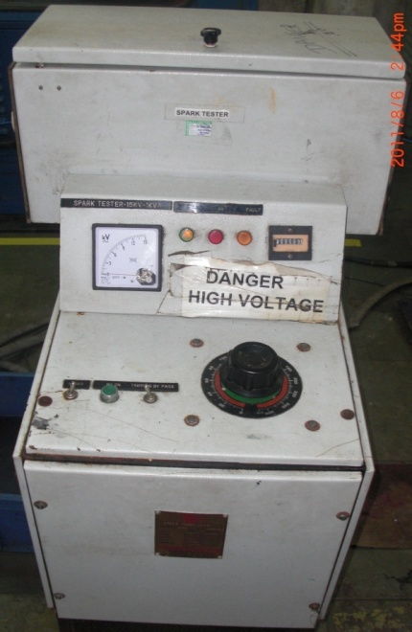
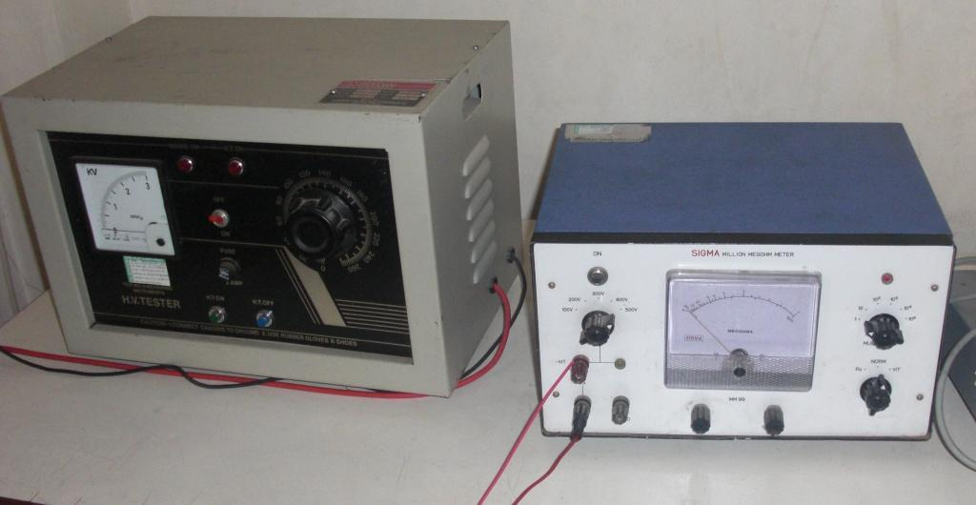
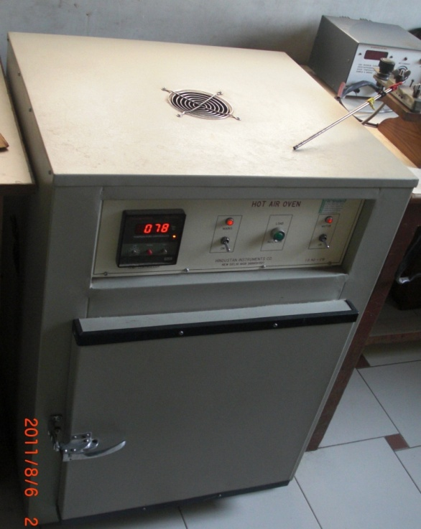
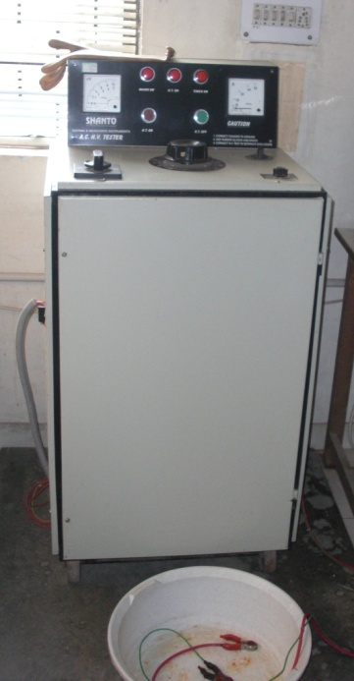
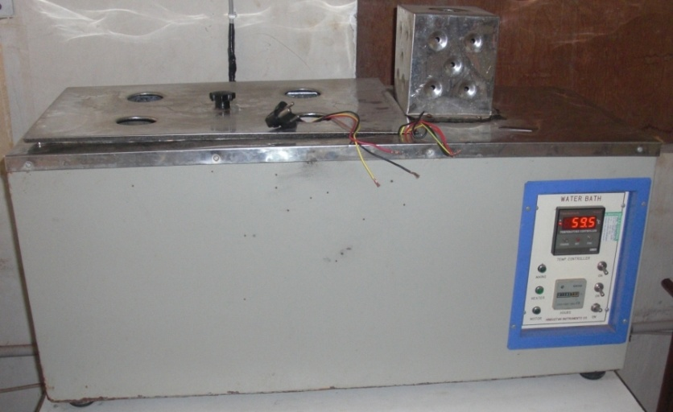
Test equipments
As per IS 694

Slide 24
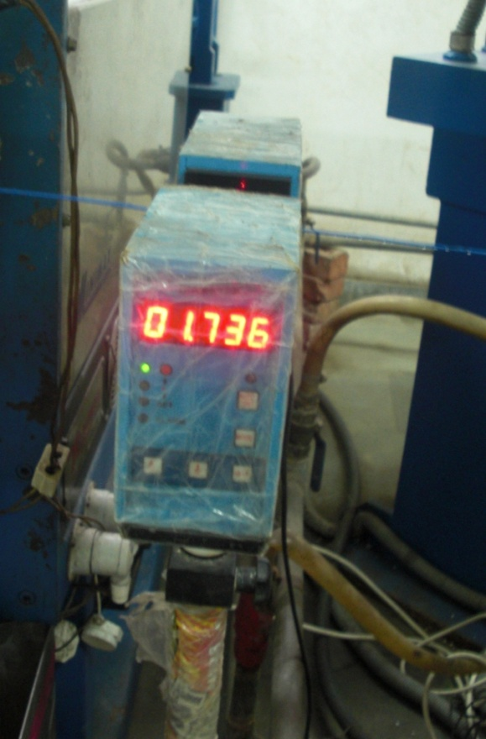
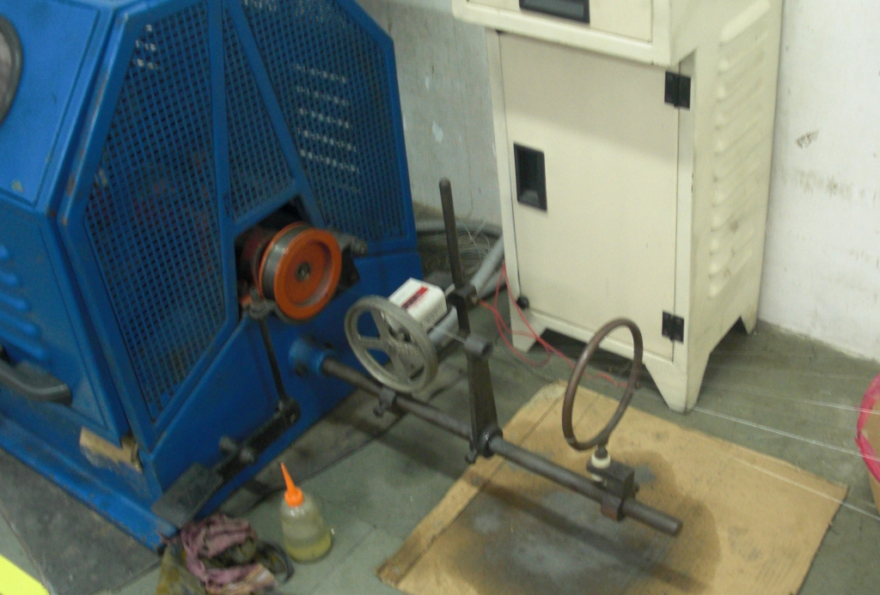
Test equipments
Online dia. controller
Online copper breakage detection system

Slide 25
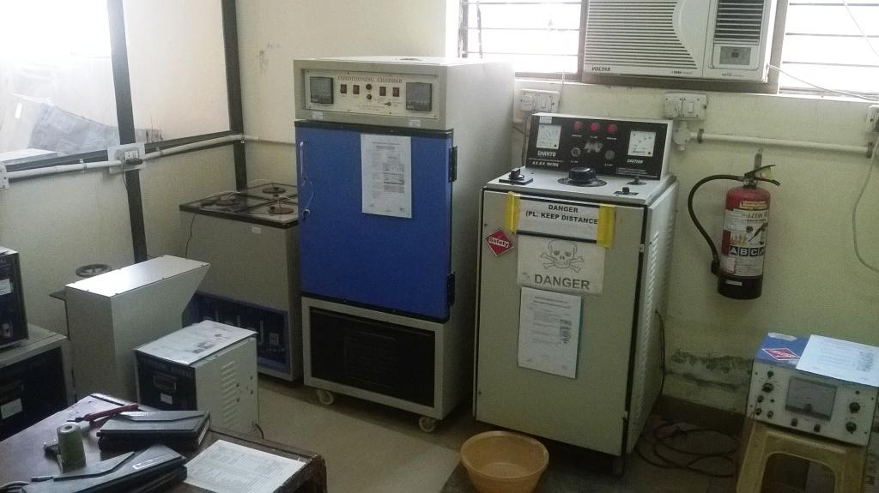
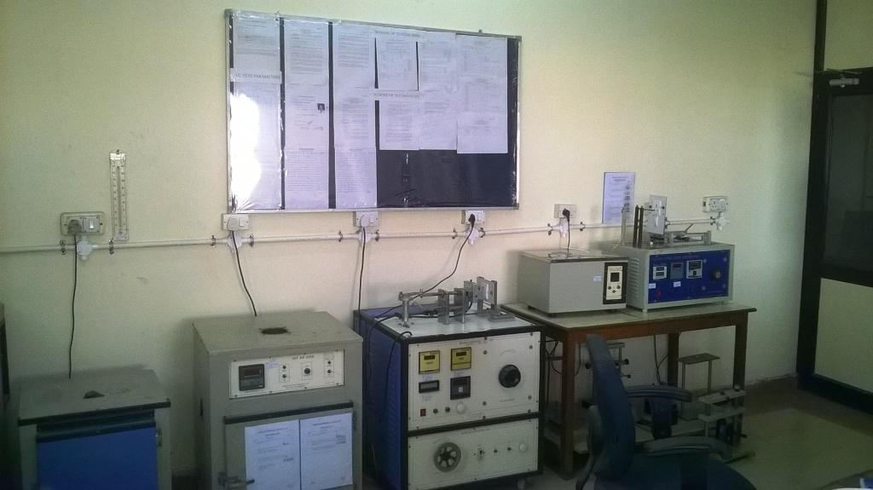

Slide 26





Every step we climb is reflected in our upgrading systems & knowledge.
ERTL –
Power Cords
These steps represent our resolve to learn more, progress and move forward . . .

Slide 27
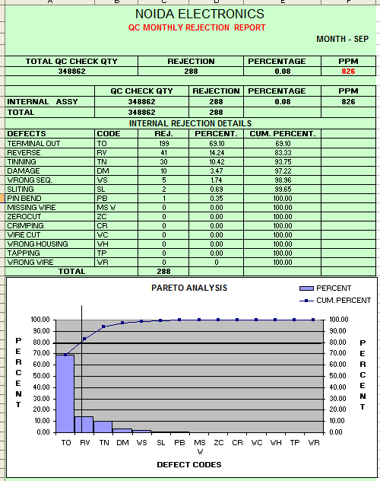
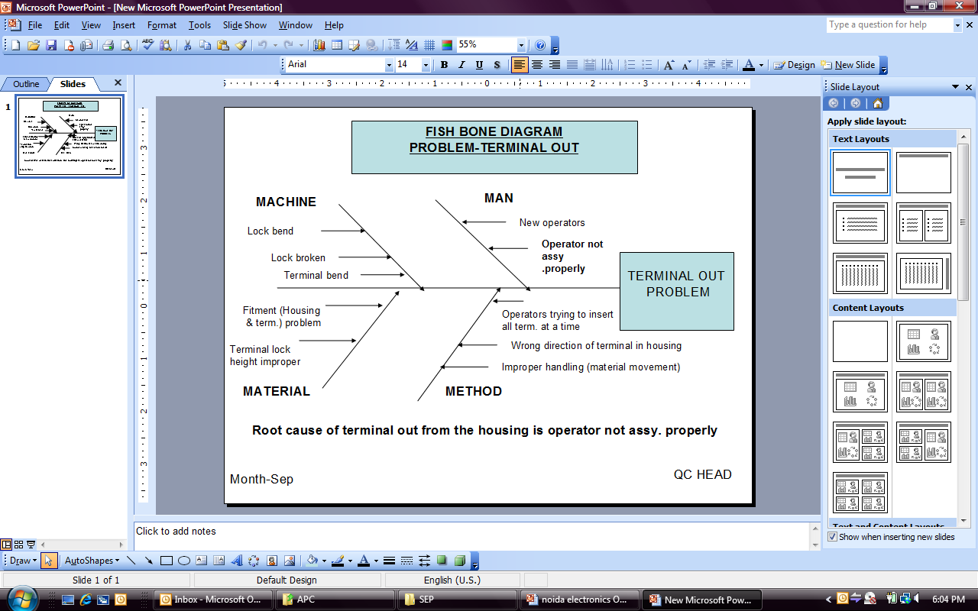
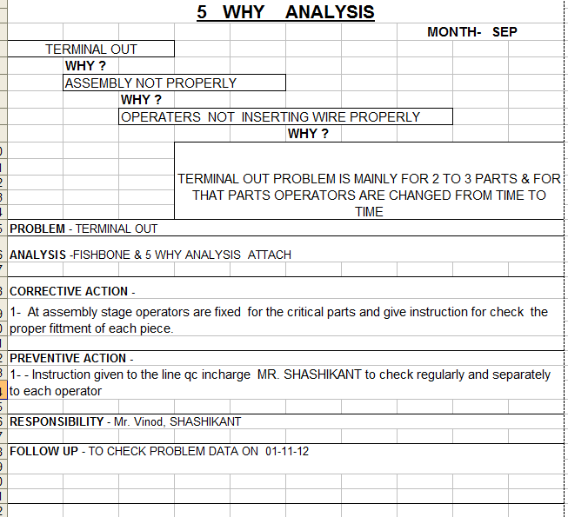
PROBLEM SOLVING

Slide 28
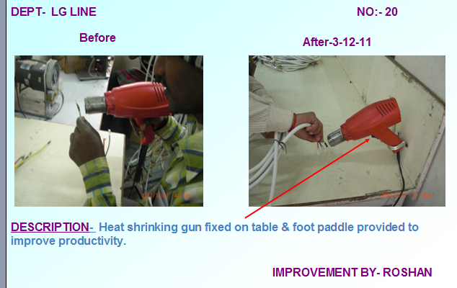
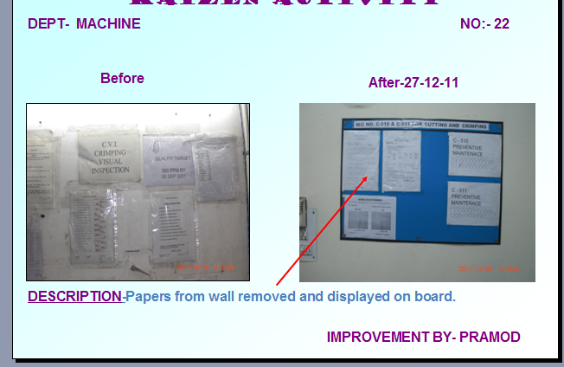
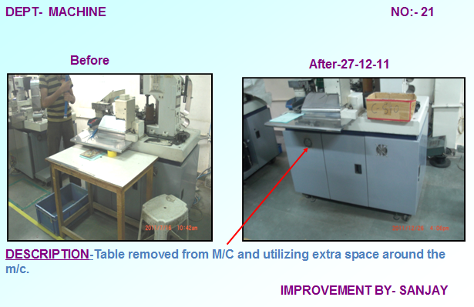

KAIZEN ACTIVITIES

Slide 29

ISO
9001:2015
Certificate

Slide 30

ISO
14001:2015
Certificate

Slide 31

IS 694
CML: 3228045

Slide 32

IS 1293
CML: 2594873

Slide 33

UL E341182

Slide 34
products which we connect…
LCD TV
Set top Box
Air conditioners
Refrigerators
Washing Machine
JMG / MG
Fans
Capacitors
Water Purifiers
LED Bulbs / Batten
Inverter / UPS
Power Supplies
Microwaves
Mobile charger
DC Adaptor
Solar Applications
Room heaters
Mobile Charger

Slide 35



Exhibitions participated

Slide 36



































we are proud of our association with…

Slide 37
!!! Ability is of little account without opportunity,
One chance is all we need to prove ourselves. !!!

Slide 38
!!! Looking forward for a long-term association
with your esteemed organization !!!
thank you
38

