Slide 1


Electronic Product Design
Prototyping
Components Sourcing
PCB Sourcing
PCB Assembly
BOX Building
Production
3D Printing
One spot for End to End Electronic Design and Electronic Manufacturing Services

Slide 2

About us
  RioSH Technologies supports the Design, Prototyping, and Production of “Electronic products” including complete design, components & PCB sourcing, Components assembly, BOX Building, and Testing.
  RioSH addresses the Home and Industrial Automation, Medical, and Defence domains.

Slide 3
Vision
Mission
RioSH visualizes being one of the top Ten Electronic Product design and manufacturing companies in India by 2040.
Ready to touch people's lives positively with high technology through sensible cost.

Slide 4
Why RioSH
Optimal production cost
Proven Experience
Accelerate time to Market
Established vendor Relationship
Inhouse Proto and Production support

Slide 5
Business Model
Vision: To collectively work and build a scalable enterprise with enthusiastic customers and
employees to generate 20 Cr with respectable EBITA By 2025
Domestic and Overseas
Markets
Domestic and Overseas
Markets
Domestic and Overseas
Markets
40% of the Revenue
40% of the Revenue
20% of the Revenue
Design Services
Manufacturing Services
ODM Products
Outsourced Engineering
Services for Hardware,
Embedded Software and
Product Design.
Outsourced Manufacturing
Services for PCB
Assemblies, Sub
Assemblies and Systems
Products RioSH
Designed on Behalf of
Customers
RioSH Technologies

Slide 6























PRODUCT ENGINEERING
EMBEDDED ENGINEERING
STRATEGIC CONSULTING
FPGA ENGINEERING
PCB ENGINEERING
24*5 CUSTOMER SUPPORT
Services
R&D
Embedded C, C++ and Arduino
PRODUCTION
Embedded OS Development
Mechanical Enclosure Designing
Device Drivers Development

Slide 7
Our Services
RioSH offers end-to-end services in the field of Embedded Systems. Our services start from Product Idea Validation, Schematic Design, Hardware Design, Firmware & Software Development, Prototype Development, Application Development, Product Testing and help clients to get Certification for the new products.
Electronic Product Design
1. Hardware design
4. Electronics Prototyping
Requirement analysis
Circuit Design
Schematics Entry
PCB Layout Design
Simulations and Analysis
Gerber Generation
PCB Fabrication
Stencil
Components Assembly
Wiring
5. Mechanical Prototyping
3D Printing
2. Firmware Development
6. Testing and Validation
Requirement analysis
Drivers Development
Code integration
Functional validation
Hardware validation
Firmware Validation
Functionality testing
System Level Validation
3. Mechanical Enclosure Designing
Enclosure design around circuit

Slide 8



RioSH Product Design Life Cycle
05
Validation & Delivery
04
Fabrication
03
Designing
02
Analysis
01
Client Requirement

Slide 9
Our Manufacturing Services
RioSH Technologies supports in prototype and production includes component and PCB sourcing, Components assembly, BOX Building and Testing. RioSH Technologies is one stop solution for Optimal cost, High Quality and Fast Delivery.
Electronic components sourcing
    Passive components
    Sensors and Electro Mechanical
    Memory and Data storage
    IC’s
    Connectors
3D Printing capabilities
Technology FDM
Build volume 200*200*250
Layer resolution 0.08/0.1/0.2/0.3/0.4 mm
Dimensional tolerance +/- 0.1 to 0.5mm
Filament compatibility ABS/PLA/Composite
PCB’s Sourcing
1-12 Layers
Impedance and Non Impedance
Electronic components Assembly
PCB Assembly
BOX Building
Wire Harness
Testing

Slide 10

Electronic Manufacturing Service
We RioSH Technologies. (ISO 9001-2015 Certified) introduce ourselves as an Electronic Manufacturing
Service provider,.
RioSH Technologies . offers end to end services from design to manufacturing and supply chain management targeting various market segments (Defense & Aerospace, Industrial & Commercial, Telecommunications, Automation & Textile)
We provide the following services
PCB Assembly For Turnkey , Job Work
Box Building Assembly.
Customized Power Supply Design & Manufacturing.

Slide 11

Equipment Installed
2 SMD Lines.
2 PTH Lines.
OUT PUT RANGE For SMD Lines | PRINTER | SMT PLACER | REFLOW
High Output line | I Print 800M | Yamaha YSM20 | Heller 1707 MKIII
Low & Med output line | Dek248 | Juki KE 760+YS 12F | Heller 1707 MKIII
1st PTH Line | Stallion u321 Fume wave Soldering machine(interchangeable bath)
2nd PTH line | Stallion u321 Spray Wave soldering machine(interchangeable bath)

Slide 12

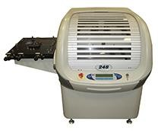
Printer’s
FULLY AUTOMATIC
IPRINT 800M
Max Stencil Size:29”*29”
Type: Glue & Paste
SEMI AUTOMATIC
DEK248
Max Stencil Size:23”*23”
Type: Glue& paste

Slide 13

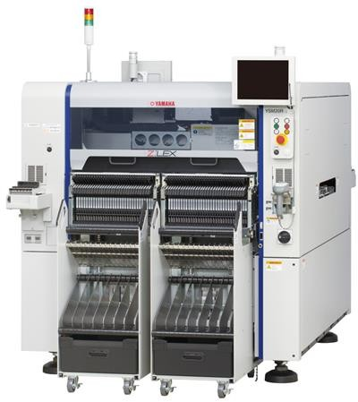
SMT Mounter’s
YAMAHA YSM 20R SV
Capacity: 95000cph.
Feeder Slots : 102+cATS 34 Fixed.
cATS Unit For 10 Fixed Tray Slots.
Revision version of its Kind of 2 Gantries with 10
heads each, Works on Dual plane.
Required PCB Dimensions: L810×W490 mm to L50×W50 mm

Slide 14

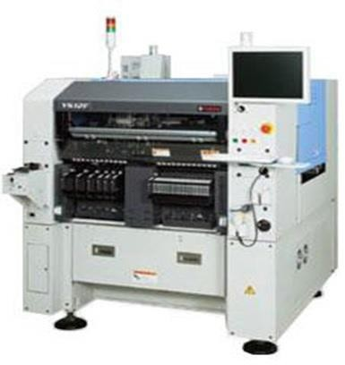
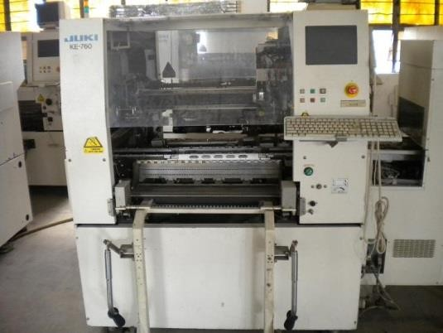
Smt Mounter’s
YAMAHA YS12F
Capacity:20000CPH Feeders:96 Feeder Slots , 8/12/16/24mm
& Tray feeding
JUKI KE760
Capacity:6000CPH
Feeders : 44 Feeder Slots , 8/12/16/24mm & Tray feeding

Slide 15
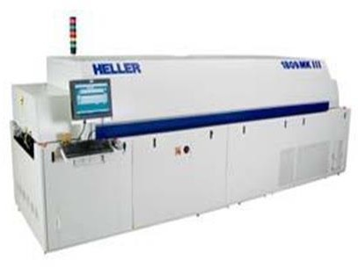
Reflow
HELLER 1707 MK-III QTY -2No’s
SPECIFICATIONS
7 Forced Convection Zones Top & Bottom.
Profile change time 5-15min.
RoHS Compliant.

Slide 16

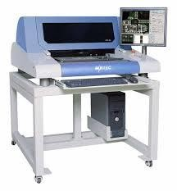
Aoi
MIRTECH MV3L
SPECIFICATIONS
Max PCB Size: 500mm*400mm
Max inspection Speed:0.37sec/frame
Cameras: 4 side viewer camera system of 5MP.

Slide 17

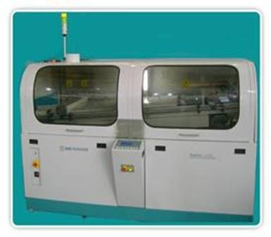
Wave Solder
Stallion u321cc.
Qty : 2No’s
SPECIFICATIONS
One Machine with Spray Nozzle.
The Other With Fume’s.
Max PCB Size: 570mm*320mm.
2 Non-ROHS Solder Bath.
1 ROHS Solder Bath.
3 Baths are for high yield.

Slide 18

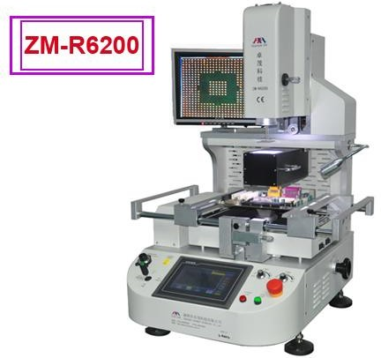
Bga Rework Station
ZM-R-6200, ZHUOMAO
Max PCB Size 470*370mm.
Min PCB Size 65*65mm.
Available BGA Chip 1*1~80*80mm

Slide 19

Maintenance & Additional Accessories
DG Kirloskar KG 40A/S.
UPS 3 No’s.
Compressor’s-2 No’s.
Chicago Pneumatic CPX20
Chicago Pneumatic CPX20
Manual Soldering Stations(Hakko/Jakko ) 25No’s.
Magnifying Lens-5no’s.
2 PCB Baking Ovens
Man Power-100 people.
3 Shifts per day for SMT operations.
Effective Systems for Quality Assurance.
We are ISO 9001-2015 TUV Certified.
ESD Norms Practiced for Good Manufacturing Process

Slide 20
RioSH Portfolio
From product sketching to technical inspiration, from feasibility to manufacturing we move your innovation into production.

Slide 21
RioSH- Process
1
Project Management System
We are following Agile process for all the Projects Work progress, Timesheet, Open Issues , Tracking System and responsible person will be updated in Agile process for all the Projects
2
Repository for Version Control
All revisions of each document will be stored and retried at any time
Easy to access and document related to project

Slide 22








Our clients

Slide 23

Distribution channel
RioSH extended the distribution network with "Vango Technologies" to enhance the capabilities in the Energy meter segment.

Slide 24















RioSH Design Partners
Note: RioSH sources the electronic components from both Online and Offline vendors. If the client required it, RioSH will share “Origin of the product” and “Date code” details to make sure the original products.

Slide 25
Required hassle-free Design and manufacturing service?
Connect with RioSH. Take production to new heights.

Slide 26
Thanks!
VISHNU VARDHAN(CEO)
E: vishnu@rioshtech.com

