Slide 1




TEAM NOVATECH IT SERVICES PVT LTD
IT Services Provide of Pan India
GST No : 07AAJCT0169P1ZR CIN No : U72200DL2021PTC390270
Address : A-31, THIRD FLOOR, B/S NEAR MAITRI APARTMENT, GALI NO 5, CHANDER VIHAR MANDAWALI, East Delhi, Delhi, 110092

Slide 2
Company Profile
Team Novatech IT Services Pvt Ltd Founded in 2021, it has emerged as a leading IT Infrastructure and Information Solution Provider in the last three years in across PAN India. We see ourselves as trusted solutions partner. We understand your needs, Identify- incorporate-Support High quality. Our Technical team have hands-on experience in all aspects of IT planning, deployment, operational management, and maintenance support as a reliable business partner, committed to providing quality services in the remotest of locations across the country.
Team Novatech IT Services Pvt Ltd is a IT service provider company which provides service/support PAN India. We embrace challenges and provide best strategies for serving things right ensuring full customer satisfaction. Team Novatech IT Services Pvt Ltd believe that technology has reached a level of maturity that the best of the ideas & management practices, generally available to big business houses are ready to be delivered to small & medium sized business. It is our endeavor to make the industry a level playing field where performance and not size determine success.

Slide 3
Company Overview.
Since 2021 we are in IT Industry.
Strong Service Delivery Infrastructure.
Who we are?
We provide end –to- end quality solutions in the area of information technology, Application, Delivery Controls and Technology refresh to our target customer. We Give Remote and Onsite Support to Client as per Requirement, We Have Dedicated IT Help Desk Setup and Help Desk Tool to Monitor Call.
Team Support
We have a highly qualified and trained team of computer engineers, who have a vast knowledge about their work. Our entire team is passionate about their job, and therefore, they can easily solve the problems within a meantime without any delay.

Slide 4
Vision, Mission & Objectives
Vision- “We are a place where people with great ideas and a zeal to
implement them with togetherness, to achieve our customer business
objectives by delivering IT professional services”.
Mission – To be a only choice in IT Industry to Provide both superior and cost-effective business solutions for its customers with excellence
and ample opportunity to growth for an individual.
Objectives - Provides end-to-end business solutions and adoption while also leveraging an organization's current IT assets. Build new products or services and to implement prudent business and technology strategies in today's dynamic digital environment.

Slide 5
Our Services
IT Consultancy Services
Assets Verification & PM Activity
FMS Services
Manpower Solutions
IT Infrastructure Support, Desktop & Laptop Support & Servers Support.
We are Providing PM activity and Asset verification Activity for Pan India Support.
Infrastructure support, Residence Engineer Support, Remote Support, Helpdesk Support
Provide Manpower as per client requirement.

Slide 6
IT Consultancy Services
We provide Network Security and Audit, Storage and Servers, IT Infrastructure Development/Support, Infrastructure Solutions (Servers, Desktop, Laptop and Storage Solutions).
Network Security
IT Infrastructure Development/Support.
Servers, Desktop, Laptop Support.
Storage and Servers Support
FMS Services
In this service we provide Infrastructure support, Residence Engineer Support, Remote Support, Network Support, and Server Support .
Remote Support
Helpdesk Support
Infrastructure support
Residence Engineer Support
Software and Hardware Support
We Provide Software and Hardware Support for Laptop, Desktop, Printer and Switch.

Slide 7
Annual Maintenance Contract
We Provide AMC Support for Desktop, Laptop, Printer, Switch and Server with one Years Break Down Services.
AMC for Laptop
AMC for Desktop
AMC for Printer
Manpower Solutions
We Provide Manpower service as per client requirement.
Provide Manpower as per client requirement.
On-Call Support
We Provide On-Call Support to Client by Remote/On Desk Support.
On-Call Support to Client by Desk Support.
On-Call Support to Client by Remote Support.
Cover PAN India On-Call Support.
Assets Verification
Consolidate physical report for all sites and Assets / inventories.
Perform reconciliation between physical Assets and Clients Assets.
Resolve difference and identifying the reasons.
Provide Assets Verification Report with Singed.
PM Activity
System & Antivirus Update.
Domain Re Joining.
Cleaning of Laptop/ Desktop/Printer

Slide 8
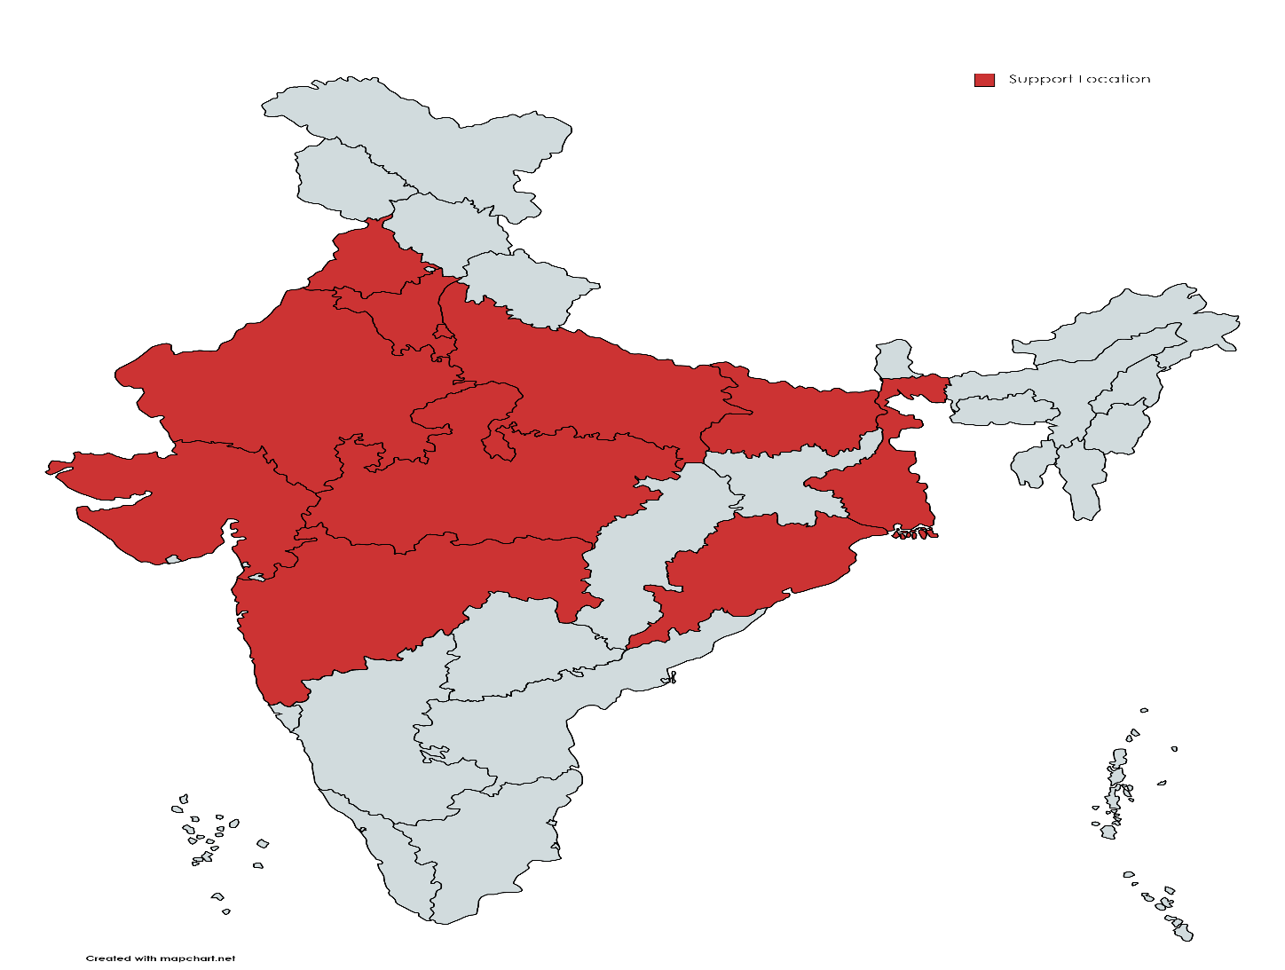
Our Presence in PAN INDIA
Delhi NCR (Head Office)
Gujarat
Madhya Pradesh
Uttar Pradesh
Odisha
Maharashtra
Punjab
Haryana
Bihar
West Bengal
Rajasthan
Haryana

Slide 9
CONTACT US
Owner Name: Harshit Pandey
Contact No: 8383874588/8920018476
Email ID: team@novatechitservices.com
and teamnovatechitservice@gmail.com
Location: A-31, THIRD FLOOR, B/S NEAR MAITRI APARTMENT, GALI NO 5, CHANDER VIHAR MANDAWALI, East Delhi, Delhi, 110092

Slide 10


