Slide 1



Slide 2


Slide 3
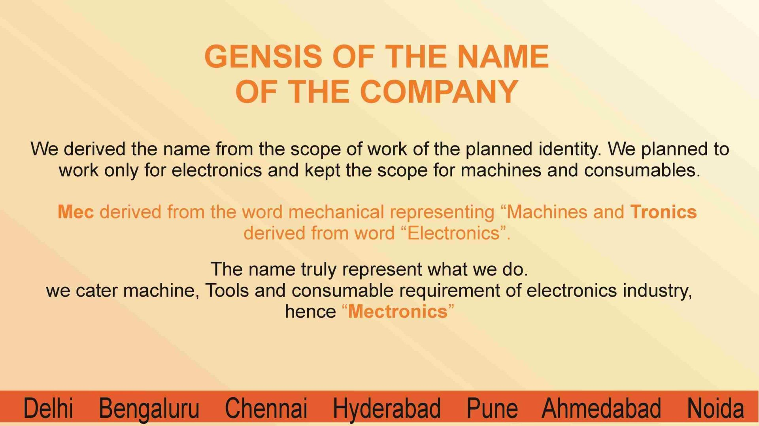

Slide 4


Slide 5
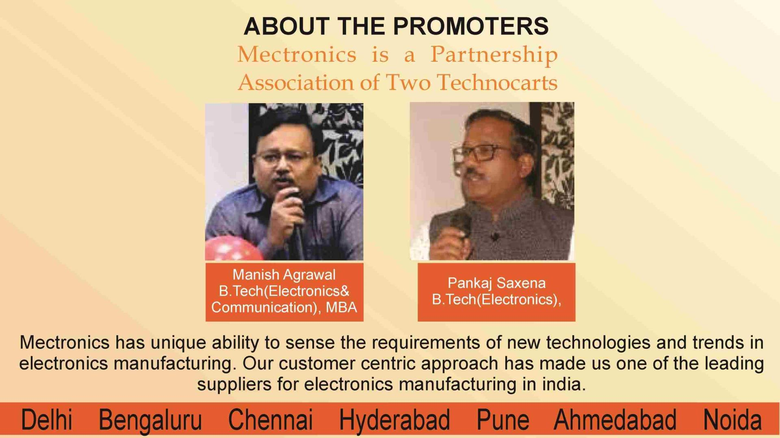

Slide 6


Slide 7


Slide 8
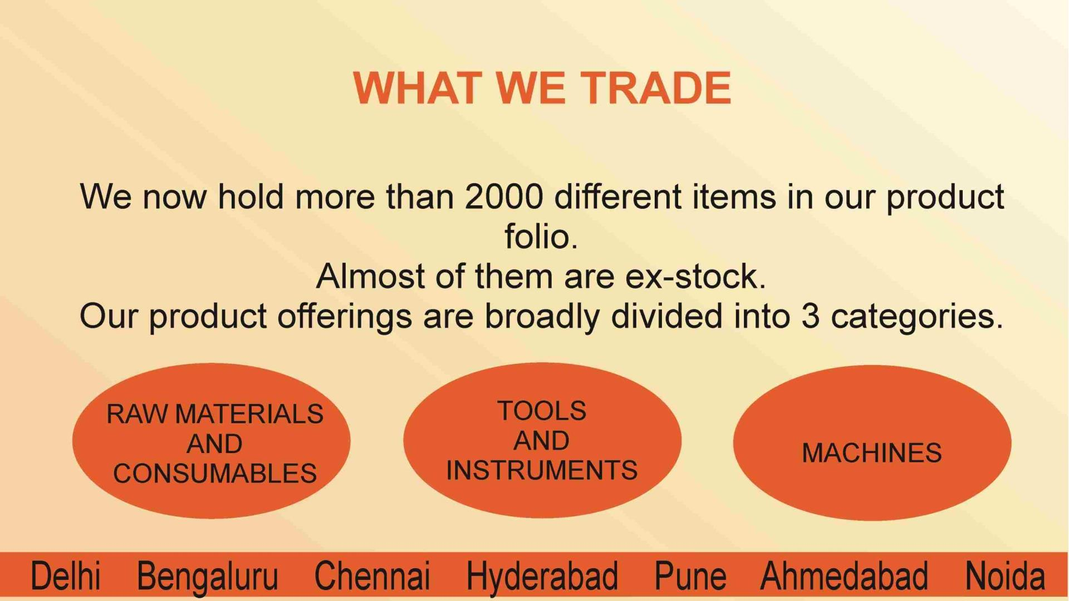

Slide 9


Slide 10

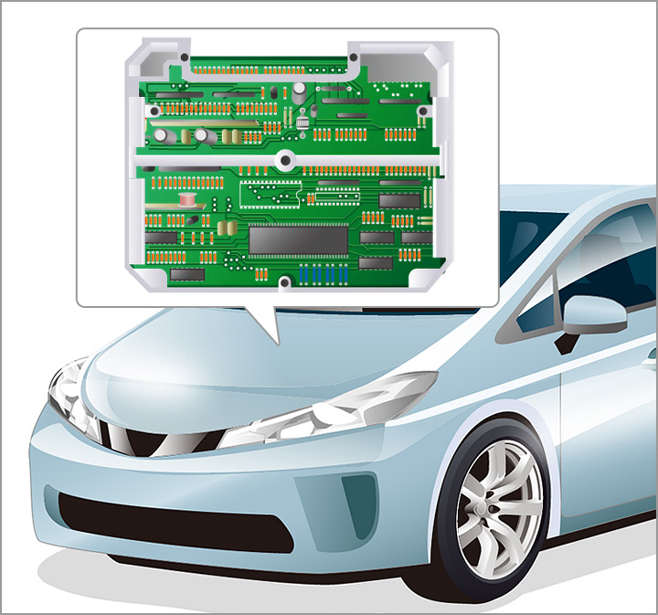
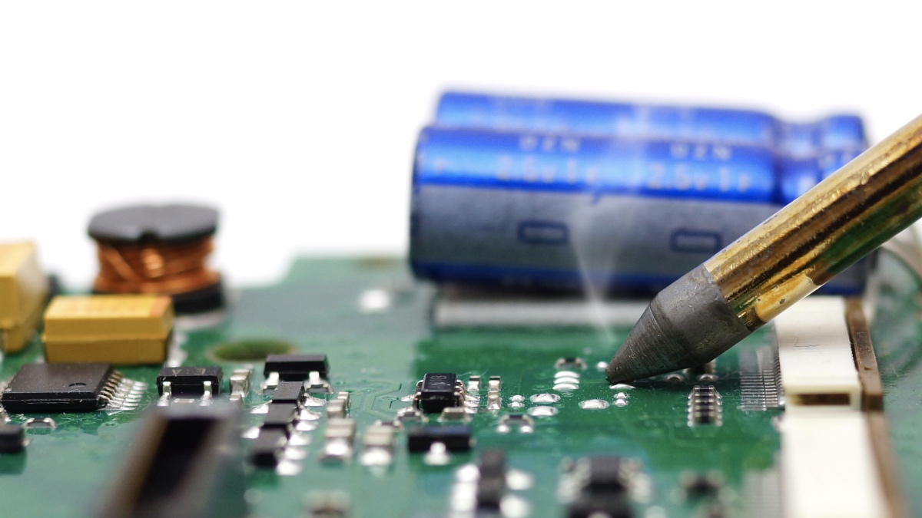
FUTURE PLANNING
ELECTRONICS ASSEMBLY INDUSTRIES EXPANSION
AUTOMOTIVE
DEFENCE

Slide 11
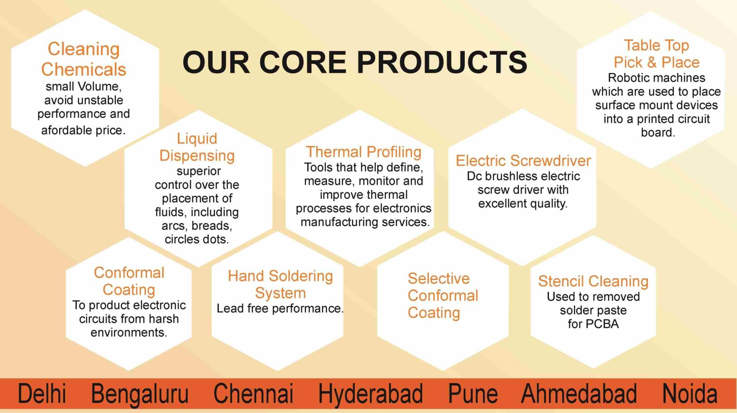

Slide 12
