Slide 1

Power relay for EV charaging system
Hongfa Product Solution

Slide 2
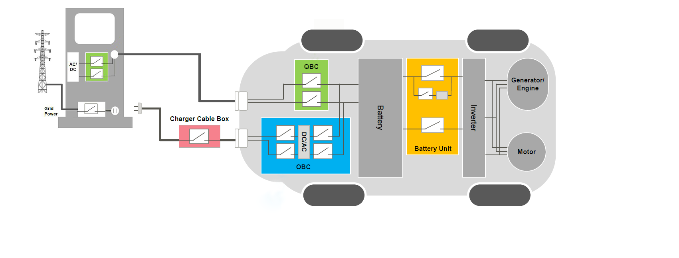

EV Systems
AC/DC
Charging Points
Power System
BMS
电磁锁
APS
Portable Charger
Charging System
Electric System
02

Slide 3
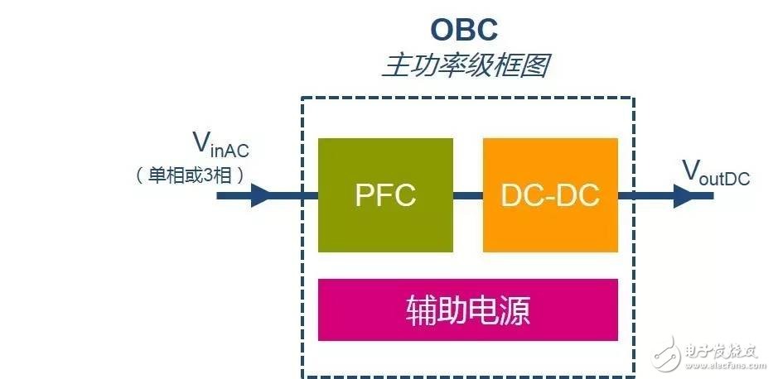
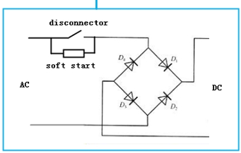
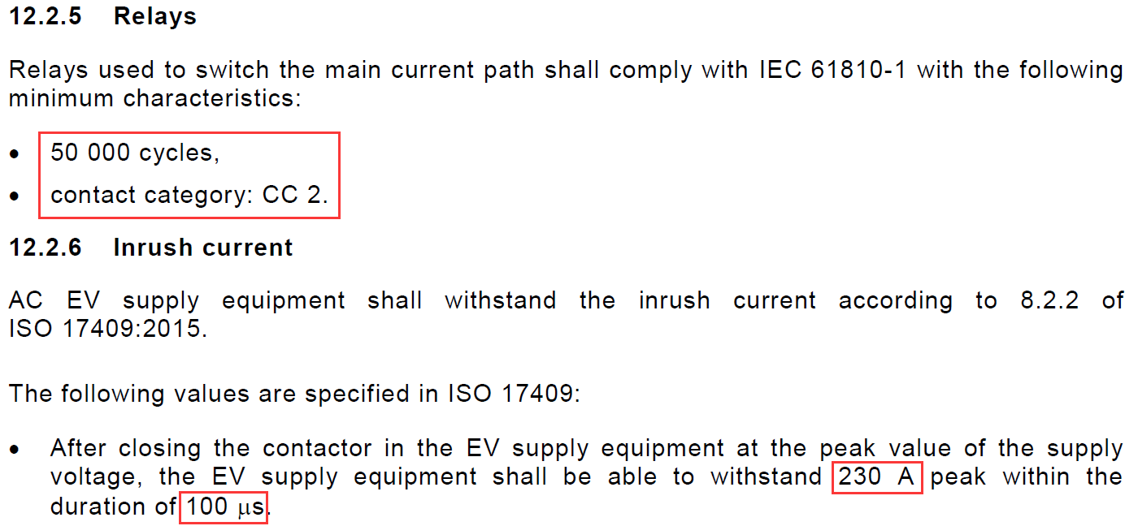
OBC
AC-DC converter consist of
PFC + DC-DC
CHN：220 VAC或380 VAC
EU：230 VAC或 400 VAC
US：120 VAC或 240 VAC
200VDC-450VDC
Requirements
IEC61851-1，GB/T18487.1
50000 cycles, before rectification
230A 100μs inrush
Long time carrying
ambient temperature 85℃~105℃
IEC61851-1：2017
Recommended（-T：105℃）
≤16A：HF115F/K-T，HF152F/D-T
32A： HF178F/-T，HF165F-50（105℃）
＞60A: HF176F,HF186F（105℃）
03

Slide 4
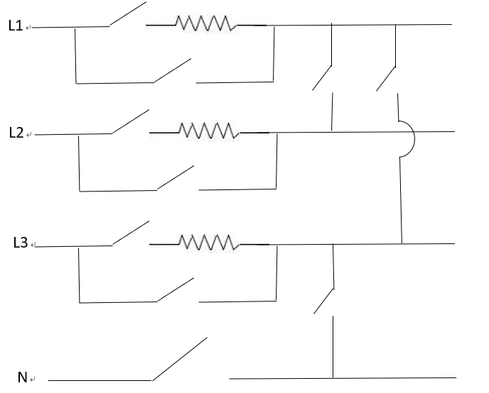
OBC
Multifunction-V2X
Single/3 phase charging
Vehicle to Grid
Vehicle to Vehicle
Vehicle to Load
Recommended:
❶
Single phase input
HF186F：55A @105℃
HF161F-40W：40A @105℃
HF189F：48A @85℃ with auxiliary contact
❷
3 phase input
HF161F-40W：40A @105℃
HF179F-W：32A @105℃
HF190F：32A @85℃ with auxiliary contact
❸
❶
❹
❹
❸
❷
❸
Pre-charge
HF179F-W：32A @105℃
❸
❷
❹
❹
Lines switching
HF179F-W：16/32/16A 600VAC @105℃
HF190F：32A @85℃ with auxiliary contact
❶
04

Slide 5
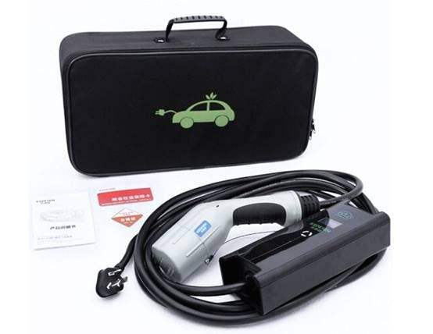
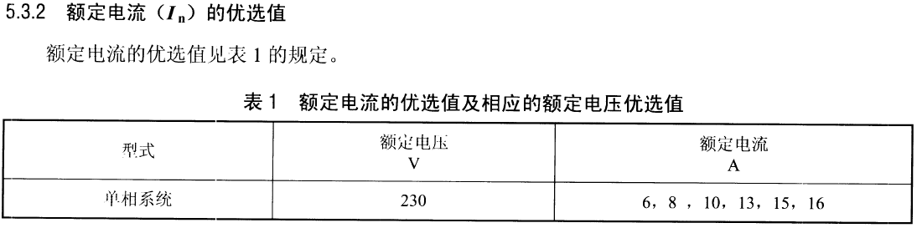
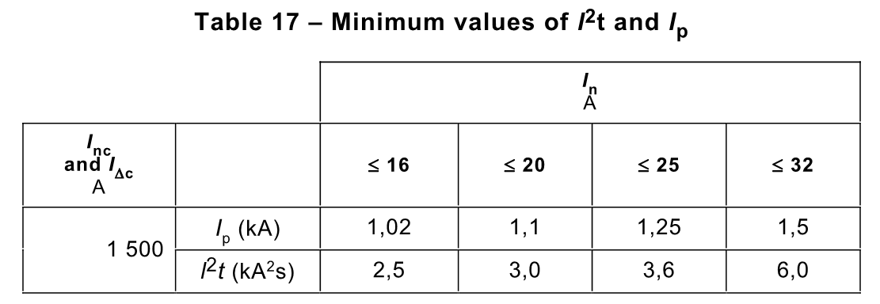
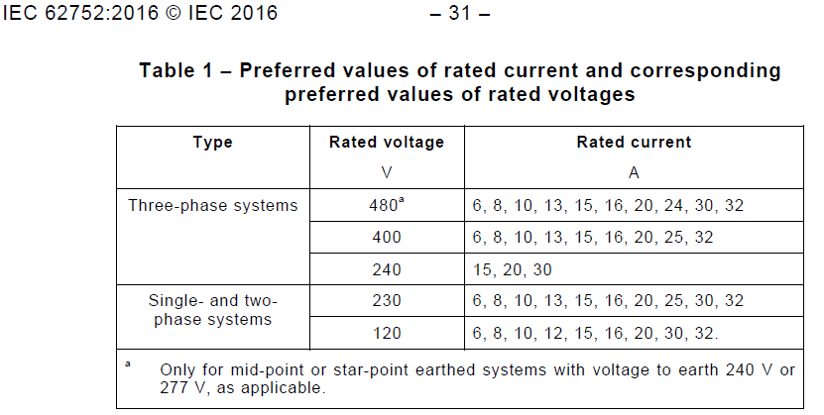
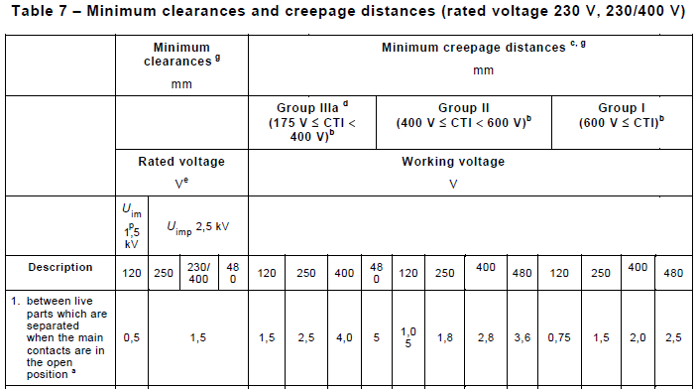
Portable Charger for Mode 2
In-Cable Control and Protective Device for Mode2
Control pilot function
Residual current function
Switching device
Requirement（IEC62752, GB/T18487.1, NB/T42077）
Short-circuit current with SCPD
Overvoltage category 2, U>230V: 2.5kV，1.5mm gap
Recommended：
≤16A: HF115FK, HF152F,
＞16A: HF178F, HF161F-W/40W, HF165F, HF179F/-W*, HF190F*, HF189F*, HF170F, HF177F*, HF185F
(Products marked with * can be withstand up to 1.5kA short-circuit current according to IEC62752 without welding, for more detail, please contact Hongfa team.)
Function Box
NB/T 42077:5.3.2
I≤16A
Single Phase
U~230VAC
IEC 62752:5.3.2
I≤32A
Single Phase
U~120/230VAC
Three Phase
U~240/400/480 VAC
05

Slide 6
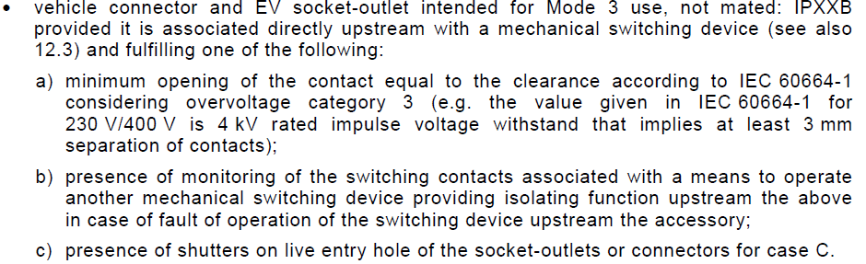
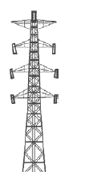
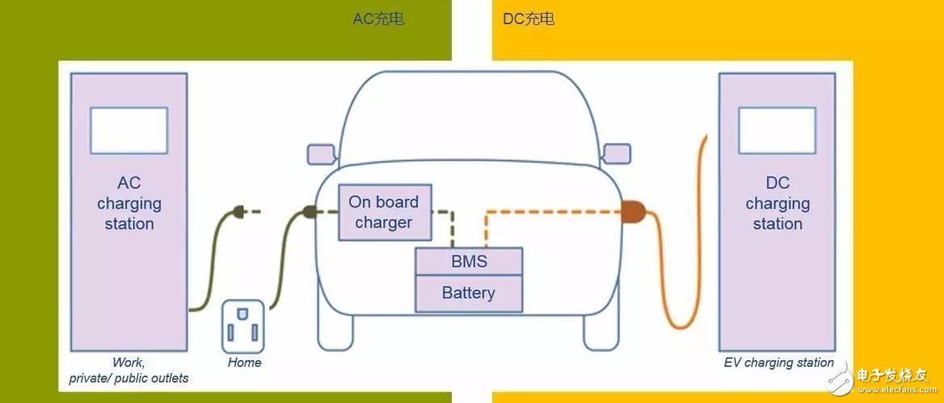
AC/DC Charging Station for Mode 3/4
AC Station, Mode 3 IEC61851-1/ GB/T 18487.3
A： Single Phase
220V 16A
B： Single/Three Phase
220/380V 32A
7.2kW ~3-4h (22kw for three phase)
C： Three Phase
U≤660V， 32A≤I≤250A
DC Station, Mode 4 IEC61851-23
Requirements of DC output relay
HVDC
Auxiliary contact
Requirements
Overvoltage category 3, 4kV, gap ≥3mm
Monitor the switching contacts
SCPD
Products
HF179F/-W(32A, 1.8/2.4mm)
HF165F(43A, 1.8/2.0mm)
HF176F(65A, 3mm)
HF186F(66A, 3mm)
*#HF177F(954)(A46)(40A,2.3mm)
#HF170F/2H(40A,3.6mm)
*#HF187F/4H(40A,3.9mm)
#HF189F(48A,2.25mm)
#HF190F(32A,2.25mm)
# aux. contact is optional
DC
AC
Breaker/Disconnector
500A or 10 times rated current on/off 3 times
6000A short-circuit current
DC/AC
RDC-DD
IEC 62955
Power Module（AC-DC）
HF165FD(30A)
HF165FD-50(32/40/50A)
06

Slide 7
Products in EV System
OBC DC Side
HVDC
Grid input
AC to DC
like OBC AC side
AC/DC
Charging
Stations
DC output/Quick Charge input
HVDC
Battery Monitor
Signal Relay
Main Relay
HVDC
Magnetic Lock of Charging Gun
HFD2,HFD3,HF32FV
BMS
电磁锁
Precharge Relay
HVDC
APS
Fan Motor
HF32FV
HF33F
HF46F
Insulation Monitor
HF181F
HFD3-VI
APS control
HF115F
HF92F
HF116F
HF30F
AC Station output
HF177F/2H(954)(A46)(40A,2.3mm)
HF187F/4H1D(32A,3.9mm)
HF179F/-W(32A,1.8/2.4mm)
HF165F(43A, 2mm)
HF170F(40A, 3.6mm)
HF170F/2H1D with aux. contact
HF186F(66A, 3mm)
......
Car window, wipe etc. in Electric System
Auto Relays
IC-CPD
HF115F/K-T(16A,105℃）
HF179F/-W(32A 105℃，1.8/2.4mm)
HF161F-W(33A, 1.5/1.8mm)
HF161F-40W（40A 105℃，43A 85℃，2mm）
HF190F(32A 2.25mm with auxiliary contact)
HF189F(48A 2.25mm with auxiliary contact)
OBC AC Side （-T：105℃）
≤16A：HF115F/K-T(882)，HF152F/D-T(882)
32A： HF178F/-T，HF165F-50
>60A : HF176F, HF186F
07

Slide 8
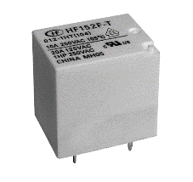
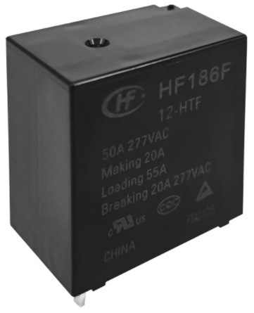
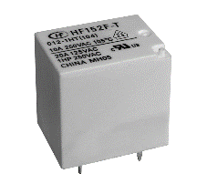
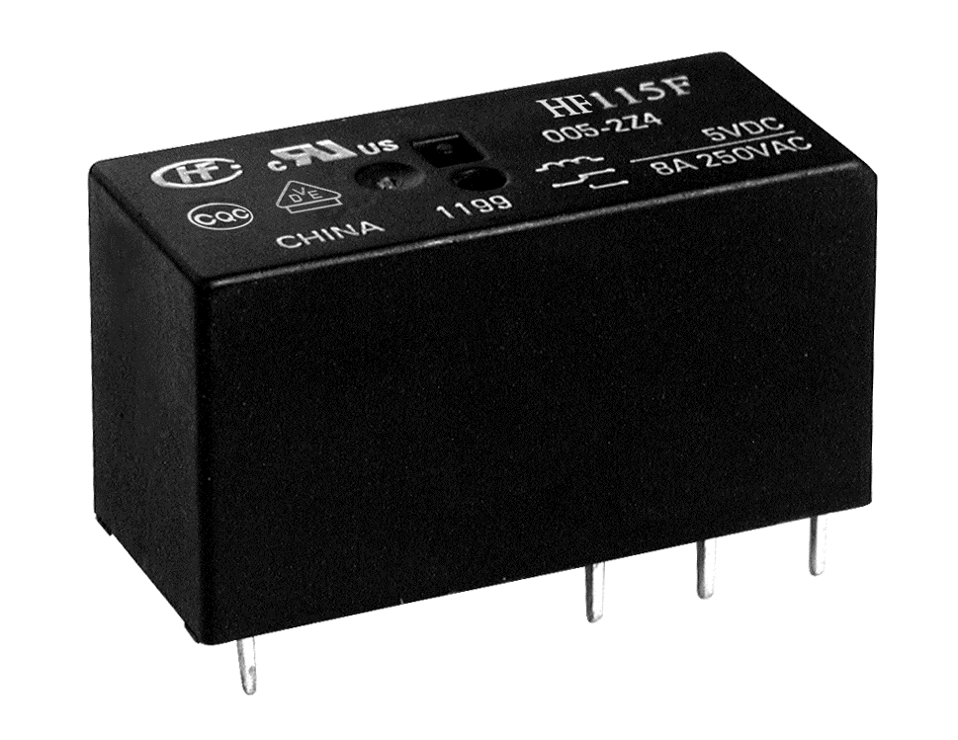
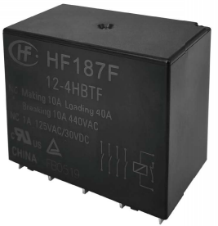
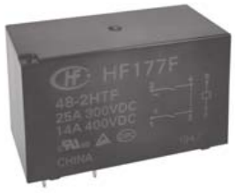
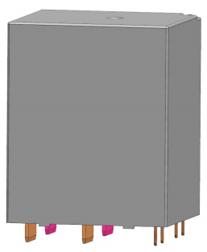
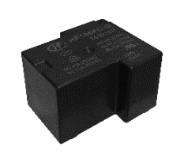
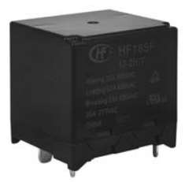
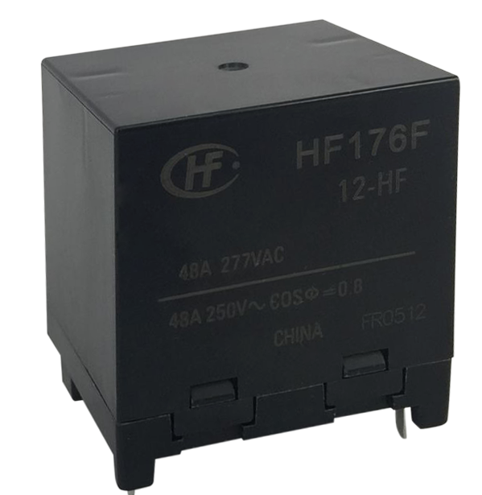
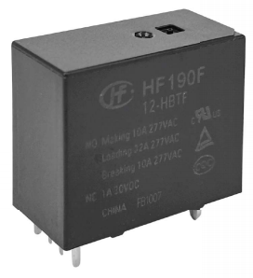
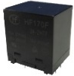
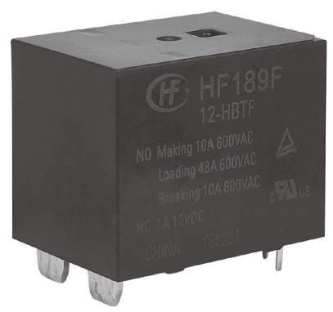
Product Map for AC charger
Ambient temp.
HF152F/D-T
HF115F/FK-T
HF165F-50
105℃
HF178F-T
HF179F, 1.8mm
HF179F-W, 2.4mm
HF161F-40W, 2mm
STD:43A
A21:50A
HF186, 3.0mm
55A 105℃
66A 85℃
HF187F/4A+1B,3.9mm
40A with auxiliary contact
HF177F(954)/2A,2.3mm
40A/35A
HF165FD(30A)
HF198F/2A,3.6mm【developing】
40A with auxiliary contact
HF178F 1A&1C
HF165F, 43A
STD:1.8mm,43A
797:2.0mm,43A
A21:2.0mm,60A
85℃
HF161F-W
STD:33A,1.5mm
477:33A, 1.8mm
456:33A, 2.0mm
704:26A, 2.3mm
A27:35A,2.3mm
HF152F/D
HF115F/FK
HF170F/2A(3.6mm)
HF170F/2A+1B
with auxiliary contact
HF185/2A, 3.0mm
50A 277VAC 85℃
HF176F, 3mm
STD:65A
A37:80A
HF190F, 2.25mm
32A with auxiliary contact
HF165F-50
STD:40A 85℃
50A 65℃
60A 60℃
A21: 60A @85℃
HF189F, 2.25mm
48A with auxiliary contact
16A
32A
40A
65A
Current

Slide 9
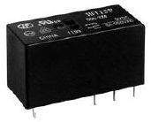
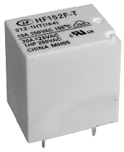
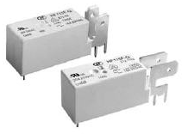
Featured products
HF115F/HF115F-H/HF115F-I/
HF115F-Q/HF115F-T
HF152F/HF152F-T
Contact rating：
HF115F 8A/12/16A 250VAC 85℃
HF115F-H 10A 250VAC 85℃
HF115F-Q 16A 250VAC 125℃
HF115F-T 16A 250VAC 105℃
Features：
1) Creepage distance: ≥10mm
Dielectric strength（coil-contacts): ≥5000VAC
Meet IEC60335-1
2) Temp. 85℃/105℃（-T）/125℃（-Q）
Productivity:
Automatic production, annual output >100 million pcs.
Contact rating:
HF152F 1H: 20A 125VAC/17A 277VAC
1Z: 16A 250VAC
HF152F-T: 105℃
Feathers:
1) Size: 21×16×20.6 mm
2) Coil power: 360mW
Productivity:
Automatic production, annual output >20 million pcs.
09

Slide 10
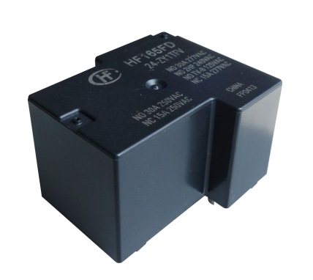
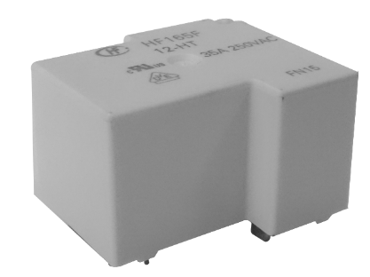
Featured products
HF161F-W
HF165FD
HF165F
Contact arrangement: 1 Form A
Contact rating: 26~33A 250VAC 85℃
2HP 250VAC
*35A type is optional
Size: 30.4×15.9×23.3 mm
Contact gap: 1.5/1.8/2.0/2.3mm
Dielectric strength (coil-contacts): ≥ 4500VAC
Contact arrangement: 1 Form A
Contact rating: 40A 250VAC
30A 250VAC
2HP 240VAC
TV-8 125VAC
Size: 32.2×27.5×20.4mm
Contact arrangement: 1 Form A
Contact rating: 35/43A 250VAC
*60A type is optional
Size: 32.2×27.4×15.4mm
Contact Gap: ≥1.8/2.0mm
Dielectric strength (coil-contacts): ≥2500VAC
10

Slide 11
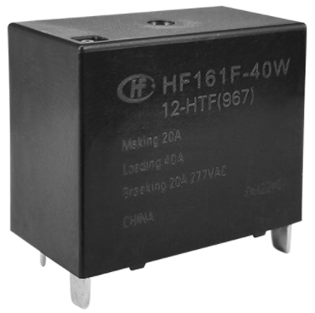
New products
HF178F/HF178F-T
HF179F/HF179F-W
HF165F-50
HF161F-40W
Size: 21.5x16x20.6mm(the same as HF152F)
Contact rating:
HF178F/HF178F-T: 85℃/105℃, 32A current-carrying
HF179F/HF179F-W: Gap=1.8/2.4mm,
16A-32A-16A 600VAC 105℃
Withstands up to 1.5kA short circuit current
(according to IEC62752) (Standard type coil)
Approval: UL/TUV/CQC
Mass production
Size: the same as HF165F
Contact rating:
32A 105℃/40A 85℃/50A 65℃/60A 60℃
*60A @85℃ type is optional
Approval: UL/TUV/CQC
Mass production
Size: 30.4×15.9×23.3 mm(the same as HF161F-W）
Contact rating: 40A @105℃, 43A @85℃
*50A type is optional
Contact gap: 2.0/1.8mm
Approval: UL/TUV/CQC
Mass production
11

Slide 12
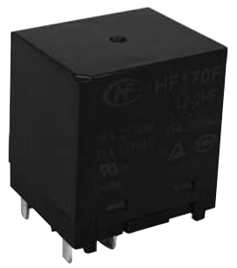
New products
HF170F/2H
HF170F/2H1D
HF176F
HF186F
Tiny
With 1 form B aux. contact
Size: 36x30x40mm
Contact arrangement: 2 Form A
Contact gap: ≥3.6mm
Contact rating:
40A 277VAC 85℃
Approval: UL/TUV/CQC
Mass production
Size: 38x33x36.3mm
Contact gap: ≥3mm
Contact rating:
20A/65A/20A 400VAC 85℃
*80A type is optional
Approval: UL/TUV
Mass production
Size: 30x20x31mm
Contact gap: ≥3mm
Contact rating:
20A/55A/20A 277VAC 105℃
20A/66A/20A 600VAC 85℃
Approval: UL/TUV/CQC
Mass production
Contact arrangement:
2 Form A+1 Form B
Approval: UL/TUV/CQC
Mass production
12

Slide 13
New products
HF190F
HF189F
HF185F
With 1 form B aux. contact
With 1 form B aux. contact
Size: 35x16x28mm
Contact arrangement: 1 Form A+1 form B
Contact gap: ≥2.25mm
Contact rating: 32A 277VAC 85℃ (Main contact)
Withstands up to 1.5kA short circuit current
(according to IEC62752)
Approval: UL/TUV
Mass production
Size: 35x25x28mm
Contact arrangement: 1 Form A+1 Form B
Contact gap: ≥2.25mm
Contact rating: 48A 277VAC 85℃(Main contact)
Withstands up to 1.5kA short circuit current
(according to IEC62752)
Approval: UL/TUV
Mass production
Size: 40x35x38.8mm
Contact arrangement: 2 Form A
Contact gap: ≥3.0mm
Contact rating: 50A 277VAC 85℃
Approval: UL/TUV
Mass production
13

Slide 14
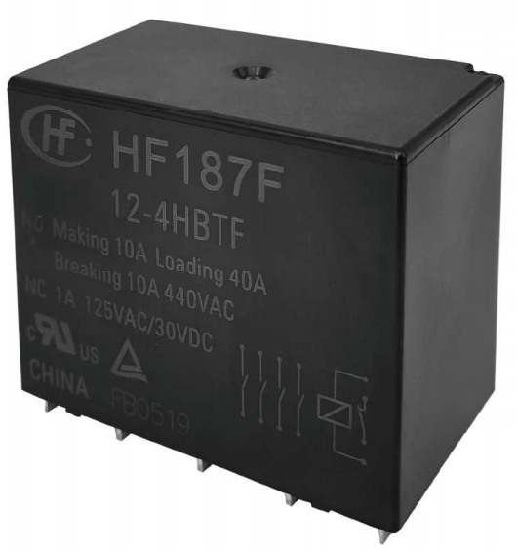
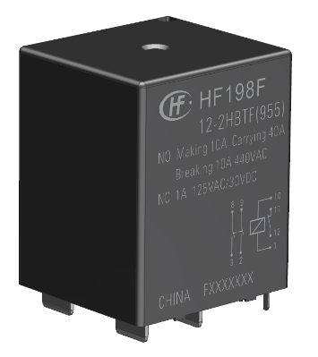
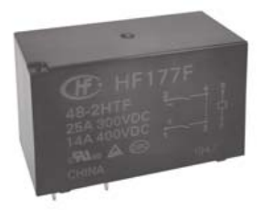
New products
EU AC Charging
HF187F
HF177F(954)
HF198F
Developing
With 1 form B aux. contact
With 1 form B aux. contact
Size: 59x35x47mm
Contact arrangement: 4 Form A+1 Form B
Contact gap: ≥3.9mm
Contact rating: 40A 277VAC 85℃(Main contact)
Withstands up to 3kA short circuit current
(according to IEC62955)
Approval: UL/TUV/CQC
Mass production
Size: 50x25x31mm
Contact arrangement: 2 Form A
Contact gap: ≥2.3mm
Contact rating: 40A/35A 277VAC 85℃
Withstands up to 4.5kA short circuit current
(according to IEC62955)
Approval: UL/TUV/CQC
Mass production
Size: 38x35x47mm
Contact arrangement: 2 form A+1 form B
Contact gap：≥3.6mm
Contact rating：40A 440VAC 85℃
Withstands up to 3kA short circuit current
(according to IEC62955)
MP: Q1/2023
14

Slide 15

Thanks
Contact us
Website: www.hongfa.com
Tel: 189604550106
E-mail: power-product05@hongfa.com
Power Relay Dept. of HQ Marketing Center
Xiamen Hongfa Electroacoustic Co.,Ltd.
Rev.2 2211

