Slide 1
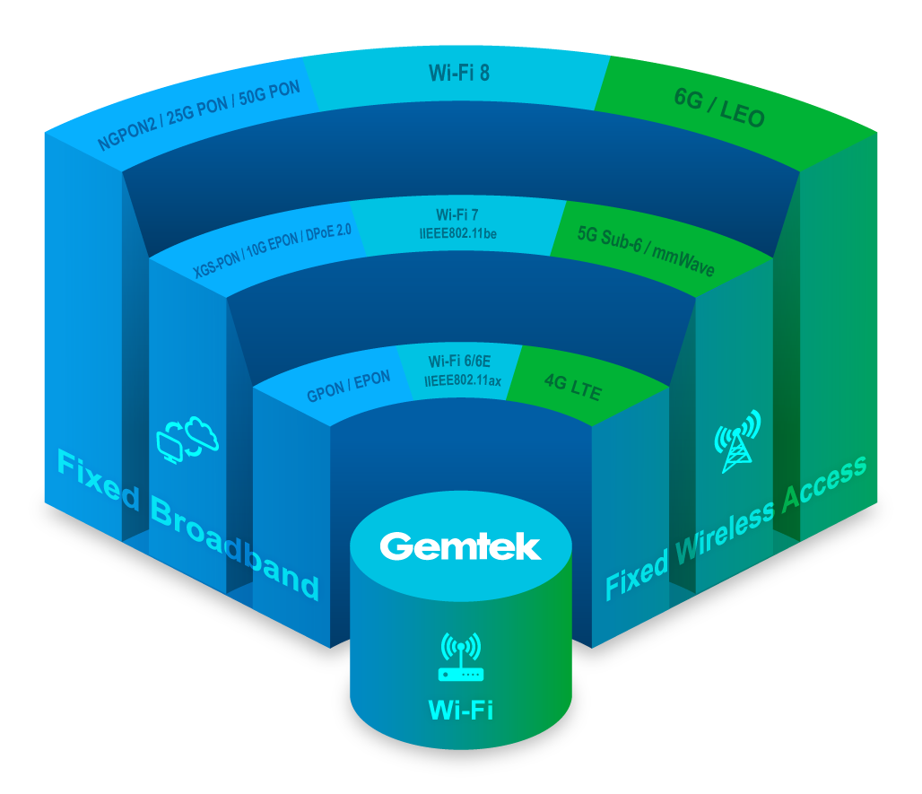
Key Technology Focus

