Slide 1

VAR & ASB Group in India

Slide 2
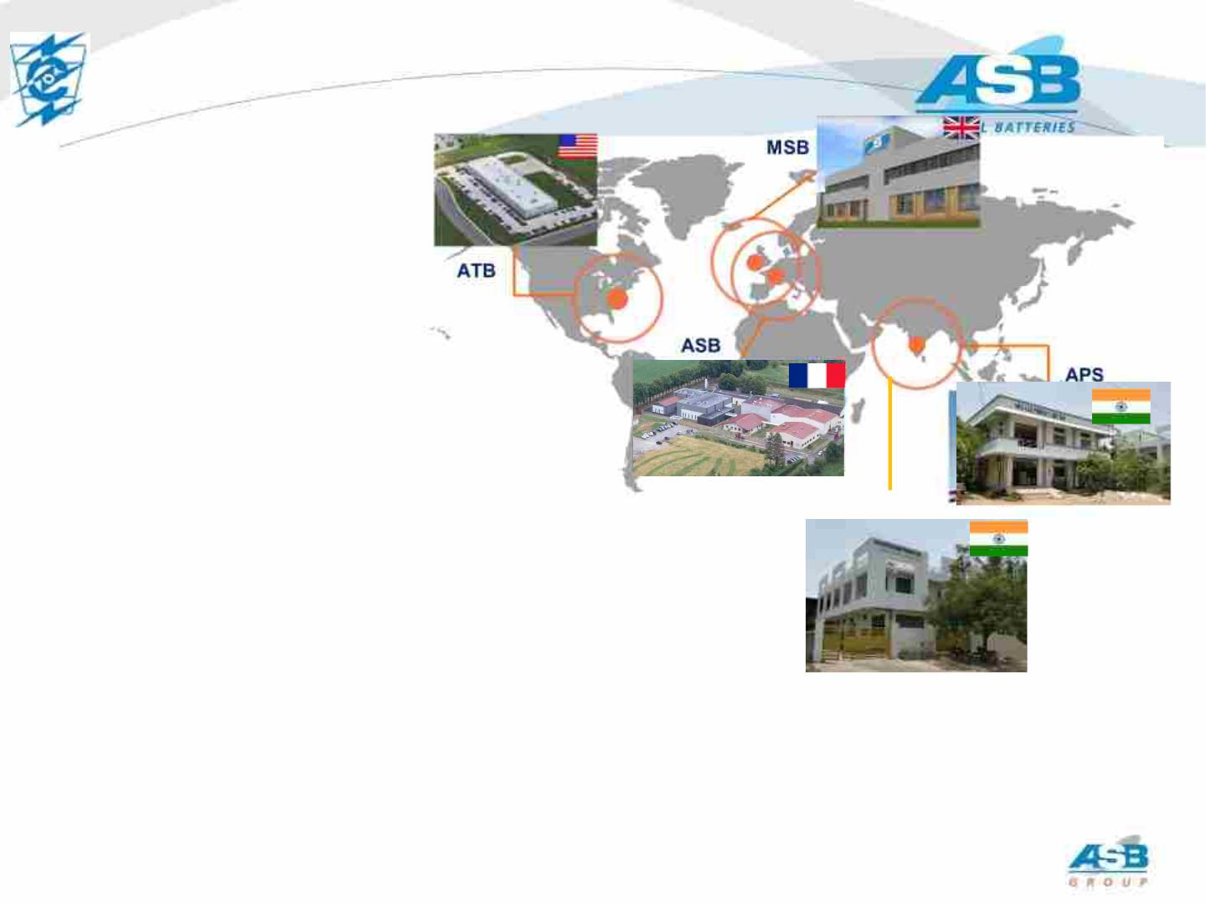
22
ASB Group – Global Presence
ASB Group in a few numbers:
§ Produces only thermal batteries
§ 460 employees
VAR
§ R&D Investment in excess of 7% of revenue
§ More than 60 years of experience
§ Single shift capacity exceeds 100,000 (28V
equivalent) and growing
§ More than 3 million batteries produced to date
§ Average of 30 development programs every year
§ All sites are ISO certified
This document is the property of ASB Group and must not be copied, reproduced, duplicated nor disclosed to any third Party, nor used in any manner whatsoever without prior written consent of VAR / ASB . © ASB2022

Slide 3

3
VAR
VAR
§ VAR is a Joint-Venture of ASB Group.
§ ASB group invests in main industrial equipment in VAR company. The new
ASB group standard equipment is fully operational since January 2019.
§ VAR has all technical capability to design and manufacture thermal
batteries following ASB Group standard processes
§ VAR will maintain ASB manufacturing Quality standards and testing.
§ VAR does not need French license
§ Single shift capacity of VAR is 30,000 (28V/220W equivalent)
This document is the property of ASB Group and must not be copied, reproduced, duplicated nor disclosed to any third Party, nor used in any manner whatsoever without prior written consent of VAR / ASB . © ASB2022

Slide 4
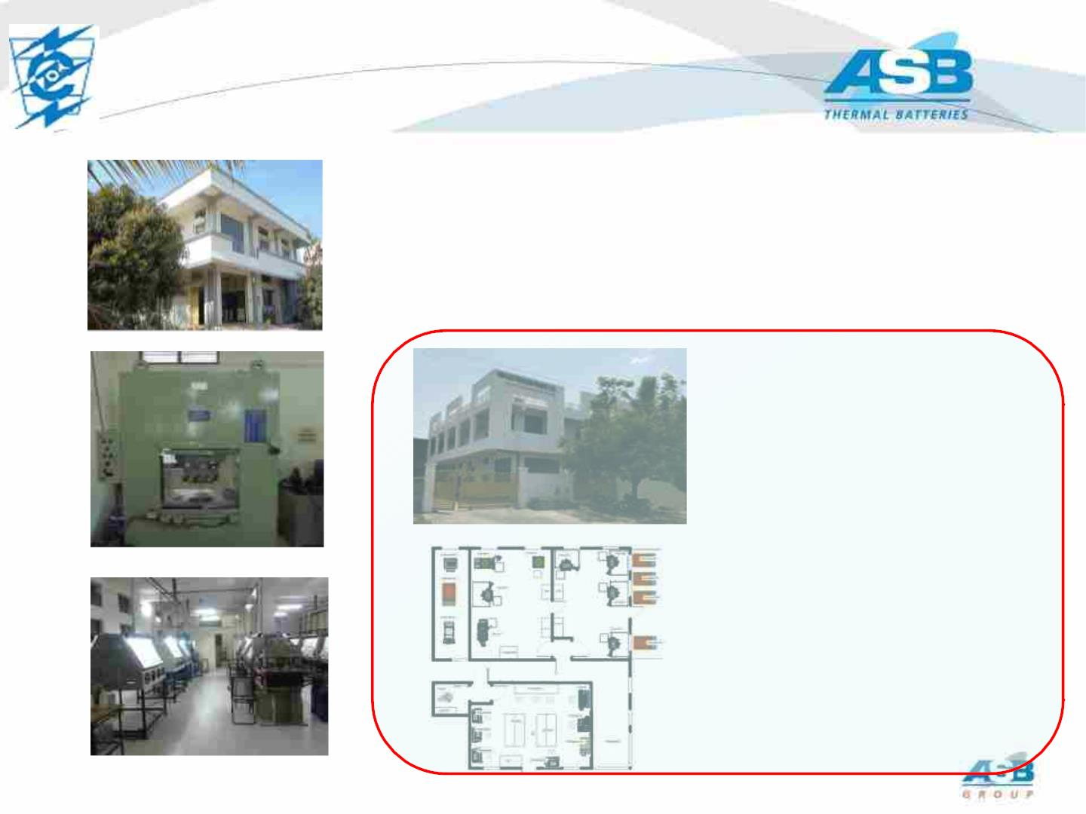
4 4
VAR Electrochem
- Based in Hyderabad –India since 1997
- ~100 Employees
- ISO9001, 2015, JV with ASB in France from 2017
- Supplier to RCI, DRDL, ARDE, BDL, NSTL,ASL,TBRL,
PGAD, ADE etc. in India (Ministry of Defence)
Large project of
Investment with ASB
France to reach ASB
group standardization
§New building
§New presses pellet manufacture
§Dry Room assembly capability
§Inspection x-ray, leak test,
§Functional Test capability
electrical, shaker
This document is the property of ASB Group and must not be copied, reproduced, duplicated nor disclosed to any third Party, nor used in any manner whatsoever without prior written consent of VAR / ASB . © ASB2022
4

Slide 5

5
Prestigious Projects
PROJECTS EXECUTED:
DOMESTIC PROJECTS UNDER EXECUTION:
• MILAN
• KONKURS
• ADE
• PGAD-II
• INVAR
• TRISHUL
• VSHORADS
• AKASH
• AKASH NG
• AKASH MK 1S
• AKASH PRIME
• SFDR
• AKASH PRIME
• KONKURS
• PGAD-I
• STAR
EXPORT PROJECTS UNDER EXECUTION:
• ADE
• ARDE
• RUDRAM
• NGARM
• QRSAM
• A1P
• HALCON
• MICA- RAFALE
• AMOGHA
This document is the property of ASB Group and must not be copied, reproduced, duplicated nor disclosed to any third Party, nor used in any manner whatsoever without prior written consent of VAR / ASB . © ASB2022

Slide 6
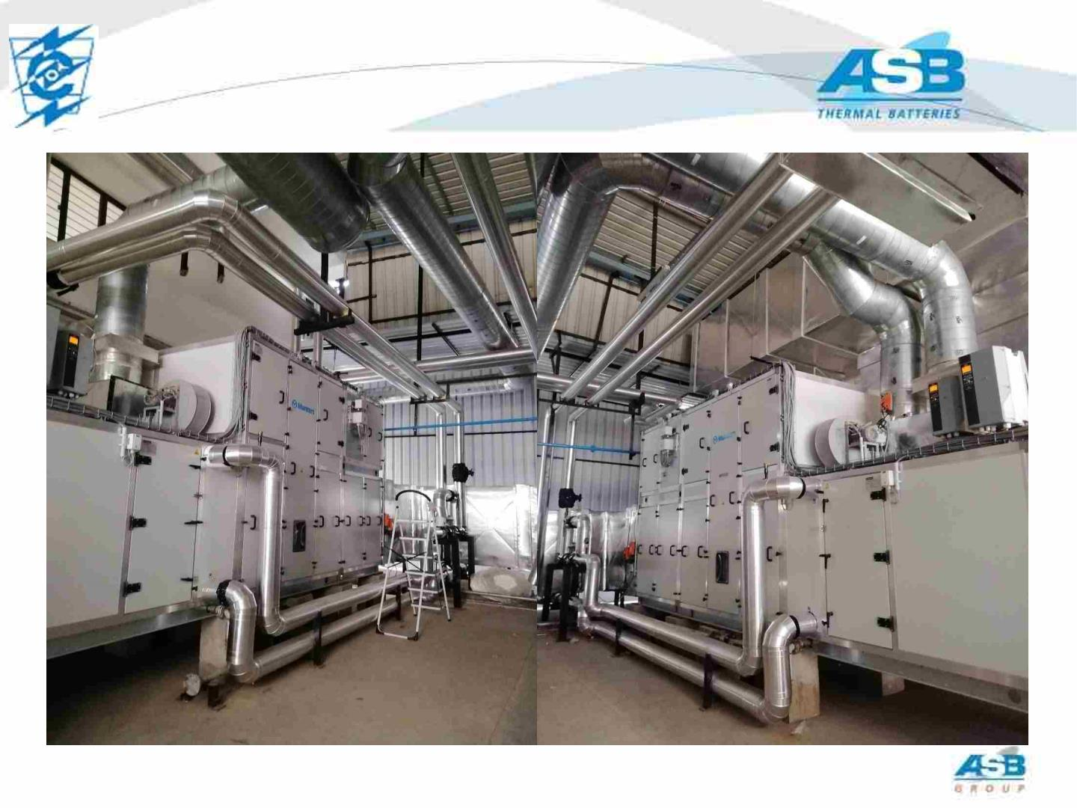
6
Dehumidifier Units
This document is the property of ASB Group and must not be copied, reproduced, duplicated nor disclosed to any third Party, nor used in any manner whatsoever without prior written consent of VAR / ASB . © ASB2022

Slide 7
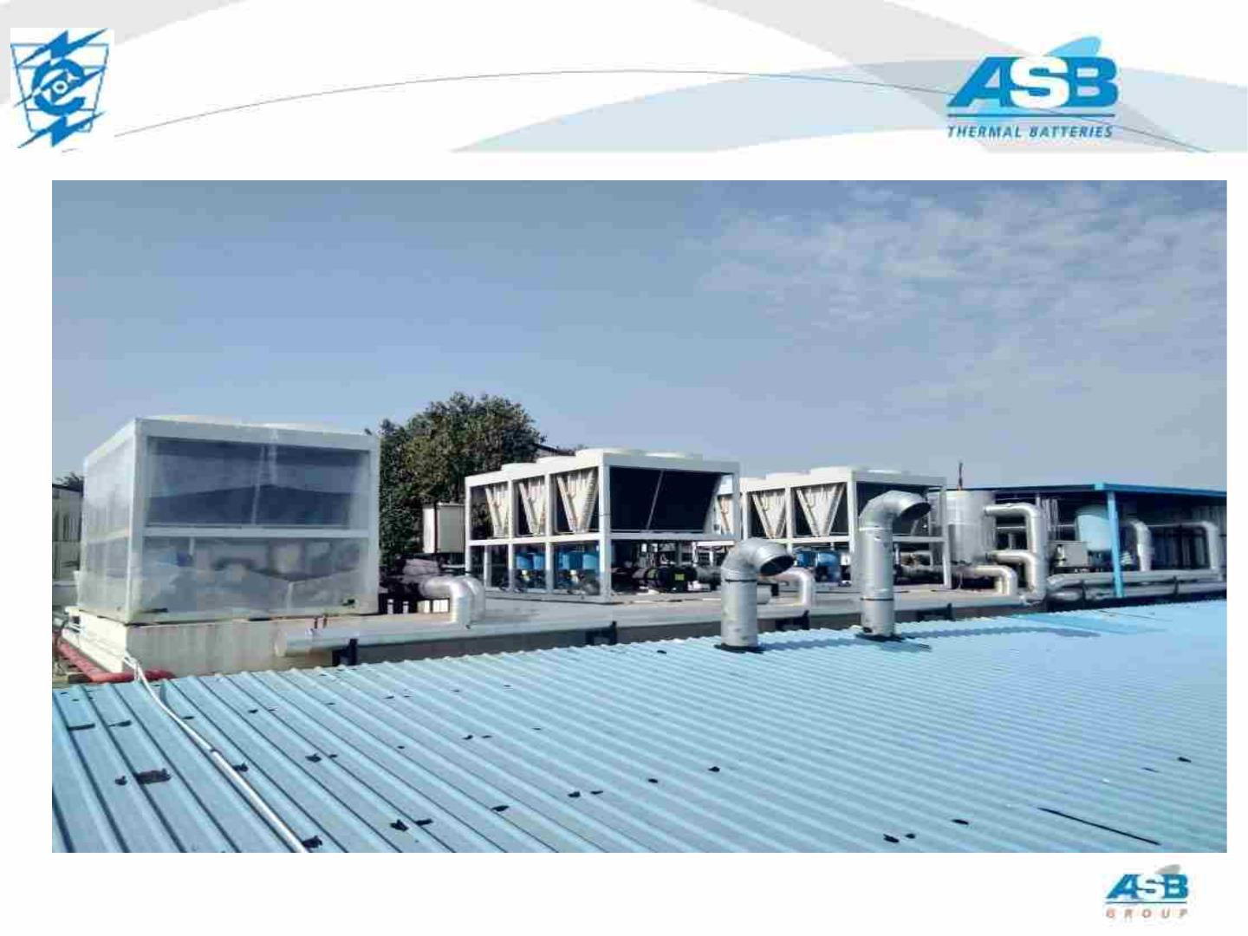
7
Chillers
This document is the property of ASB Group and must not be copied, reproduced, duplicated nor disclosed to any third Party, nor used in any manner whatsoever without prior written consent of VAR / ASB . © ASB2022

Slide 8
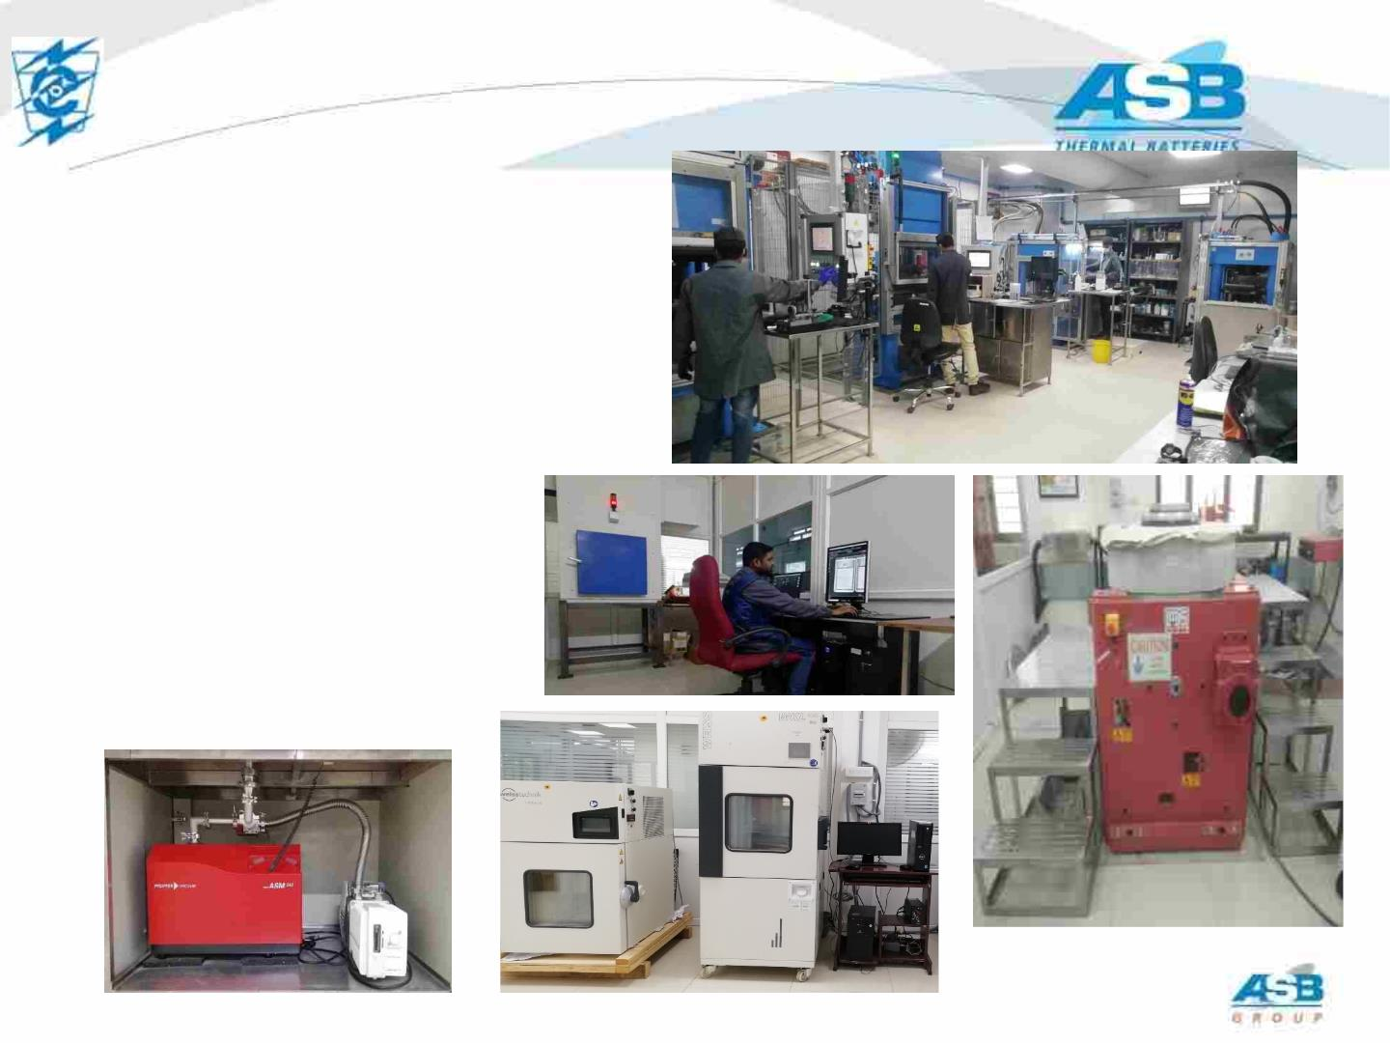
8
State of Art Infrastructure facility
§ Dry rooms,
§ Automatic Presses for pellets,
§ X-Ray equipment,
§ Environment test equipment
§ Vibration equipment
§ Acceleration equipment
§ Bump
This document is the property of ASB Group and must not be copied, reproduced, duplicated nor disclosed to any third Party, nor used in any manner whatsoever without prior written consent of VAR / ASB . © ASB2022

Slide 9
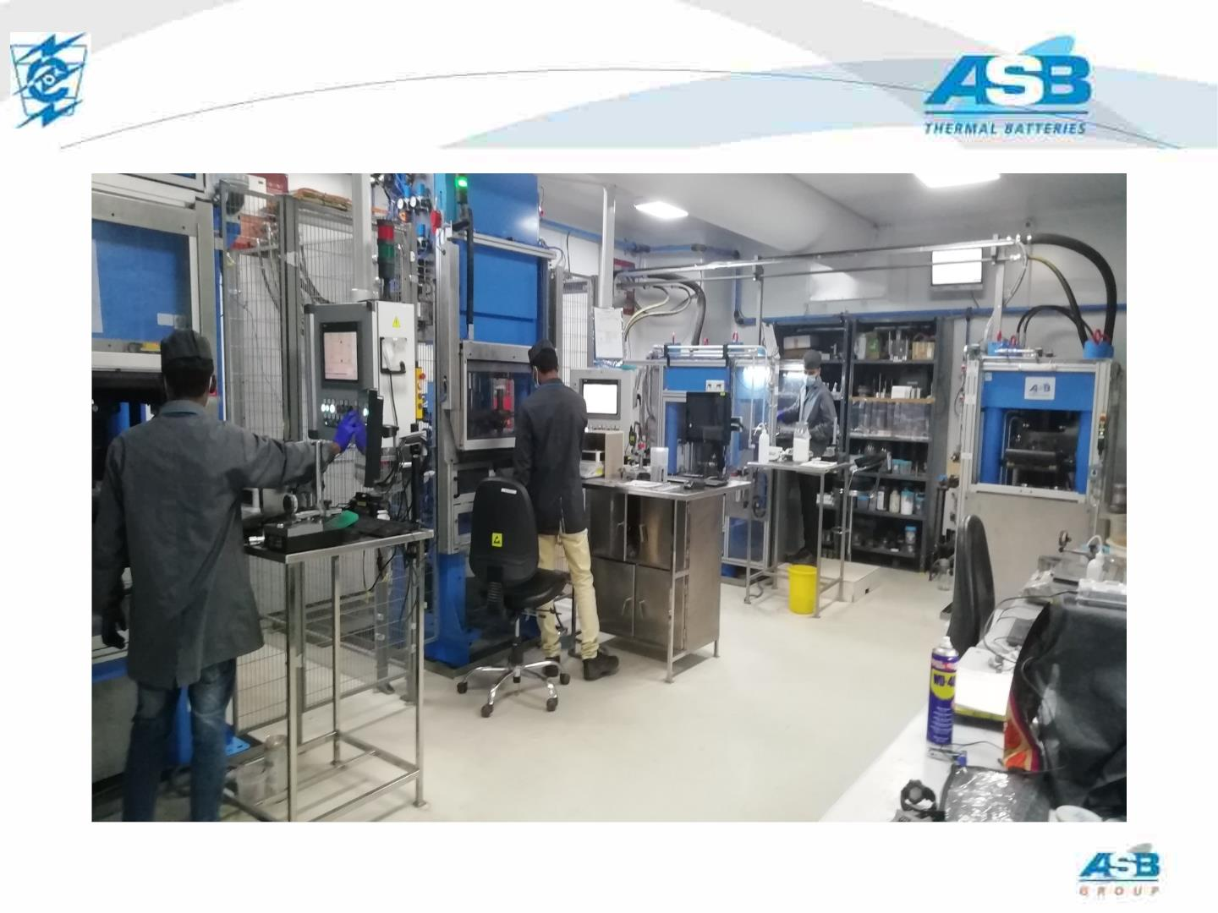
9
Dry Room Facility at VAR
This document is the property of ASB Group and must not be copied, reproduced, duplicated nor disclosed to any third Party, nor used in any manner whatsoever without prior written consent of VAR / ASB . © ASB2022

Slide 10
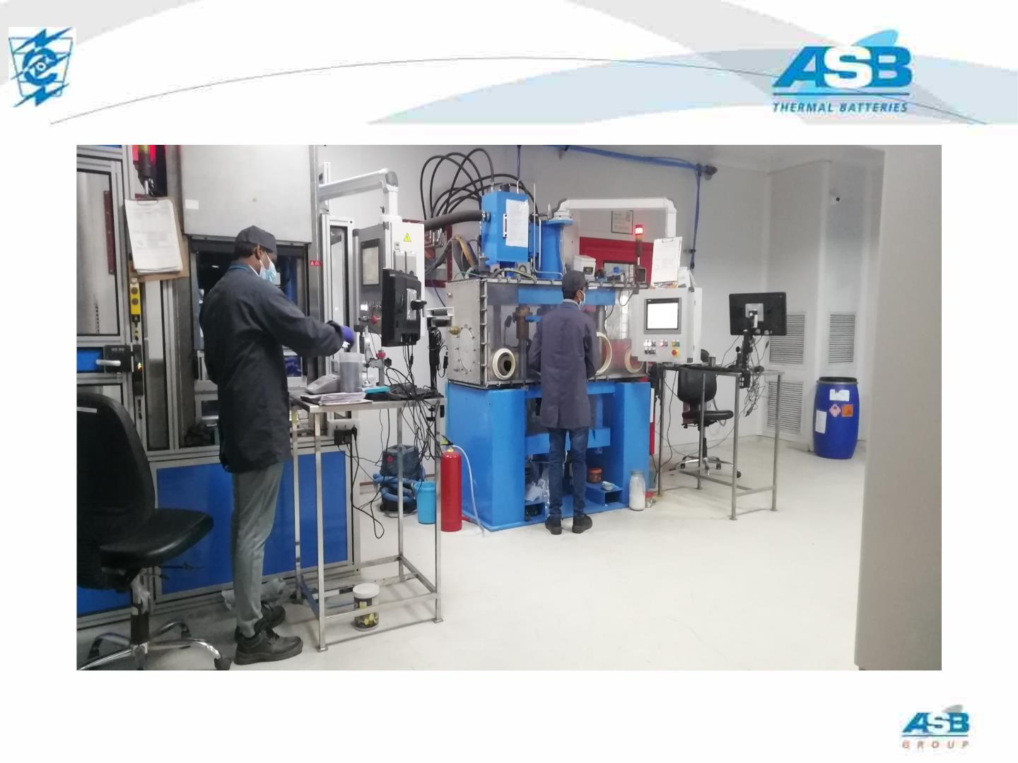
10
Dry Room Facility at VAR
This document is the property of ASB Group and must not be copied, reproduced, duplicated nor disclosed to any third Party, nor used in any manner whatsoever without prior written consent of VAR / ASB . © ASB2022

Slide 11
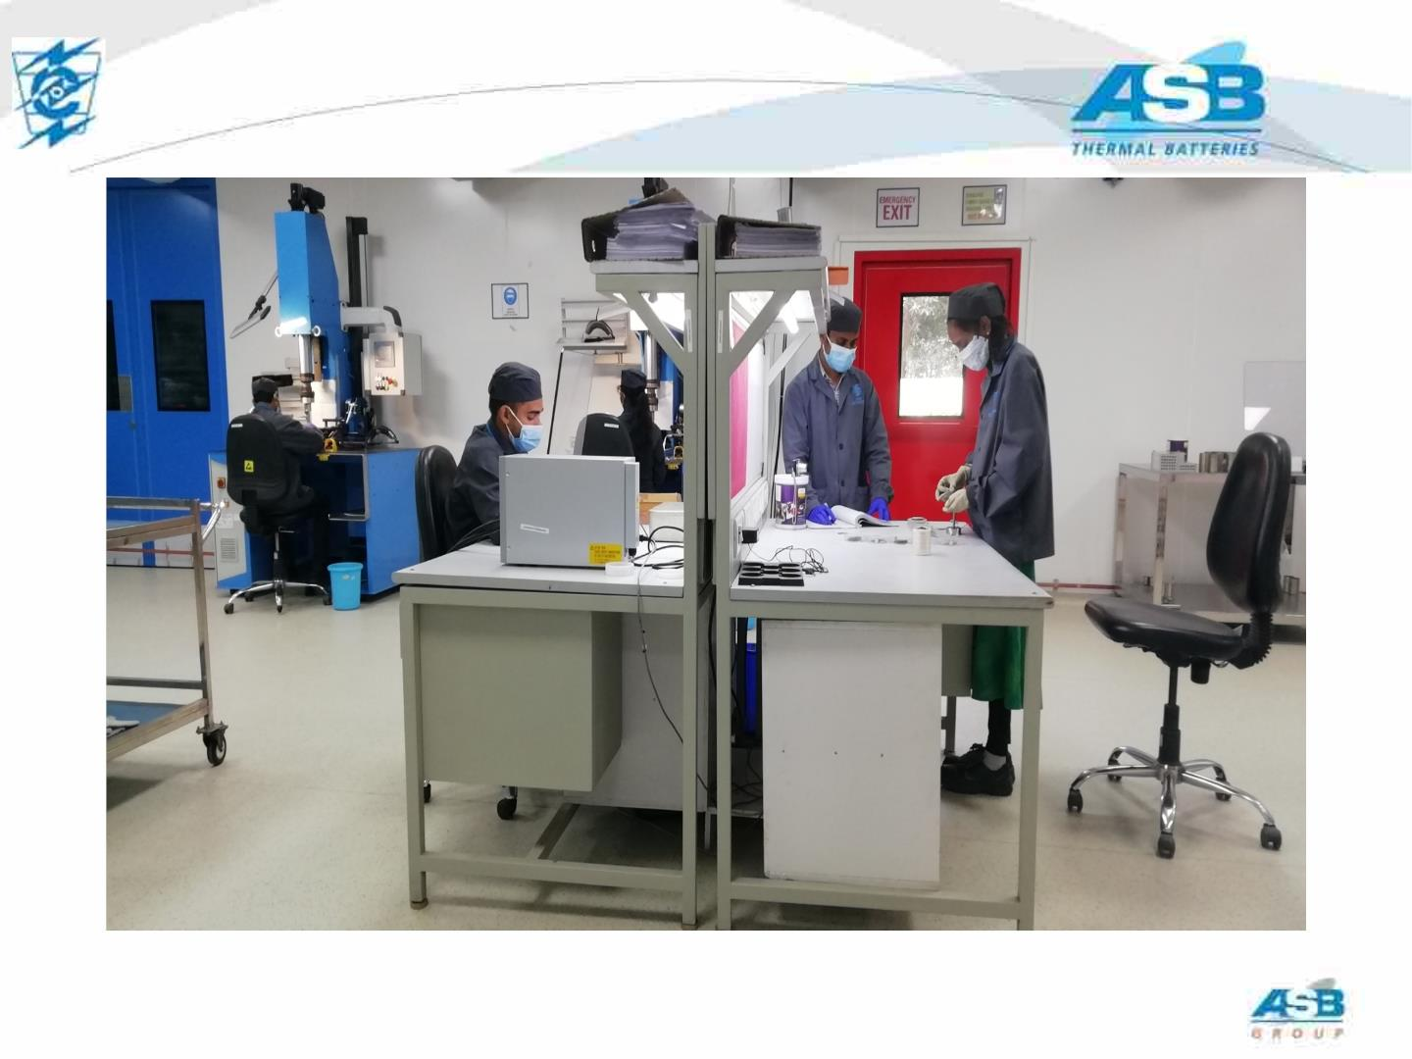
11
Dry Room Facility at VAR
This document is the property of ASB Group and must not be copied, reproduced, duplicated nor disclosed to any third Party, nor used in any manner whatsoever without prior written consent of VAR / ASB . © ASB2022

Slide 12
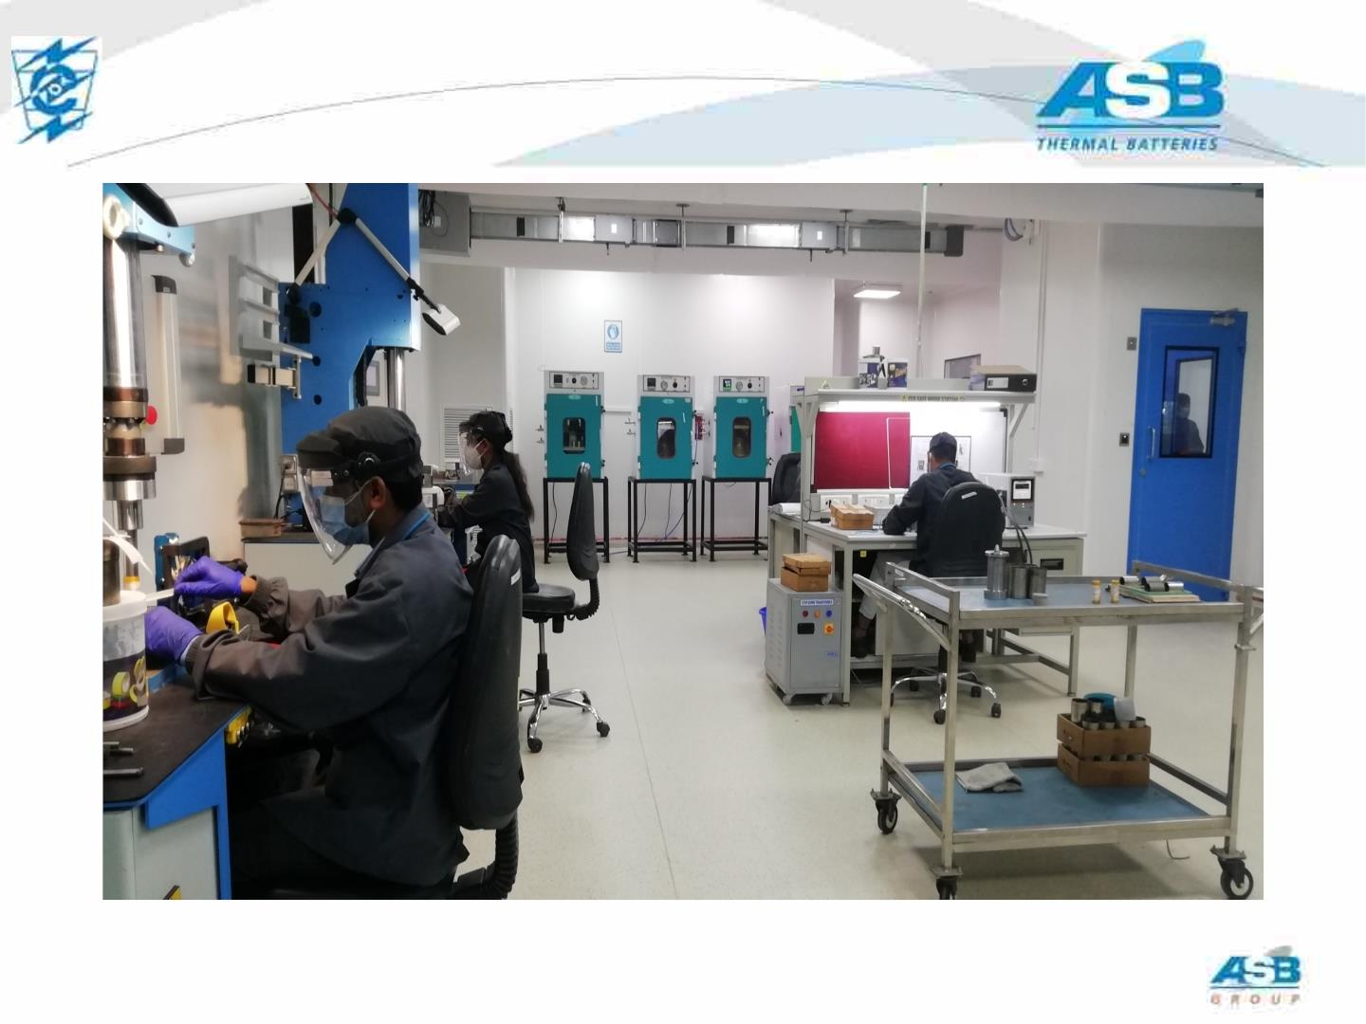
12
Dry Room Facility at VAR
This document is the property of ASB Group and must not be copied, reproduced, duplicated nor disclosed to any third Party, nor used in any manner whatsoever without prior written consent of VAR / ASB . © ASB2022

Slide 13
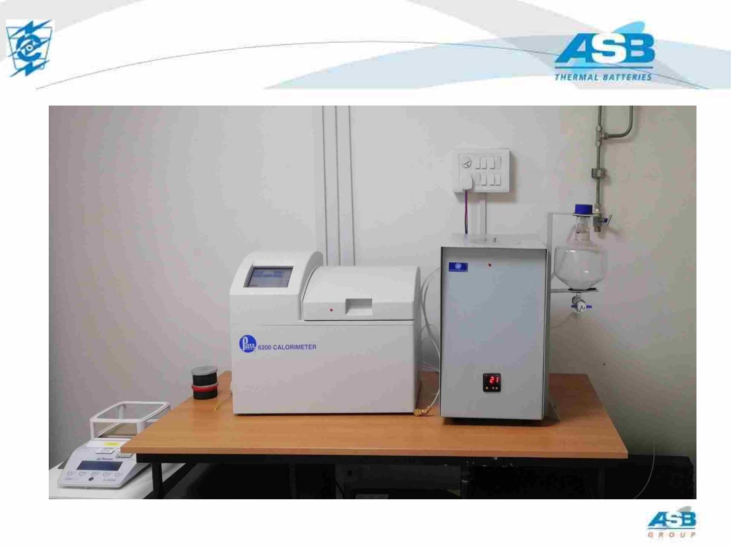
13
PARR CALORIMETER
This document is the property of ASB Group and must not be copied, reproduced, duplicated nor disclosed to any third Party, nor used in any manner whatsoever without prior written consent of VAR / ASB . © ASB2022

Slide 14
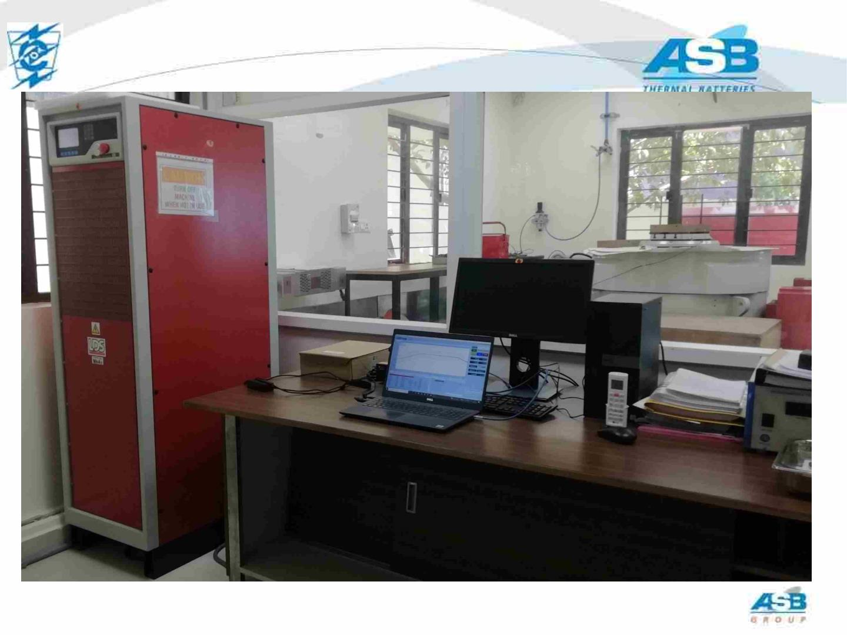
14
SHAKER CONTROLLER SETUP
This document is the property of ASB Group and must not be copied, reproduced, duplicated nor disclosed to any third Party, nor used in any manner whatsoever without prior written consent of VAR / ASB . © ASB2022

Slide 15
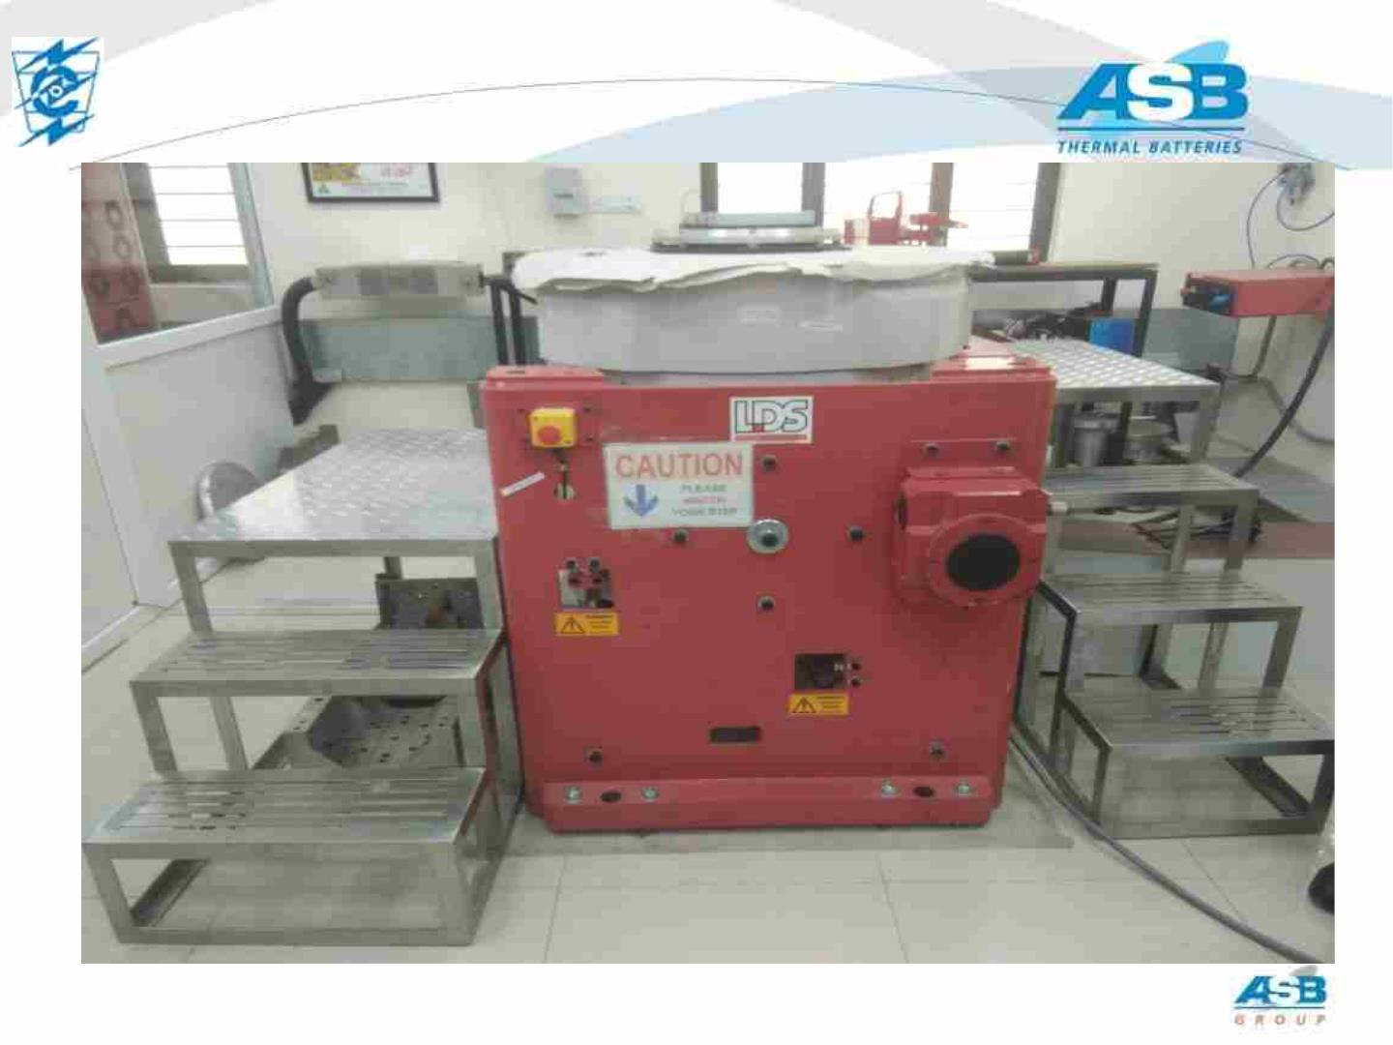
15
Vibrator
This document is the property of ASB Group and must not be copied, reproduced, duplicated nor disclosed to any third Party, nor used in any manner whatsoever without prior written consent of VAR / ASB . © ASB2022

Slide 16
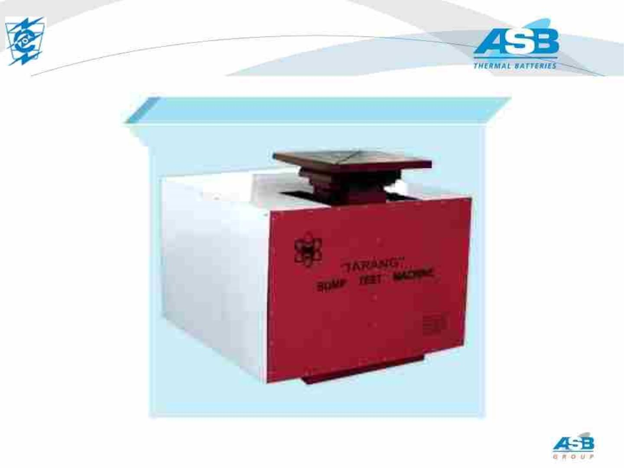
16
BUMP TEST MACHINE
This document is the property of ASB Group and must not be copied, reproduced, duplicated nor disclosed to any third Party, nor used in any manner whatsoever without prior written consent of VAR / ASB . © ASB2022

Slide 17
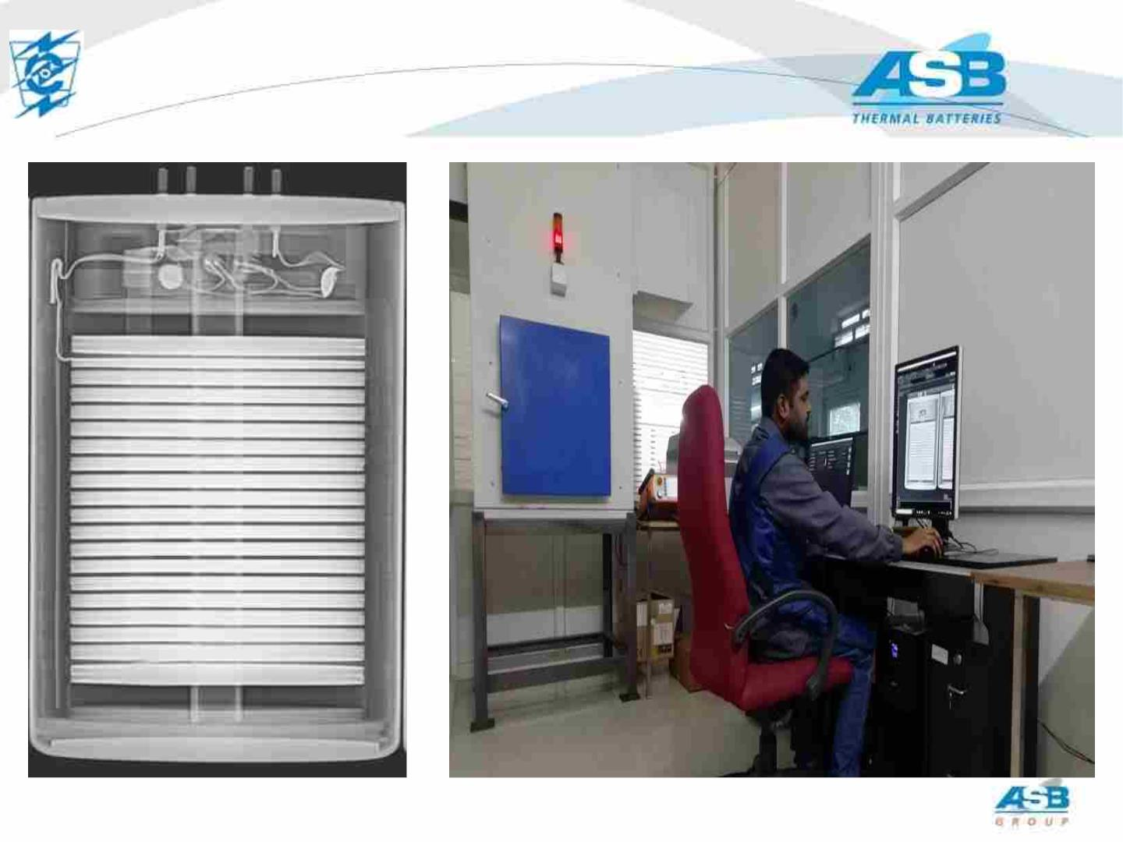
17
X-RAY FACILITY
This document is the property of ASB Group and must not be copied, reproduced, duplicated nor disclosed to any third Party, nor used in any manner whatsoever without prior written consent of VAR / ASB . © ASB2022

Slide 18
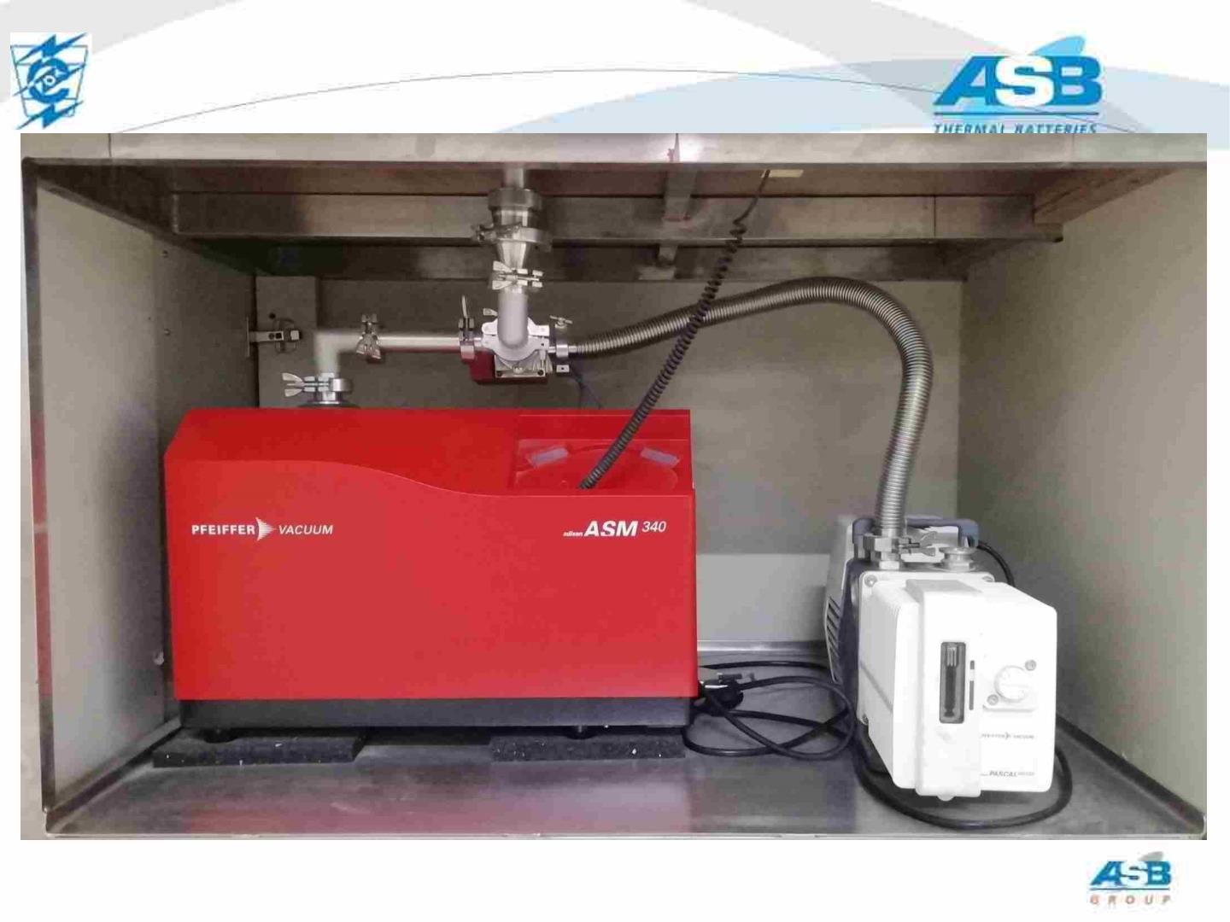
18
BATTERY LEAK CHECK FACILITY
This document is the property of ASB Group and must not be copied, reproduced, duplicated nor disclosed to any third Party, nor used in any manner whatsoever without prior written consent of VAR / ASB . © ASB2022

Slide 19
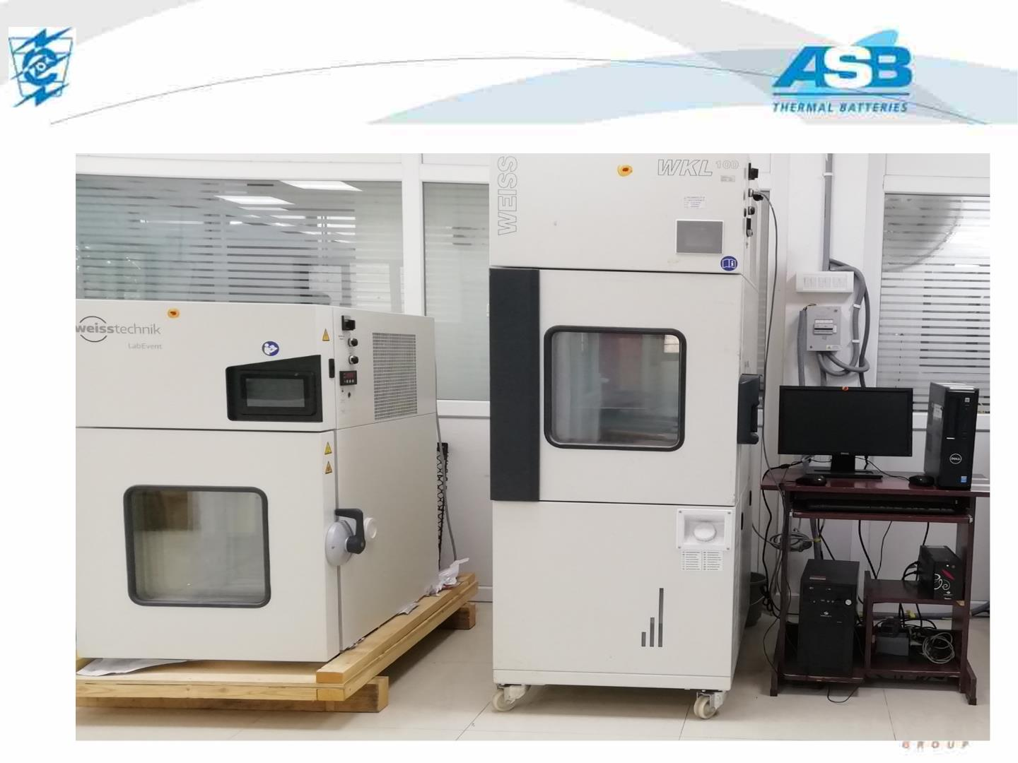
19
ENVIRONMENTAL CHAMBERS
This document is the property of ASB Group and must not be copied, reproduced, duplicated nor disclosed to any third Party, nor used in any manner whatsoever without prior written consent of VAR / ASB . © ASB2022

Slide 20
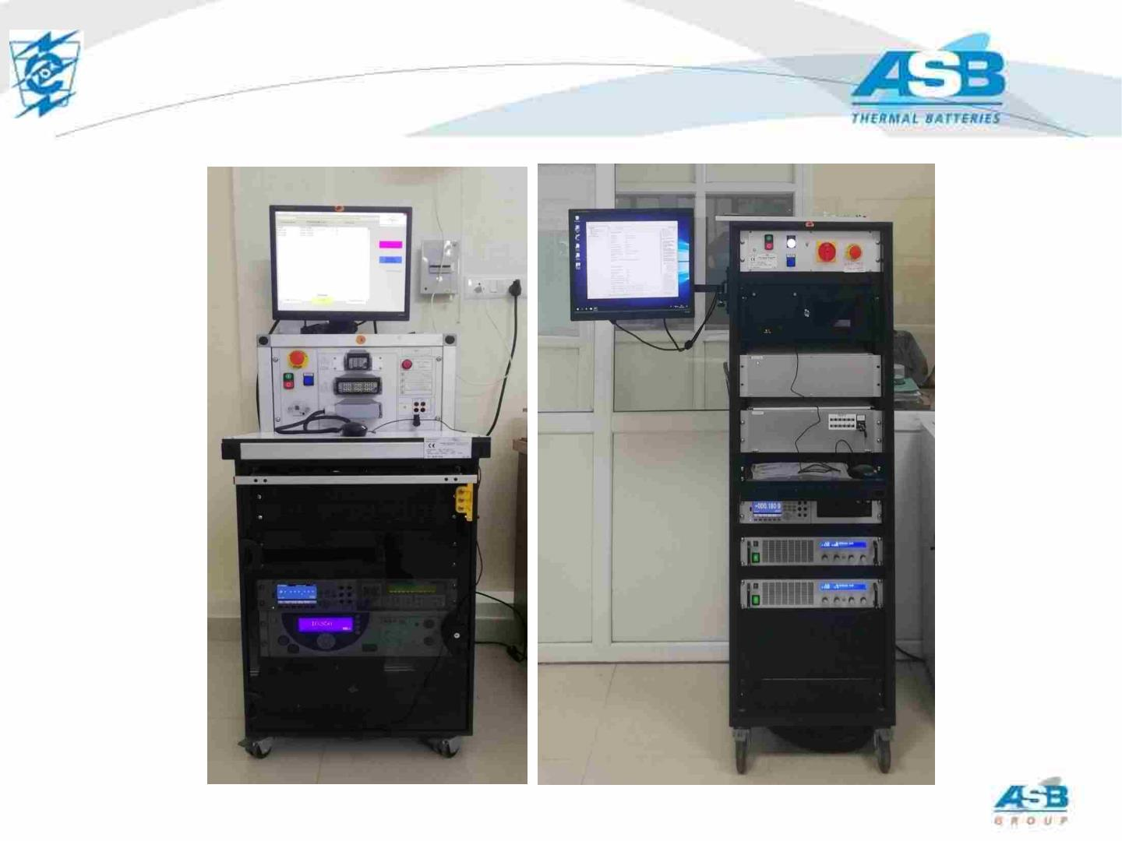
20
BATTERY NON-DESCTRUCTIVE AND FIRE
TEST FACILITY
NON-
DESTRUCTIVE
ELECTRICAL
TEST BENCH
FIRING TEST
BENCH
This document is the property of ASB Group and must not be copied, reproduced, duplicated nor disclosed to any third Party, nor used in any manner whatsoever without prior written consent of VAR / ASB . © ASB2022

Slide 21
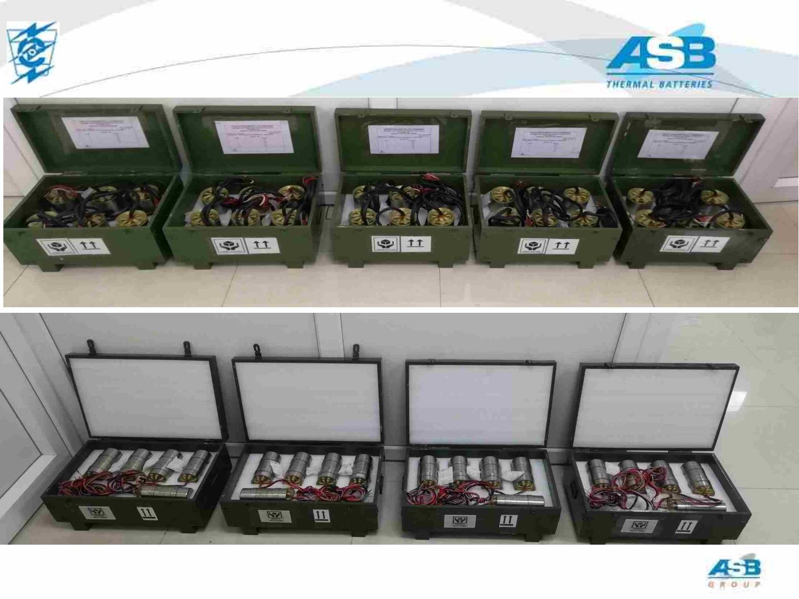
21
PREPARATION FOR SHIPMENT
This document is the property of ASB Group and must not be copied, reproduced, duplicated nor disclosed to any third Party, nor used in any manner whatsoever without prior written consent of VAR / ASB . © ASB2022

Slide 22
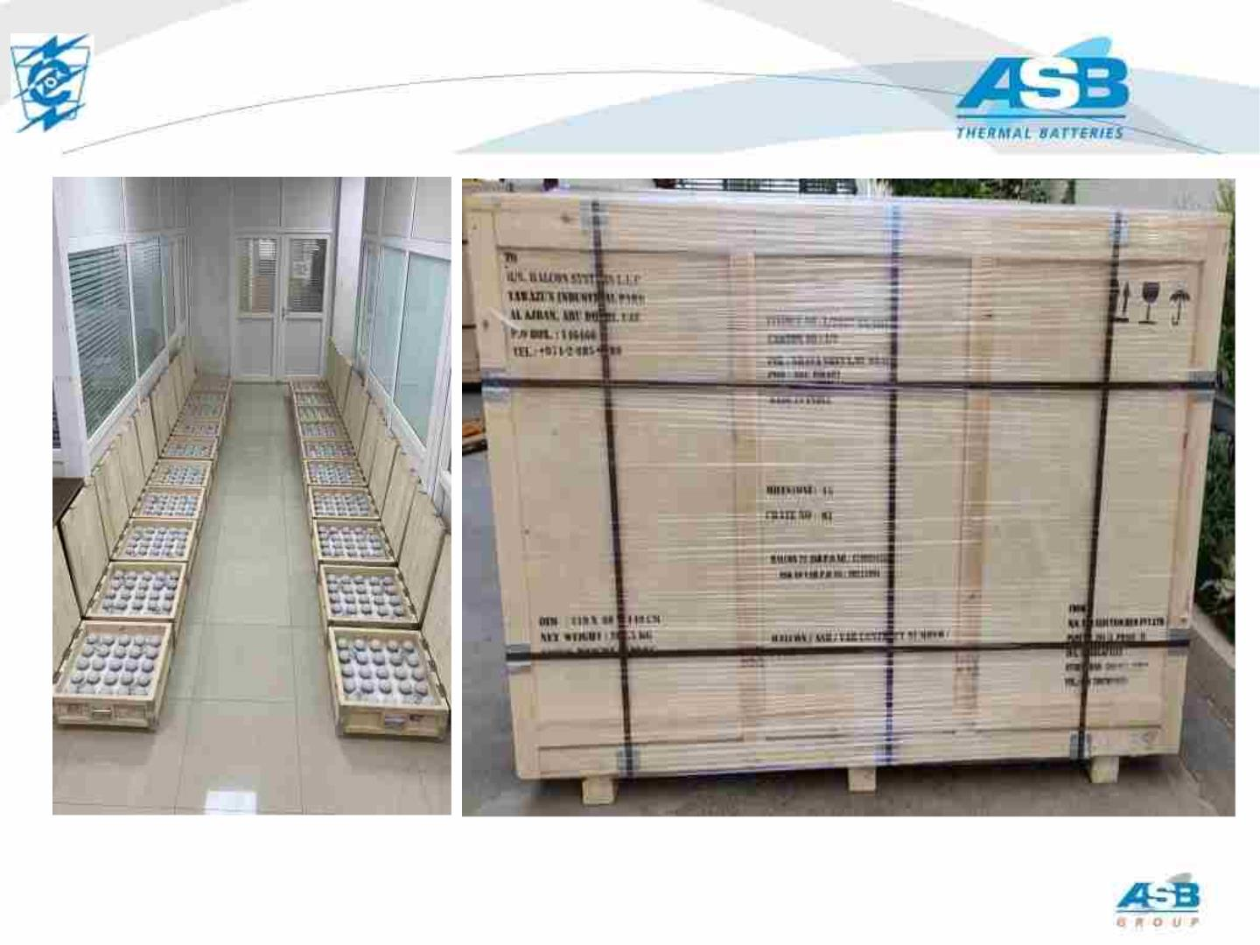
22
PREPARATION FOR SHIPMENT
This document is the property of ASB Group and must not be copied, reproduced, duplicated nor disclosed to any third Party, nor used in any manner whatsoever without prior written consent of VAR / ASB . © ASB2022

Slide 23

23
Thank You
VAR Contacts
Dr.R.N.Prasad
dr.prasad@varelectrochem.in
info@varelectrochem.in
This document is the property of ASB Group and must not be copied, reproduced, duplicated nor disclosed to any third Party, nor used in any manner whatsoever without prior written consent of VAR / ASB . © ASB2022

