Slide 1




Apollo Micro Systems Limited
(A BSE & NSE Listed Company)
Missile Defence | Avionics | Naval Defence | Ground Defence
Home Land Security | Telecom Electronics
Automotive & Transportation

Slide 2

Executive Summary
Company Overview
Company with 37 Years of standing in ADS Sector.
Successful and proven track record in execution of Indigenous Defence & Space Solutions.
A Research driven company with strong R&D team and huge repository of re-usable “building blocks” of hardware as well as software IP’s.
Average Spend of 7% to 8% of revenues in R&D
CEMILAC Certified & AS 9100 D Certified for Design of AVIONIC Systems, ISO 14001 Certified, ISO 45001 Certified
Approved Partner of DRDO & Defence PSU’s
Qualified & Trained workforce.
Collaborative R&D Partner for Embedded Hardware and Software Designs & Identified Production Service Provider in the areas of Electronic Mfg Facilities and Mechanical Precision Machining Facilities of Bharat Electronics Limited.
Company has state of the art facility right from design to assembly and testing as an End –to-End Solution Provider offering “ Total Solutions Under One Roof”
Company has its participation in several Indigenous Defence Programmes and these solutions are qualified to be a part of supply chain in production phase under DcPP.
Apollo Micro Systems
02

Slide 3
Key Highlights
Apollo Microsystems
37+
Company Standing in Industry
300+
Qualified & Experienced workforce
150
Workforce with Strong R&D Capabilities
500+
Developed On- Board & Ground Support Systems
20.00%
YoY Growth in Past 2 Years Revenue CAGR (FY21-22)
0.11%
ROCE % FY22
7.04
EPS for FY22
03
20+

Slide 4



All about AMS
Apollo Microsystems
We design & develop high-performance, custom built ruggedized Electronics & Electro-mechanical Systems for mission and time critical applications meant to withstand extreme environmental conditions in Aerospace, Defense, Space, Home Land Security and Transportation Sectors.
Defence Avionic Systems
On-Board & Ground Support Equipment for Avionics
Satellite Space Systems
Payload Checkout Systems and Earth Station acquisition
systems for Space applications
Defence –Aerospace Systems
On-Board Weapon System Electronics solutions & Ground
Support Equipment for Missile Systems
Homeland Security & Telecom
Telecom and Networking solutions & Integrated Security and surveillance solutions for Homeland security applications
Defence -Naval Systems
On-Board Weapon electronics and Ground Support equipment
for Torpedoes, Decoys -Jammers, Submarines and Ships
Automotive & Transportation
In Transportation sector, we have worked on, Passenger
Information Systems (Viz., Token Display System, Arrival/ Departure Information Display System etc)
Apollo Micro Systems
04

Slide 5





First Developmental Model of Expendable Decoy supplied for Indian Navy
Our Journey
Reached Milestone of over INR 1 bn Turnover
Apollo Microsystems
Installed State of the art facility for Defence Systems Manufacturing Facility Inaugurated by Head of State, & Eminent SCIENTIFIC Group
2015
Delivered Fully Indigenous Integrated Mine Management System for Coal & Iron Ore Mines
2007
Started offering Indigenous Processor Boards for Defence applications
1990
First Pvt Company in Defence Electronics to be ISO certified
2004
Converted to Pvt Ltd Company
1997
1985
Incorporation of AMS as Proprietary Company offering Electronic CAD Design Services
1992
Started offering On-Board Systems for
Defence
2000
First Indigenous Pay-Load Checkout System is supplied to ISRO replacing Legacy
Imported Systems
2005
Launched Telemetry Products for ISRO applications
2010
Successfully configured Indigenous Automatic Launcher Controller for AGNI range of Missiles
Apollo Micro Systems
05

Slide 6

Our Journey
Apollo Microsystems
Reached Milestone of over INR 1 bn Turnover
Company Listed in NSE & BSE
Company is Heading towards Inaugurating its Weapon Integration Facility in next 6 Months
2022
2015
2018
2017
Reached a Milestone of over INR 2bn Turnover
2021
Entered into RF & Microwave Designs through Acquisition of an established RF Company
Apollo Micro Systems
06

Slide 7

Founder Promoter & Managing Director
Apollo Microsystems
Mr. Baddam Karunakar Reddy
Founder and Managing Director
He is the Founder and Managing Director of Apollo Microsystems Ltd. He chose to become an entrepreneur and founded AMS in 1985 as a Proprietary Company and in 1997 converted into a Private Limited company and he is heading the company under diversified board of Directors.
Under his leadership, AMS has grown from a design company to a turnkey solution provider. He was instrumental in successfully developing solutions for defence & space programmes with his innovative ideas and miniaturization techniques. He is a visionary and has relentlessly worked on developing import substitution technologies.
Apollo Micro Systems
07

Slide 8



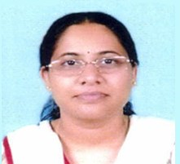

Board of Directors
Apollo Microsystems
Apollo Microsystems
Mr. Chandrapati Venkata Siva Prasad
Whole-time Director(Technical)
Mrs. KarunaSree Samudrala
Independent director
Mr. Addepalli Krishna Sai Kumar
Whole-time Director(Operations)
Sri Lakshmi Reddy Vangeti
Non – Executive Director
Raghupathy Goud Theegala
Chairman and Independent Director
Apollo Micro Systems
08

Slide 9

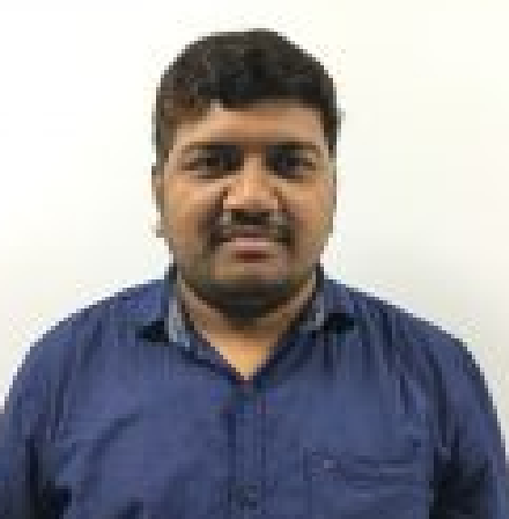

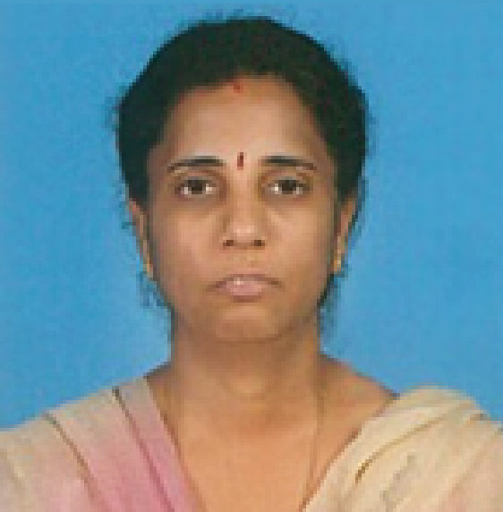
Key Managerial Personnel
Apollo Microsystems
Ch. Sudarshan Chief Financial Officer
V C Siva Shankar Company Secretary
A. Venkateswara Rao Vice President Marketing
Supriya Kondap Associate Vice President
Apollo Micro Systems
10

Slide 10

Mission & Vision Statements
Mission
"Convert Your Concepts Into Reality"
Mission Statement reflects our desire to realize the concepts of our
customer using state of the Art technologies and developing innovative technologies for applications based on Hardware and Software. We configure our technologies for different applications to realize customer requirements.
Vision
To emerge as a world-class company and a unique solution provider with
“Total Solutions Under Our Roof”
Apollo Micro Systems
11

Slide 11


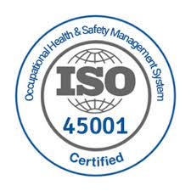

Quality Certiﬁcations
Apollo Microsystems
12
Apollo Micro Systems
03

Slide 12

Our Offerings
Apollo Microsystems
Research
Development
Q&T
Ideation
Designing
Production
Final
BTS(Build-to-Spec)
Design, Development and
manufacturing of complex On- Board and ground based electronic systems including software for Aerospace Defence & Space Sectors.
BTP(Build -to -Print)
Engineering Designs
Qualiﬁcation Testing
Company is equipped with full
fledged ESS facility and offer Qualification & testing Services.
We offer Electronic manufacturing Services and Box Assembly services as a Built to Print Services.
We offer Engineering Design Services and precision
machining services with state of the art High Speed CNC machines.
Apollo Micro Systems
13

Slide 13
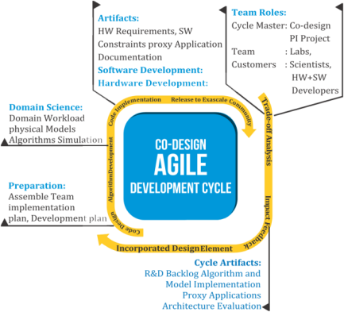
R&D Strengths
Apollo Microsystems
Strong R&D team of 150 engineers with core Competency in developing Embedded Hardware & Software
Hardware designs team has extensive industry experience and expertise in designing hardware and software; including packaging of electronic hardware for various verticals.
Immense working knowledge and various controllers, processors, DSP’s (Digital Signal Processors) , FPGA’s(Field Programmable Gate Arrays) etc.
Leading service provider in board design for the ADS (Aerospace, Defence and Space) markets.
In-house R&D Centre, is CEMILAC certified.
R&D Collaborative Partner for Bharat Electronics Limited in Embedded Hardware & Software design
Apollo Micro Systems
14

Slide 14

Business Process Flow
Apollo Microsystems
Receipt of purchase order
Preliminary design review stage
Acceptance testing
System Design
Quality Testing
Resource allocation
Generating system requirement specifications
Production Prototype Units
Manufacturing qualified units
Apollo Micro Systems
15

Slide 15
Embedded Design Services
Hardware Design
Hardware Design & Engineering
Board & System Design: Concept to total product development
DSP/FPGA Based Design, PCB Designs, Single Board Computers
Diagnostics, BSP, Driver Development
Design, Circuit Simulation, Analysis and Prototyping
Re-Engineering and Miniaturization
Verification and Validation Services
Desing Analysis
Veriﬁcation & Validation Services
Code Reviews
Inspection of Software Development and Test Documents
Functional and Structural Coverage and testing
Software - Hardware
System validation Testing
Testing Services
Software Test Plan for Software and Hardware Integration Testing
Test Process for Software and Hardware Integration Testing
Functional and Structural testing
Test reports for Software and His Testing Test Case and Test Reports as per IV & V requirements
Thermal Analysis - Power Integrity - Signal Integrity
Embedded Software Design Dev.& Sustainance
Complete Software Life Cycle Support
Software Requirement Specifications Generation
Modeling and Simulation
High Level and Detailed Design Implementation
Host Interface Development
Platform Development
Re-Platforming
Apollo Micro Systems
16

Slide 16
TECHNOLOGY MATRIX
Industries & Markets
Aerospace, Defence & Space | Industrial Automation, Automotive & Railways | Utility, Energy & Power | Homeland Security | Telcom & Networking
Design For Certification
CE, FCC, EMI/EMC, MIL, IEC, ROHS, DNV, and ATEX Certification
Middleware Layer
Codecs & DSP/GPU Algorithm Development for Various Audio, Video and Images
Open Source Application Integration and Customs Back-End Application Development
Application Framework Porting & Integration, UI Design and 3rd party Application Integration
Protocol Library, Application Framework, Services for CAN, USB, RS232/485, Ethernet, Wireless LAN, Bluetooth RFID, 2G/3G-GSM/GPRS, 2G/3G Software Stack, 1553B, ARINC
Application Layer
BSP Layer
Board Design Bring Up, Boot Loader and File Development, Real Time Operating System, Device Driver and OS Porting Services
RTOS Porting: Linux, Windows CE, Android, QNX and VX Works
Expertise
Instrumentation Systems, Signal Processing, Control Electronics, Power Electronics, RF
Telemetry Systems, Automotive & Telematic Systems
Interfaces
Audio/Video, Display, Camera, LCD, Touch Screen, Fingerprint scanner, Joystick, IR Remote, GPS, NFC, Storage, Sensors, Others
Connectivity
Ehternet, GigE, USB, VME, PCI, UPX, cPCI, PCIe, MODBus, profi-Bus, CAN, MOST, PMC, WiFi, Bluetooth, GSM
MCUs-8051, PIC, 196, 386, 486, UPX, ARM | MPUs-ARM, TI, Renesas, Freescale, DI, Broadcom, Intel, CORTEX, Net Silicon | TI and ADI DSPs | FPGAs-Xilinx, Altera, Atmel, Lattice, Actel ZYNC, Kintex 7
Architecture
Apollo Micro Systems
17

Slide 17
Software Design Services
Software Design
Application Development
We provide custom application development solutions to large
established enterprise companies to small to small startup organization. We also help our client to migrate existing application to new technologies and platforms.
Device Driver Development
AMS has extensive experience working with device drivers. Starting
from the UNIX System, we have worked on most of the host operating systems for desktops and servers and embedded drivers for platforms of RTOS.
Custom built application development
Client/Server Applications
Distributed Applications System Integration Middle Tier Development Database Management System Integration
Host Drivers
Our team not only develops and ports software, or maintains device
drivers for our customers, but also brings a value through rich experience in optimization, performance tuning and certification. We have capability to develop drivers for followint interfaces.
PCI, PCI-X, Pcle, cPCI, PXI, PCMCIA ISA
18
Apollo Micro Systems

Slide 18
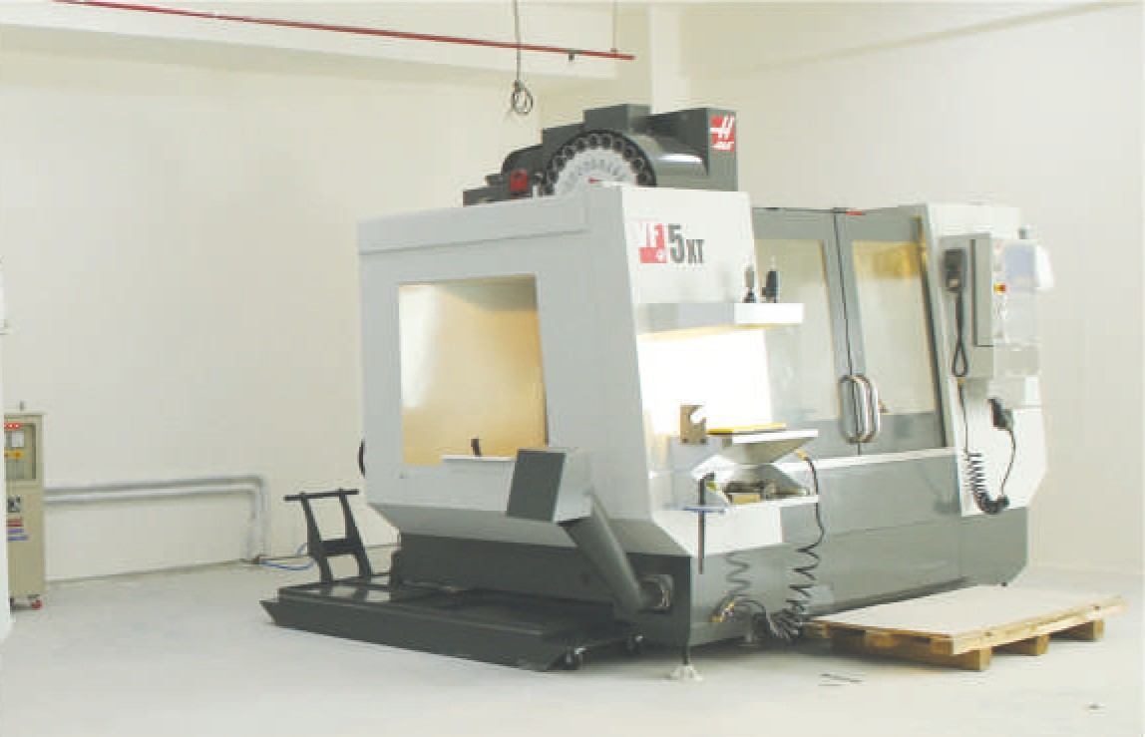
Engineering Services
Precision Engineering
Infrastructure Facilities
High speed CNC vertical
machining centres Drilling machines Tapping machines
EDM Wire Cut Machines Cutting machines Helicoil tool
Milling Machine
Service Offerings
Product Design and Development
Sheet Metal Design Services Reverse Engineering Services Structural and Stress Analysis Jigs and Fixture Designs
Manufacturing Support and Process Planning Design for Manufacturing (DFM) Services Product Engineering and Development
03
Apollo Micro Systems
19

Slide 19
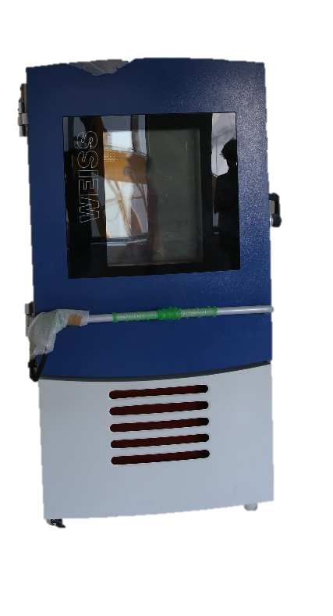
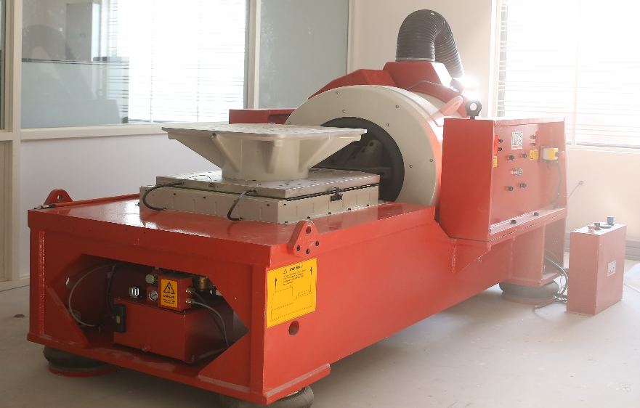
ENVIRONMENTAL TEST FACILITIES
Precision Engineering
03
Apollo Micro Systems
203

Slide 20
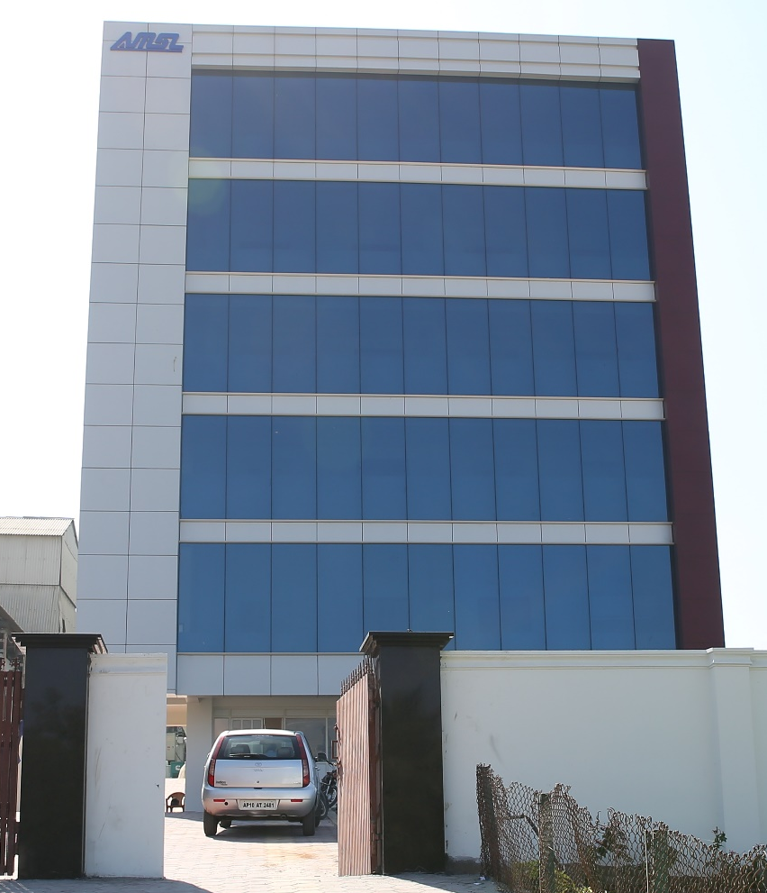
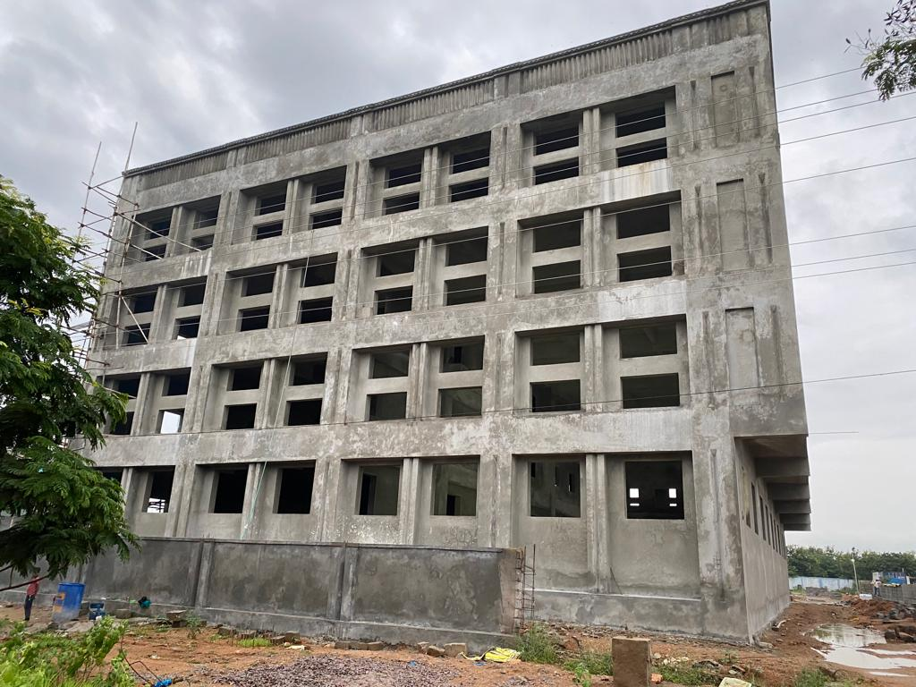
PRESENT & UPCOMING FACILITY
Precision Engineering
55000 Sqft Facility in IDA Mallapur, Hyderabad Unit-I
40000 Sqft Facility in Adibatla , Hyderabad Unit-II
03
Apollo Micro Systems
21

Slide 21
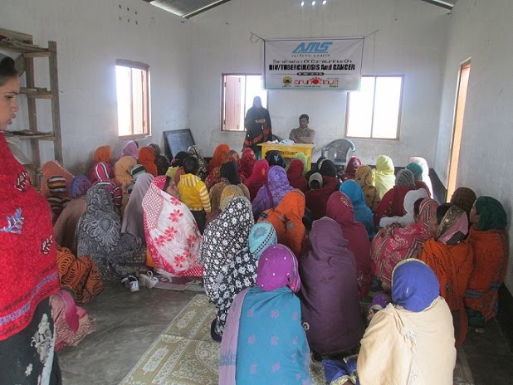





CORPORATE SOCIAL RESPONSIBILITY
Precision Engineering
03
Apollo Micro Systems
22

Slide 22

THANKS FOR YOUR TIME
03
Apollo Micro Systems
22

