Slide 1
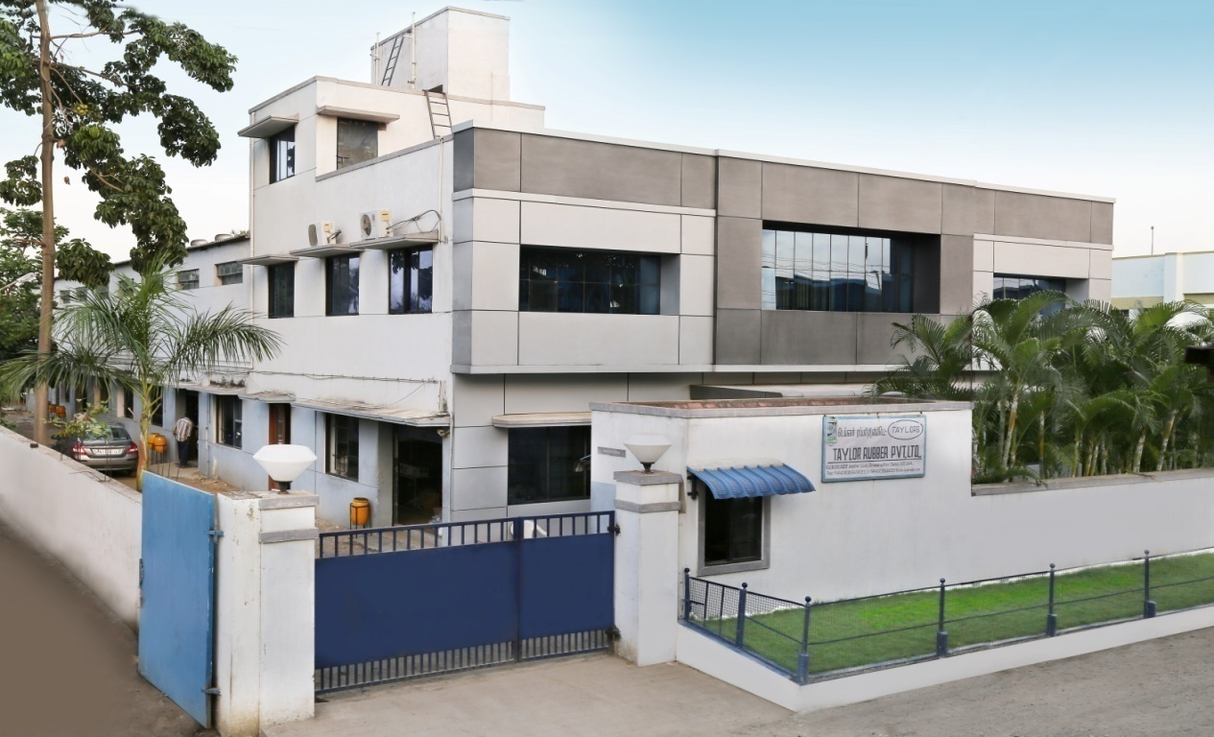

TAYLOR RUBBER PVT LTD
TAYLORS
283, SIDCO Industrial Estate, Thirumudivakkam, Chennai 600 044, India.
info@taylorrubber.com
nrs@taylorrubber.com

Slide 2
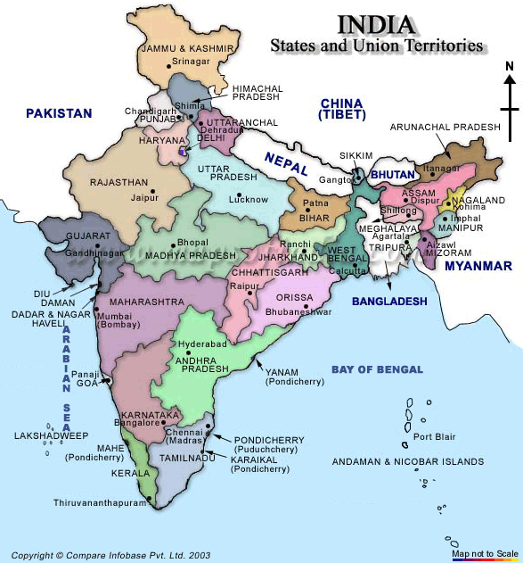
OUR LOCATION
TAYLORS
we are here

Slide 3
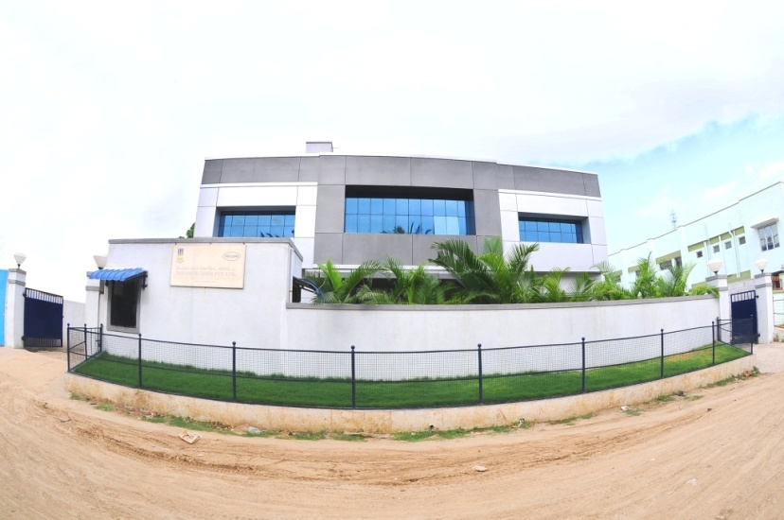
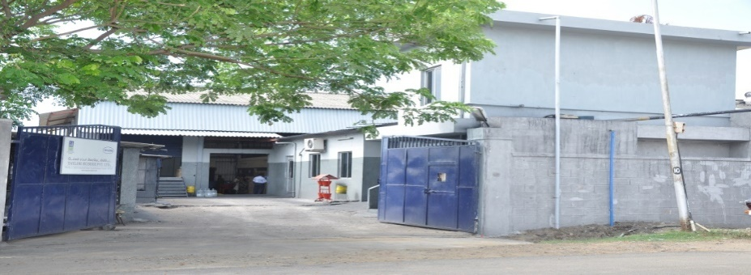
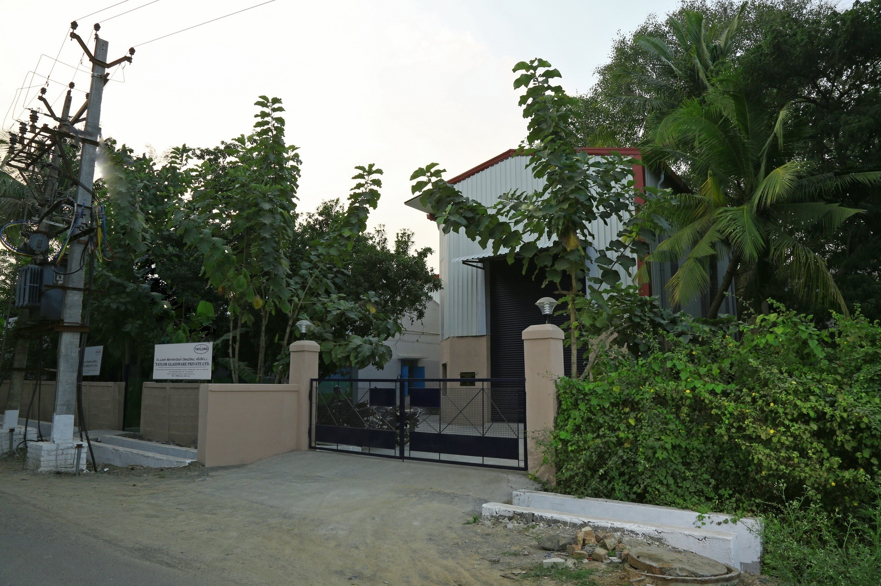
BRIEF HISTORY
TAYLORS
Started in 1980
Promoted by Mr. T T Ashok
Units – 4
3 Verticals
Taylor Rubber Pvt Ltd
Taylor Glassware Pvt Ltd
Cofle Taylor India
Combined Factory area: 4500 Sq. m
( 2000, 1010 , 940 & 550 Sq. m.)
Employee Strength – 235
Diverse footprint – Major customers in
Consumer durable sector
Automotive sector
Trucks, Forklifts and Tractors

Slide 4







KEY PERSONNeL
TAYLORS

Slide 5
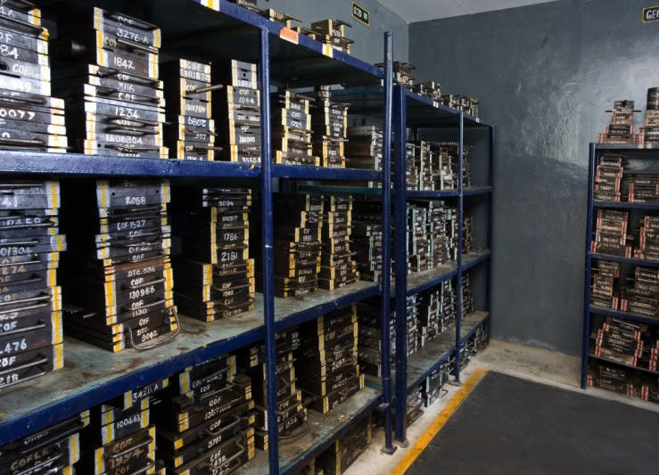
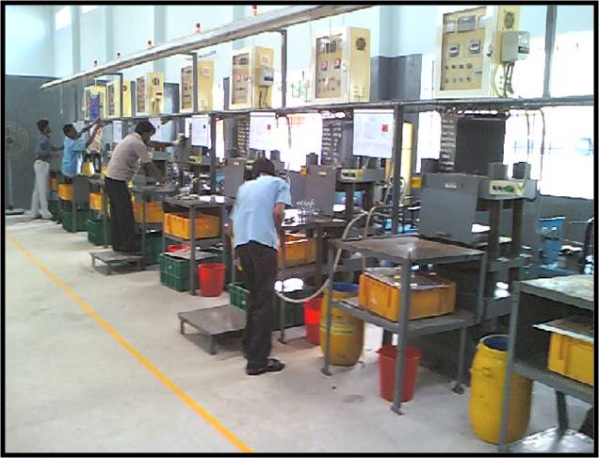
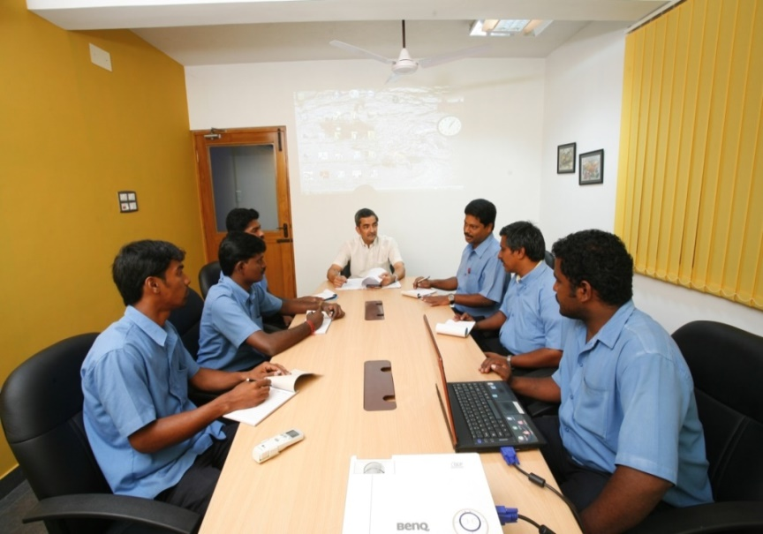
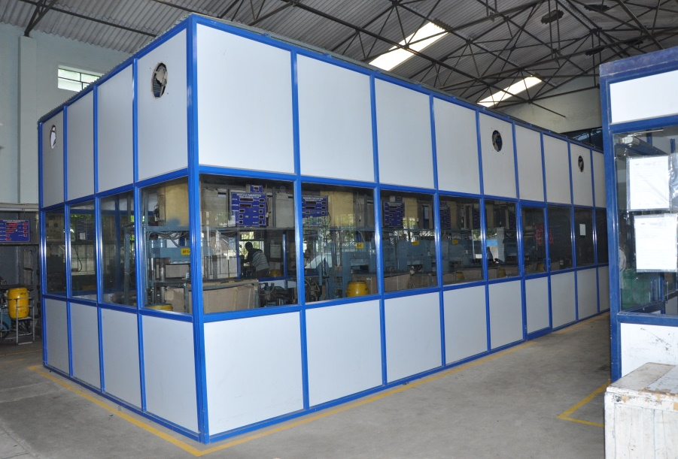
FACILITIES
TAYLORS
MOULD ROOM
MOULDING AREA – BLACK COMPONENTS
CONFERENCE HALL
MOULDING AREA – COLOUR COMPONENTS

Slide 6
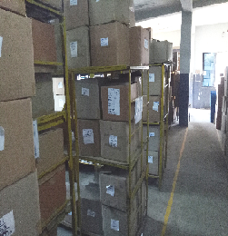
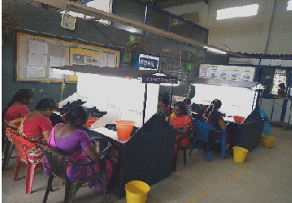
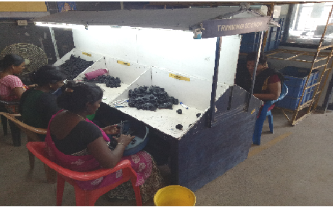
FACILITIES
TAYLORS
DISPATCH SECTION
INSPECTION SECTION
TRIMMING SECTION

Slide 7

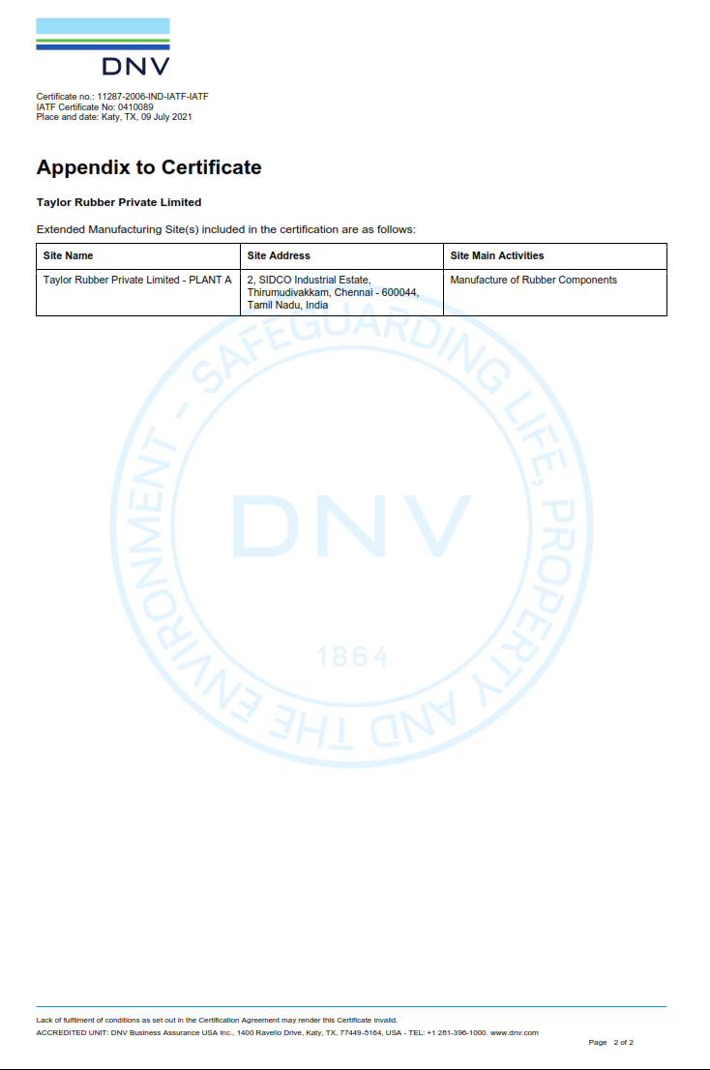
IATF 16949:2016 CERTIFICATION
TAYLORS

Slide 8










DOMESTIC CUSTOMERS
TAYLORS
*Please note. We at Taylor Rubber have a non-disclosure agreement with our customers and the information presented here is confidential.

Slide 9












GLOBAL PRESENCE
TAYLORS

Slide 10
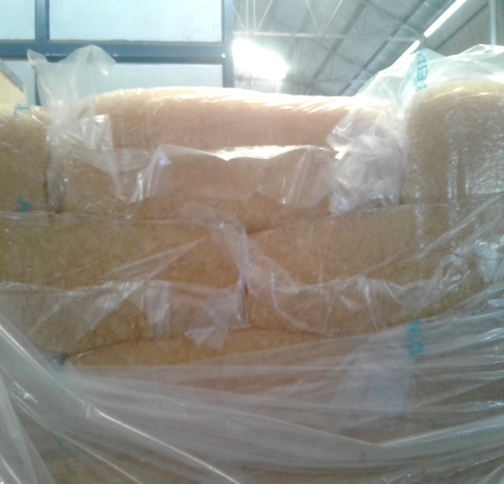
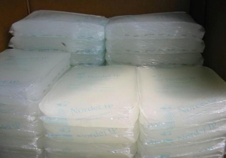
TYPES OF POLYMER
TAYLORS
NR - Natural Rubber
SBR - Styrene Butadiene Rubber
CR - Neoprene
NBR - Nitrile Butadiene Rubber
EPDM - Ethylene Propylene Diene Rubber
Special grades - VITON, SILICON and HNBR
NBR
CR
POLY ACRYLIC
VAMAC
AFLAS
NBR-PVC
PLASTICS – NYLON6, NYLON6.6, POLYACETAL, POM, PP, PVC, PP/EPDM, LDPE, HDPE, ABS, TPE ETC.
METALS – CR STEEL, SPRING STEEL, STAINLESS STEEL, EN1A-NON LEADED, DIE CASTING

Slide 11
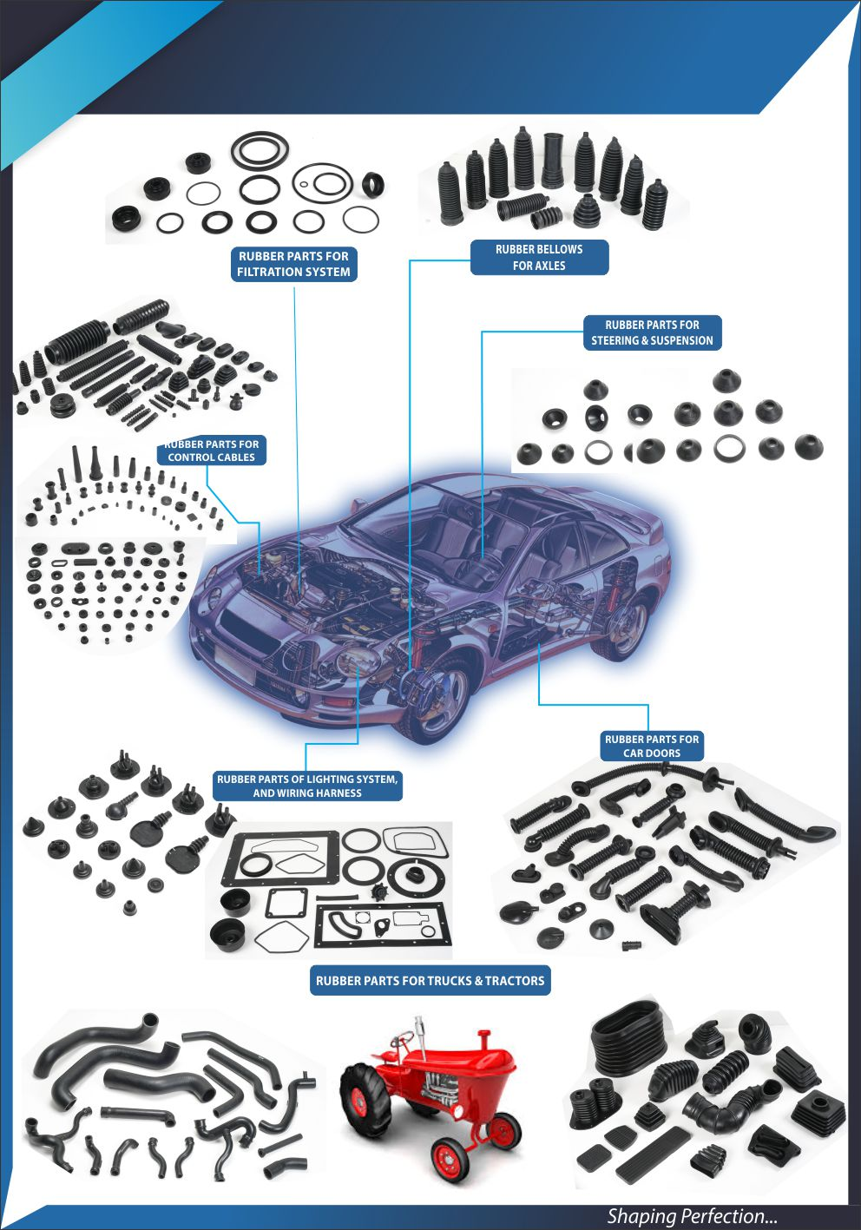
APPLICATION OF COMPONANTS
TAYLORS

Slide 12
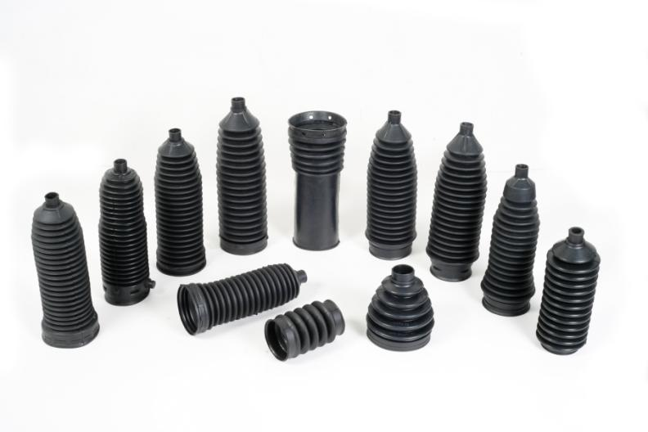
TPE BELLOWS FOR LCV AND HCV
TAYLORS

Slide 13
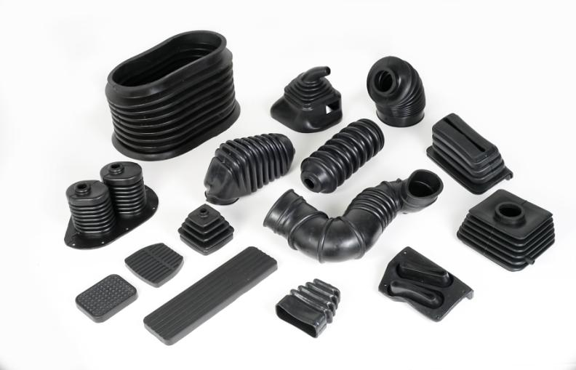
RUBBER PARTS FOR TRUCKS AND
TRACTORS
TAYLORS

Slide 14
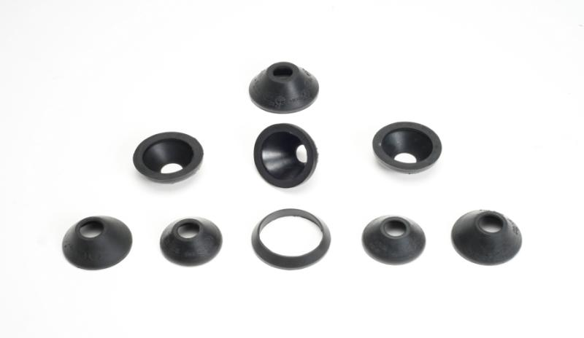
TAYLORS
RUBBER PARTS FOR TIEROD ENDS & SUSPENSION JOINTS

Slide 15
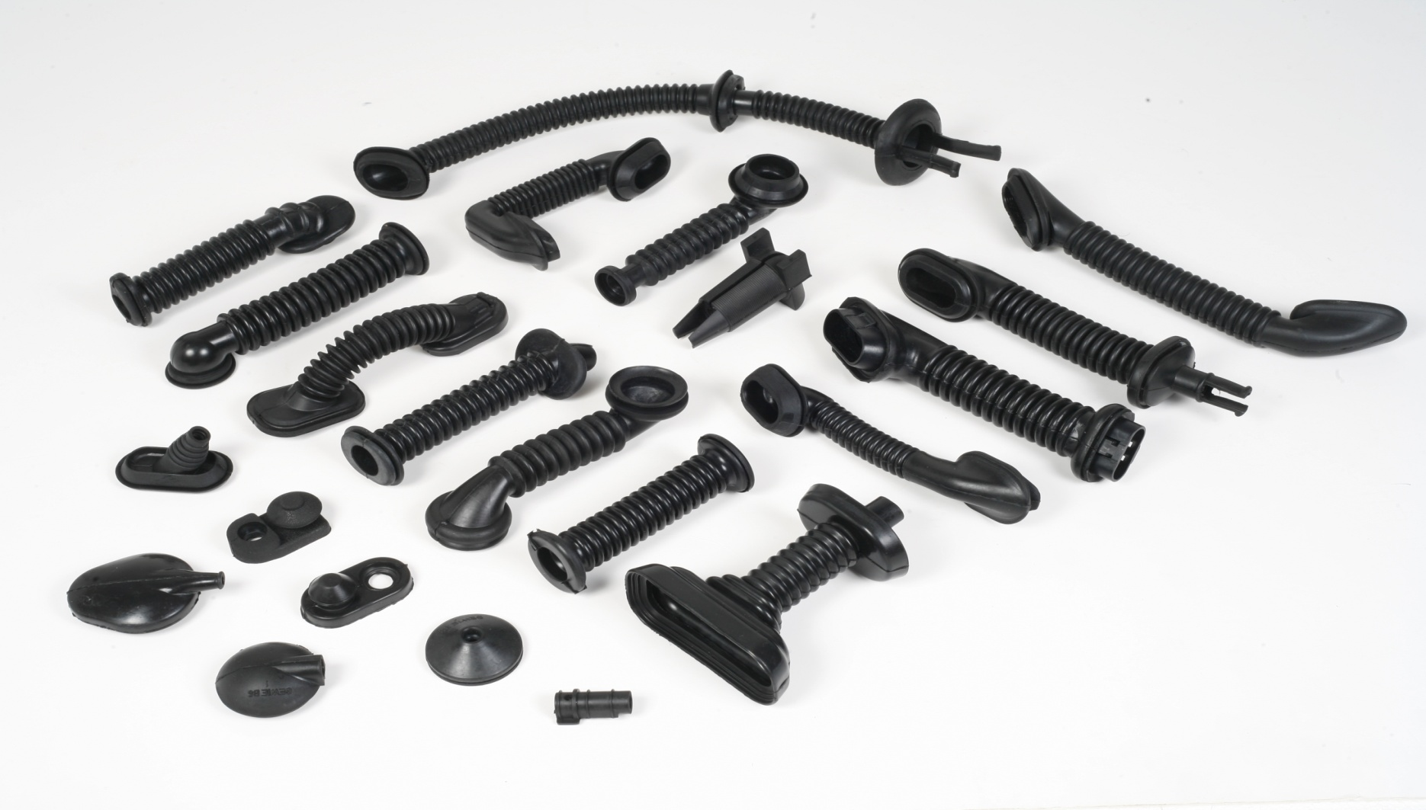
RUBBER PARTS FOR CAR DOORS
TAYLORS

Slide 16
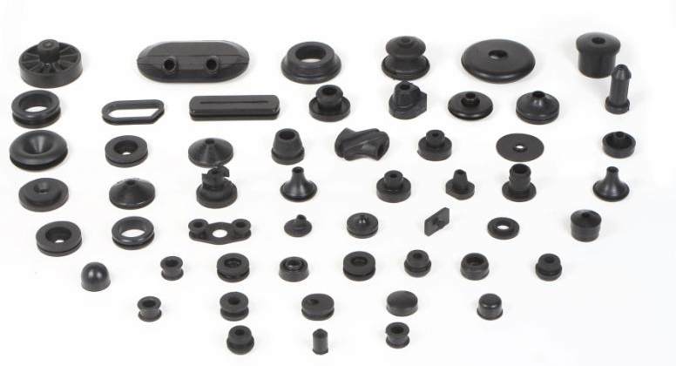
TAYLORS
RUBBER GROMMETS FOR CONTROL CABLES

Slide 17
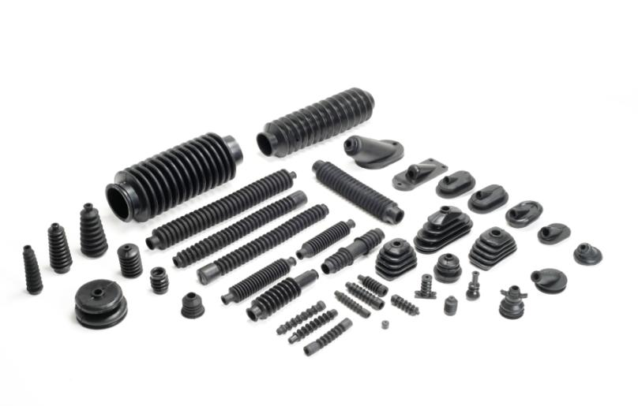
TAYLORS
RUBBER BELLOWS FOR CONTROL CABLES

Slide 18
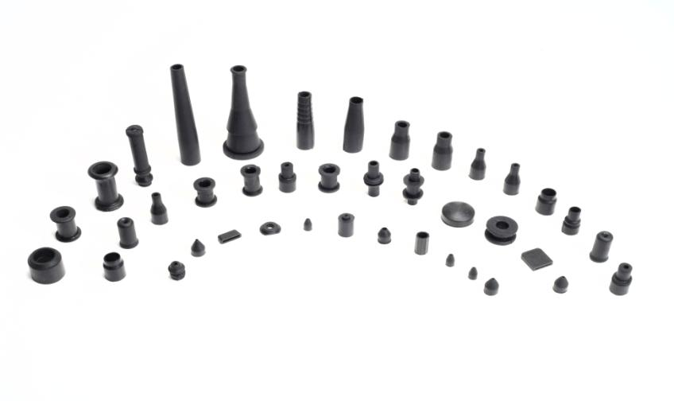
TAYLORS
RUBBER SLEEVES FOR CONTROL CABLES

Slide 19
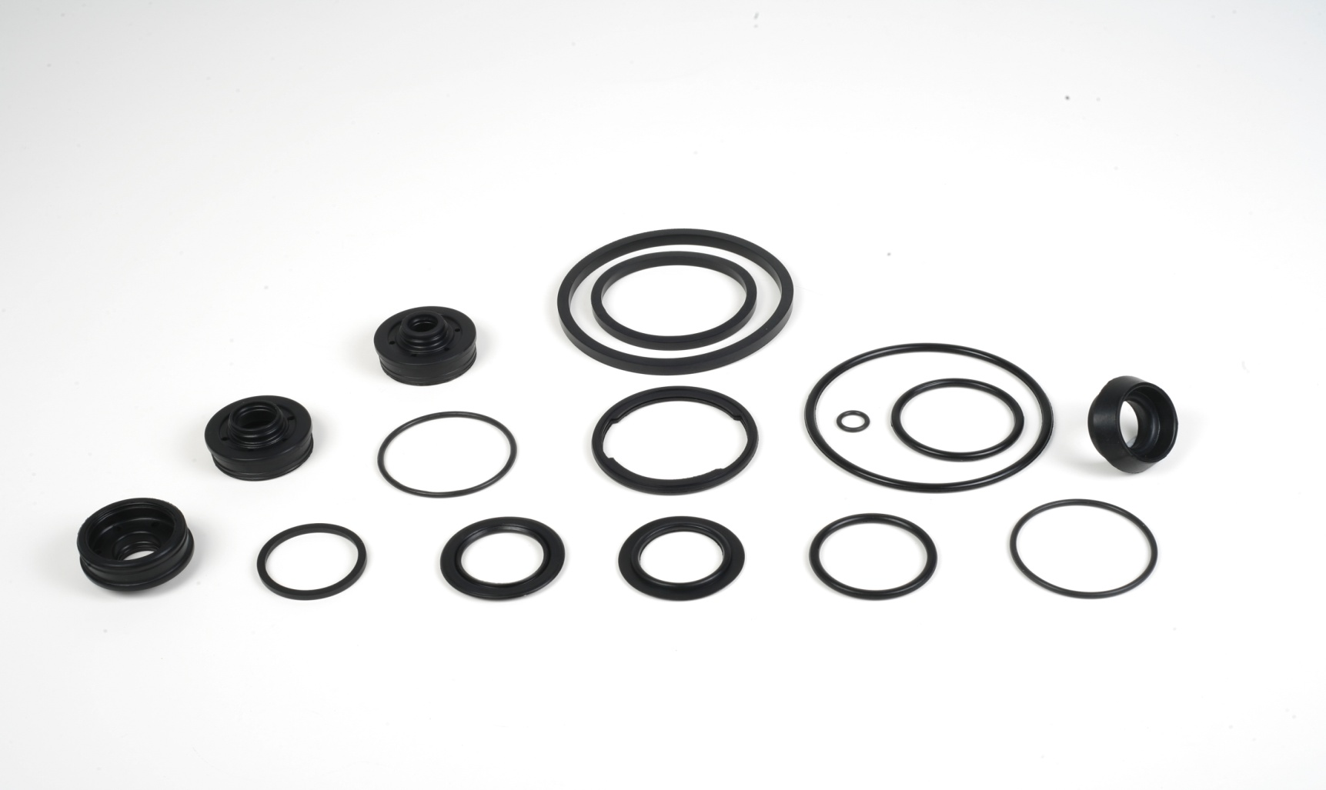
RUBBER PARTS FOR FILTERS
TAYLORS

Slide 20
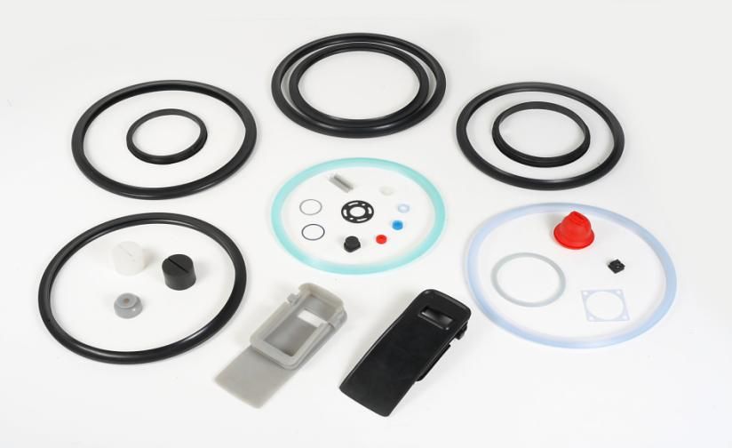
TAYLORS
RUBBER PARTS FOR THE CONSUMER DURABLE SECTOR

Slide 21
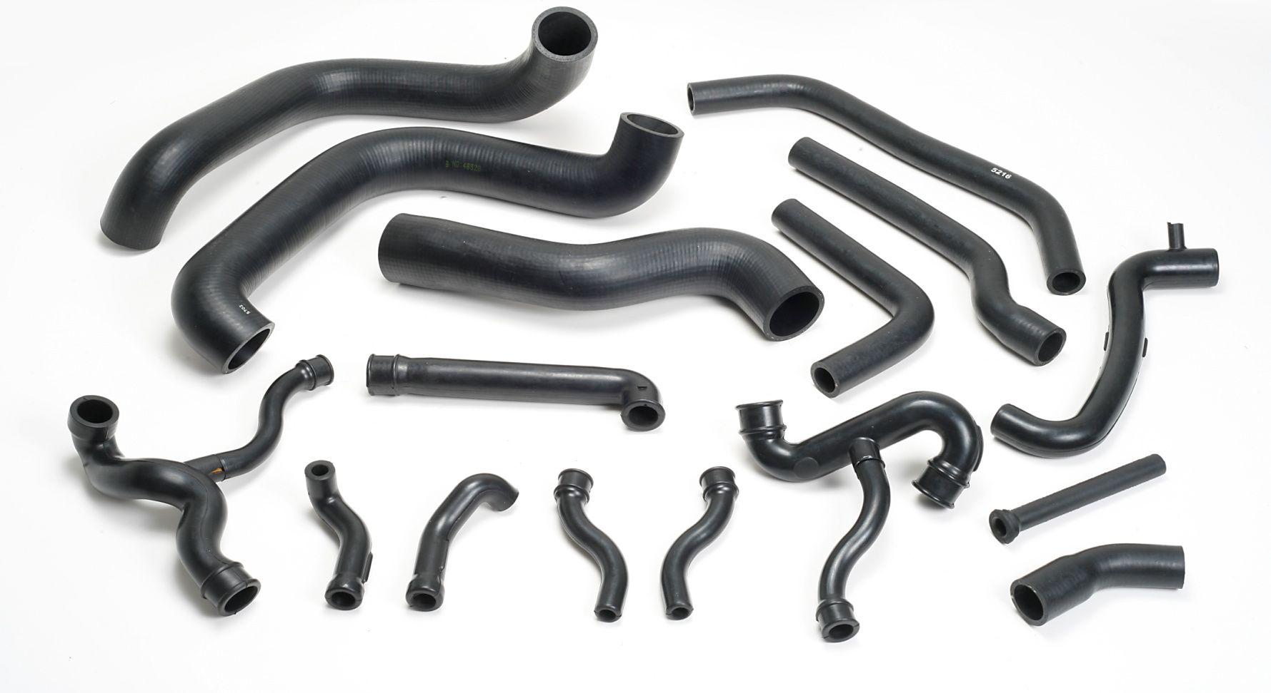
TAYLORS
RUBBER HOSES FOR AUTOMOTIVE & NON-AUTOMOTIVE APPLICATIONS

Slide 22
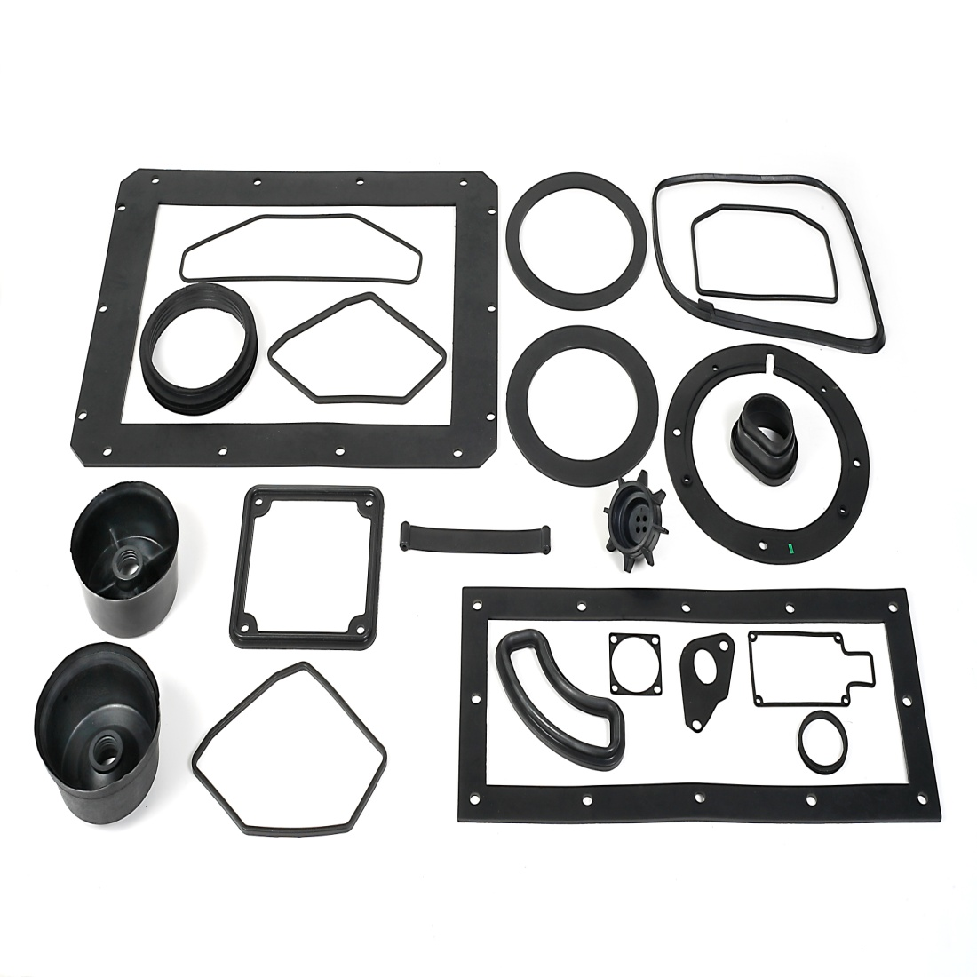
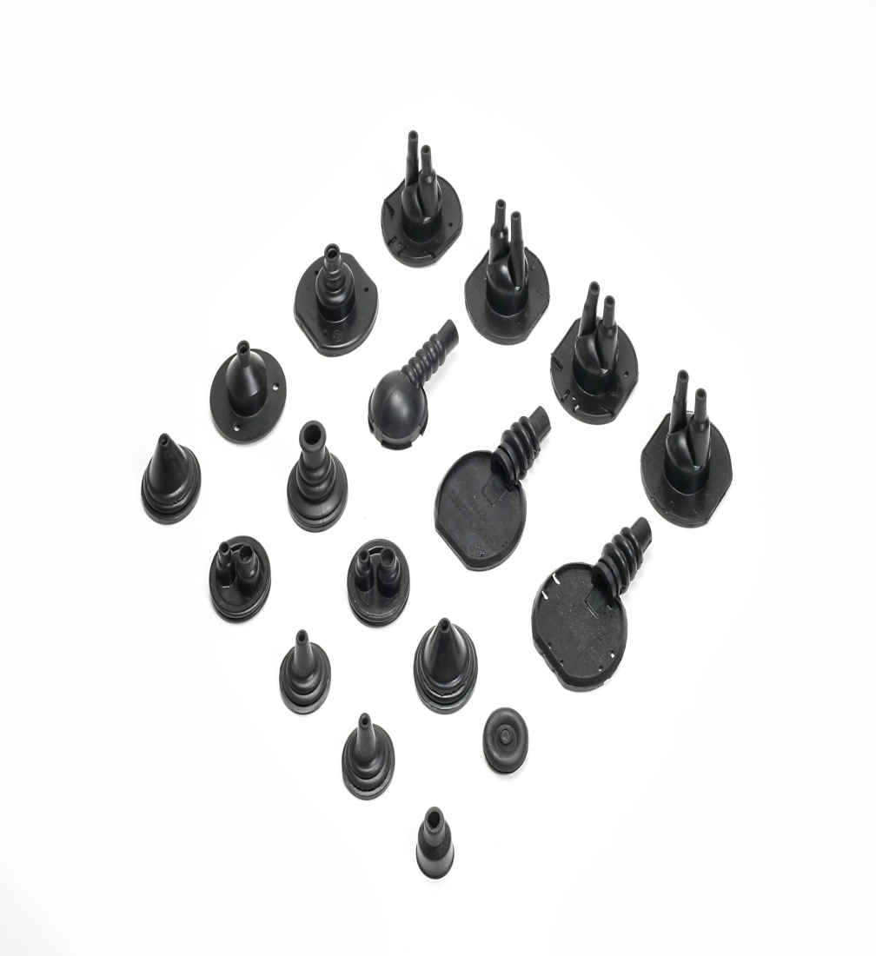
RUBBER PARTS FOR LIGHTING SYSTEM, WIRING HARNESS & TOWBARS
TAYLORS

Slide 23
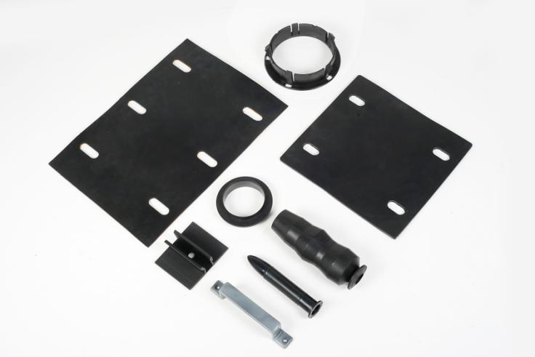
TAYLORS
RUBBER PARTS FOR WIND & SOLAR ENERGY

Slide 24
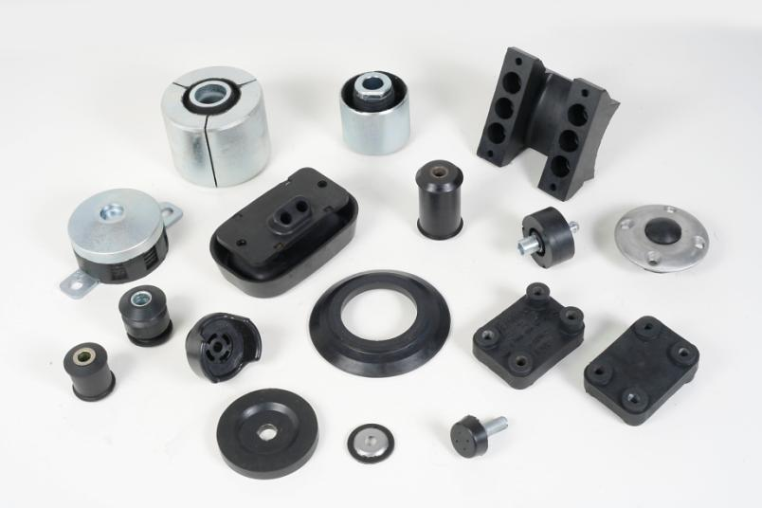
RUBBER TO METAL BONDED PARTS
TAYLORS

Slide 25
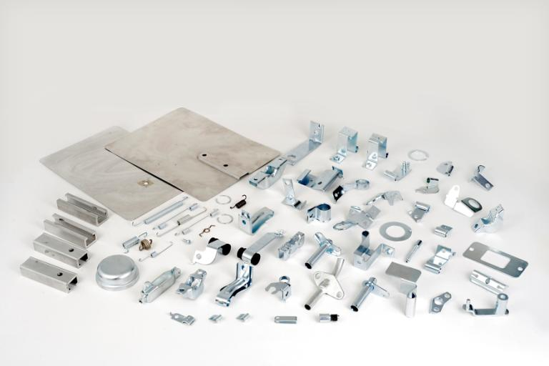
METAL PARTS
TAYLORS

Slide 26
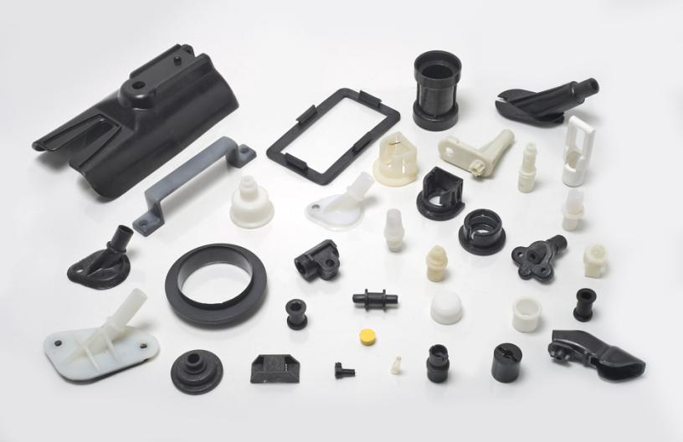
PLASTIC PARTS
TAYLORS

Slide 27
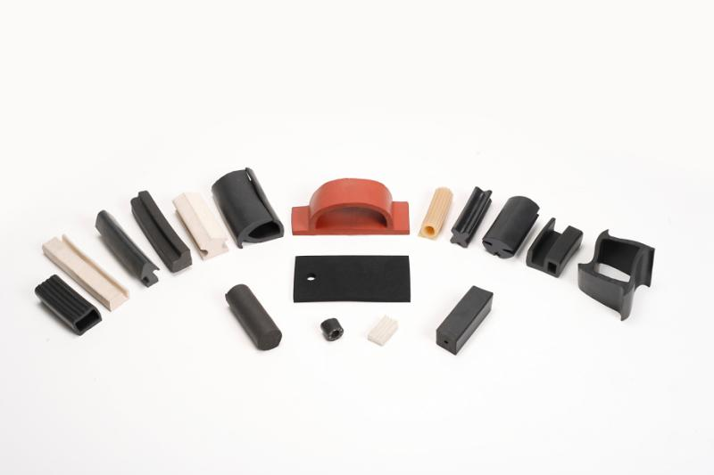
RUBBER PROFILES
TAYLORS

Slide 28
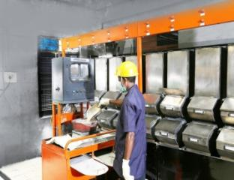
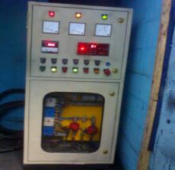
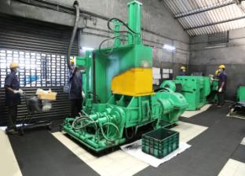
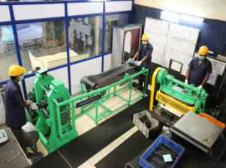
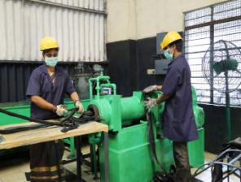
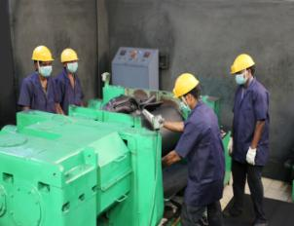
MIXING PROCESS
TAYLORS
Automated Weighing System
Dispersion Kneader
Kneader Controller
Calendering Line
Extrusion
Open Mixing Mill

Slide 29
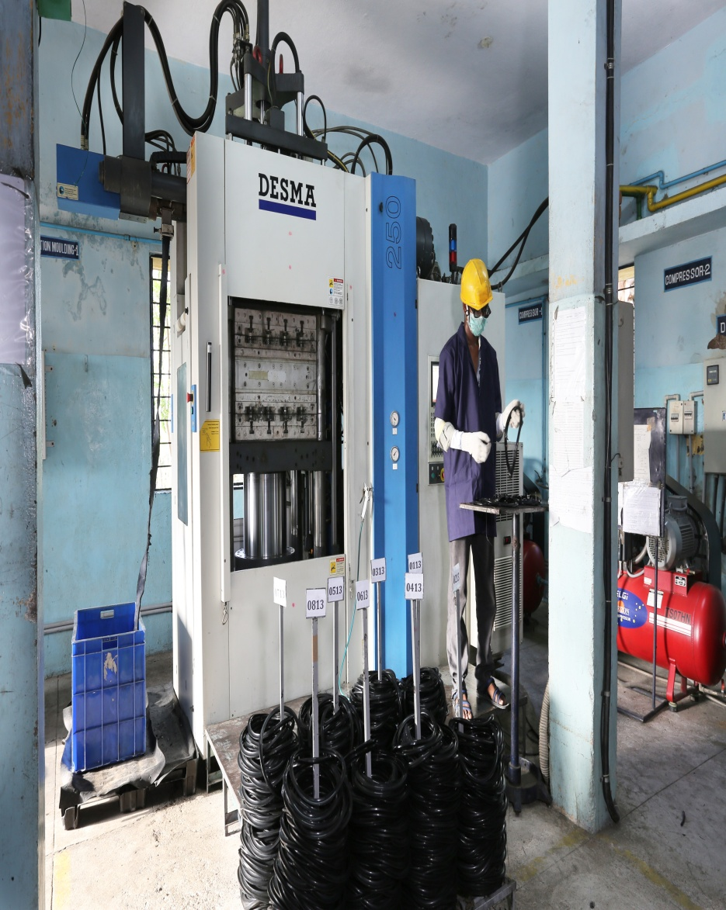
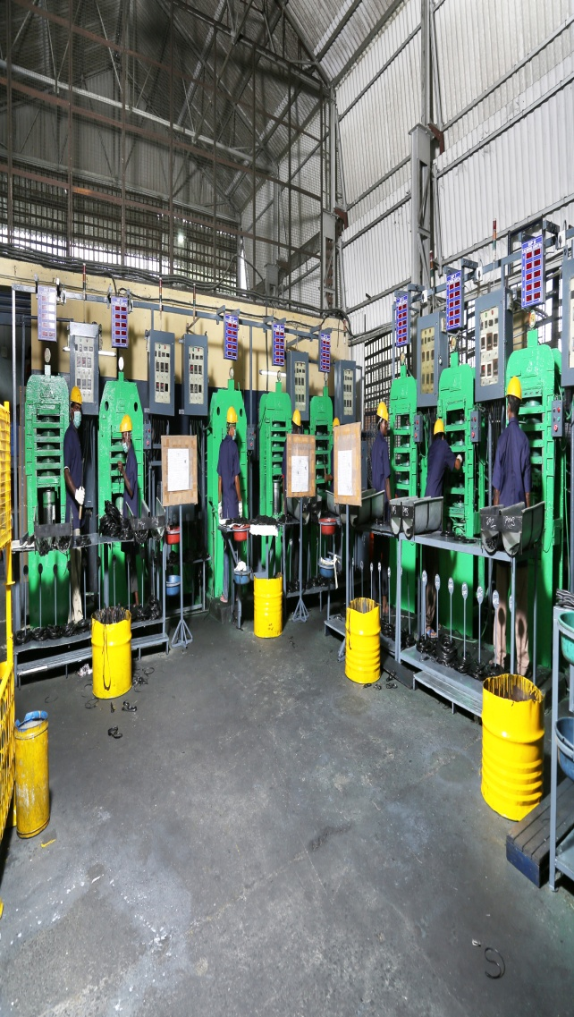
MOULDING TECHNOLOGY
TAYLORS

Slide 30
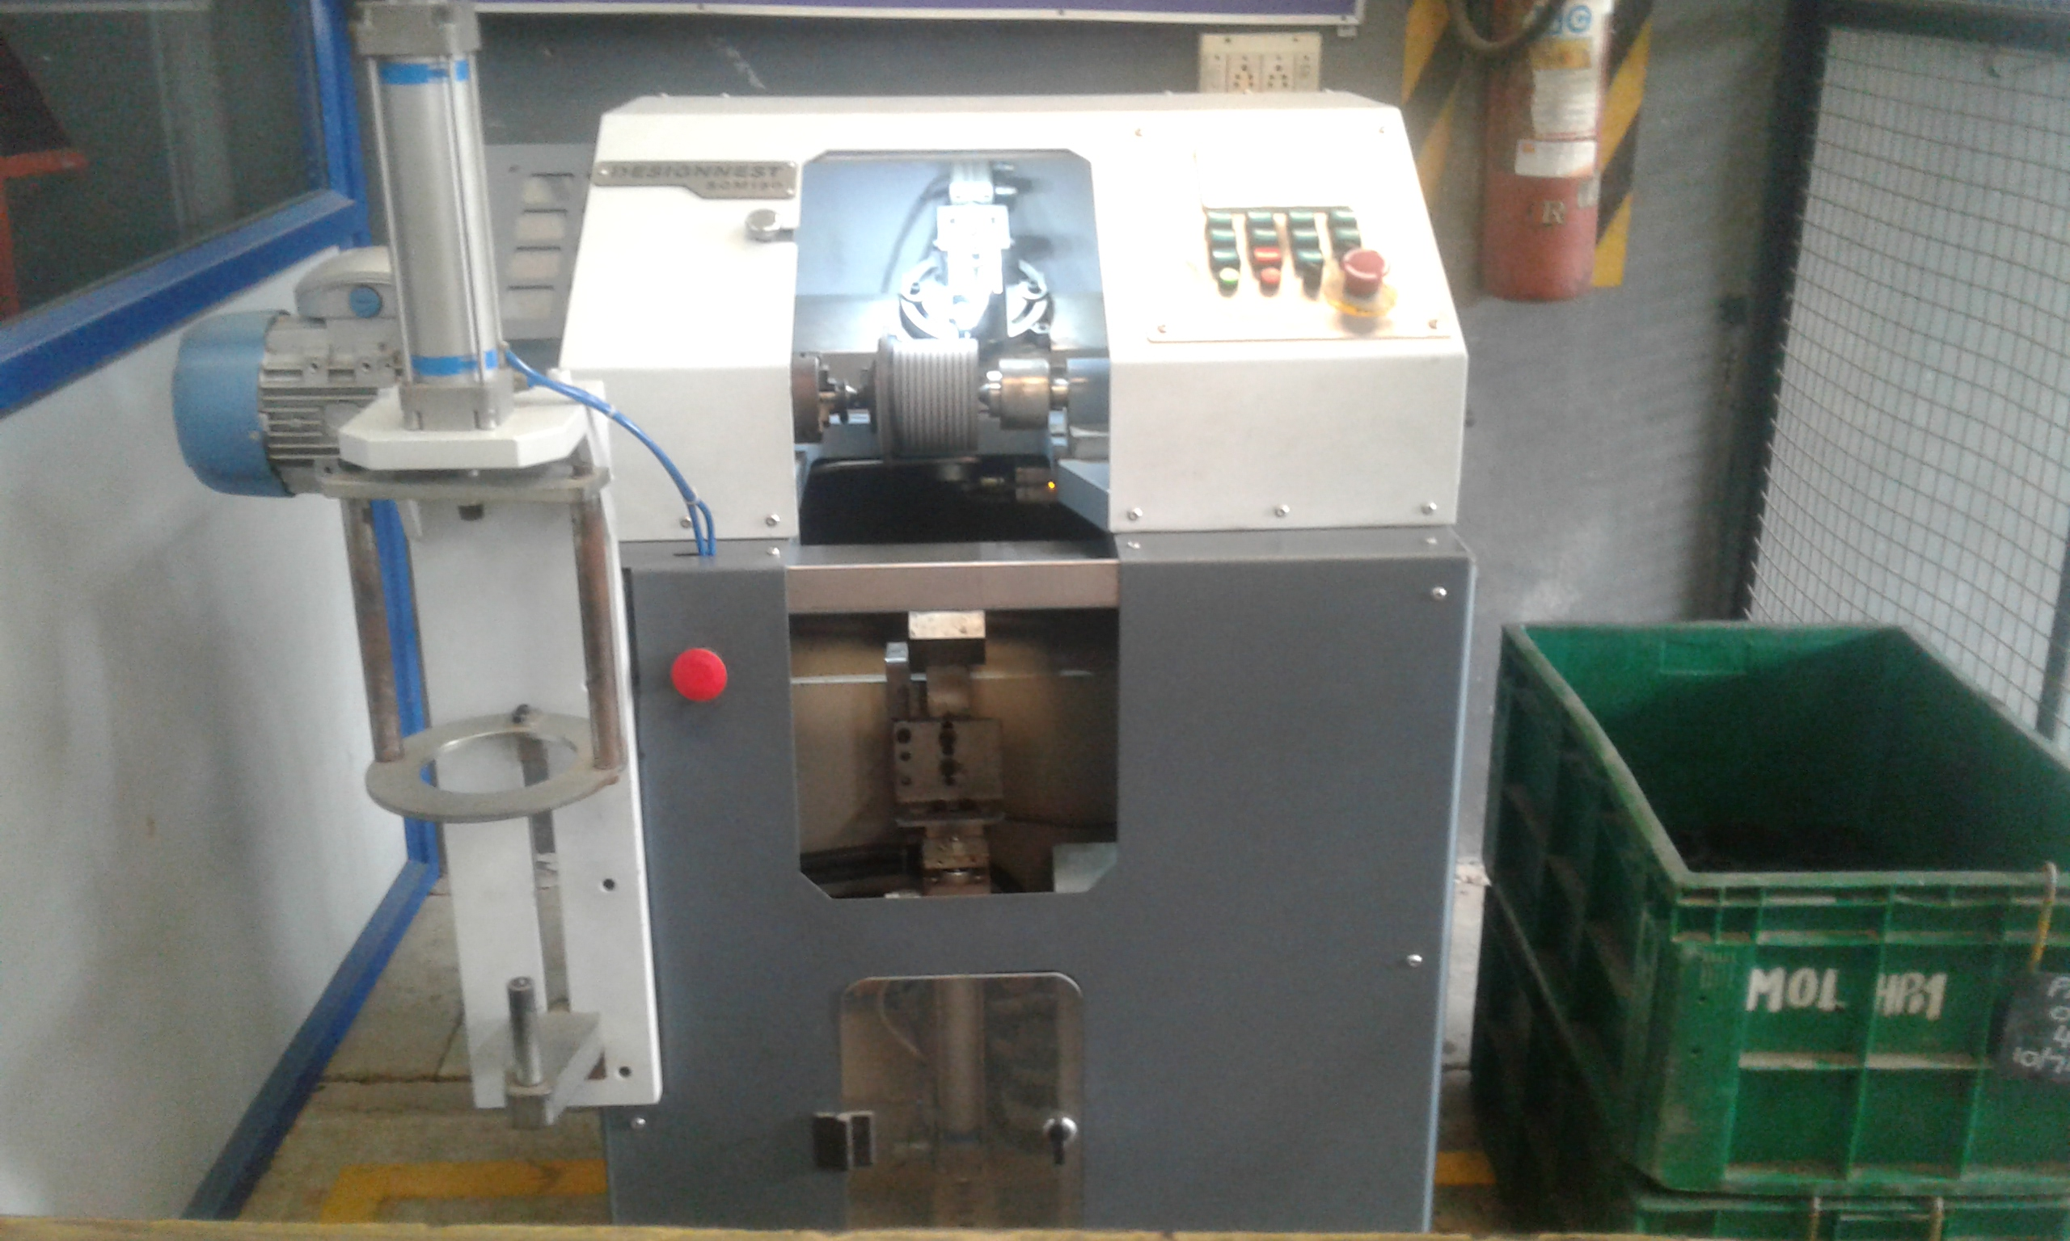
TAYLORS
SLICING MACHINE FOR FLAT
GASKETS

Slide 31
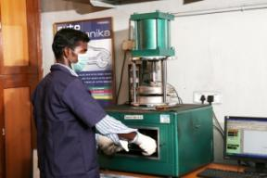
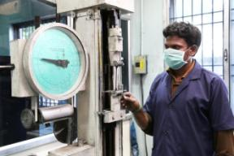
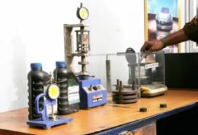
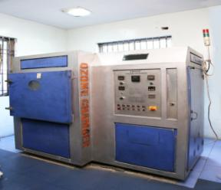
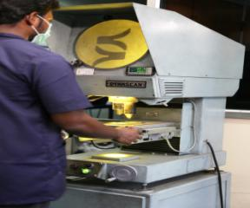
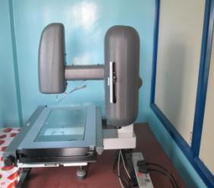
TESTING FACILITIES
TAYLORS
RHEOMETER
TENSILE TESTER
DENSIMETER & COMPRESSION SET APPARATUS
OZONE CHAMBER
PROFILE PROJECTOR
VISUAL MEASURING SYSTEM

Slide 32


Our Journey to excellence continues . .
THANK YOU
For further details/enquiries, Please contact Mr. NR Srinivasan, President
nrs@taylorrubber.com
+91-9840299240
+91-44-42429292
http://www.taylorrubber.com/

