Slide 1

Software
Development
Solution’s
Design
Distribution
Manufacturing

Slide 2

Fortune Marketing:
Well into its 3rd decade
& going strong
While the longevity of companies world-over is
decreasing, Fortune Marketing Pvt. Ltd. has
been one organization that has been
successfully keeping pace with successive
waves of trade-patterns, adapting to multiple
product & innovation-cycles and creating values
for its clients, for over 25 years now.
01

Slide 3

A story of
Rise & Recognition
A Delhi-based tiny IT-trading firm
of the beginning has enlarged into
a big & dynamically agile
organization, involved in
Distribution, Software
Development, Solution Design &
Manufacturing of different
security surveillance & IT-
products & solutions, with a
robust pan-India footprints &
appeal.
02

Slide 4

A one-stop-source for a huge
number of products & solutions
Surveillance Hard Drives, Solid State Drives,
Flash Drives, IP CCTV Products, Biometric
Products, Access Control, Computer
Hardware & Peripherals, Data Storage
Solutions, Networking, Mobile Accessories,
different Software products and Audio &
Multimedia-solutions,
And many more….
03

Slide 5

Our Vision
Our Mission
vision is deep-rooted in being
Our mission is
a company which lives on
true business-ethos and
works & leads as a true
aggregator, supplier & maker
of hi-tech products, with the
foundation of sustained
ambition & constant
encapsulated in
continually identifying
market-trends and
creating reliable &
scalable business-
models to meet the
opportunities.
competitiveness.
04

Slide 6
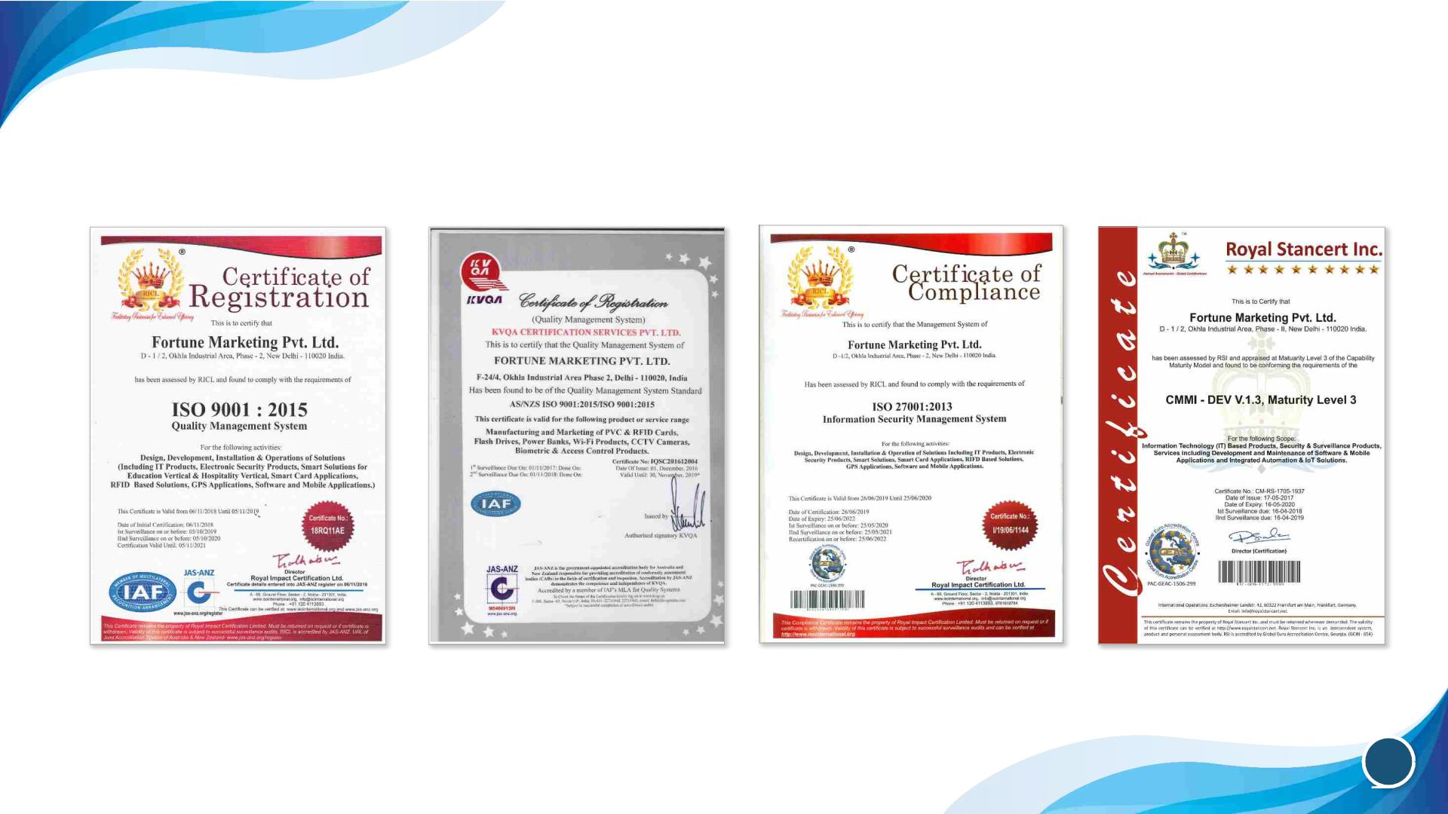
Quality in products & mechanism
ISO 9001:2015/ISO
9001:2015 AS/NZS
(Manufacturing)
ISO 9001:2008/ISO
9001:2008 AS/NZS
ISO/IEC 27001:2013
CMMI - DEV V.1.3,
Maturity Level 3
05

Slide 7
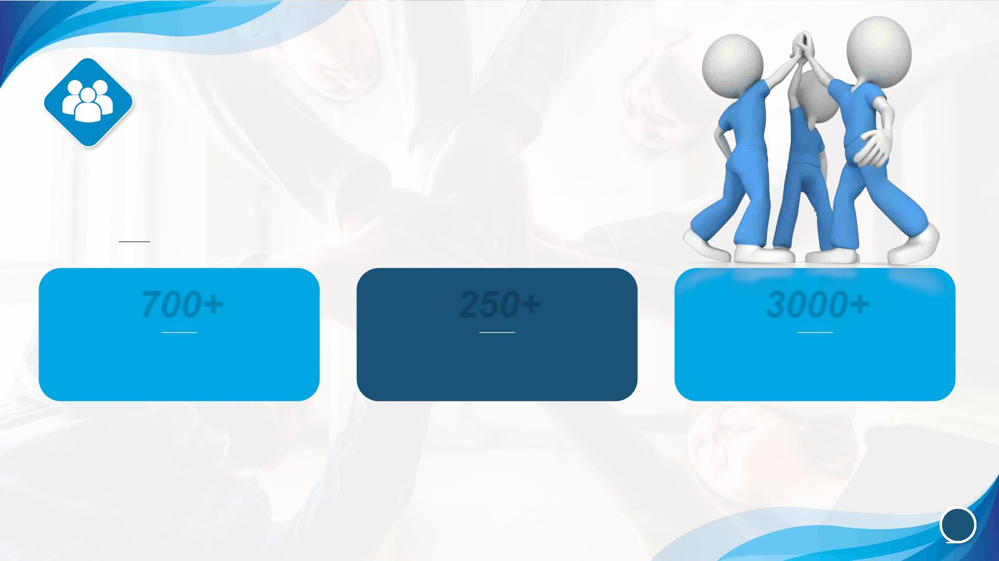
Massive workforce Across Nation
700+
250+
3000+
Sales Teams
Active Partners of Re-sellers,
System Integrators, LFRs &
OEMs
Staff
All of them work cohesively for shared interests & goals
06

Slide 8
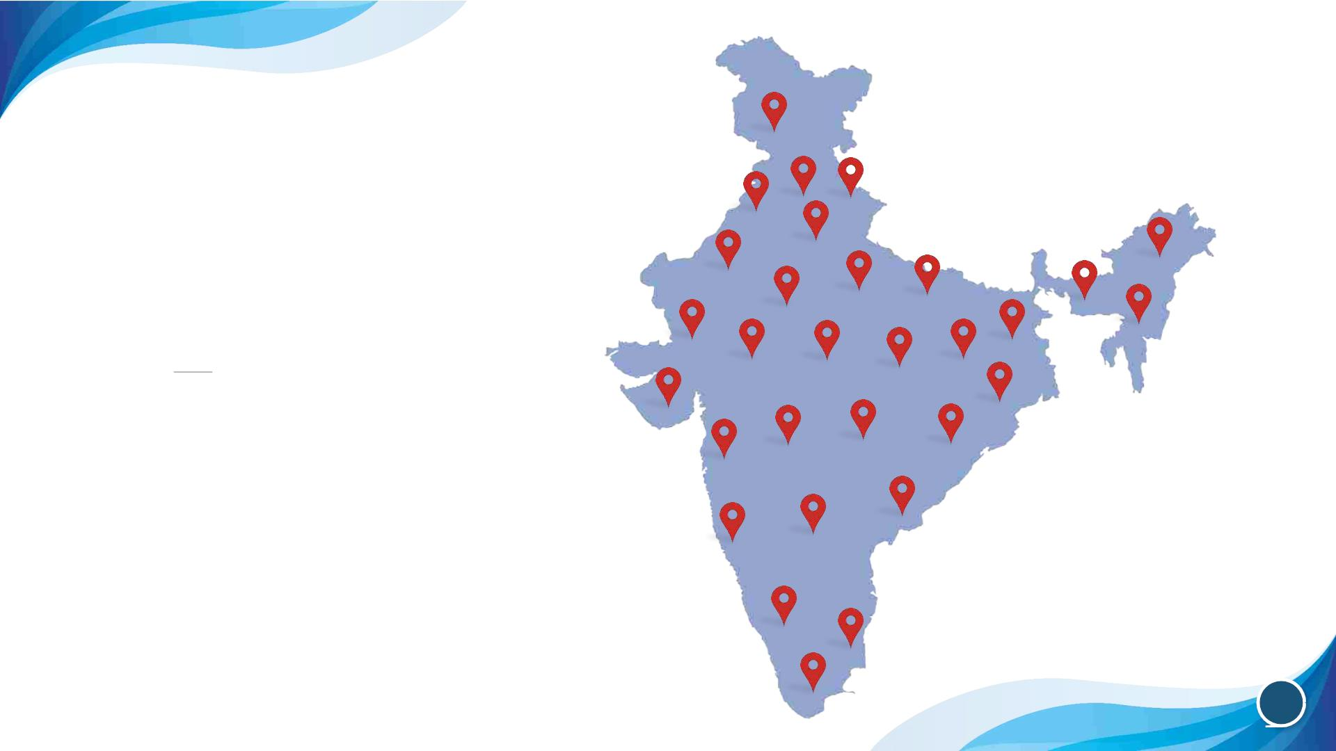
Effective & widespread
distribution-network
24 Branch Offices across
Indian geography
07

Slide 9

A nationwide spread of 21
warehouses empowers our
supply-chain mechanism
4 Mother Warehouses at
Chennai, Mumbai, Kolkata &
Delhi,
ensures efficient storage, movement and
a regular supply of goods to our partners.
08

Slide 10

A destination of high
visibility for different brands
While on-boarding of different top-tier global
brands reflects major milestones in our journey,
it also illustrates our global recognition as a
destination of high visibility for them.
09

Slide 11

HP
Storage Products
Internal
SSDs
External
SSDs
We’ve been exclusive distributor of HP
Storage Solutions across India.
10

Slide 12

PNY & HP
PNY
Flash Drives, SSDs, Micro SDXC,
Micro USB Duo Link OTG, DRAM.
HP
SDHC, SDXC, Metal Flash Drives,
Sliding Flash Drives, Flash Drives with
OTG etc.
We’ve been associated with these brands fo
over 10 years now.
11

Slide 13

Acer
Storage Products
DRAMs
Solid State Drives
SSDs
We’ve been exclusive distributor of ACER
Storage Solutions across India.
12

Slide 14

Enter
IT Peripherals
Keyboard, Mouse, Cabinet Motherboard,
Monitor SMPS etc.
Lifestyle
Earphone, Powerbank, Bluetooth Speaker,
Charging Cable, Wireless Charger
Enter is our own brand with a
strong recall-value of products.
13

Slide 15
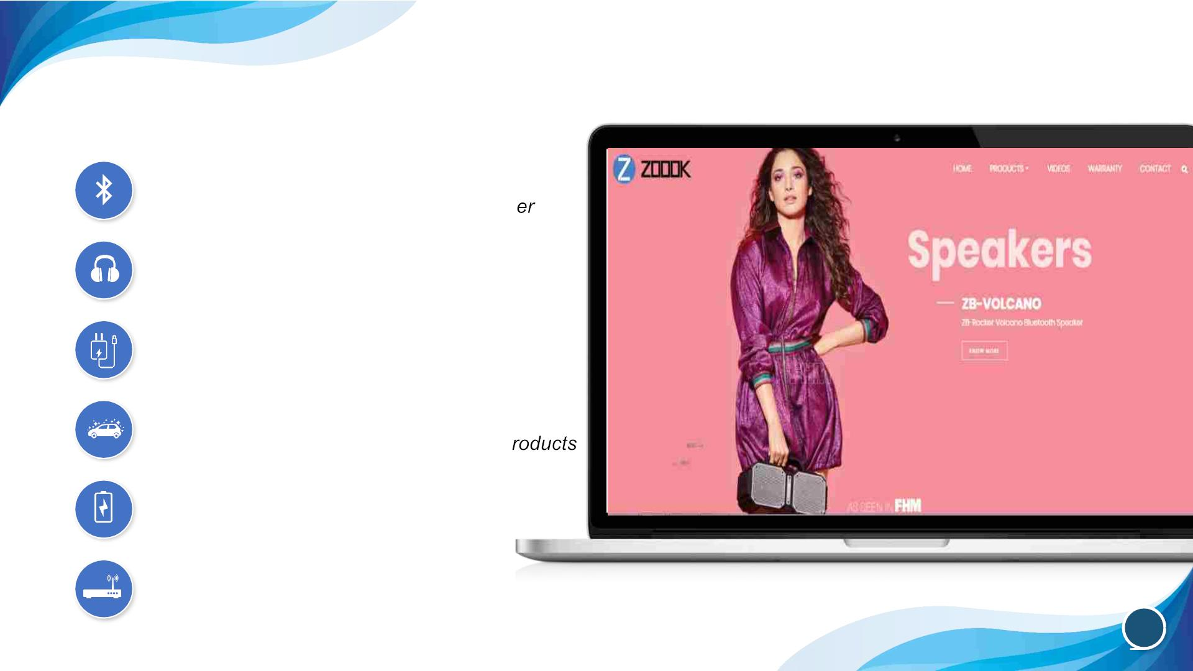
Zoook
Bluetooth
Speaker, Earphone, Headphone & Receiv
Musicana
Headphone, Speaker, Earphone etc.
Gadget-fashion
Chargers, Cables, Cases & Protectors
Moto69
Car Care, Interior Accessories & Safety P
PowerVault
Powerbank
Rover-Connect
Data Card & Router
14

Slide 16

Secureye
CCTVs
Smart Home Products
Entrance Products
RFID Cards
Biometric Products
Video Doorphones
We became the first countrywide distributor
of this global brand in 2005.
15

Slide 17
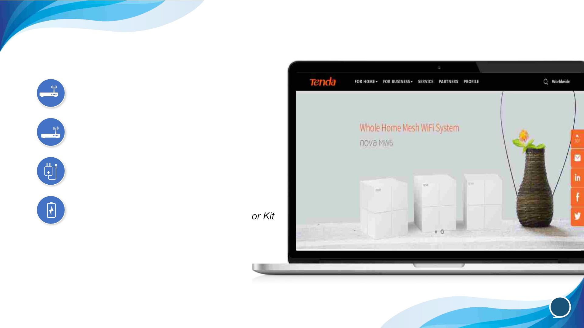
Tenda
Mesh
Home Mesh Wi-Fi System
Router
Smart Wireless Routers.
Switch
5/8/16 Port Desktop/Ethernet Switch
Power line
Power line Extender Kit, Power line Adapt
We’ve been exclusive distributor of Tenda
Networking Solutions in India for many years.
16

Slide 18
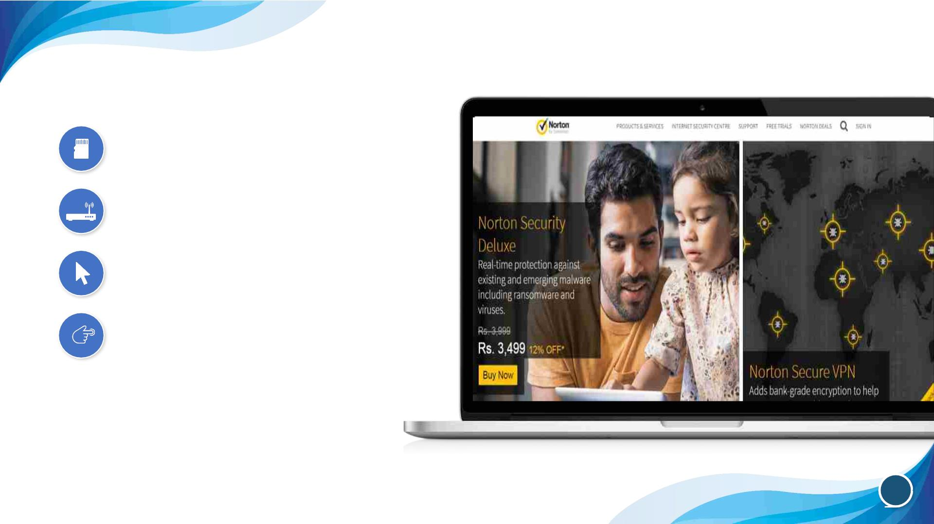
Norton
Norton Security
Real time protection against malware
Norton Secure VPN
Protection of Wi-Fi hubspots.
Anti-Virus
Security against virus in PC/Mac/Laptop
Mobile Security
Security solution for mobile devices
We’ve been exclusive distributor of Norton
Security Solutions for many years.
17

Slide 19
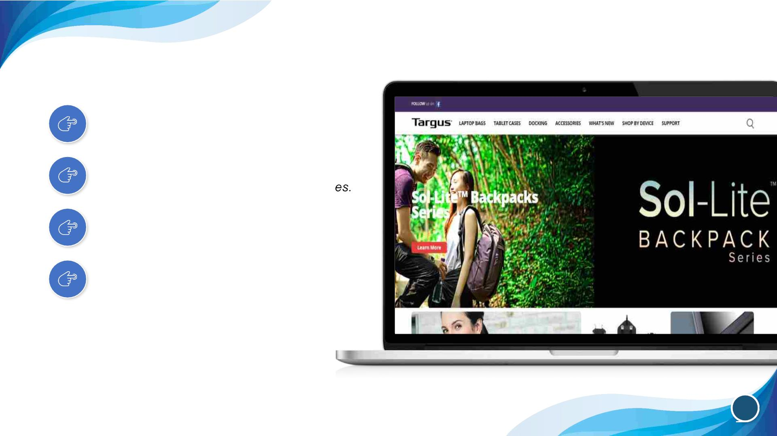
Targus
Bagpacks
Laptop Bags, Carry Bags, Bag packs etc
Docking Stations
Universal, Docking Stations, All Accessori
Input Devices
Wireless Mouse, Hubs and Keyboards
Accessories
Cooling Pads, Cable Locks, Presenters
We’ve been exclusive distributor
of Targus in India.
18

Slide 20

Seagate
SSD
FireCuda
BarraCuda
Skyhawk
Exos
We’ve been Seagate’s exclusive distributor
of SSDs in India.
We’ve been in a tie-up for HDD-business for over 20 years now.
19

Slide 21
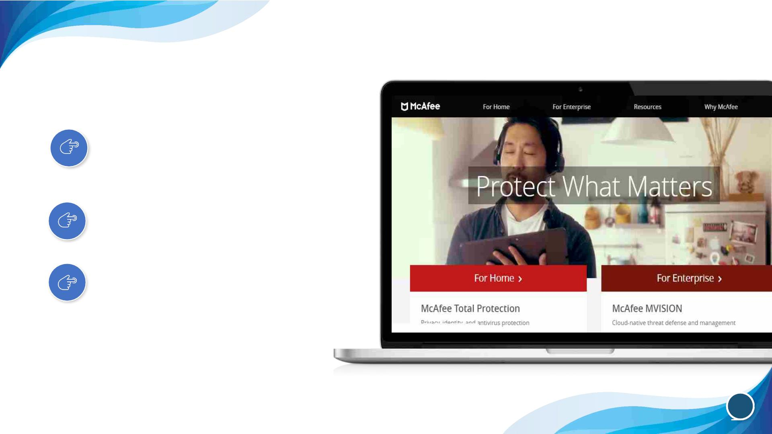
McAfee
Premium Antivirus
Antivirus for PC, Antivirus for Mac
Virtual Private Network
VPNs
Safe Browsing
Parental Controls
We’ve been exclusive distributor of MacAfee in India.
20

Slide 22
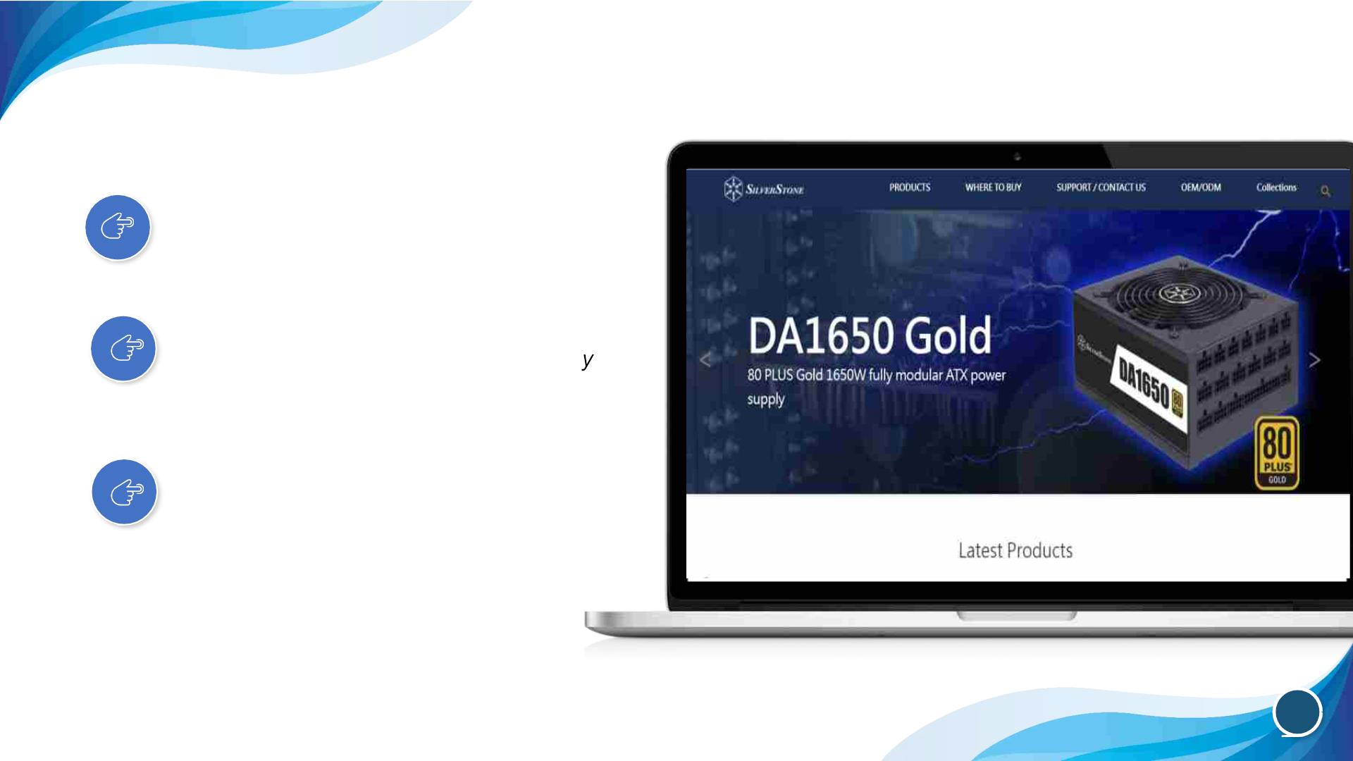
SilverStone
Computer Chassis
Tower case, shoebox/cube case
Power Supply
Wattage, Form Factor, Cable Modularit
Server
2U,3U,4U, NAS Chassis, Rail
Slide compatibility
We’ve been exclusive distributor of SilverStone in India.
21

Slide 23

To drive growth further,
we started manufacturing in 2016
Evolving technologies, disruptive business-models &
increasing customer-expectations pushed us into
manufacturing Flash Drives PVC & RFID Cards.
22

Slide 24
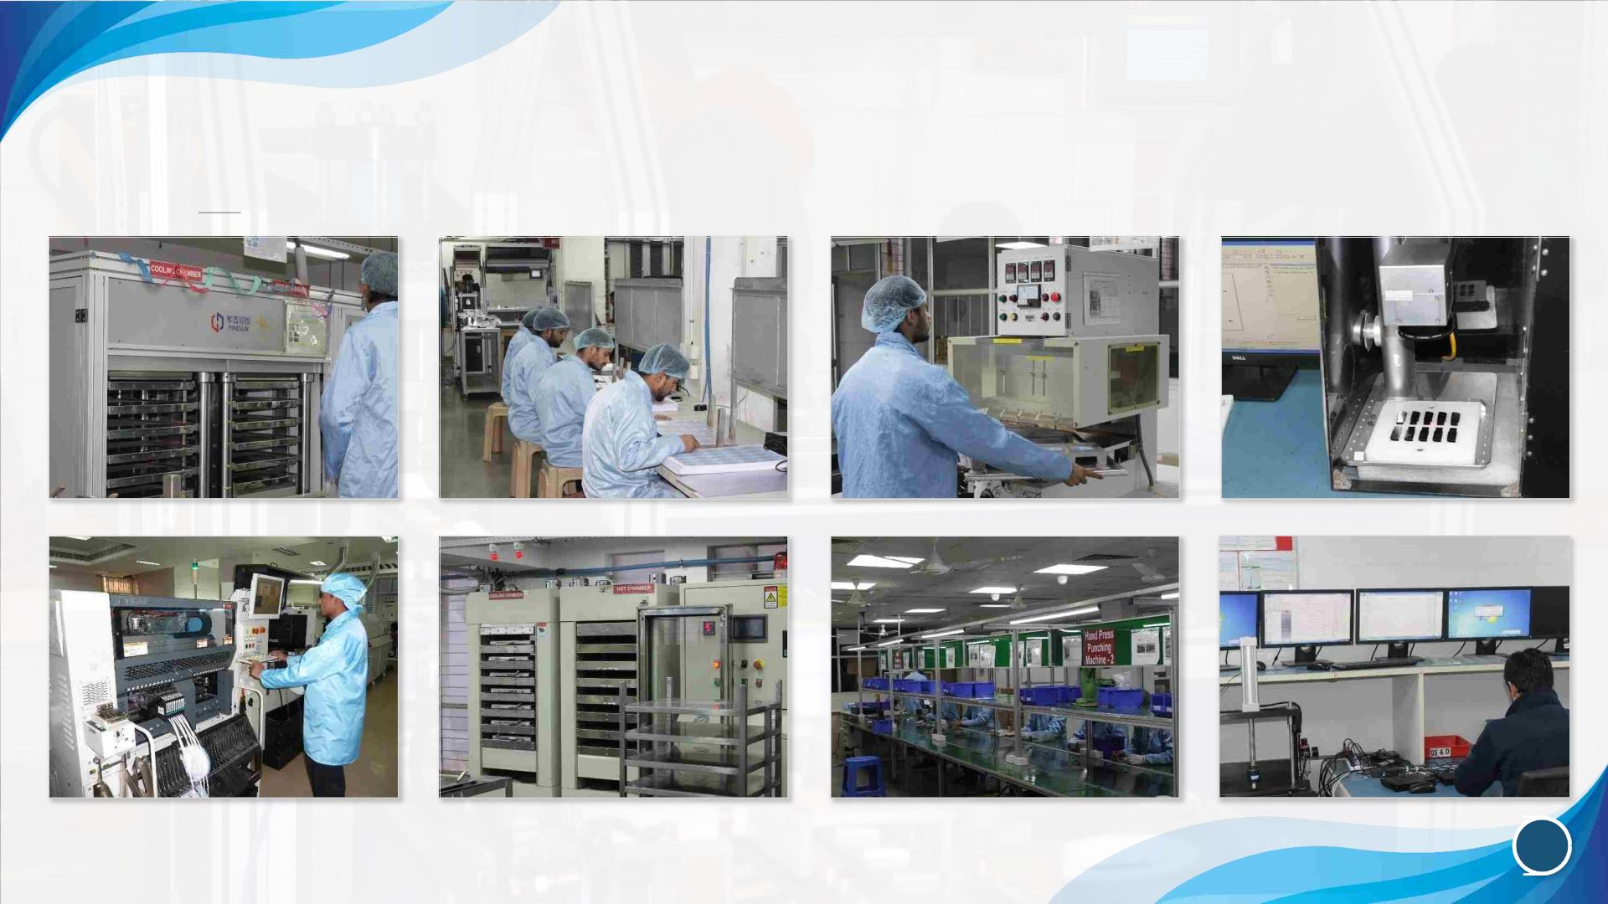
A top-in-line infrastructure
23

Slide 25

A sophisticated Call Centre
enhances our customer
relationship
We run a dedicated Call Centre for CCTVs,
Biometric Products & Tenda Networking
Solutions to boost our sales & extend
support to our customers.
24

Slide 26

Our post-sale support
strengthens bond between
us & channel-partners & end
-customers
• Sales-professionals stay in touch with the
customers even after the product-delivery
• We’ve a regular availability of different
products at every single branch of the
company
• We’re keen to correct defects in faulty
products or exchange them
• Our Customer Service responds promptly
to the customers’ queries
25

Slide 27

Committed to evolve with times &
respond proactively to market-
demands & developments, Fortune
is marching on a journey, replete
with greater promises,
performances & profitability.
26

Slide 28

91 – 011- 4994 0000
sales@fortune-it.com
www.fortune-it.com

