Slide 1
ACT Plast Paints Pvt. Ltd.

Slide 2
ABOUT US
Company Overview
ACT Plast has been established as a Plastic Decorative Parts & Engineering components Manufacturer in Chennai.
Company Strategy
Vision To be a leader in the Decorative Parts Manufacturer through innovation and advanced technology.
Mission Our Mission is to be a leader in providing engineered decorative solutions for customers with whom we develop long-term business relations.
Core values We grow through creativity, invention and innovation. We integrate honesty, integrity and business ethics into all aspects of our business functioning.
Goals Regional expansion in the field of Decorative parts and develop a strong base of key customers. Increase the assets and investments of the company to support the development of services.

Slide 3
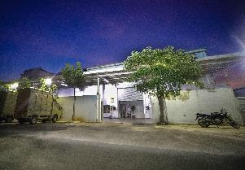
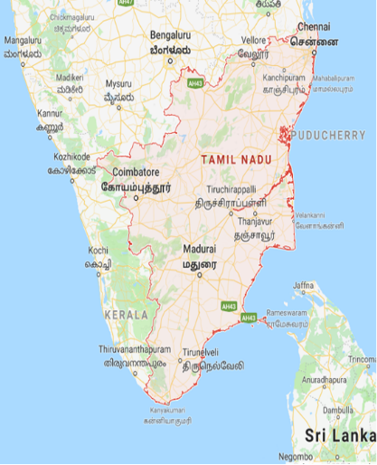



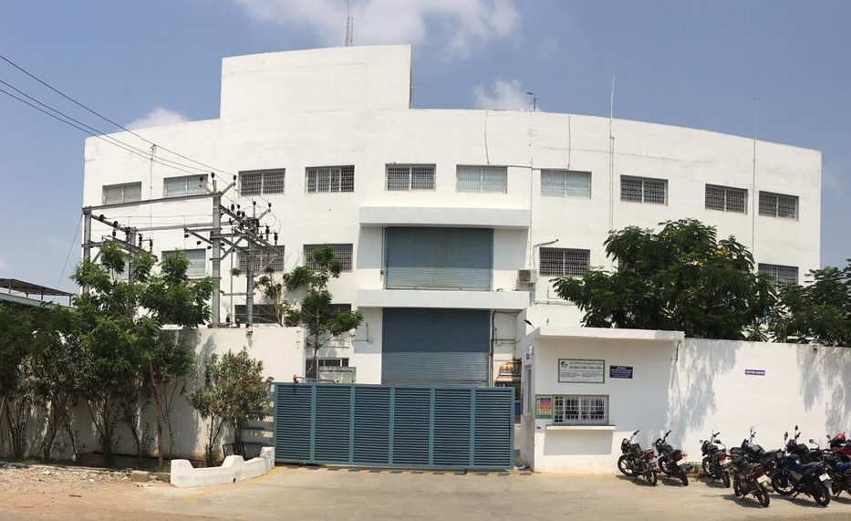
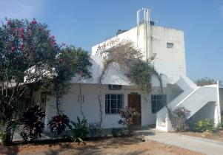

FOOT PRINTS
Unit : I
105/4, 5A Ezhichur Main Road, Ezhichur,
Sriperumbudur Taluk, Kanchipuram District,
Chennai - 603 204, Tamil Nadu, India.
Land Area : 5220 Sq. Mts
Building Area : 1050 Sq. Mts
Unit : II
S-37, Pillaipakkam SIPCOT Industrial Park, Vengadu Village, Sriperumbudur Taluk, Kanchipuram District,
Chennai - 602 105, Tamil Nadu, India.
Land Area : 3800 Sq. Mts
Building Area : 6040 Sq. Mts
Unit : III
231/5A, Poothurai Main Road,
Poothurai Village , Vanur Taluk,
Villupuram District India – 605 111,
Tamil Nadu, India.
Land Area : 6070 Sq. Mts
Building Area : 2325 Sq. Mts

Slide 4

MILESTONE
Apr - 2018
IATF-16949 Certified by TUV SUD
Apr - 2018
Established Unit – 3 in Poothurai Near Pondicherry
Jan - 2017
Green Channel Certified by M/s Whirlpool
Jun - 2015
Unit – 2 Established in Pillaipakkam Chennai
Mar - 2013
Fully Auto Robotic Paint Line Started
Feb - 2012
Laser Marking Facility added
Sep - 2010
Unit – 1 Relocated to Ezhichur Chennai @ Own Premises
Feb - 2006
Unit – 1 Inaugurated in Ekkaduthangal

Slide 5
SALES GROWTH
Projection

Slide 6
PROCESS PORTFOLIO
Plastic Injection Molding
Painting
Pad Printing
Laser Etching
Chrome Plating
Hot Foil Stamping
Ultrasonic Welding
Value added assembly
Screen Printing
Membrane switches
IMD – In Mold Decorative
IML – In Mold Labelling
IME – In Mold Electronics

Slide 7
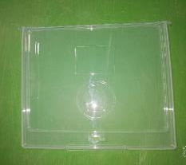

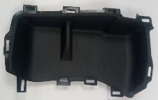
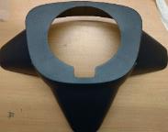
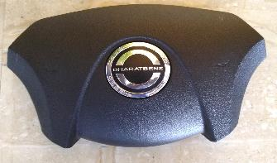
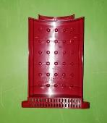
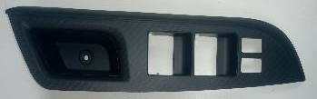
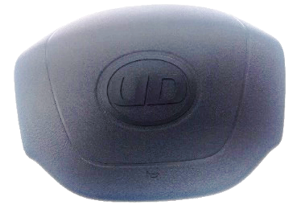
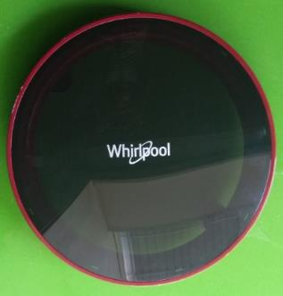
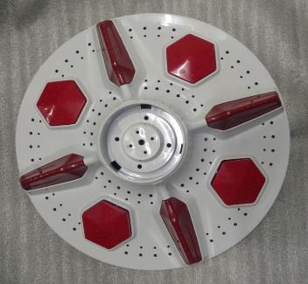
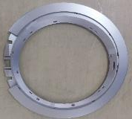
PLASTIC INJECTION MOLDING
Plastic Injection Molding
Advantages:
Have a huge range of molding machine from 50T to 1300T fully automated.
Clear part, Colored clear part and different surface finishes as per customer standard.
High Efficiency with enhanced strength.
Applications : Home Appliances, Automotive, Mobile communications etc.
Major Customers : Faurecia Visteon, Nifco, LS Automotive, Reydel/SMRC Automotive, Kostal, seoyon e-hwa automotive Bharath Benz, Hyundai, Renault Nissan, Ford, PSA, BENZ, Whirlpool, Phillips, BSH etc.

Slide 8
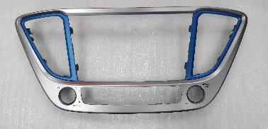
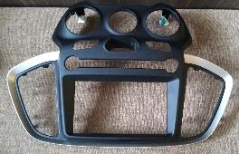
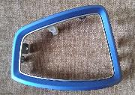
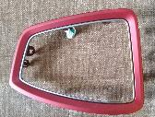
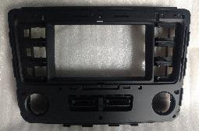


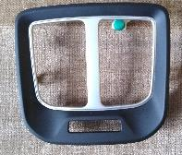

PLASTIC PAINTING
Plastic Painting
Advantages:
Fully automated and robotized painting unit.
Even distribution of paint with better finish..
Gloss finish, Matt finish, satin finish soft touch finish etc. can be achieved
Dual Color painting is possible.
Applications : Home Appliances, Automotive interior and exterior parts
Major Customers : Faurecia Visteon, Nifco, LS Automotive, Reydel/SMRC Automotive, Kostal, seoyon e-hwa automotive Bharath Benz, Hyundai, Renault Nissan, Ford, PSA, BENZ, Whirlpool, Phillips, etc.

Slide 9
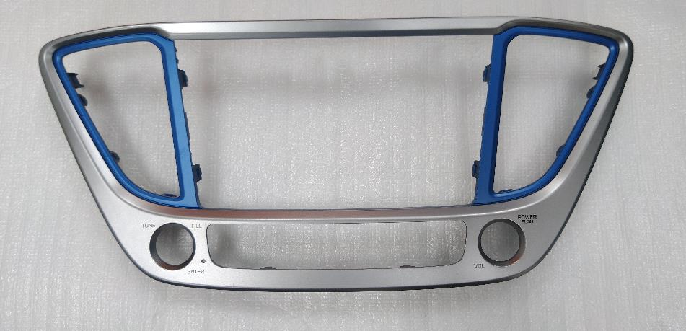
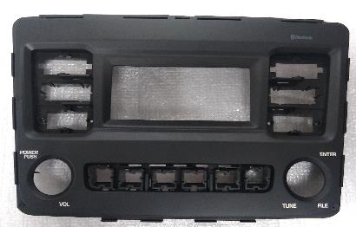
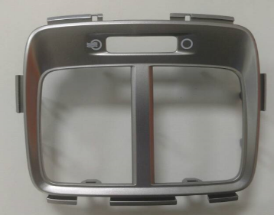

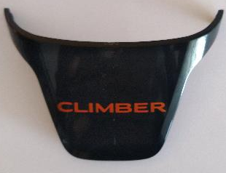
PAD PRINTING
Pad Printing
Advantages:
Printing can be done on 3 dimensional part of all shapes and size
Also can be printed on delicate and mechanical sensitive products.
Fine subjects also can be printed using this process.
The maximum size Pad printing capability is 75mm Dia.
Applications : Home Appliances, Automotive interior etc.
Major Customers : LS Automotive, Philips, Hyundai, Renault Nissan, etc.

Slide 10
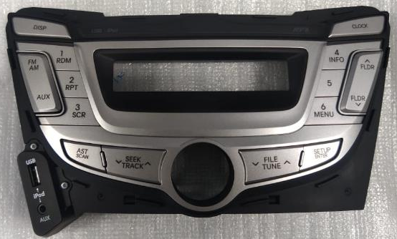
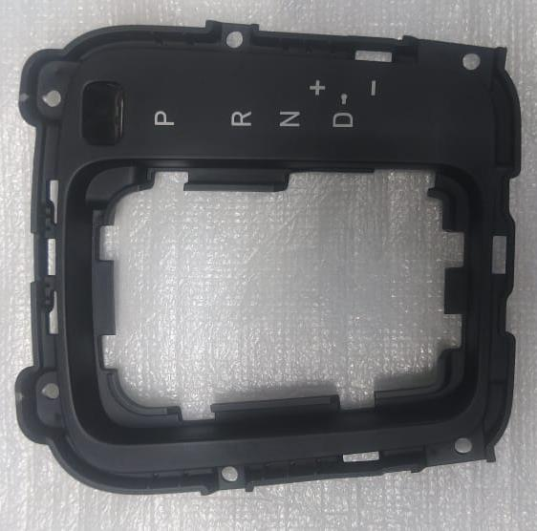
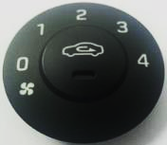
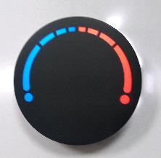
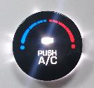
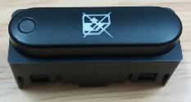
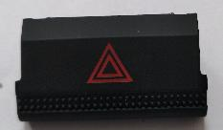
LASER ETCHING
Laser Etching
Advantages:
Precision engraving can be achieved through Laser etching
It will pass interior test requirement of automotive standards.
Both day and night condition illumination is achieved.
Laser etching can be made 300 x 300mm at one stretch
Applications : Home Appliances, Automotive interior etc.
Major Customers : Kostal, Hyundai Mobis, Faurecia, Hyundai, Ford etc.

Slide 11
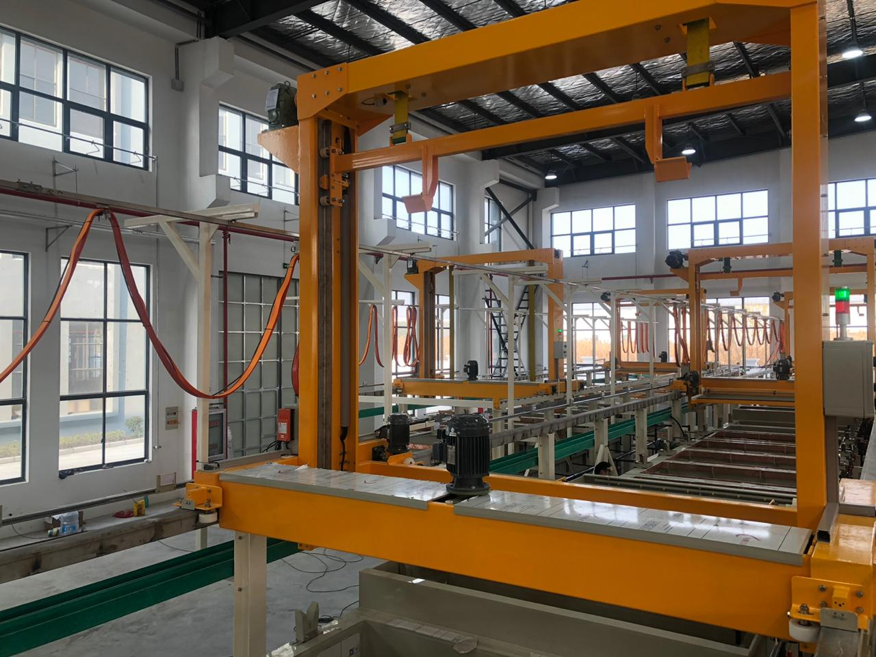
Chrome Plating
Chrome Plating Line – Complete automation for plastic parts
Start of Production @ AUG-2020
Max hanger size / Parts
1500 (L) X 1200(W) X 300 (Depth)

Slide 12
Hot Stamping – Ultrasonic Welding – Assembly
Hot Foil Stamping : Our Hot stamping capability can make different kinds of hot stamping process. Our engineers are expert in guiding the process from the tool design stage itself. We have capability to print parts up to 300 mm in length.
Ultrasonic Welding : ACT has 4 Ultrasonic Welding lines to meet specific customer requirements. Ultrasonic Welding is a great replacement for screws, glue, and snap-fit designs. As such, it has broad range of applications and is a cost-effective and environmentally friendly solution.
Value added assembly : Manufacturing of individual components to fully-assembled functional devices require a holistic approach to building products. We need to combine technology with expertise and wisdom in delivering the desired outcome. Therefore, We understand and are committed to be a one point supplier who offer mix ‘n‘ match solutions to save customers both time and money

Slide 13
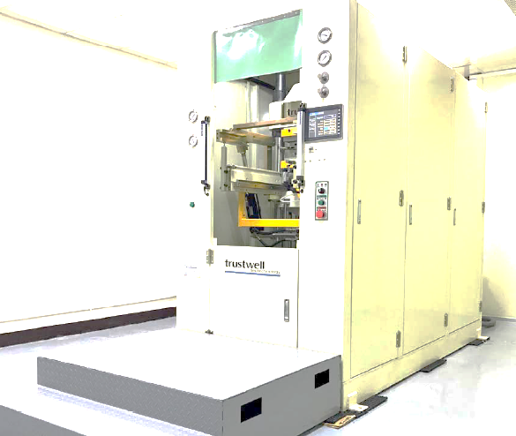
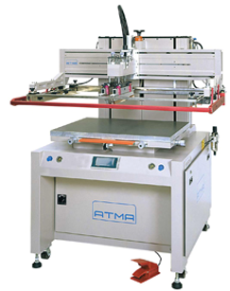
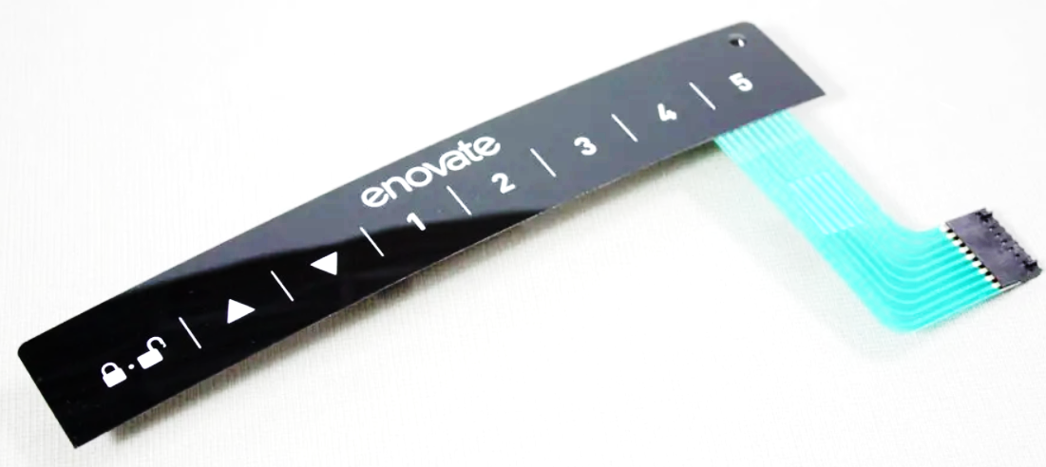
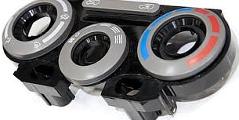
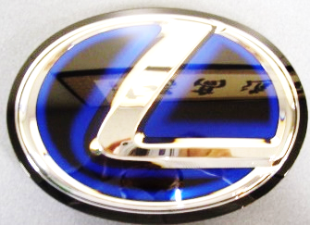
Screen Printing
Screen Printing
Advantages:
Printing, forming and injection process in single-roof platform with highly skilled team.
Speciality in design concept proposal and solution provider to customer
State-of-the-art, world’s latest technology with fully automated Japanese, German & Taiwan make machines.
Applications : Home Appliances, Automotive, Mobile communications, Computers etc.

Slide 14
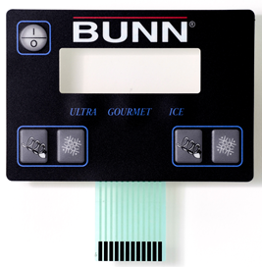
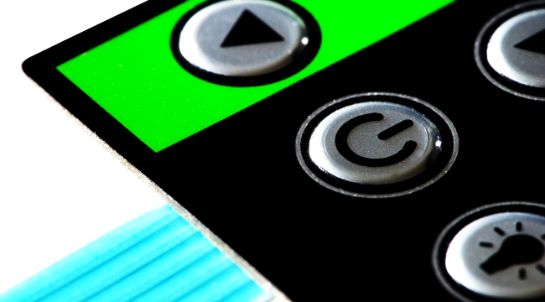
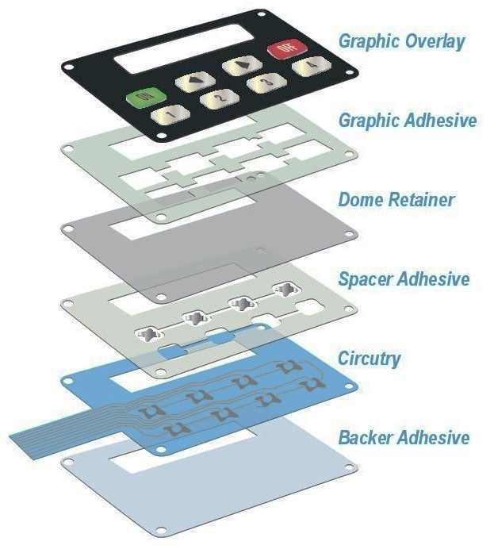
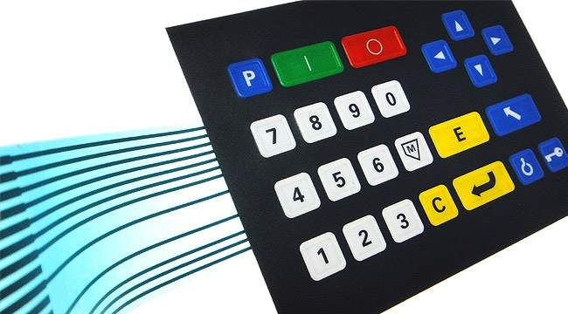
New Products Introduction
Membrane Switches
Advantages:
Membrane Geeks on developing complex, integrated human-machine interfaces with unique functional, graphics with performance requirements.
Extensive understanding about India US and Europe quality standard in membrane switch and related products.
Applications : Home Appliances, Electronic Applications etc.

Slide 15
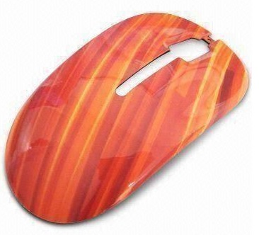
New Products Introduction
IMD – IN Mold Decorative
The technology used to transfer graphics in to injection molding parts.
Advantages:
High accuracy in positioning is possible.
Scratch resistant, corrosion resistant and long service life.
The color can be changed at will, and the pattern can be changed at will.
Cost effective, eliminates pasting process,
Applications : Home Appliances, Automotive, Mobile communications, Computers etc.

Slide 16
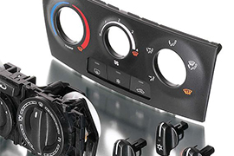
New Products Introduction
IML – IN Mold Labelling
The technology where the pre formed printed film is used during injection molding
Advantages:
This process achieves high-precision decoration of the three-dimensional surface.
It is highly integrated, saving subsequent assembly processes with improved yield.
The decorative pattern is built in, never worn out.
Light transmission for easy and clear display functions.
It is better, lighter, more solid, more choices, and more secure for end users.
Applications : Home Appliances, Automotive, Mobile communications, Computers etc

Slide 17
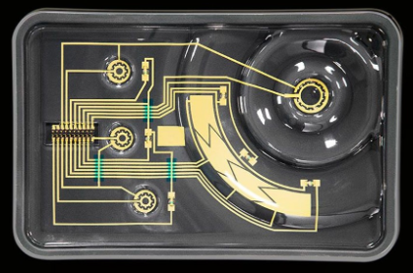
New Products Introduction
IME – IN Mold Electronics
The technology where the product is integrated with functional parts.
Advantages:
IME allows to add functional parts even onto the complex plastic parts which is not possible in conventional laminating process
IME surface decoration is possible with IMD/IML process
Eliminates printed circuit boards, light guides and make product look sleek and compact.
Applications : Home Appliances, Automotive, Medical equipment's, Water Purifiers.

Slide 18
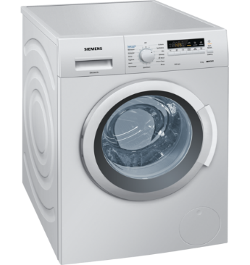
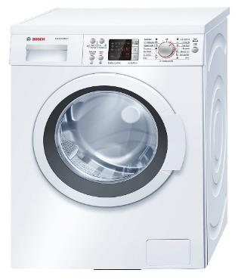
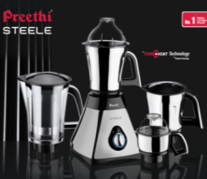
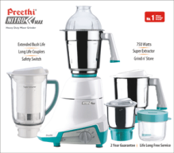


PRODUCTS GALLERY
Washing Machine Parts
Knob

Slide 19
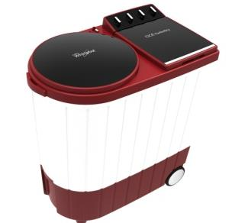
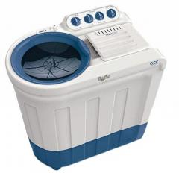









PRODUCTS GALLERY
Splutch parts
Under base parts

Slide 20







PRODUCTS GALLERY
PACE MODEL PARTS

Slide 21








PRODUCTS GALLERY
Mixer Grinder parts

Slide 22







PRODUCTS GALLERY
Model: Hyundai Verna
Audio Panel , Air vent & Console Parts

Slide 23







PRODUCTS GALLERY
Model : Nissan Sunny
Model : Hyundai Eon
V – Bracket
Fin – LH/RH
Body side
Knob
Audio Panel , Air vent & Console Parts

Slide 24




PRODUCTS GALLERY
Model : Hyundai Grand i10 Nios
Model : Renault Duster
Roof rail parts

Slide 25










PRODUCTS GALLERY
Model : Ford Eco Sport
CC Parts, DP Parts & IP Parts

Slide 26







PRODUCTS GALLERY
Model : KIA Seltos
Molding , Garnish , Skid Plate
Cluster Facia , RR Panel

Slide 27




PRODUCTS GALLERY
Model : Hyundai Aura
Model : Renault Duster
Radiator Grill Assembly
Door Handle & Console Parts

Slide 28




LAB FACILITIES (Injection Molding)
Moisture Analyzer
To Check Moisture content in Plastic RM
Muffle Furnace
To Check filler content in Plastic RM
MFI Tester
To Check the Melt flow index of the Plastic RM
Lux Meter
To Check Light Intensity

Slide 29







LAB FACILITIES (Painting)
Spectro Photo Meter
To Check Color
Gloss Meter
To Check Gloss Level of the Part
B4 Ford Cup
To Check Application Viscosity of paint
Particle Counter
To give dust levels in paint shop
Anemometer
To Check Air Velocity
Cross Cut test
To perform cross cuts for adhesion test
DFT Meter
To Check Paint Thickness

Slide 30












MANUFACTURING CAPABILITIES
Plastic Injection Molding – 40 No
Painting Robot – 1 No.
Manual Spray Painting – 6 Lines
Flat Spray Painting – 1 No.
Laser Etching – 3 No.
Pad Printing - 5 No.
Hot foil stamping – 1 No.
Thermoforming – 1 No.
Leak test SPM – 2 No
Hotplate Welding – 2 No
Ultrasonic Welding – 2 No
Assembly

Slide 31
INJECTION MOULDING MACHINES DETAILS

Slide 32




















CUSTOMERS

Slide 33













OEM’S

Slide 34

Thanks
ACT Plast Paints Pvt. Ltd.
Admiring Customer Thoughts…
…. A Winning Attitude

