Slide 1


Slide 2
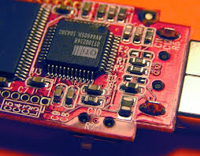
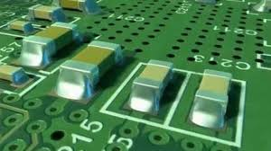
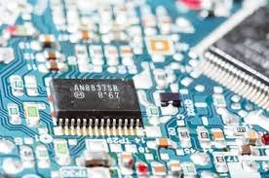
INTERODUCTION
Surface Mount Technology is an area of electronic assembly used to mount electronic components to the surface of the printed circuit board (PCB).
SMT was developed to reduce manufacturing costs and also to make more efficient use of PCB space.
Introduction of surface mount technology it is now possible to build highly complex electronic circuits into smaller and smaller assemblies with good repeatability due to the higher level of automation.

Slide 3






COMPANY PROFILE
Company Name : InFocus Electronics Technology
Company Logo :
Company Location : Thirumudivakkam Industrial Estate
Type of Manufacturing : Electronics Manufacturing Service (PCB Assembly)
Manufacturing Service : Surface Mount Technology (SMT), Through Hole Technology (THT) & Assembly
Contact Number : +91 7708535618
E-Mail Id : info@infocuselectronicstechnology.com
Website : https://infocuselectronicstechnology.com/
Register of Firms as No : FR/Chennai South/358/2022.
GST Number : 33AAJF12688B1Z1

Slide 4

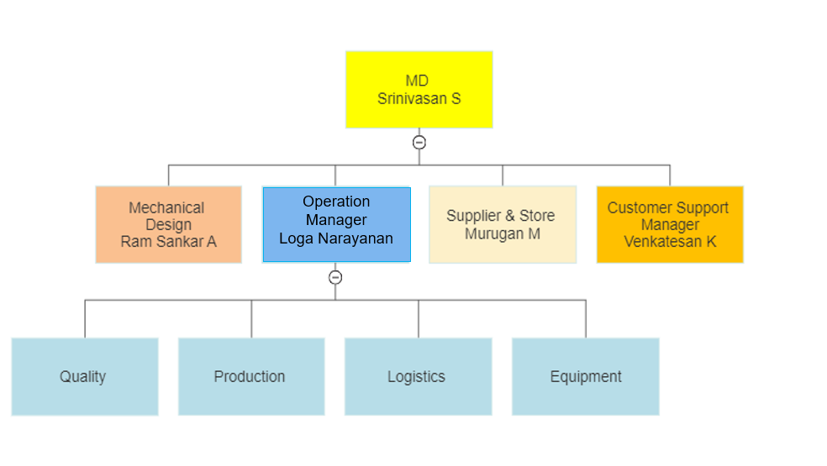
ORGANIZATIONAL CHART

Slide 5

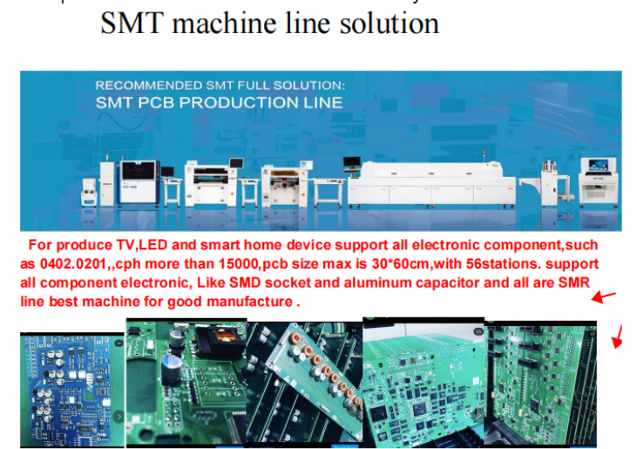
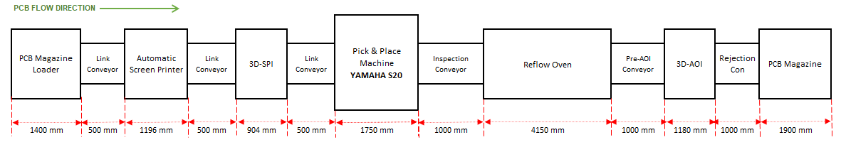
MACHINERY SPECIFICATION

Slide 6

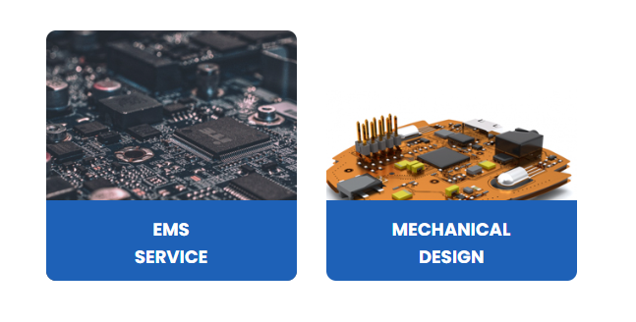

OUR KEY STRENGTH
Surface Mount Technology
Through Hole Technology
Mechanical Design
Design for manufacturing (DFM)
Design for Assembly (DFA)
Failure Analysis
PCB Design & Analysis
Conformal Coating
Final Assembly

Slide 7

OUR CAPABILITY
Fully Automatic line configuration.
High complex double-sided PCB assembly.
High mix, low to medium volume assemblies.
High Configuration SMT assembly lines.
Very least component in industry Fine Pitch SMT(008 – 004), Through-hole and POP assemblies.
3D based Automated Solder paste inspection.
3D based Automated optical inspection.
IPC A 610 standards class 2 and class 3.
Design for manufacturing (DFM) & Design for Assembly (DFA).
Mechanical Design.
Maximum 510 X 450 MM PCB Assembly.
No clean process.

Slide 8

CUSTOMER SERVICE
On time delivery.
Just in time (ZIT).
Tear down analysis.
Customer satisfaction.
Full fill the customer requirement and expectation.
End to End manufacturing traceability.
Schedule adherence.
Right time, Right Quantity and Right Delivery (RRR) system.

Slide 9
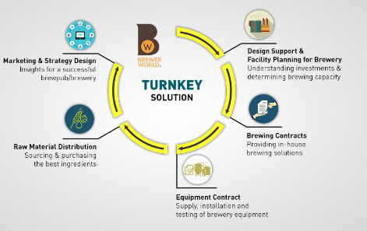
TURN KEY
Supply chain management.
Turnkey Component Sourcing — from your BOM and approved supplier list.
Component Cost Reduction.
End-of-Life and Obsolescence Notification & Resolution.
Automated Shipping Systems for External service.

Slide 10
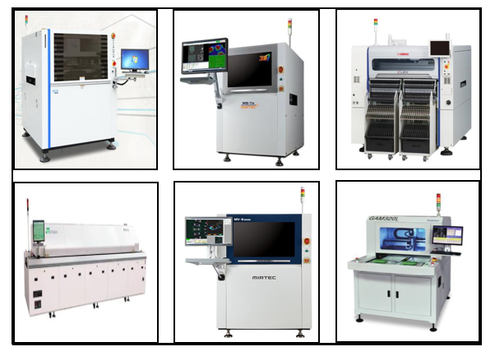
10000 Sqft ESD dust free workspace
COMPANY OVERVIEW
Automatic Screen Printer- HC 600E
3D-Solder paste Inspection - Mirtec
Pick & Place data - Yamaha SM20R 42000CPH
Reflow- JT 10 Zone - Pb Oven
3D AOI - Mirtec
Router - Genitec 320L
Dry Cabinet- Dr.Storage
7CH-Reflow profiler- KIC
Metcal - Temperature controlled soldering stations.
Capability of handling 01005 to IC, QFP, QFN BGA, POP (Up to 0.1mm pitch)
Rework Stations
Baking Oven

Slide 11




10000 Sqft ESD dust free workspace
SNAPSHOT
Technology Experience and standard global processes
Strong Local Supplier Ecosystem
Made In India
Domestic Product
Logistics: Proximity to Sea Port & Freight

Slide 12

10000 Sqft ESD dust free workspace
FOCUS ON QUALITY
Quality Management System.
ESD controlled Environmental.
Class 8 Environmental.
IPC Certified Engineers.

Slide 13

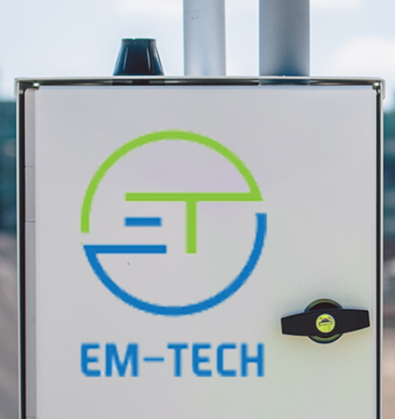




10000 Sqft ESD dust free workspace
OUR CUSTOMER

Slide 14

Contact Number : +91 7708535618

