Slide 1

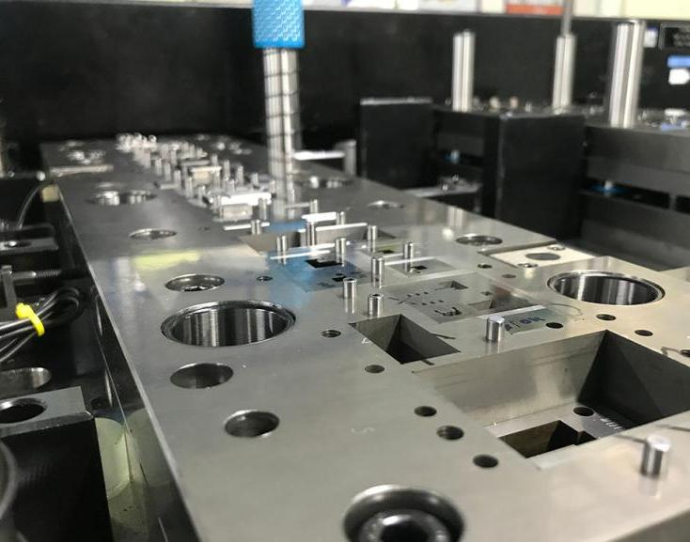

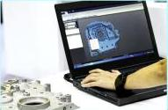
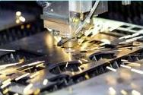
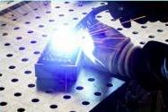
www.veerometals.com

Slide 2



We’re obligated to ensure the
health & safety of our staff & visitors
COVID appropriate guidelines to be followed. (If Any)
Please ask for the nearest emergency exit(s) to you.
Upon hearing the emergency siren, assemble at the safe assembly point immediately and await instructions.
Please visit/walk in the factory shop floor area only with a designated guide.
Wear appropriate personal protective equipment.
Always walk within the marked yellow lines.
Do not touch or attempt to operate any machine.
Please be alert for forklift siren.
This is a non-Smoking facility.
Kindly report any observed unsafe practice.

Slide 3
Established in 1965
Privately held Company
Manufacturing Facility in India & Philippines : Total - 30,000 sqm.
Lines of Business
Stamped Components
Precision Fabrication
Mechanical /Electro Mech. Assy
Tooling
Machining
Metal Additive Manufacturing
- Automotive & Industrial
  - Metal Enclosures/IT & Industrial Racks/Welded Sub-Assy/
Busbar Fabrication (Copper & Aluminium)
- Powder Coated/Painted/Non-Painted
- Press Tools & Fixtures
- CNC Machining & CNC Turning
- Metal 3D-Printing
Notes:
All picture delete
Blue box delete

Slide 4



Vision
To deliver excellence to our stakeholders by designing and manufacturing commendable products & services, driven by Technology, Innovation & Sustainable Business practices.
Mission
To be one-stop shop for Precision Metal Parts & Assemblies.
To remain recognized as Centre of Excellence in our field.
To continue as a preferred supplier for our customers.
Notes:
Vision mission new slide

Slide 5



Core Values
Ethics- We strive to be ethical in our code of conduct.
Safety- It’s our primary responsibility to create a safe working environment.
Sustainability- We pledge to make our operations sustainable.
Value-addition- We like to provide value to our stakeholders.
Excellence & Innovation- We pursue excellence in everything we do and we value challenges because they drive us towards innovation.

Slide 6













Organization Structure
Management Team
Business Development
HR
Finance
Design & Engineering
Sourcing
MR
EHS, QMS
Operations
Quality & Qualifications
Procurement & Planning
Manufacturing
Warehouse
Logistics

Slide 7

We’re uniquely
positioned in the industry
Integrated facility for product manufacturing in all core lines of business.
Large Manufacturing Capacity. In-House Manufacturing Facility for Press Tools.
A rich experience of 50+ years.
Robust quality systems.
Strong Mechanical Engineering team for Design & Engineering.
Digitization of processes to measure business performance.
Ability to offer VMI Solutions globally; Warehouses in USA (Tulsa, Oklahoma; Brownsville, Texas) & Europe (Grenoble, France).

Slide 8
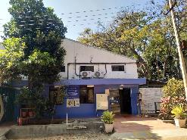
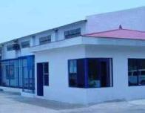
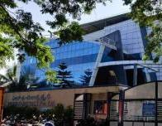
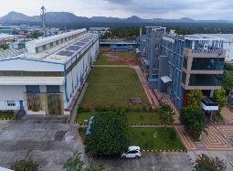
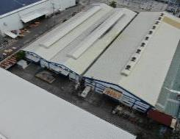
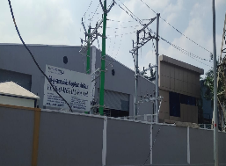
Our Manufacturing Footprint
UNIT 1
Jalahalli - 1965
2,000 sqm Employees-100
UNIT 2 (EOU) Huskur Road - 2005
9,500 sqm Employees-400
UNIT 3 (EOU)
Jigani - 2009
4,500 sqm Employees-270
UNIT 4
Harohalli - 2018
6,000 sqm Employees-170
UNIT 5
Philippines - 2012
4,500 sqm Employees-140
UNIT 6
Chennai - 2023
3,500 sqm Employees-20
Notes:
Add Plant photos
2 slides
1 with plant img and other with info
Box shape diff
Old slide 5

Slide 9

A whole host of Certifications reflects
our commitment to Precision, Quality and Sustainability in every facet of our working
IATF 16949 : 2016
AS 9100D : 2016
ISO 9001 : 2015
EN 15085 – 2, CL-1
ISO 14001 : 2015
ISO 45001 : 2018
ISO 27001 : 2013
C-TPAT

Slide 10
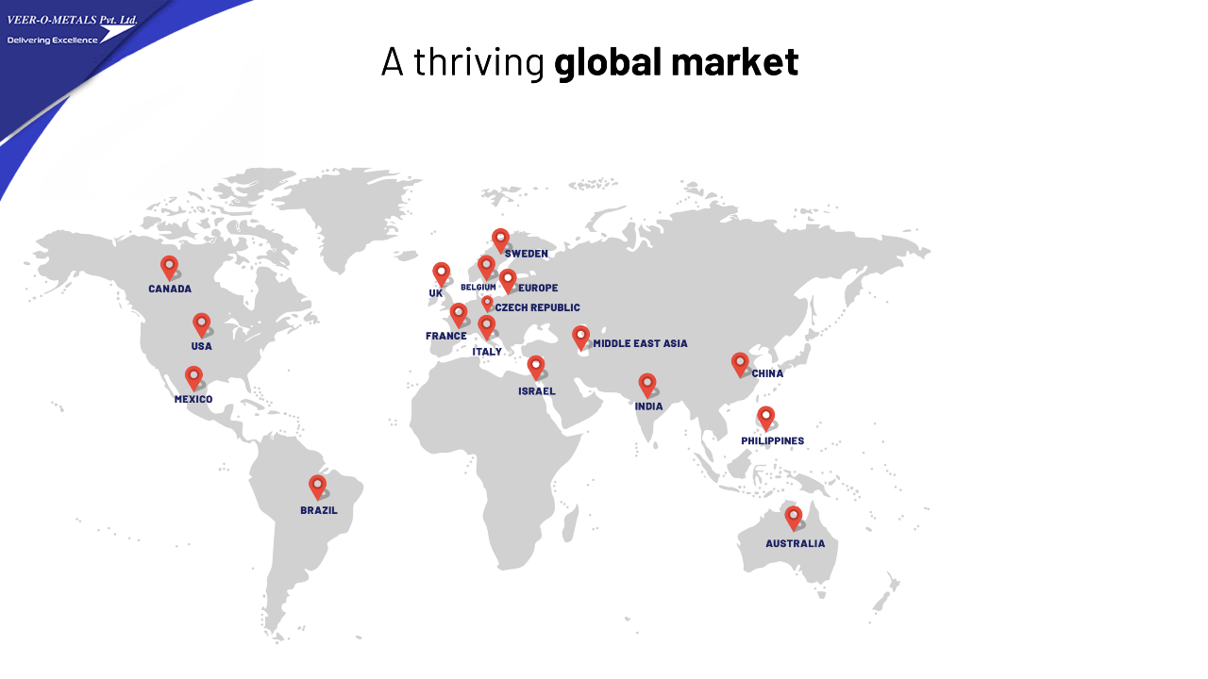


Slide 11
Geographical spread of sales
INDIA
Notes:
Bold no.

Slide 12

We cater to a diverse range of Industry Segments
Top Growth Industries in 2023
Automotive
Networking & Telecom
Clean Energy
Mobile & Appliance

Slide 13





















Our esteemed customers & growing…

Slide 14
Our Core Competencies
Manufacturing
Stamping, Press Tool Design & Fabrication,3D- Printing, Laser Cutting, Punching, Bending, Welding, Machining.
Surface Treatment
Painting, Powder Coating, Screen Printing.
Assembly (Mech / Elec)
Clinch Nut/Standoff Insertion, Riveting, Electro-Mechanical Assembly, TOX
Packing
Palletization, Shrink Wrap, Sea-worthy Packing.
Design for Additive Manufacturing (DFAM), Design & Development, Design Tools - Solid Works, CREO,CATIA, AutoCAD, Visi & Siemens-NX.
Design & Engineering
ERP System
SAP
APQP/PPAP System
SoftExpert Enterprise Quality Management + Project Management (under implementation)

Slide 15
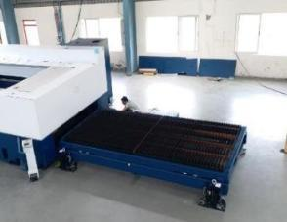
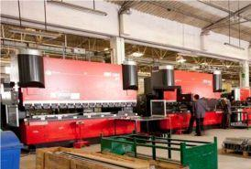
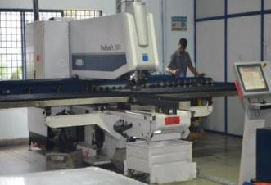
Infrastructure – India
Laser Cutting (4mX2m)
CNC Press Brakes (3m)
CNC Turret Punch Presses
3D-Printer

Slide 16
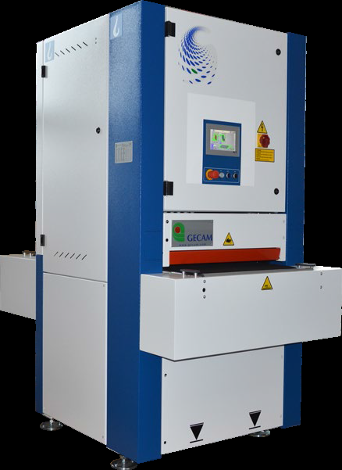
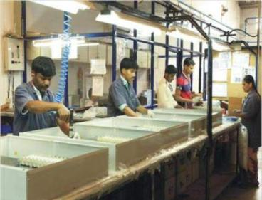
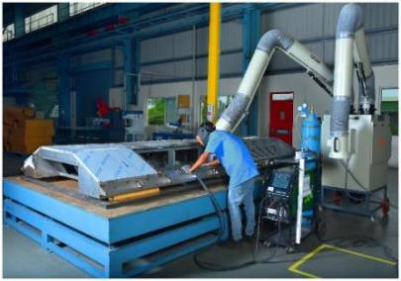
Infrastructure – India
Mechanical Assembly
Welding (TIG/ MIG/ Resistance)
Polishing Machine

Slide 17
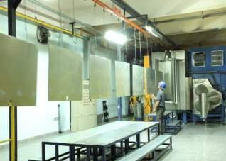
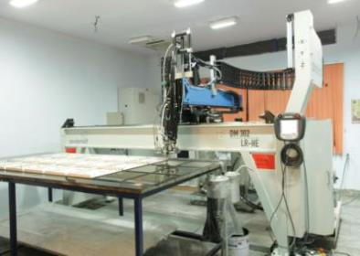
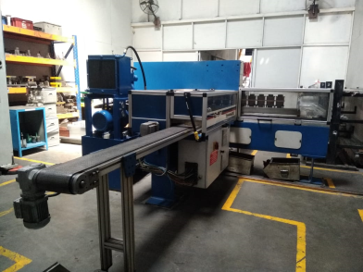
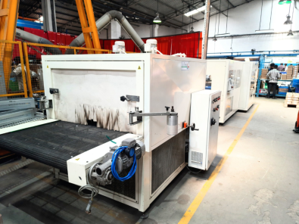
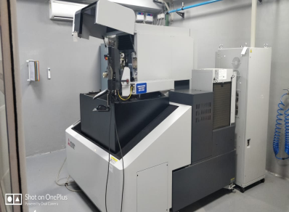
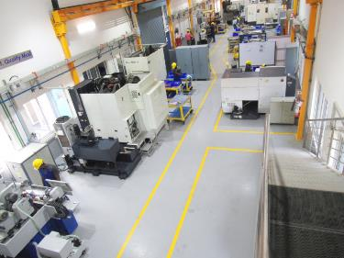
Infrastructure - India
Powder Coating
CNC Gasket Dozing Machine
Busbar
Shrink Wrap Machine
Wire EDM
Tool Room & Machine Shop

Slide 18
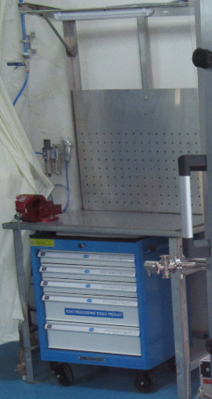
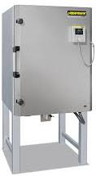
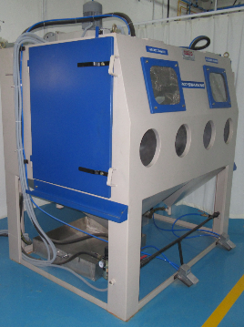
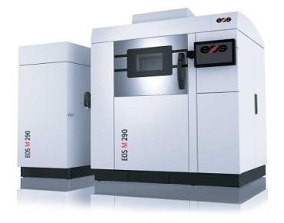
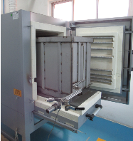
Infrastructure - India
3D-Printer
Shot Peening
Nabertherm Furnace
Cleaning Room
Metal Additive Manufacturing

Slide 19
Current Facility - India
Stamping & Fabrication | Welding | Finishing | Specialized Equipment | Assembly
Stamping Presses -46 20T-500T | Aluminum Resistance Welding | Automatic Pre-Treatment & Powder coating plant Conveyor length 208mm-02 Plants | Busbar punching & Bending Machine-23 | Mechanical Assembly / Electro Mechanical Assembly Lines
Laser cutting-02 | MIG Welding | Water wash liquid painting Booth-01 | 3D-Printer-01
CNC Turret Punch-09 | TIG Welding | Screen printing | CNC Gasket Dozing Machine-01
CNC Press Brakes-23 | Resistance Welding |  | Shrink wrapping Machine-01
Perforation Press-01 | Projection Welding |  | Time Saver Machine-01
Riveting Presses-30

Slide 20
Current Facility – India
(Tool Room & Machine Shop)
SL.No |  | MACHINE NO | MACHINE NAME | MAKE / MODEL | NOS | TRAVEL SIZE
CNC MACHINES
1 | VMC-01 |  | VMC M/C | JYOTI/ VMC – 1260 | 1 | X 1220 Y 600 Z 600
2 | VMC-02 |  | VMC M/C | MAKINO /SLIM 3n | 1 | X 500 Y 400 Z 400
3 | VMC-03 |  | VMC M/C | MAKINO / PS 105 | 1 | X 1050 Y 510 Z 460
4 | VMC-04 |  | VMC M/C | Hartford /HCMC-2110 | 1 | X 2000 Y 1000 Z 800
5 | VMC-05 |  | MILLING M/C | Millstar /JY-VH450PC | 1 | X 1100 Y 420 Z 500
6 | CNC TURN -01 |  | CNC TURNING | JYOTHI/DX 200-5A | 1 | X 200 Z 400 (max. swing Dia 300)
7 | CNC DRILL -01 |  | CNC DRILLING EDM | CHMER / CMH32CA | 1 | X 300 Y 200 Z 200
8 | WC-01 |  | WIRE CUT EDM | MITSUBISHI / MV1200R-D | 1 | X 400 Y 300 Z 220
9 | SPEDM-01 |  | DIE SINKER(SPARK EDM) | MITSUBISHI / EA 8S | 1 | X 300 Y 200 Z 200
10 | WC-02 |  | WIRE CUT EDM | MITSUBISHI / MV2400S-D | 1 | X 600 Y 400 Z 310
QUALITY ASSURANCE
1 | CMM -01 |  | COORDINATE MEASURING MACHINE | CARL ZEISS/CONTORA G2 | 1 | X 1000 Y 1600 Z 600
2 | VMM -01 |  | VIDEO MEASURING M/C_ | CARMAR /VMM4030D | 1 | X 400 Y 300 Z 175
CONVENTIONAL MACHINES
1 | DM-14 |  | RADIAL DRILLING MACHINE | INFRATIREA / GR -516 | 1 | DIA 3.0MM TO DIA 40.0MM DRILLING
2 | SG-01 |  | SURFACE GRINDER | PROTH /PSGS-3060 AH | 1 | X 600 Y 280 Z 240
3 | CG-01 |  | CYLINDRICAL GRINDER | SUPERTEC /G25P-50NC | 1 | DIA 250 X 500
4 | DM-01 |  | DRILLING MACHINE | EIFCO / BDM/GT | 1 | DIA 1.0MM TO DIA 13.0MM DRILLING
5 | DM-02 |  | DRILLING MACHINE | EIFCO /BDM/MD | 1 | DIA 1.0MM TO DIA 13.0MM DRILLING
6 | SG-02 |  | SURFACE GRINDER | FEVERATTO | 1 | X 3000 Y 700 Z 250
7 | BG-01 |  | BENCH GRINDER | BOSCH /GBG 35-15 | 1 | DIA 150 X 20MM BORE- 2 WHEELS
8 | HG-01 |  | HAND GRINDING MACHINE | BOSCH / 4 Inch | 1 | DIA 100
9 | M1TR-01 |  | 1MTR MILLING MACHINE | MANFOLD 4KS | 1 | X 1200 Y 250
10 | SG-03 |  | SURFACE GRINDER | JONES AND SHIPMEN - 540 | 1 | X 450 Y 150
11 | BS-01 |  | BAND SAW | ITL INDUSTRIES / NANO-250 ITL | 1 | PIPE STRUCTURE DIA 260,260X260MM
12 | PP-01 |  | AMADA POWER PRESS (TP-110-C) | AMADA / TP-110-C | 1
13 | PP-02 |  | SX-10 POWER PRESS (PP-08-32T) | SX-10/PP-08-32T | 1 | 32T
14 | SC-01 |  | SLUGGER 14" METAL CUTTER | SLUGGER | 1 | PIPE STRUCTURE DIA 260,260X260MM
15 | PP-03 |  | KOMATSU POWER PRESS 200T | KOMATSU 200 MT PRESS / OBS 200 | 1

Slide 21
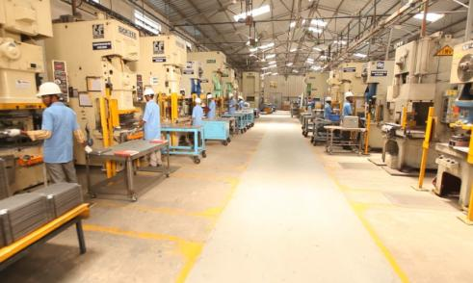
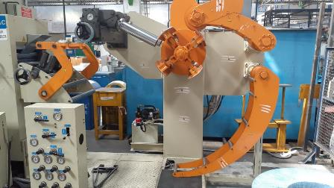
Stamping - Base Raw Materials
Materials | Thickness (in mm) | Grades
Carbon Steel : Cold Rolled , Hot Rolled, Galvanized & Medium To High Carbon steel | CR: 0.5 - 3.0 HR: 3.0 – 8.0 | SECC, SGCC, Galvannealed, Alu Zinc, Magnelis. SPCC, SPCC-EDD, SAE 4130,SAE1018, SAE 1010 SAPH 440, HR-E250,HR-E350, HR 410,4130,1079,1074, C40, C45, C75, C390, C440, DC03, S235JR32
Aluminium : Multiple Grades with tempers | 0.5 - 6.0 | Al 1050 H14, Al 1060 H14, Al 1100 H14, Al 1200 H14, Al 2024 T0, Al 3003 H14/24, Al 5052 H32/T0, Al 5754 H22/H111, Al 5083 T0/H111/H116, Al 6061 T6/T651, Al 6082 T6, Al 6351 T4/T6 Al 7075 T6, Al 8011 H14
Stainless Steel : With varied finishes like brush, hairline | 0.5 - 6.0 | SS : 304,304 L,316, 316L and 430 and 301
Copper : | 0.5 - 8.0 | ETP
Coil Feeder & Straightener (TOMAC)
4 Coil Feeders-Coil Width- Max 400mm, Thickness- Min 0.5 mm- Max 5 mm (Cold rolled/Hot rolled steel)

Slide 22
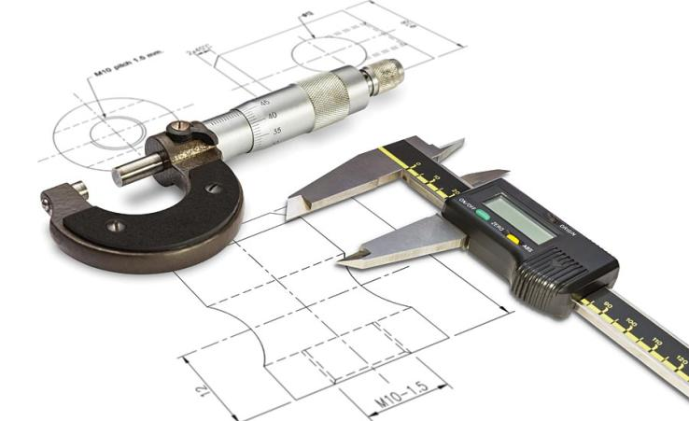
Metrology & Testing
CMM- FARO- 6 Axis
CMM-CARL ZEISS-1000x1600x600 mm
Video Measuring System -300x200 mm
Spectro Photometer
Salt Spray Chamber
Profile Projector
Rockwell Hardness Tester
Density & Surface Roughness Meter

Slide 23
Our Expansion Plan
2023
Feb - High-Speed Stamping 80T, Chennai.
Mar - High-Speed Stamping Line 160T, Harohalli, Bengaluru.
May – Third Party Warehouse, Ohio USA.
Aug – 4kw Fibre Laser, Makali, Bengaluru.
Sep - Robotic Welding Line, Harohalli, Bengaluru.
Nov – Third Party Warehouse, Guadalajara, Mexico.
Dec - Manufacturing Plant (6000 sqm), Dobbaspet, Bengaluru.
2024
Dec - Manufacturing Plant (15000 sqm), Harohalli, Bengaluru.
(Machine shop, Stamping, Fabrication, Powder coating, Painting, Metal-3D Printing)

Slide 24

Products

Slide 25
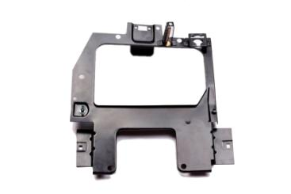
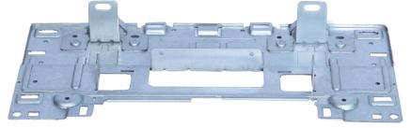
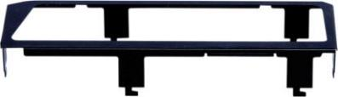
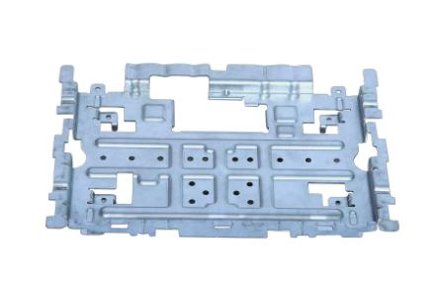
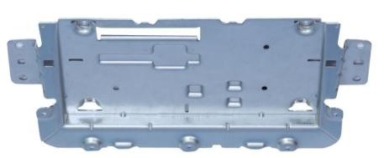
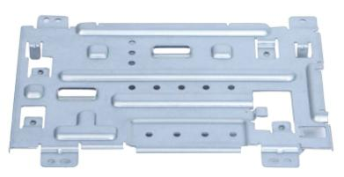
Stamped Components - Automotive

Slide 26
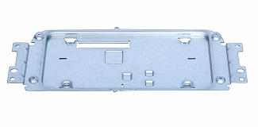
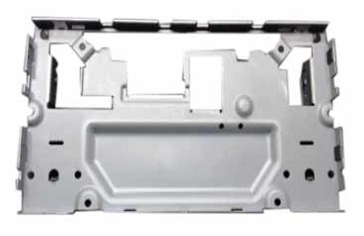
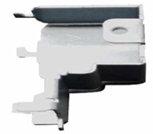
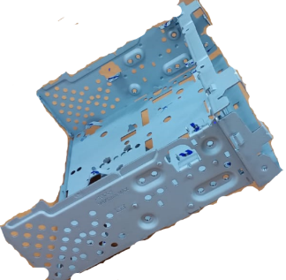
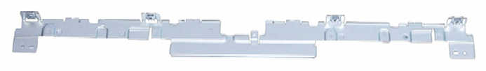
Stamped Components - Automotive

Slide 27
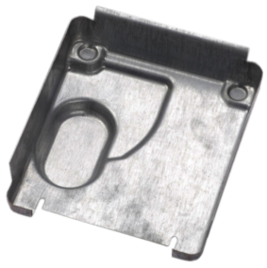
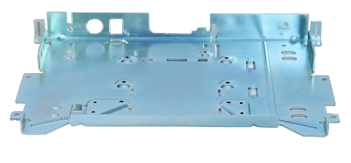
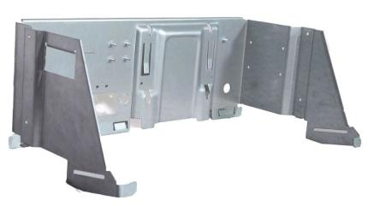
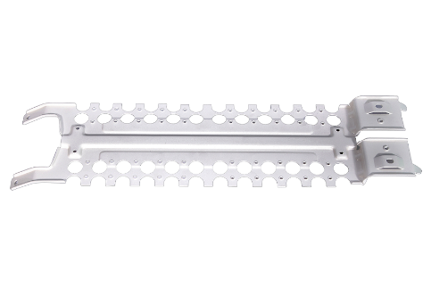
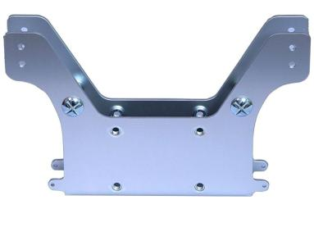
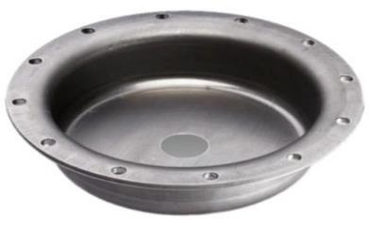
Stamped Components - Industrial

Slide 28
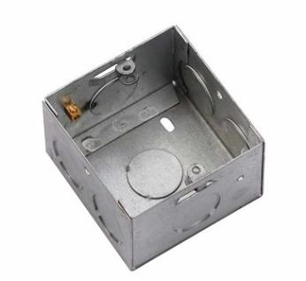
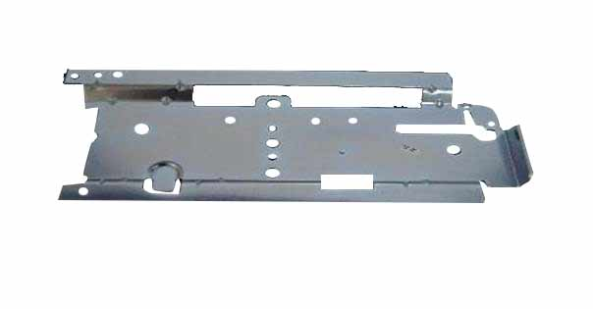



Stamped Components - Industrial

Slide 29

Stamped Components – Industrial

Slide 30





Stamped Components – Industrial

Slide 31


Stamped Components – Industrial

Slide 32







Fabrication - Copper Parts

Slide 33





Fabrication - Copper Parts

Slide 34




Export Shipment - Packaging

Slide 35




Recyclable - Packaging

Slide 36
ESG - Environmental, Social &
Corporate Governance

Slide 37


Our Factories
Powered with Renewable Energy
MAKALI,
BENGALURU
JIGANI,
BENGALURU
HAROHALLI, BENGALURU
Installed Power
550kW
Installed Power
250kW
Installed Power
250kW
Solar Power
500kW
Solar Power
150kW
Solar Power
150kW
Status
Operational Since
Apr-2018
Status
Operational Since
Apr-2019
Status
Operational Since
Nov-2020

Slide 38


Sustainability is
integral in our mechanism
We follow ISO 26000 guidelines for Social Responsibility.
We rank high with a score of 60/100 at the Sustainability Management System of EcoVadis.
We’re a proud member of UN Global Compact, committing ourselves to a principled approach & value-system to doing business.
Commitment to reduce Carbon Emission to 50% by 2025.

Slide 39





We care for the community through our CSR Initiatives
Spastics Society of Karnataka (sponsoring vocational / educational training kits for kids with developmental disabilities)
Indian Cancer Society (supporting hospice providing free palliative care for patients in the last leg of their disease cycle)
Youth For Seva (providing rain coats and school kits for kids attending schools in rural North Karnataka region)
Vardhan Sewa Sansthan (supply of medical equipment for free ultrasound scanning services)
Akshaya Patra Foundation, ISKCON Bengaluru (sponsoring vehicles that distribute mid-day meals to children attending schools in the semi-urban and rural areas near Bengaluru)
Sri Sri Rural Development Trust (implementing solar powered smart classrooms in the Anley & Tangtse region of Ladakh State)

Slide 40


Veer O Metals,
well into its 6th decade,
with more promise & potential..

Slide 41
Contact Us
Plant :
Veer-O-Metals Pvt. Ltd.
Shed No.2; Sy. No: 51/1A; Huskur Road,
Heggadadevapura Village, Dasanapura Hobli,
Bengaluru – 562 123, INDIA.
Phone :+91-80-2371 2195, 2371 2196, +91-97399 91967
Website: www.veerometals.com
Mr. Sham Sunder - Chairman
Mr. Praneet Kumar – Managing Director
Mr. Vaneet Sham Sunder – Director
 +91 99019 05555
E-mail: sales@veerometals.com
Corporate Office :
Veer-O-Metals Pvt. Ltd.
No: A-02, BEL Industrial Estate,
Jalahalli, Bengaluru – 560013, INDIA.
Phone :+ 91-80-23712195 / 23712196

