Slide 1

Corporate Presentation
Group Companies

Slide 2



Group Companies
COSMO GROUP
COSMO FERRITES LIMITED
Backward Integration in chemicals, masterbatches
and adhesives.
An all in one solution to
all pet products,
Accessories and services.
A global leader in speciality films for packaging, labeling, lamination and synthetic paper applications.
Leading manufacturer and exporter of Mn-Zn Based Soft Ferrite Cores for Power Electronic Industries.
Manufacturer of Coils and Transformers

Slide 3




Slide 4
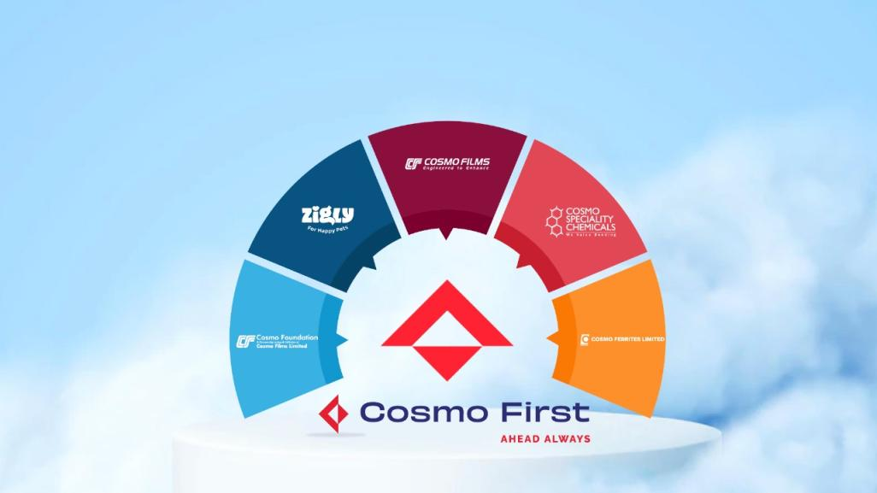
OVERVIEW OF OUR BRANDS

Slide 5


WHY FIRST?
Cosmo at its core has always been pioneering revolutionary innovations to create a better life for the people, the planet, and the community we live in; built on trust, empathy, and compassion.
All through our journey, we have prided ourselves in our ability to provide industry-first niche solutions in the areas of packaging, lamination, industrial and labeling applications. We have made inspiring diversifications into speciality chemicals, consumer care, and D2C retail, aiming to be a pioneer in these previously fragmented industries.
We are today at an exciting time in an exciting age. We have always been first and It is therefore fitting that we have a name that represents this new Cosmo. A name that captures the heartbeat of who we are and a name that we can all truly be proud of.
Cosmo Films from now on is Cosmo First, Ahead Always!

Slide 6









COSMO FILMS LTD
Establishment
Promoter
Established in 1981, Cosmo Films Limited is one of the largest BOPP film players in the world with a sales turnover of USD 311 Million in FY 2018-19.
Promoted by Mr. Ashok Jaipuria, 1st generation entrepreneur, who introduced the country to BOPP Films.
World Leader in Thermal Lam Films
Public Listed
Cosmo Films is the world’s largest producer of thermal lamination films.
The company is listed on the Bombay Stock Exchange (BSE) & National Stock Exchange (NSE), India.
Certifications
Awards & Recognition
ISO 9001:2000
ISO 14001:2004
British Retail Consortium (BRC)
American Institute of Baking (AIB).
Winner of several awards for innovation viz. PFFCA, Asia Star, SIES, SAP Hana, SAP Visionary etc.
Strong R&D Focus
Strong Export Footprints
Collective R&D experience of over 30 years Recently received one patent for Release BOPP Film, holds 6 patents in India and 3 in the US
Have a state of the art R&D centre in Aurangabad.
Leading BOPP Films exporter from India with export to more than 100 countries.

Slide 7

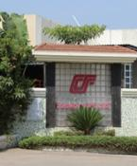
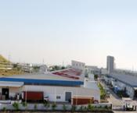
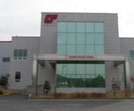
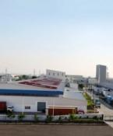
MANUFACTURING FOOTPRINT
Waluj, Aurangabad, India
BOPP- 5 lines
Thermal- 2 lines
Coating -3 lines
Metalizing- 1 line
CPP- 1 line
Shendra, Aurangabad, India
BOPP- 1 line
Thermal- 4 lines
Coating- 2 lines
Metalizing- 1 line
TOTAL INSTALLED CAPACITY
BOPP -2,00,000 TPA (9 lines)
Thermal- 40,000 TPA (7 lines)
Coating- 16,000 TPA (6 lines)
Metalizing - 20,000 TPA (4 lines)
CPP- 9,000 TPA (2 lines)
CSP- 7,200 TPA (1 line)
Karjan, Vadodara,
India
BOPP- 3 lines
Coating - 1 line
Metalizing - 2 lines
CPP - 1 line
CSP - 1 line
Asan, Korea
Thermal- 1 line
* Shrink film production planned in 2022
**BOPET line to be commissioned by 2022

Slide 8

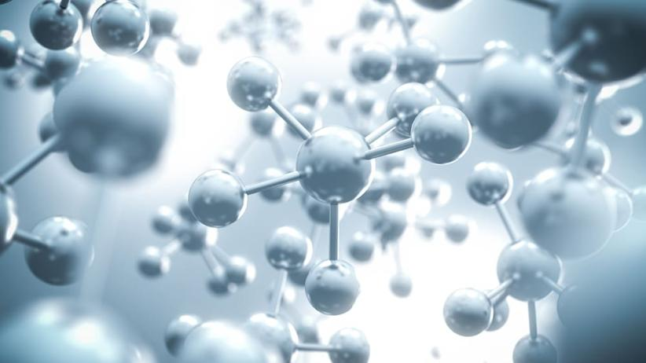
COSMO SPECIALITY CHEMICALS
A 100% Subsidiary of Cosmo Films
COSMO SPECIALITY CHEMICALS
Textile Additives & Chemicals
Master Batches
Adhesives Batches
Textile Additives
Polymer resin
Fillers
Compounding
Adhesives for B2C
Packaging Adhesives

Slide 9


COSMO SPECIALITY CHEMICALS
A 100% Subsidiary of Cosmo Films
Brand Purpose
To enrich lives with chemistry, responsibly.
Mission Statement
To provide eco-friendly consumer centric products that bring
in enhanced functionalities and aesthetics.
Vision
“To be a preferred specialty chemicals company, constantly
innovating for a better & safer tomorrow”.

Slide 10

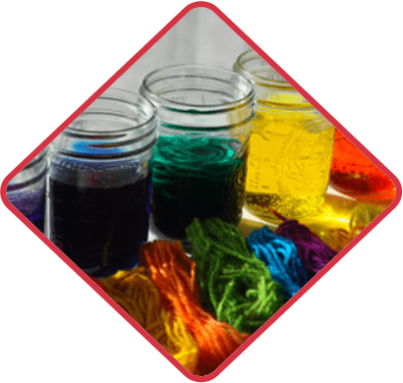
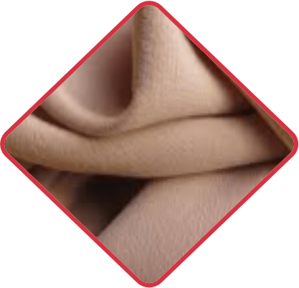
COSMO SPECIALITY CHEMICALS
A 100% Subsidiary of Cosmo Films
Textile Auxiliaries Segments
Development of Textile auxiliaries will be for three segments:
Cotton
Polyester
Nylon
Each segment of textile material will have to pass through the following treatments:
Pre-treatment
Enzymatic desizing, bio scouring, bleach activator
Dying auxiliaries
Lubricating, soaping agent
Finishing
Silicon softener, antiviral

Slide 11





COSMO SPECIALITY CHEMICALS
A 100% Subsidiary of Cosmo Films
Adhesives
800 T/Month by 2025-26
B2C
B2B
PVA Wood
adhesives
Acrylic Construction adhesives
Acrylic PSA
PVA
Lamination
Epoxy for flooring &
Metal bonding
High speed applications.
Very good green bond.
Environmental friendly durable adhesives.
Clear removable.
Linerless PSA.
High bond strength and Quick setting and long term bond.
Termite and humidity resistant.
Admixture for cements better binding and water resistance.
Water proofing polymer additive.
Alternative for mechanical fasteners and rivets.
Excellent for joining dissimilar substrates
Formulations for Low temp curing one component system
User friendly application

Slide 12





ZIGLY
For Happy Pets
Brand Purpose
Happy Pets- Our Purpose is to
give happy and healthy lives to the
furry companions who makes our
lives whole.
Mission Statement
Pet families To provide easy access to reliable, standardized and quality pet care that enhances the joy of pet parenting.
Care Givers To provide steady and
equitable income opportunities to pet
lovers who chose to transform their
passion in to profession.
Vision 2025
“To build India’s largest Pet care
ecosystem connecting Pet families
with compassionate reliable and
competent caregivers”.

Slide 13
BRAND ARCHITECTURE
Cosmo Pet Care
Cosmo Pet Care
Zigly
Zigly Foundation
Zigly Training Academy
Pets familia
by Zigly
Retail Platform
Zigly
Retail Platform
Adoption & awareness
Training Platform
Community
Zigly.com
Zigly Centres
Beboji
Product Private Labels

Slide 14


OUR INNITIATIVES AND ACHIEVEMENTS
Infrastructure
R&D labs with most sophisticated equipment and instruments, one in India & another one in USA.
Some of the equipment & instruments
Barrier Testing (OTR & MVTR).
Differential Scanning Calorimetry (DSC)
Thermo Gravimetric Analysis (TGA )
Dynamic Mechanical Analyzer
Mass Spectrometer (MS).
Optical Microscope.
Dynamic Mechanical Analyzer.
FTIR – Microscope
Scanning Electron Microscope (SEM).
UV spot coating and screen printing.
ANSI Barcode scanner.
UV Flex proof 100.
Achievements
Recognition and certification by Department of Scientific & Industrial Research, Government of India.
Recently received one patent for Release BOPP Film.
Multiple patents with 6 in India and 3 in the US.
Multiple product development Awards such as India star, IFCA STAR and PFFCA STAR awards.
First thermal lamination film to take extrusion coating without the primer.

Slide 15
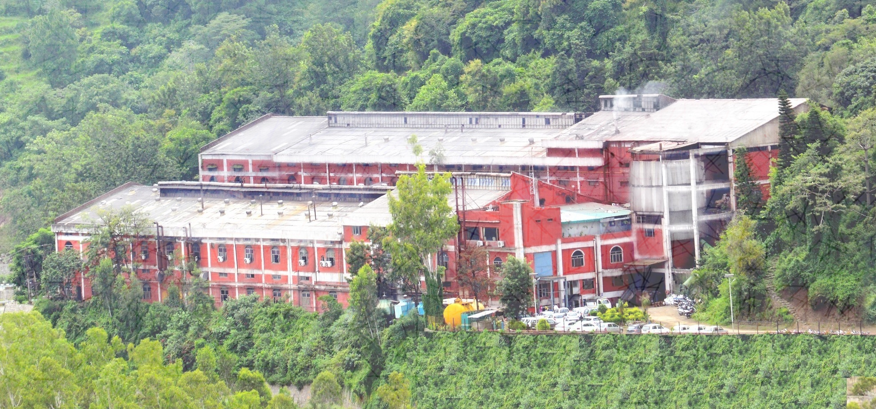
COSMO FERRITES LIMITED
A leading manufacturer of soft ferrite cores

Slide 16





COSMO FERRITES LTD.
Background
Capabilities
Established in 1986. Cosmo Ferrites Limited is one of the largest soft ferrite manufacturer in India with sales turnover of
₹ 1160 Million (USD 16 Million) in FY 22.
Mn-Zn based Soft Ferrites capacity 3600 MT.
In house Ferrite Powder capacity 3600 MT.
Accreditations
ISO 9001:2015
ISO 14001:2015
ISO/TS 16949
UL94 V-0
Stake Holders
Mr. Ashok Jaipuria
1st Generation Entrepreneur, introduced the country to Soft Ferrite Cores.
Mr. Ambrish Jaipuria
CEO & Executive Director at Cosmo Ferrites Ltd.

Slide 17
Who We Are
Manufacturing Plant Located in the foothills of Himalaya. Area 20600 sq m. | PUBLIC LISTED Listed on the Bombay Stock Exchange (BSE) | EMPLOYEES 720+ employees
VISION To become the Product and Quality leader of soft ferrite cores. | MISSION We endeavour to be an organization which delivers outstanding customer service, respects all individuals working with it and always encourages initiative & innovation | VALUES Conduct business with integrity and fairness. Focus on our customer’s need. Excellence in quality & customer service. Mutual respect and teamwork.

Slide 18

Cosmo Ferrites Journey So Far
In-house R&D setup with the help of DSIR (GoI)
5 new materials and few shapes introduced
Component capacity expanded with installation of state-of-art kiln of 650 MT to meet growing demand of the market
Two 50T Dorst Presses, one Hydraulic cum Dorst of 100T and a new kiln 750 MT to enhance capacity
Increased capacity by another 750 MT and accelerated the export business to more than 50 countries
Established in 1987 Cosmo Ferrites Ltd. commenced its production with an annual capacity of 500 MT
Powder and component capacity enhanced to 1500 MT & 600 MT respectively
Further expanded its component capacity by 250 MT to meet increasing global market demand
New vertical Alisha Coils & Transformers introduced to bridge the gap and offer customized solutions
Production capacity increased by 1200 MT with installation of new kiln in the plant
R&D
Productivity
Addition
Global Leader
Incorporated
Growth
Expand
New Vertical
Augmentation
1986
1987
1988
1994
1995 2000
2001
2005
2006
2010
2010
2014
2015
2016
2016
2021
2022 2023
www.cosmoferrites.com

Slide 19
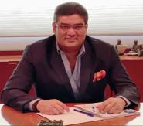
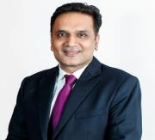
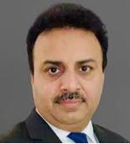
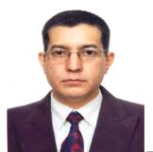
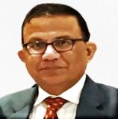
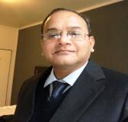
Leadership Team
Mr. Ambrish Jaipuria
Chairman
Mr. Pankaj Poddar
Group CEO
Mr. Vikas Puri
Business Head
Mr. Sanjeev Katoch
General Manager
Mr. Sanjiv Jindal
Chief Financial Officer
Mr. K Sriram
AGM (Operations and R&D)

Slide 20
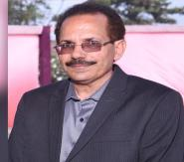
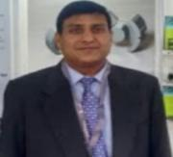
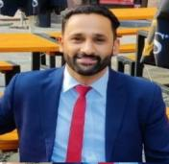

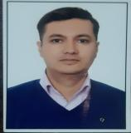
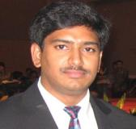
Professional Team
Mr. Ramesh Chaudhary
AGM (SMC, IT & Costing)
Mr. P K Jain
Sr. Manager (Domestic Marketing)
Mr. Pradeep Sharma
Manager (Export Marketing)
Mr. Ravi Luthra
Manager HR
Mr. Rajesh Kumar
Manager Purchase
Mr. Satya PVV
Business Head ACT

Slide 21
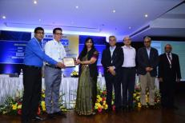
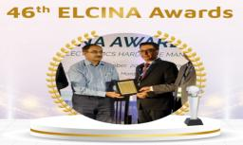
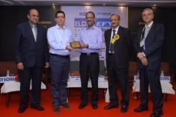
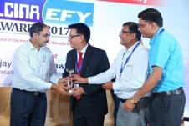
Awards
Recognized by ELCINA Awards for continuous growth and development.
ELCINA-EFY Certificate of Merit for Outstanding Achievement in “Exports/Large Scale” Year 2016-17
ELCINA-EFY Certificate of Merit for Outstanding Achievement in “Exports” Year 2020-21
ELCINA-EFY Certificate of Merit for Outstanding Achievement in “Exports/Large Scale” Year 2013-14
43rd ELCINA-EFY Award for Outstanding Achievement in “Exports/Large Scale” Year 2017-18

Slide 22
Business Journey
Sales Revenue
Geography Wise %

Slide 23












Our Customers - Domestic

Slide 24












Our Customers - Domestic

Slide 25












Our Customers - Export

Slide 26


Company Presence Global
1
64 % - Asia
India | China | Sri Lanka
Thailand | Taiwan
Malaysia | Vietnam | Japan
2
28 % - Europe
Germany | Italy | Poland
Czech Republic | Spain
United Kingdom | France Ukraine | Denmark
3
3 % - North America
United States of America
4
3 % - Turkey
5
1% - Others
Africa| Brazil| Latin America | Oceania

Slide 27
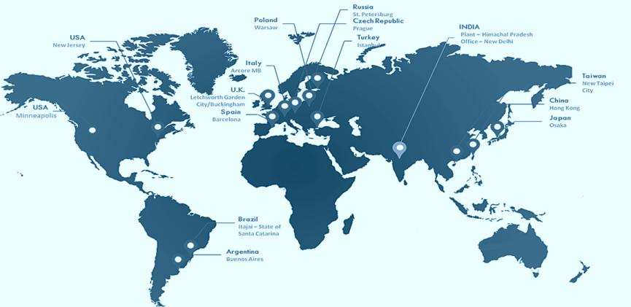
Distributor Network

Slide 28
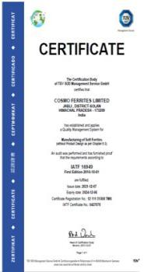
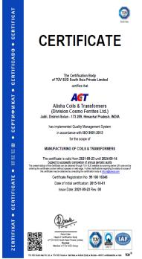
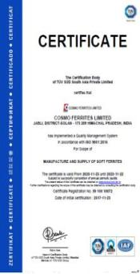
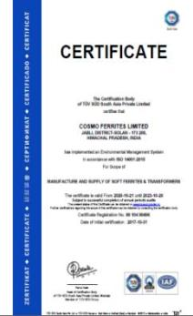
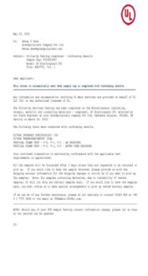
Compliance with Global Standards
IATF 16949
ISO 9001:2015
(ACT)
ISO 9001:2015
(CFR)
ISO 14001:2015
UL94 V-0 Approved
Coating

Slide 29

ALISHA COILS & TRANSFORMERS
(A Unit of Cosmo Ferrites Limited)
Was setup in 2015 with a vision to move into forward integration in Soft Ferrite Industry.
Our Ferrite Core Transformers and allied products are manufactured as per the international standards of quality and safety.
All safety rules and regulations are strictly followed in making our products.
Intense quality check takes place right from the stage of procurement of the raw materials to the final stage of the delivery of the finished product.

Slide 30



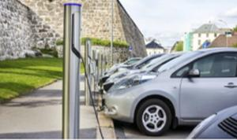
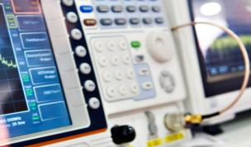

Segments We Serve
Automotive
Antenna, Sensors
Solar
Inverter, Current Sensor
Industrial Electronics
Medical , Power Supplies
Electric Vehicle
Battery Charger, OBD, Wireless Charging
EMI Filters
Line Filter, Choke
Lighting
Inductor, Transformer

Slide 31



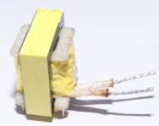
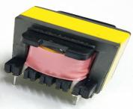
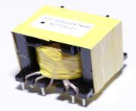
Product Categories – ACT
BLDC
LIGHTING
E-Vehicle
DC-DC Converter
AC-DC Converter
Motor Controller
Battery Charger
Fan Driver
Motor Controller
Electronic ballast for energy efficient lamps
Electronic chokes for Tubular Lamps

Slide 32



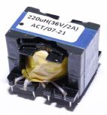
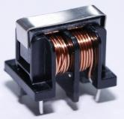
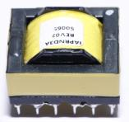
Product Categories- ACT
POWER CONDITIONING
EMI FILTERS
CHARGERS
E-Vehicle
BLDC
Medical electronics
Telecom
SMPS
Induction
Battery Chargers
Solar invertors
Sensors
Mobile Charger
Setup Box Charger
RO Charger
Adopters

Slide 33
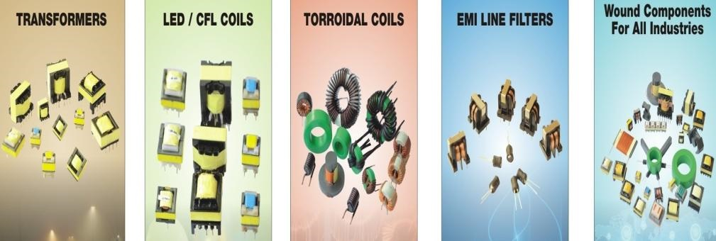
PRODUCT RANGE

Slide 34
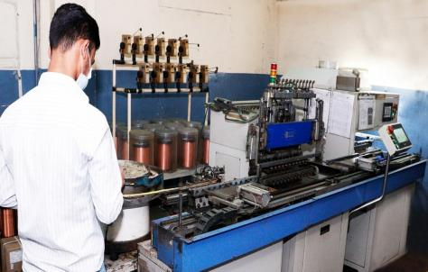
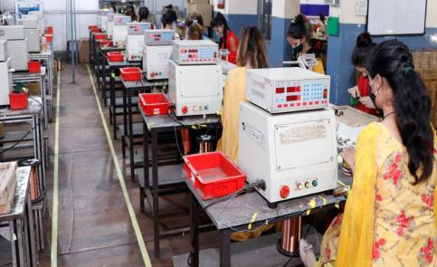
CAPACITY
MULTI SPINDLE LINE
SINGLE SPINDLE LINE
60Mn Pcs/Annum
5.5Mn Pcs/Annum

Slide 35
Product Categories- Ferrites
Toroid (With and Without Coating)
Sizes Available from 06 mm to 202 mm
Application - Wide Band and Pulse Transformers and Common Mode Chokes
UU Cores
Sizes Available from 10 mm to 141 mm
Application – Power Transformer and Inductors
Sizes Available from 10 mm to 128 mm
Application – Power Transformer and Inductors
EE Cores
Pot Cores
Sizes Available from 14 mm to 36 mm
RM Cores
Sizes Available from 05 mm to 14 mm
EER/ETD Cores
Sizes Available from 29 mm to 59 mm
Application – Power Transformer and Inductors
Application – Power Transformers, Power Inductors, Converters, Inverters, SMPS and Filter Inductors
Application – Power and Wide Band Transformer; High Q Inductors and Tuned Transformers

Slide 36
Product Categories- Ferrites
PQ Cores
Sizes Available from 20 mm to 71 mm
Application – Power Transformer and Inductors
EC Cores
Sizes Available from 35 mm to 90 mm
Application – Power Transformer and Inductors
PM Cores
Sizes Available from 50 mm to 87 mm
Application – Power Conversion Transformer
Planar Cores
Sizes Available from 18 mm to 153 mm
Application – Differential Inductors and DC/DC, AC/DC converters
I Bars, Plates
Sizes Available from 20 mm to 186 mm
Application – Antennas, High Frequency Welding, EV Charging.
EFF Cores
Sizes Available from 15 mm to 30 mm
Application – Excellent space utilization for transformers and inductors

Slide 37



Our Approach to Sustainability
Technology
Environment
Values
Customized innovation
Ahead in product development curve
Wide product portfolio under one roof.
Carbon footprints reduction
People health , safety and well beings
Flexibility in job -line allocation
Risk management practices.
Transparency and accountability
Effective Internal Control Environment

Slide 38
Operation & Infrastructure
Annual Powder Production capacity - 3600 Tons
Hydraulic Press
Dorst Press
Rotary Press
Annual Ferrite Production Capacity- 3600 Tons
Rotary Grinder
Precision Grinder
2 Station Grinders
4 Station Grinders
Powder Processing
Pressing
Sintering
Grinding

Slide 39
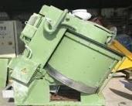
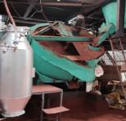
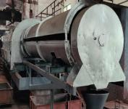
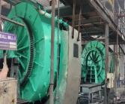
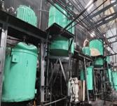
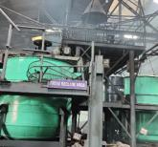
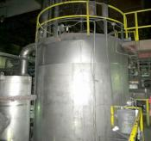
Powder Production Process
Mixing & Homogenizing
(Eirich Dry Mixer)
Pelletizing
(Pelletizer)
Pre sintering
( Rotary kiln)
Coarse Milling
(Ball Mill)
Fine Milling
(Attritor mill)
Organic Mixing
(Slurry Tank)
Spray Drying & granulation
(Spray Dryer)

Slide 40
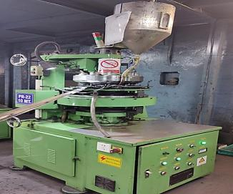
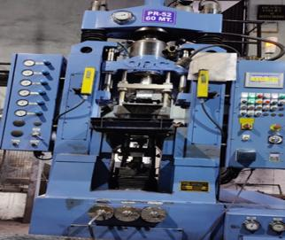

Pressing Process
ROTARY
Smaller geometry
0.5-24 g green core weight /pc
DORST
Medium geometry
25 g - 350 g green core weight /pc.
HYDRAULIC
Larger geometry
350 g to 2 kg green core weight /pc.

Slide 41

Sintering
Kiln 1
Year of installation 2011
Brand - Reidhammer
Capacity-70 MT/month
Kiln 2
Kiln 3
Kiln 4
Brand - Reidhammer
Brand - Reidhammer
Capacity-75 MT/month
Year of installation 2015
Brand – CTEC
Capacity-100 MT/month
Year of installation 2022
Kiln 5
Brand - Reidhammer
Capacity-20 MT/month
Year of installation 2007
Year of installation 1996
Capacity-35 MT/month

Slide 42




Grinding
  Rotary Grinder
  Precision Grinder
  2 Station Automatic Grinding Line
  4 Station Automatic Grinding Line

Slide 43

Expansion Plan: Increasing Capacity of Powder Production
3600 MT / annum to 6600 MT/Annum
SOP - Q 4 2022
Salient features
Compact production system
Precise batch composition
Continuous and efficient process
Improved process control

Slide 44

Expansion Plan: Top Hat Kiln for Sintering 10000 to 14000 µi
Capacity of 300 MT / annum
SOP Q3 -2022
Salient features
Sintering of high end materials with improved performance
Precise atmospheric control
Perfect system for
high permeability ( µi 10000 )
Ultra low loss power material( 80 kw/m³ at 500 KHz)
Ultra high saturation ( B _{sat} 600 mT at 25°C )

Slide 45
Expansion Plan: Indigenization of Raw Material Sources
Focus
Mitigating supply chain interruption and geopolitical issues of raw material import
Orientation towards Make in India
Reducing dependency on China
Ensuring availability of quality raw materials
Manganese Oxide
Setting up a Manganese Oxide plant of capacity 1200 MT / annum SOP - Q3 - 2022)
Cosmo patented technology (patent no –219969 ) on extraction of Mn-Oxide from Ores
Zinc Oxide
Local sources developed & fully used for regular production
Iron Oxide
Successfully developed local sources for supply of quality iron Oxide

Slide 46

Future Expansion Plan- FY24
State-of- The-Art Infrastructure & Building for Ferrite Production

Slide 47
R&D, Quality & Technology

Slide 48





About Ferrites
Ferrite
(A class of advanced electro-ceramics having magnetic properties which contains iron oxide as a major ingredient)
Soft Ferrite
(Inductors & transformer)
Ni-Zn Ferrite
FY24
(For EMI / EMC with high impedance)
Hard Ferrite
(Permanent magnet)
Mn-Zn Ferrite
- Low loss material for efficient power transmission
- High permeability material for filter application

Slide 49


Ferrite Material Profile
POWER GRADE MATERIAL/ LOW LOSS MATERIAL
HIGH PERMEABILITY MATERIAL
Key properties
Low power loss
High magnetic flux density
High Curie Temperature
Key properties
High permeability
Low loss factor
No. of material grades available in Cosmo- 09
No. of material grades available in Cosmo- 08
Typical Grades- CF 292 (High B_{sat} ), CF297 (low loss), CF295 (temperature stability), CF 139 (moderate power loss)
Typical Grades- CF 195 (µi 5000), CF 190 (µi 6000), CF 197(µi 7000), CF 199 (µi 9000), )

Slide 50
Quality Management Principles
Customer-Centric Organization
People involvement
Process Approach
Systematic Approach :- Indigenous ERP to track traceability, control and access to every stage with progress status.
Continual Improvement plans and its tracking
Factual Approach to Decision Making
Mutually Beneficial Supplier Relationships

Slide 51
Quality Tools Practiced
Lean Six Sigma
Measurement System Analysis (MSA)
Total Preventive Maintenance (TPM)
Customer complain reduced ( FY 2020-21 vs 2021-22) : 30%
Reduced customer returns of total sale ( FY 2020-21 vs 2021-22): 0.65% - 0.3%

Slide 52
Quality Compliance
Our products conform to IEC standard for all electrical and mechanical parameters of ferrite.
Compliant with RoHS and REACH standards
International Electrotechnical Commission (IEC)
A leading global organization head quartered at Geneva ,Switzerland that sets the International Standards for all electrical, electronics and related technologies.

Slide 53
Quality Gates
Raw Material Inspection
XRF analysis, SSA, Particle size distribution
Powder
Preparation
XRF, SSA, Granulate Size distribution, Bulk Density, Moisture content, Granulate flowability
Pressing
Visual, Dimensions, Green Density
Packing
Quality Assurance
Grinding and Finishing
Visual Checking, Dimensions, Electrical Properties
Sintering
Visual Checking, Dimensions, Sintered density, Electrical Properties
Final Testing

Slide 54
Material Development-Ongoing R&D Projects
Present portfolio
Target profile
Low loss at 500 KHz
Material Grade: CF249
Power loss : 80 kw/m³ at 500 kHz, 100°C, 50 mT
Low loss at 3 MHz
Material Grade: CF250
Power loss : 800 kw/m³ at 3 MHz, 100°C, 30 mT
Power
Material
Ultra low loss at 100 KHz, 200 mT
Material Grade: CF298
Power loss : 250 kw/m³ at 100°C, 100 KHz, 200 mT
Low loss at 100°C
Material Grade: CF297
Power loss : 400 kw/m³ at 100°C, 100 KHz, 200 mT
Low loss at high ambient temperature (140°C)
Material Grade: 289
Power loss : 400 kw/m³ at 140°C, 100 KHz, 200 mT
High saturation
Material Grade: CF292
Saturation : 480 mT at 25°C, 10 KHz , 1200 A/m
Ultra high saturation
Material Grade: CF293
Saturation : 600 mT at 25°C, 10 KHz , 1200 A/m
High Permeability Material
Average µi 10000 at 10 KHz, 25°C with improved frequency response upto 200 KHz
Material Grade: CF199 A
Average µi 9000 at 10 KHz, 25°C
Material Grade: CF199

Slide 55
R&D Roadmap(2022-2025)
CF 298
Q2’2024-25
CF 289
Q4’2023-24
CF 250
Q2’2023-24
CF 293
Q1’2023-24
CF 249
Q4’2022-23
CF 199A
Q2’2022-23

Slide 56








R&D Resource Center
Material characterisation & quality control
Computerised BET surface analyser for determining specific surface area of powder materials
XRF for determination of material composition and purity level accurately
Particle size analyser for determination of particle size distribution in powder material
Product synthesis and evaluation
Atmosphere controlled kiln
Powerloss set up
Transformer analyser
LCR Meter
Hi-Pot tester

Slide 57




Expansion of R&D Resource Center
(Planned)
Powerloss combined with B-H loop tracer capable to measure upto 3 MHz= Planned in Q2 ‘2022-23
Precision Impedance analyzer capable to measure up-to 100 MHz- Planned in Q4’2022-23
High resolution digital microscope (1000 x) for determining granulate shape, size, defects and micro crack –Planned in Q3’2022-23
XRD for determination of crystalline phases present in ferrite system-Planned in 2023-24

Slide 58
Ferrite Application

Slide 59




Application Team
Mr. Binod Aggarwal
Expert in Power Electronics Application
M Tech in Power Electronics from IISC (Bangalore)
Dr Palas K. Haldar
Expert in Electro ceramics
M Tech , Ph. D in Material Science from University of Calcutta
Mr Karuna Sagar
New Product Development
M Tech in Material Science from Thapar University, Patiala
Mr Binod Agarwal brings with him more than 35 years of experience in companies like Cree, Wolfspeed.
He’s having number of patents in power electronics field like :-
Dr Palas K. Haldar has papers published in various international and national journal in the field of ceramics .
Description | Patent Number
Totem pole converter system. | 10224809
Hybrid analog and digital converter controller. | 9606564
Boost converter with reduced switching loss and method of operating the same. | 9564806
Control system for a flow cell battery. | 9035617
Bi-directional buck boost circuit. | 8723489
Solar power systems including control hub. | 20140285023
Mr Vikas Thakur
Application Engineer
B Tech in Electronics & Communication from HPTU,Simla.

Slide 60
Application
EV Charger
Integrated Magnetics(Inductor+ Transformer)
Working on optimized shape of transformer and magnetic volume.
Cost Effective
Better Performance
Distributed gap magnetics for PFC converters and resonance inductors for LLC converters.
Better Performance at higher frequencies
Integrating shim inductors along with transformer for PSFB topology.
Integrating common mode choke and differential mode chokes in one common magnetic structure.

Slide 61

Shapes under consideration
Torroid core with a central limb. Main magnetizing inductance is controlled by the torroid and leakage can be designed with the central limb.
Planar core with 2 section in the middle instead of conventional single.
EE core with un-equal limb core areas and unequal limb air gaps.
PQ core with double central limbs with equal or un-equal area.

Slide 62
Comparison
1kW,100kHz,V_{in}=400V, V_{out}=40V, Limb area=125mm²,L_{m}=250µH, L_{r}=51µH
 | Tr3 (Un-equal gap) |  |  | Tr2 (Un-equal gap) |  |  | Tr2 ( Equal gap) |  |  | Separate Xformer | Separate Inductor | Total
Primary turns | 72.4 |  |  | 73.1 |  |  | 65.9 |  |  | 27.15 | 36.5
Sec turns | 7.84 |  |  | 7.97 |  |  | 12 |  |  | 5.43 | NA
Copper loss(W) | 4.48 |  |  | 3.97 |  |  | 4.53 |  |  | 3.08 | 1.98 | 5.06
Core loss(W) | 1.59 |  |  | 1.6 |  |  | 1.81 |  |  | 1.63 | .653 | 2.2
Copper weight | 80.5 |  |  | 81.8 |  |  | 94 |  |  | 59 | 47.2 | 106.2
Core weight | 76.3 |  |  | 76.7 |  |  | 87 |  |  | 74 | 36 | 110
Gap(Left, center, right)mm | 1.7 | .1 | 1.7 | 3.5 | .9 | .1 | 1.5 | 1.5 | 1.5 | .68 | 3.9
Flux density
Note: comparison at 100Khz,1KW and a max flux density of 100mT, separate transformer and inductor are on PQ core whereas for others, cylindrical 3 limb structure has been assumed.

Slide 63



DISTRIBUTED AIR GAP DESIGN OF THE INDUCTOR
Fringing of the flux near air gap is increased due to air gap. Larger air gap means more fringing Fig(a) (top left).
Fringing of the flux near the air gap causes extra eddy current losses in nearby conductors Fig(b) (top right).
Fringing effect can be substantially reduced by providing 3 or more smaller air gaps Fig(c) (bottom).
Fringing reduces the effective air gap of the core.
Eddy current effect shall be more pronounced in LLC inductor and transformers compared to PFC inductor.
One of the main dis-advantages of the ferrite core is that it saturates suddenly . This also can be reduced with distributed core.

Slide 64


Integrating Common mode and differential mode choke.
Different configurations are possible. One possibility is with EE core.
Other possibility is with toroid by adding another central limb.
Differential mode inductance may be tweaked by putting extra winding on the central limb.
Be careful about the flux in right and left limb as flux due to differential mode adds in one and subtracts in another.
Good estimation of common mode current is needed to compute correct flux density in core.
Need to develop a model for impedance curve vs frqeuency .
Better efficiency and material saving by integrating common mode and differential mode chokes

Slide 65
Reach Us
NEW DELHI
Head Quarters:
517, 5th Floor, DLF Tower-A,
New District Centre, Jasola,
New Delhi – 110 025, India
HIMACHAL PRADESH
Regd. Office and Works
Post Office – Jabli
District – Solan
Himachal Pradesh – 173 209
India
Email-Id:
sales@cosmoferrites.com

Slide 66
Thank You

