Slide 1
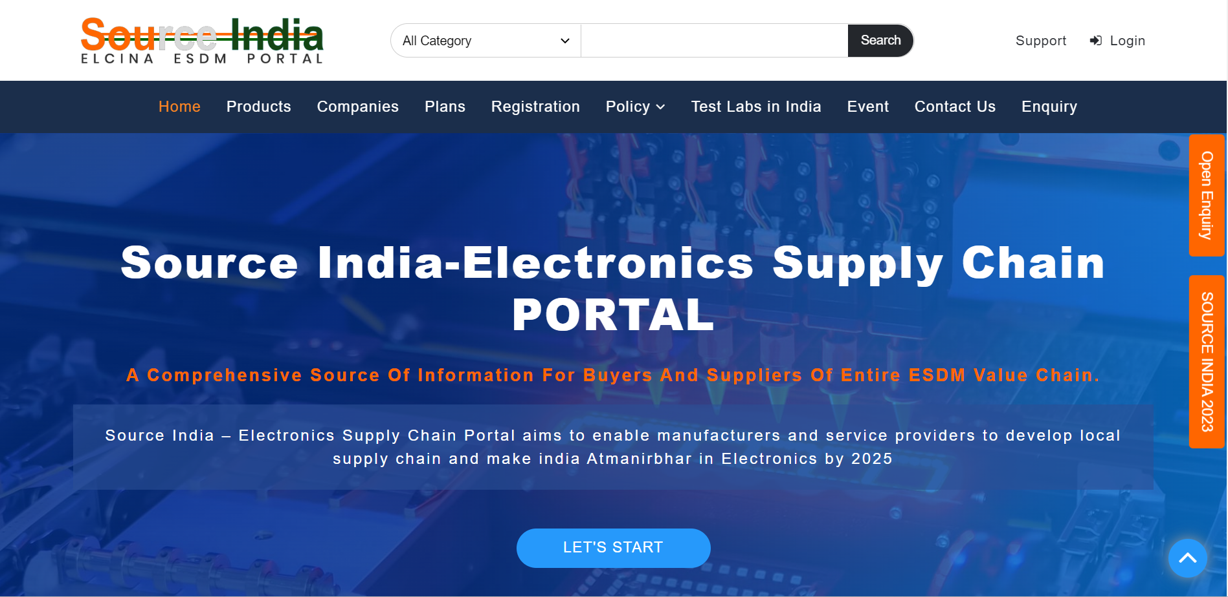

Slide 2
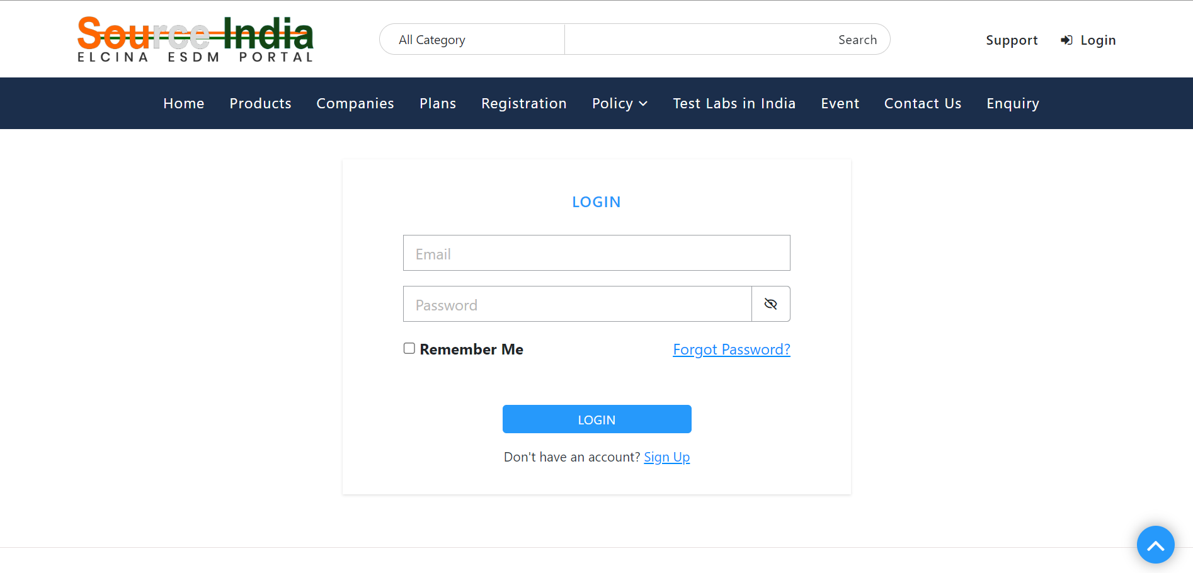
Log in with username and password

Slide 3
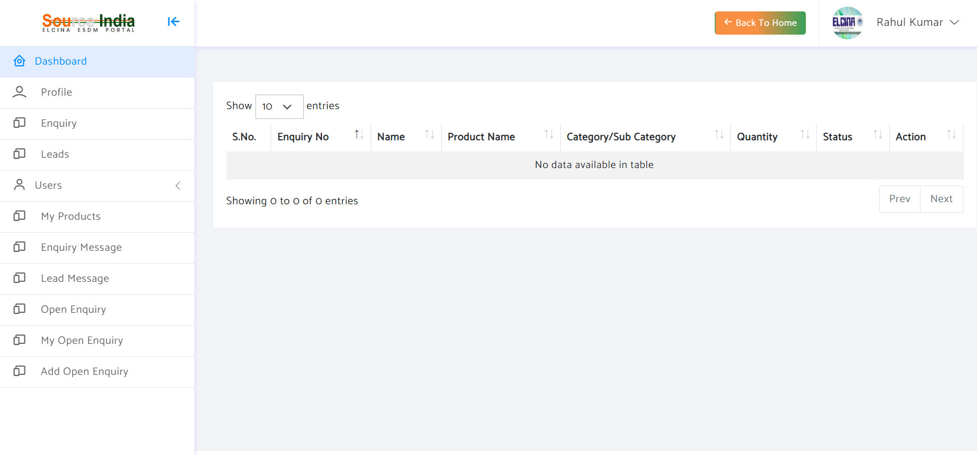
Landing page once you Log In

Slide 4
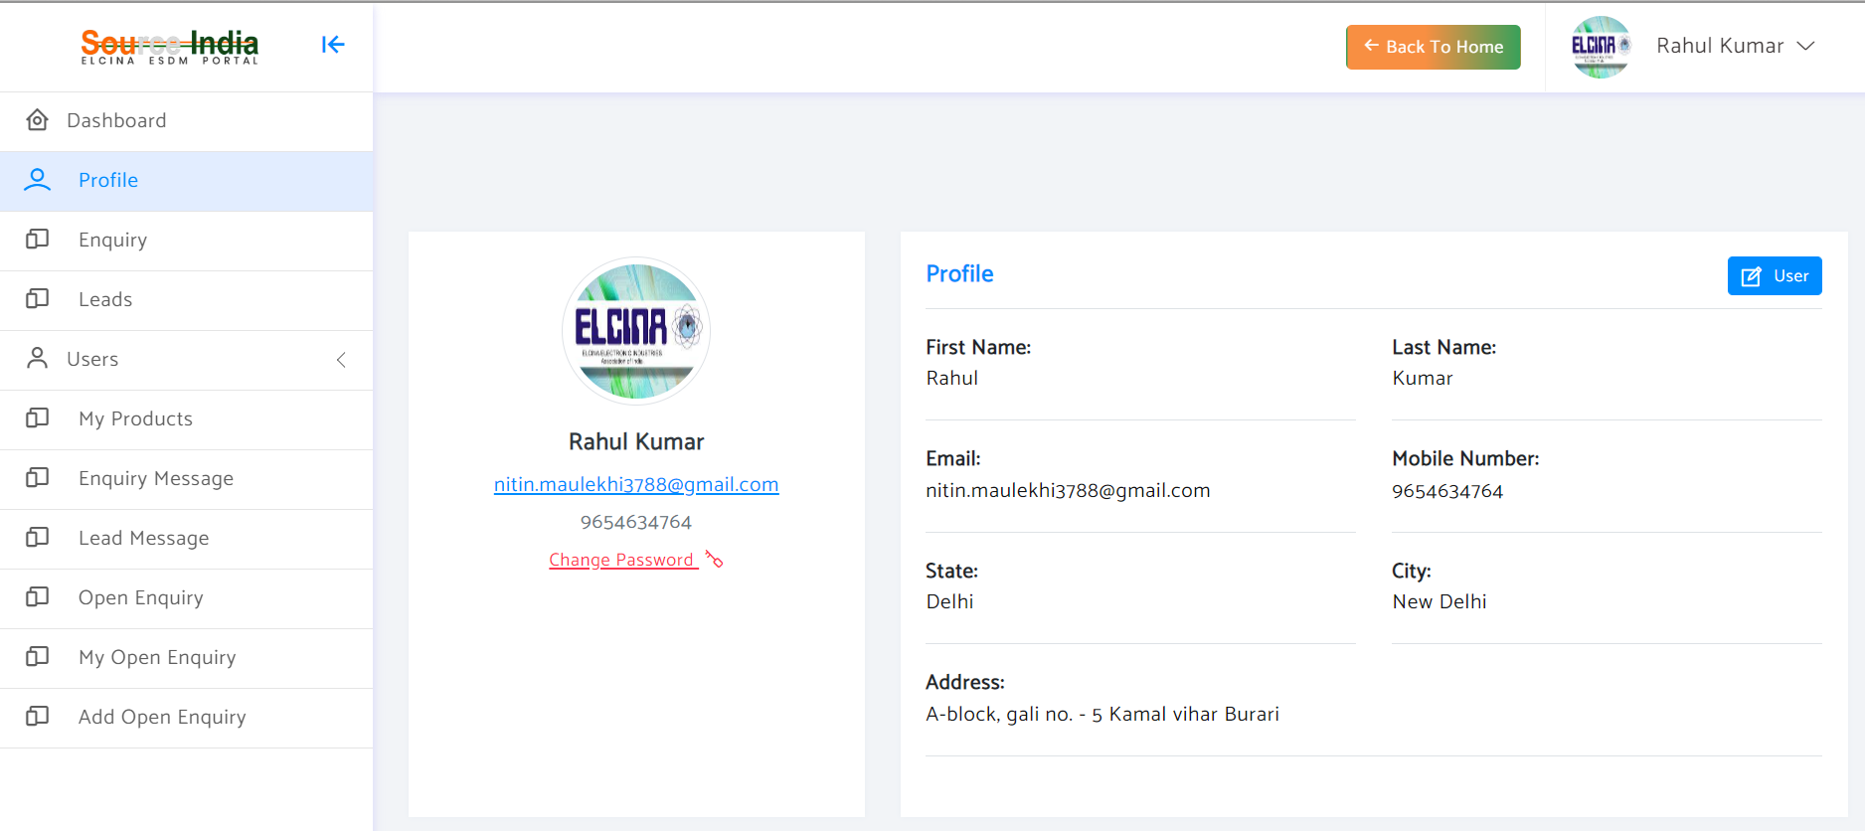
To edit your profile, click on "User"

Slide 5
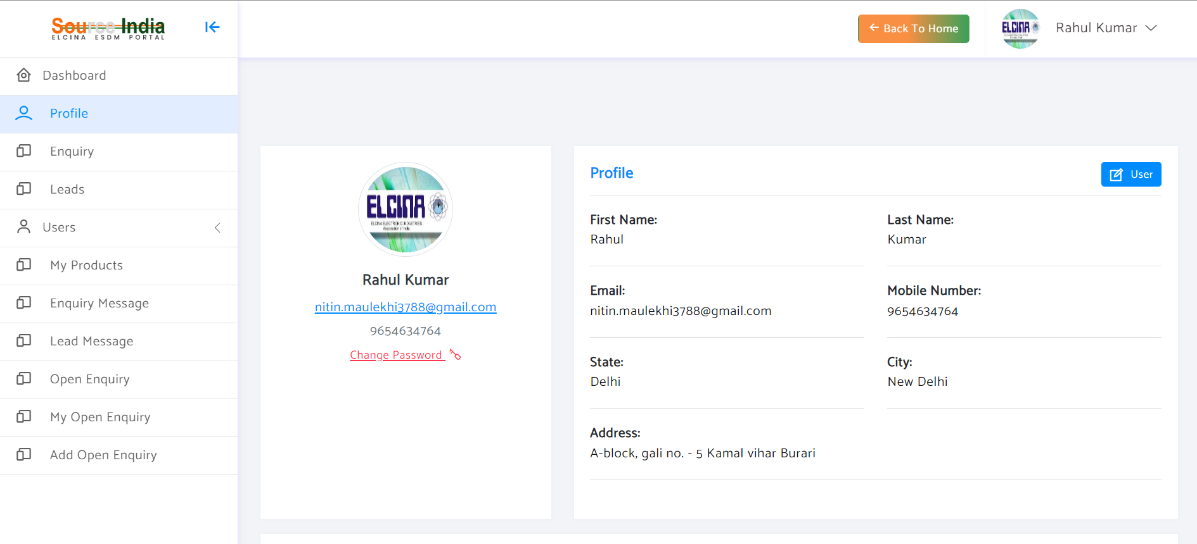
IT is advised to change your password on first login

Slide 6
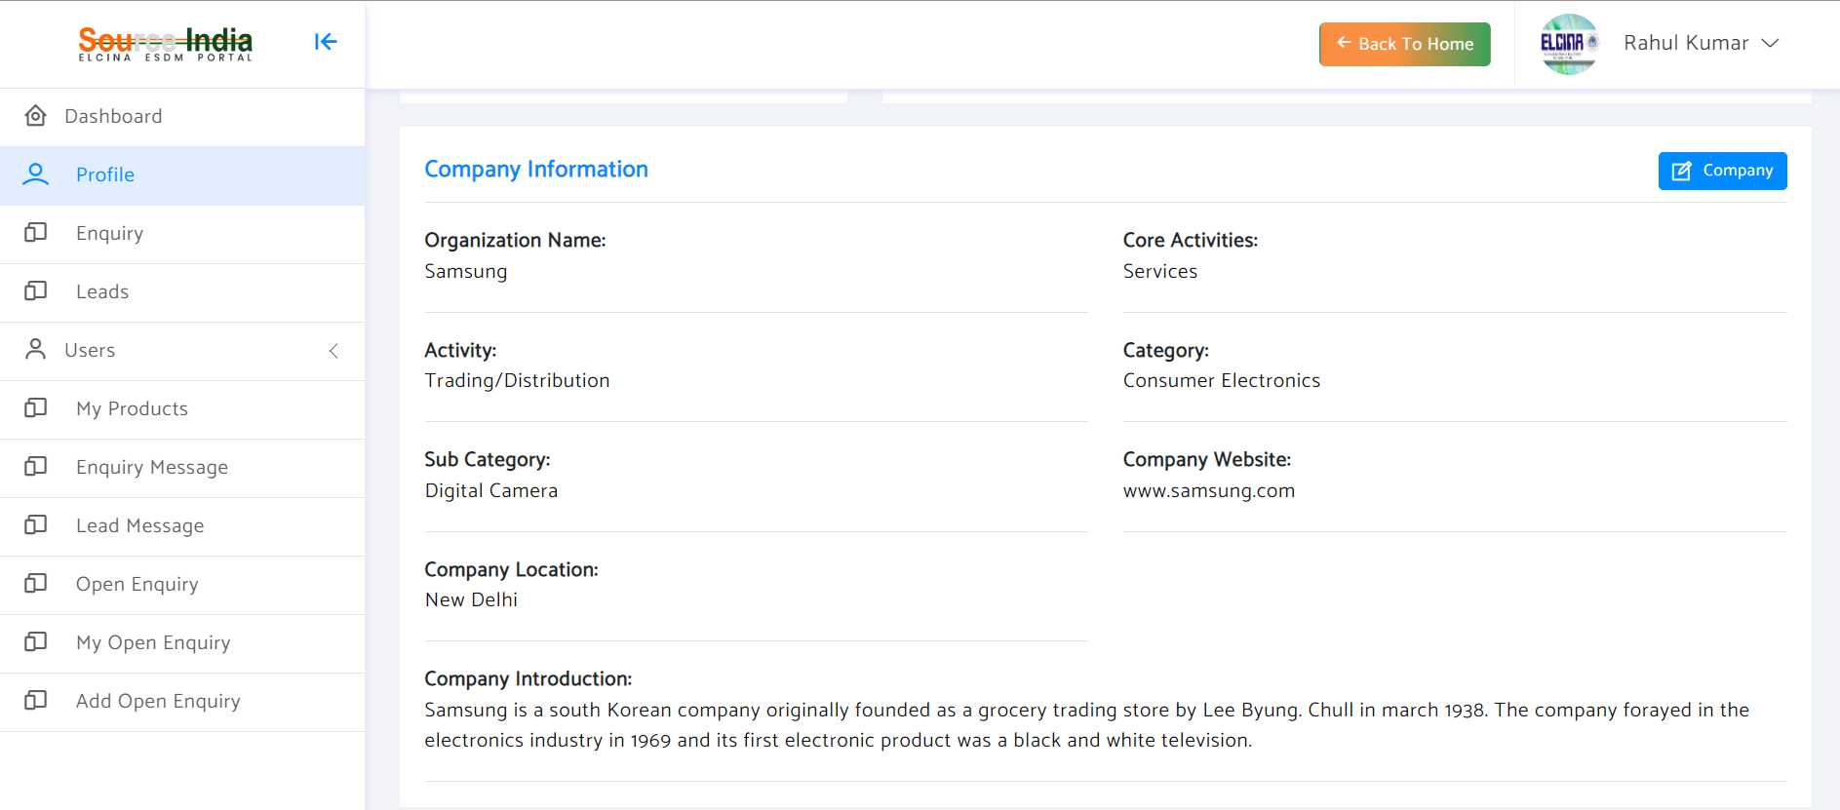
To edit your company profile, click on "Company"

Slide 7
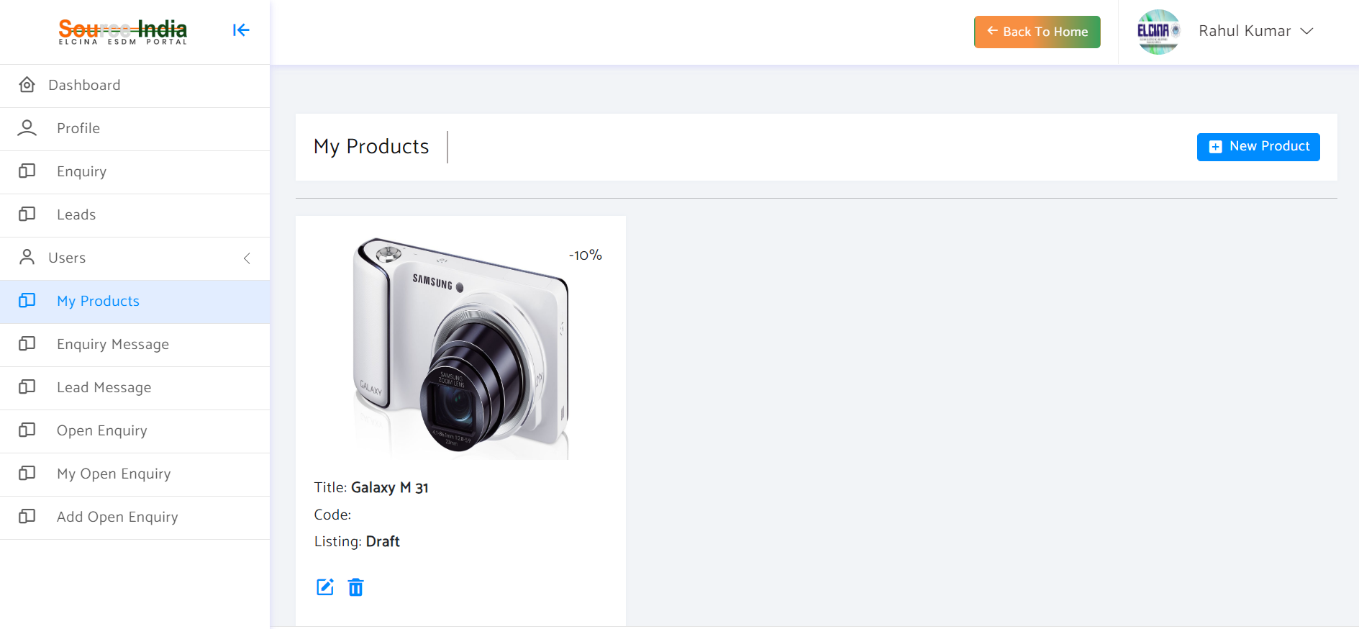
To add your products, click "New Product"

Slide 8
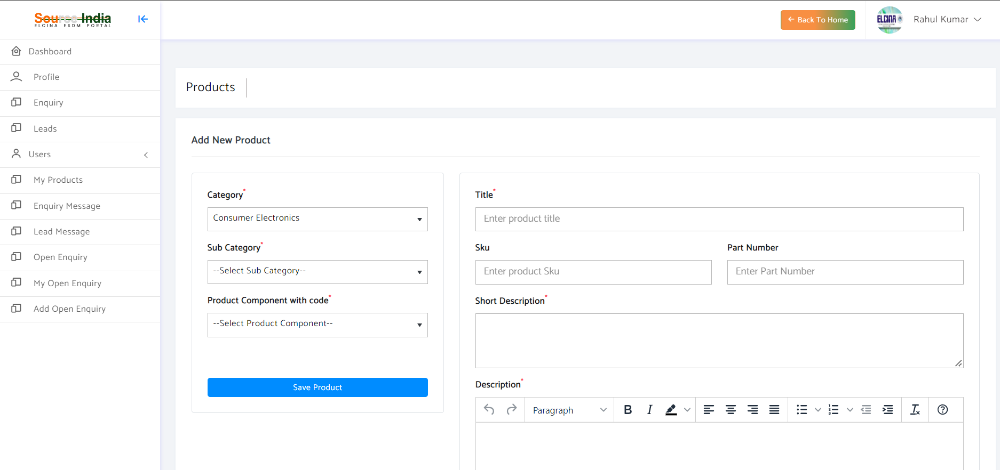
Add product details and save

Slide 9

Later if required you can edit your product

Slide 10
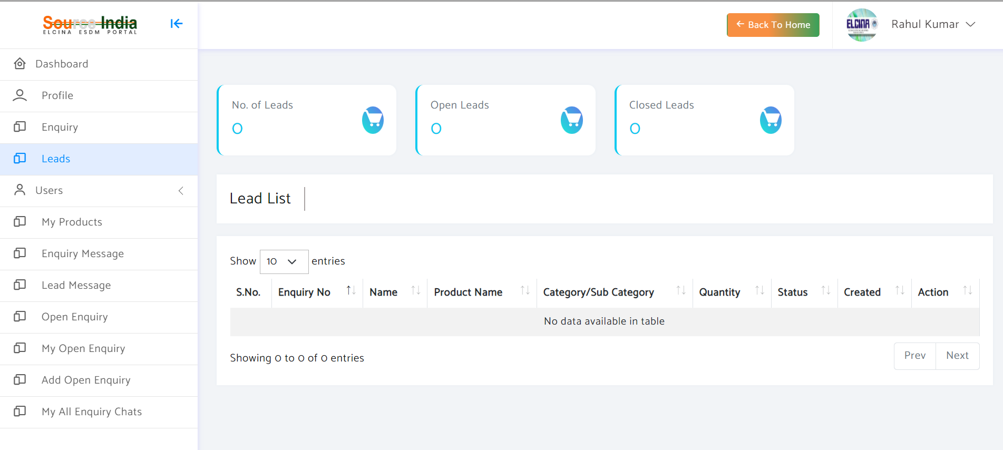
Here you can see all the "Leads" which you have received from other "Buyers"

Slide 11
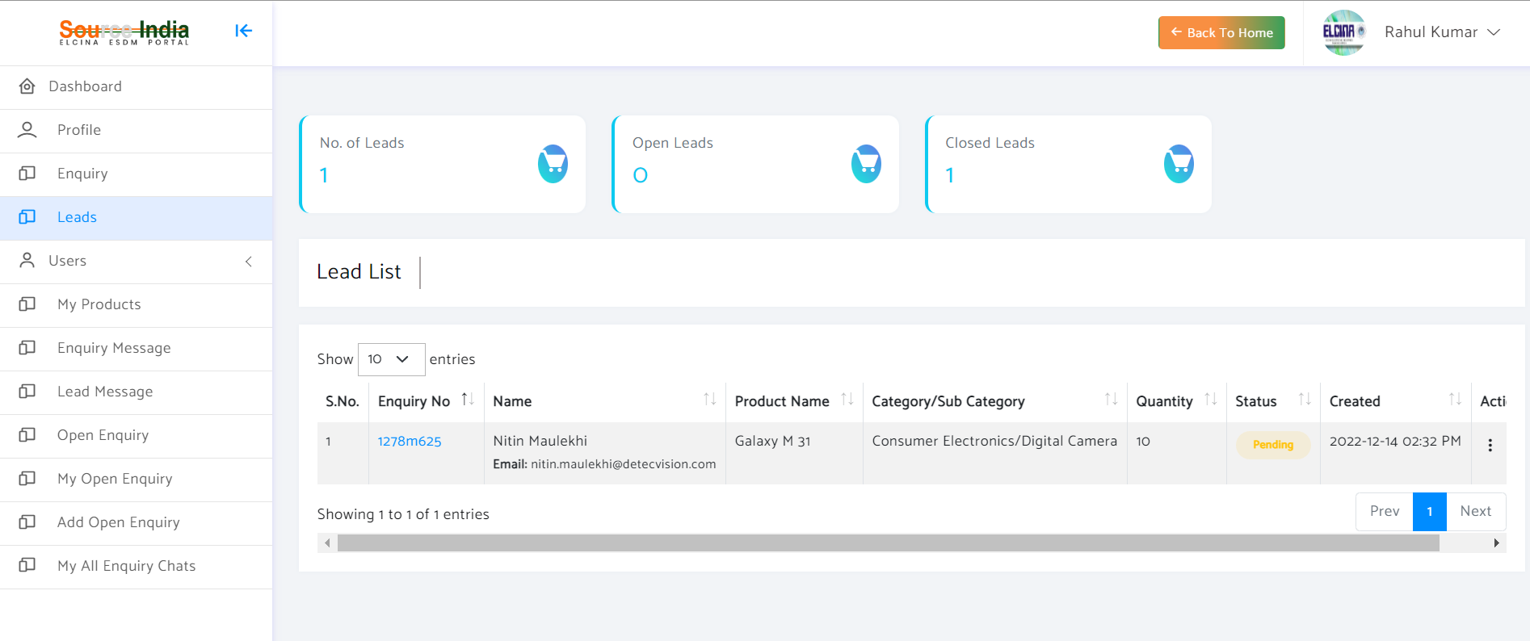
Click here to see your "Lead"

Slide 12
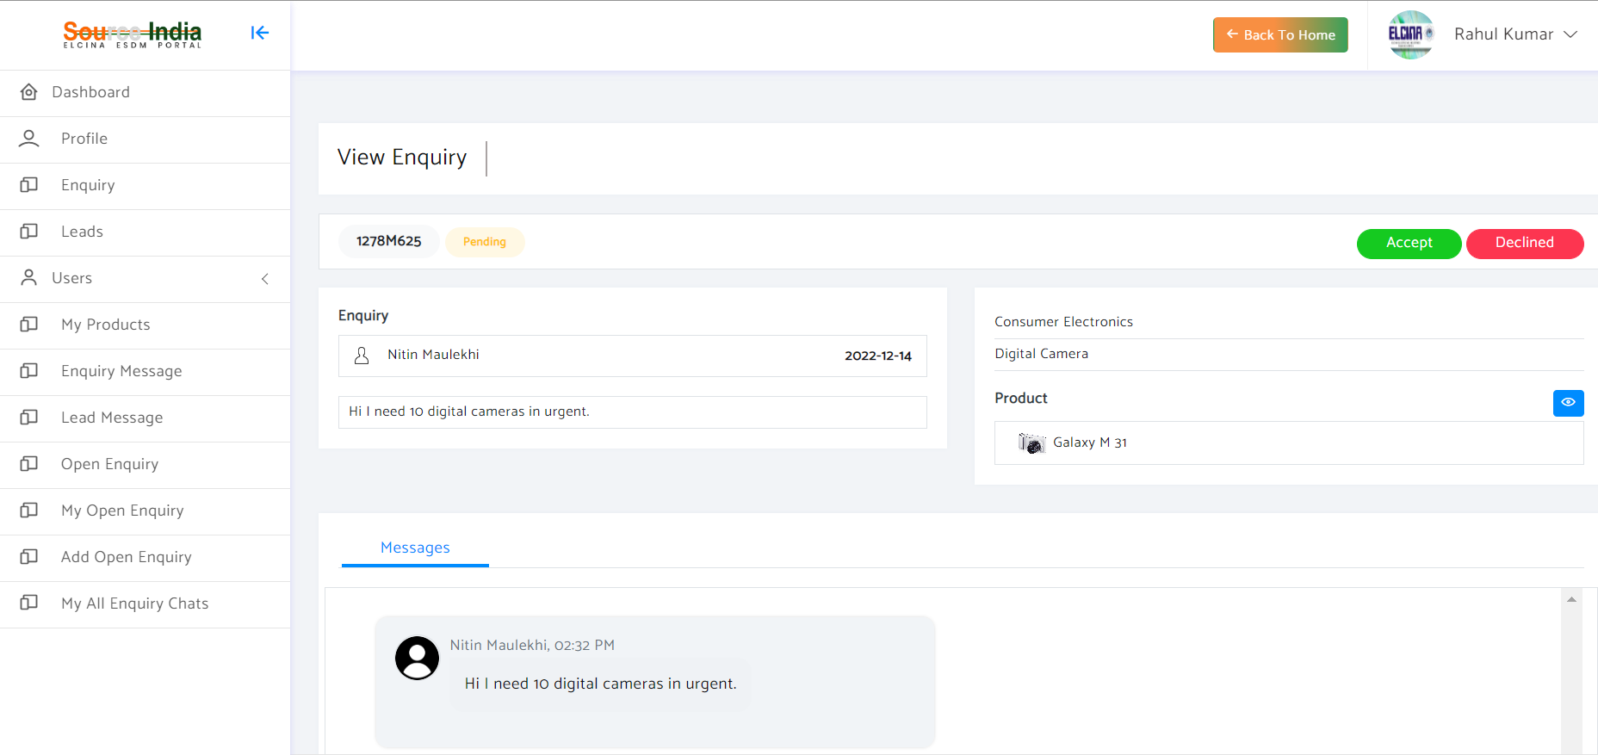
Choose "Accept" to continue the discussion over chat or "Declined"

Slide 13
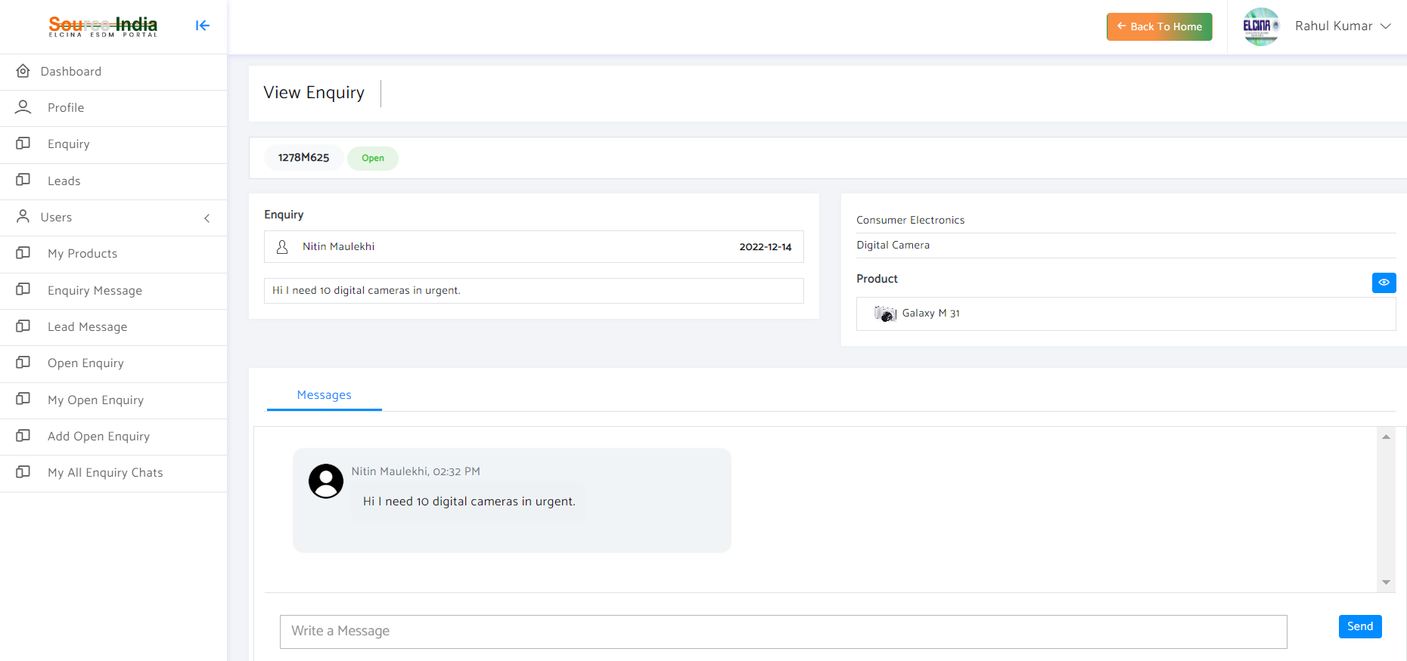
After "Accepting" the enquiry you can directly chat with the buyer

Slide 14
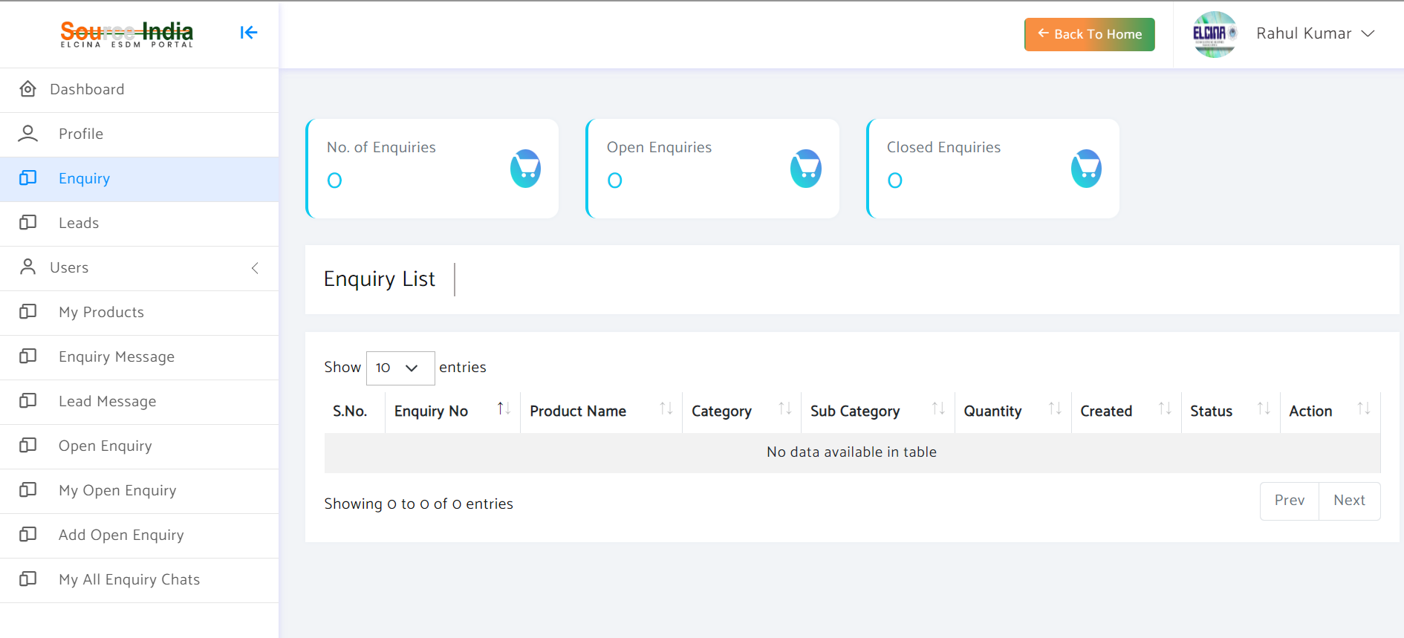
Here you can see all the "Enquiries" which you have created to "Buy Items"

Slide 15
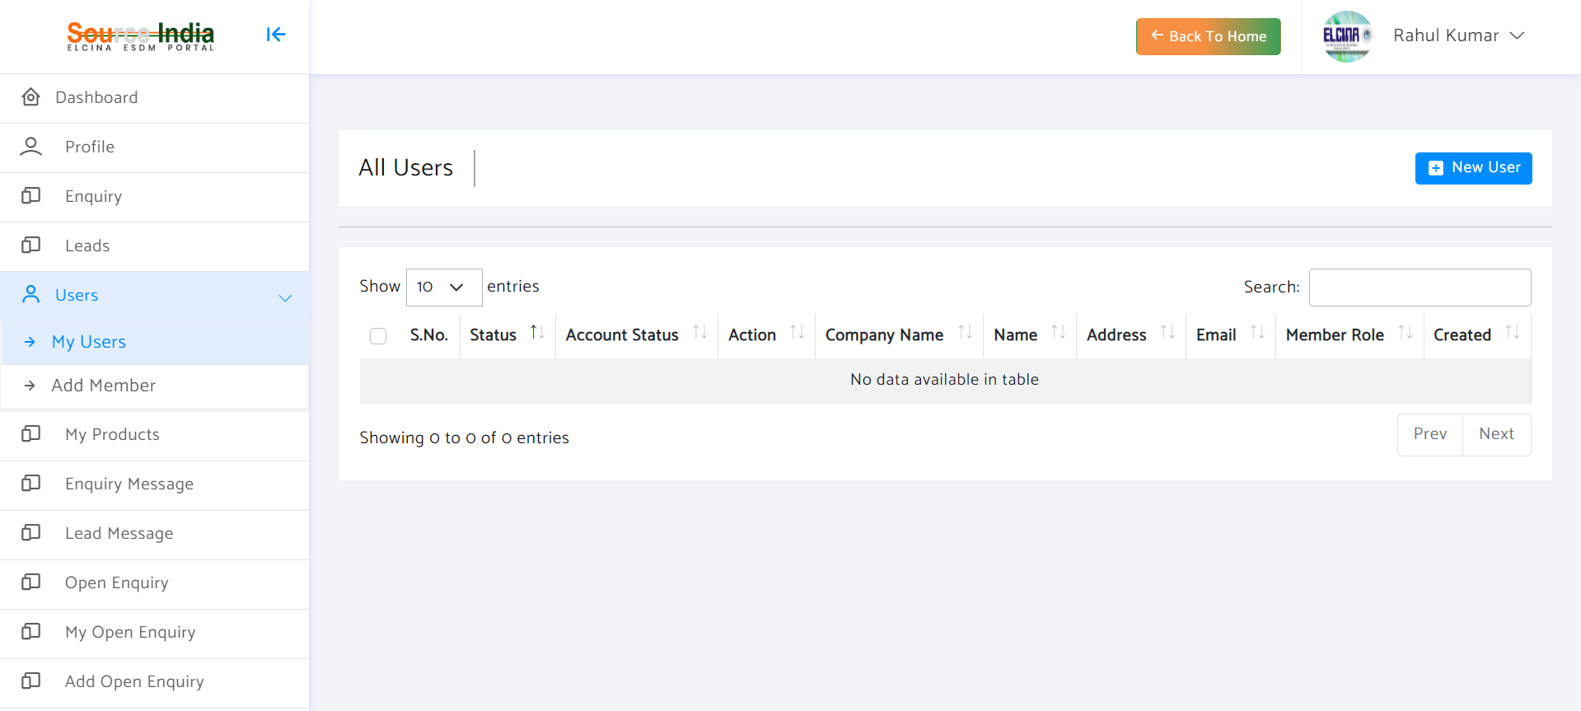
To add user, click "New User“, you may add user from your company and assign them roles

Slide 16
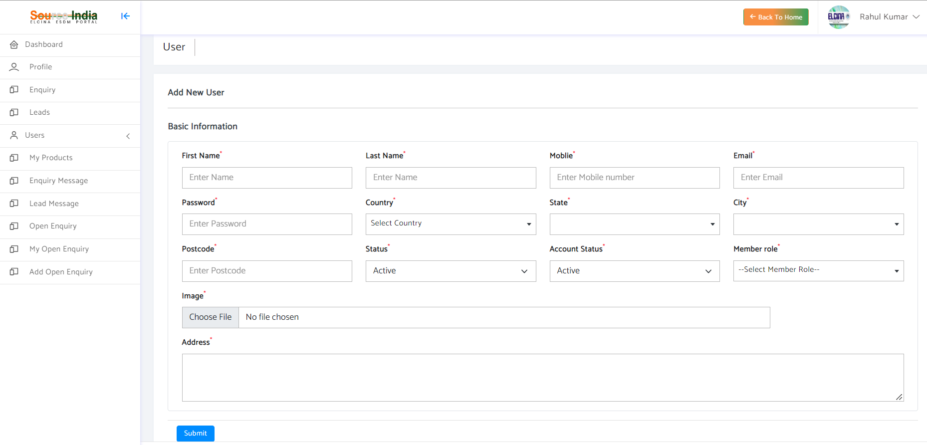
Add user details

Slide 17
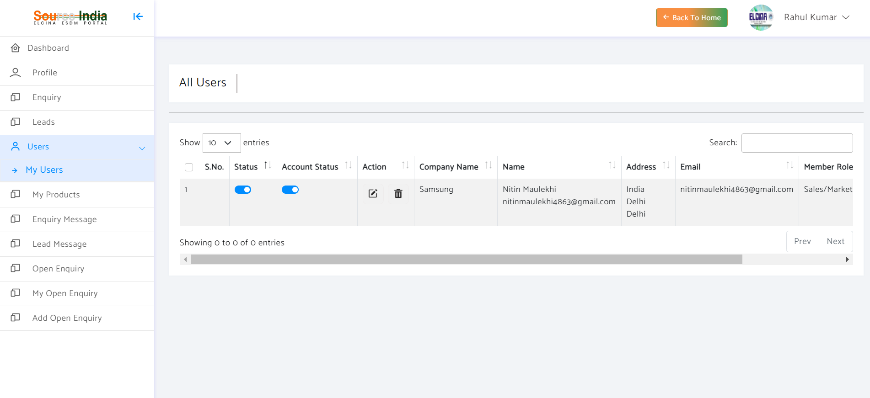
You can change their status and account status after clicking this

Slide 18
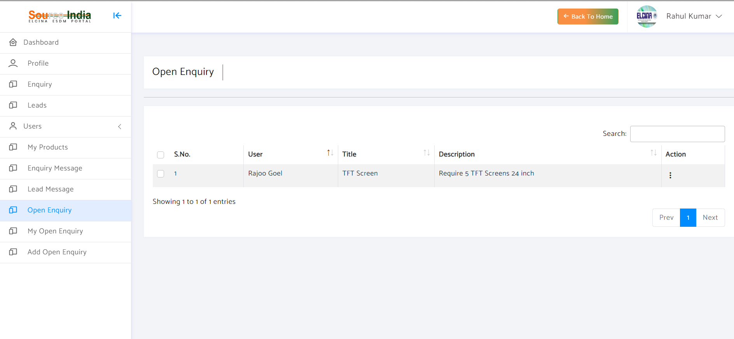
Here you can see all open enquiries, which are on the Portal and not specific to you. If you are interested, you may respond the enquiry and the buyer will be intimated

Slide 19
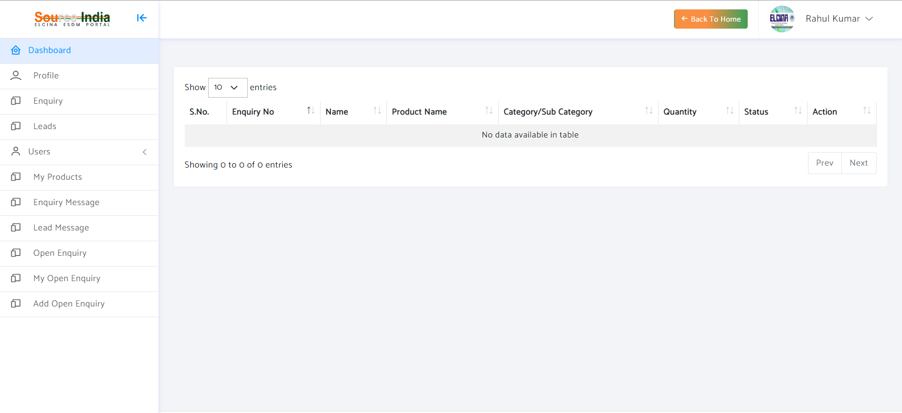
Here you may can add your open enquiry which will be listed on the Portal

Slide 20
Thank you!
Please send your feedback at sourceindia-electronics.com

